Slide 1
Coles County Entrepreneurship Class
Beginning Fall of 2012

Slide 2
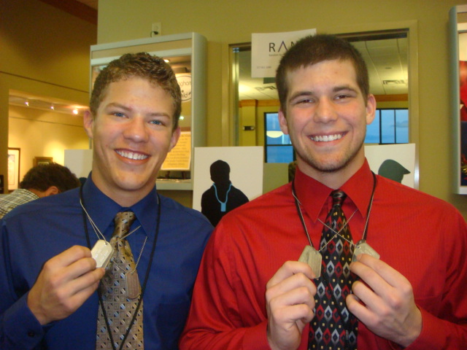
Mission – To provide early entrepreneurship education and business support services thereby spurring economic growth in the region.

Slide 3
Why this Class?
E-Clubs
Junior Achievement
Camp e3
Coles County E- Class
EIU
Ent. Minor
Business Counseling

Slide 4
Central Illinois is 2x more risk adverse than the rest of the country.
Milliken University Study 2005

Slide 5
46% of millennials want to start a business in next 5 years.
EMPLOYERS study - Sharalyn Hartwell, Generation Y Examinar

Slide 6
Population Loss
Brain Drain

Slide 7
CEO Class - Beginning Year Retention
3 out of 24 return home

Slide 8
CEO Class - End of Year Retention Poll
21 out of 24 return home

Slide 9
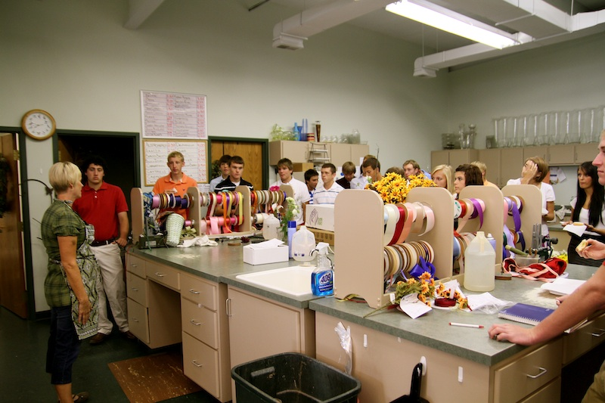
Partners
Mattoon Area Community Foundation
Eastern Illinois Education for Employment Services
Schools
Community

Slide 10
Effingham County CEO CLass
CEO 2010-2011

Slide 11
Student Perspective

Slide 12
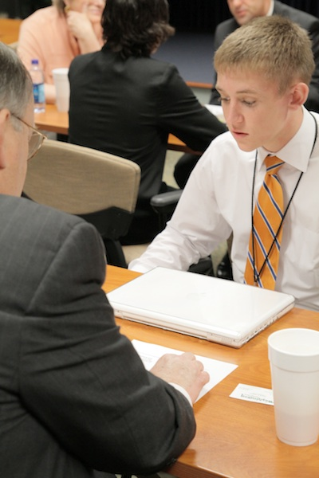
How Can You Help?
Financial Partner - $1,000 per year for 3 years
E-Class Committee
Volunteer as a Business Mentor
In-kind Donations
Host the Class for a Quarter
Serve as a Class Champion

