Slide 1

Austin Cheney, PhD, MBA, P.E.
Dean

Slide 2
Welcome
Why is the Lumpkin College of Business and Technology (LCBT) the “right place” to be?
Purpose
We engage and inspire leaders to improve the world around them.
Vision
Lumpkin College – an inclusive environment, where students immediately begin their careers through an intensive educational experience that develops an extraordinary skill set and network, translating into a lifetime of professional success.

Slide 3
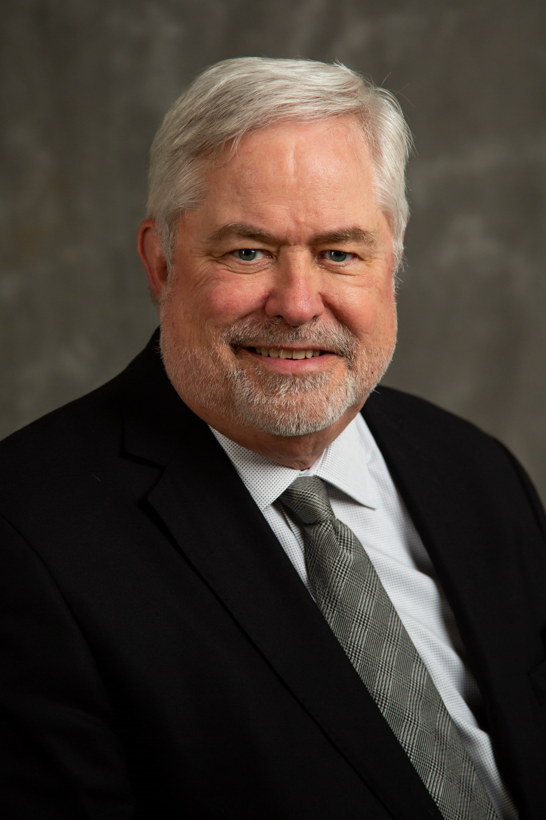
Dr. David Martin, Chair
School of Business

Slide 4

Dr. Mahmoud Al-Odeh, Chair
School of Technology

Slide 5
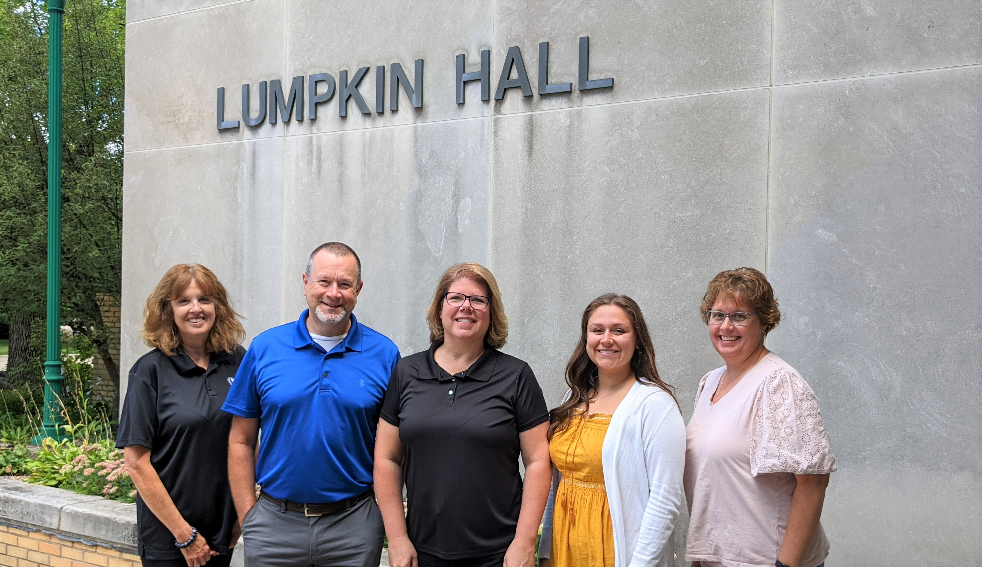
Lumpkin College Student HELP Hub for Engagement, Leadership, and Professionalism
Located in Lumpkin Hall 2051
  Academic and Professional Advising
Located in Lumpkin Hall 2131
  Internships
  Study Abroad
  Registered Student Organizations (RSOs)
  Other Engagement Opportunities

Slide 6
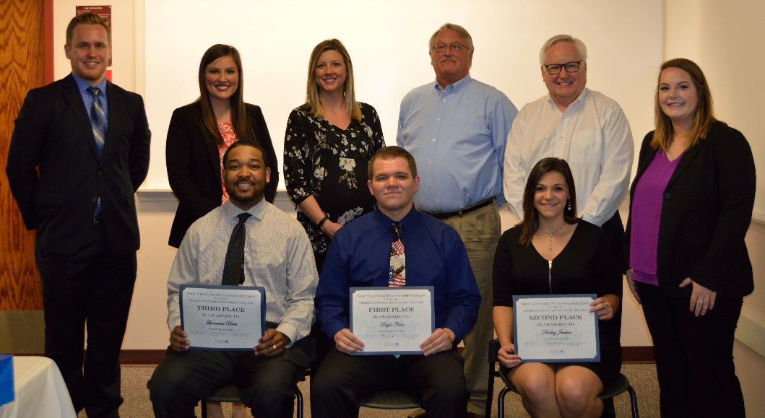
Engage Intentionally
The Lumpkin College of Business and Technology is a network of active stakeholders.
  Project-Based Learning
  Guest speakers/Company Visits
  Lumpkin College Student Hub
  Executives in residence
  Student Competitions
  Student Organizations
  Internship opportunities
  Dean’s Student Advisory Board
  Study abroad
  Homecoming
  Faculty and staff are good agents of connection - undergraduate research, employers, alumni
  Graduates of the Last Decade (GOLD)

Slide 7
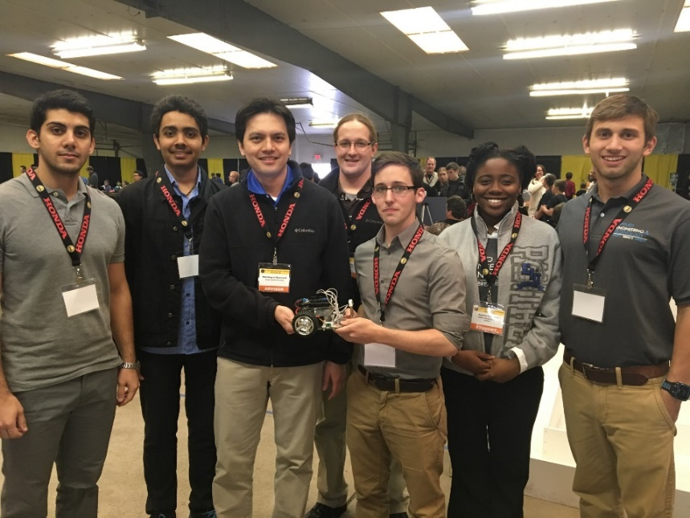
School of Technology Programs
Bachelor’s Programs
  Computer & Information Technology (CIT)
  Construction Management (CMG)
  Digital Media Technology (DGT)
  Engineering Technology (EGT)
  Organizational Development (ODL) - online only
Master’s Programs
  Cybersecurity (CYB) - interdisciplinary, online
  Talent Development (ATD) - online only
  Technology (TEC) - online
  Sustainability (CERE) - interdisciplinary, online

Slide 8
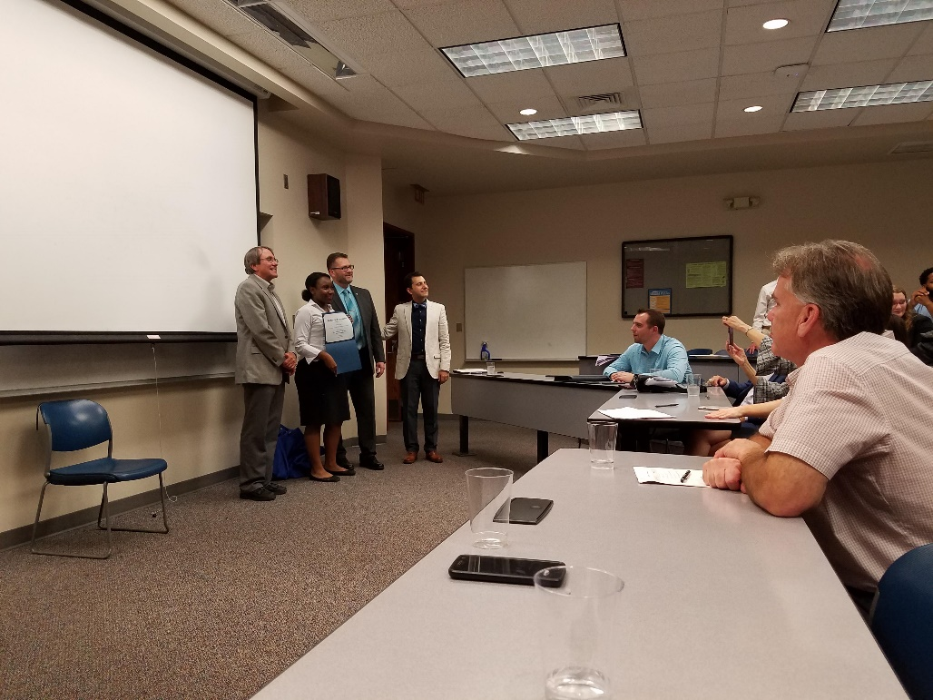
School of Business Programs
Bachelor’s Programs
  Accounting (ACC)
  Business Analytics and Information Systems (BAIS/MIS)
  Finance (FIN)
  Hospitality and Tourism (HTM)
  Management (MGT)
  Marketing (MKT)
  Business Administration (BUS) - online only
Master’s Programs
  Business Administration (MBA) - online
Minors
  Accountancy ○ Management
  Business Administration ○ Management Info Systems
  Business Analytics ○ Marketing
  Entrepreneurship ○ Operating & Supply Chain Mgmt
  Finance
  Human Resource Management

Slide 9
Outcomes
Extremely High Placement Rates
  95% or higher for each program in Lumpkin - placement in their field of study or going to graduate school
  Average salaries for graduates are above national averages
Regular Career Growth
  Many graduates earn advancements frequently
Alumni Get Involved
  Graduates of the Last Decade (GOLD)
  Business Advisory Board
  School of Technology Advisory Board
  Lumpkin Executive Advisers to the Dean (LEAD)

