Slide 1


Slide 2


Thank You!
School of Extended Learning
Aaron White
Debbie Meadows

Slide 3




Introducing
Sierra Hollenbeck
Southern Illinois, Indiana & Missouri
Ryan Howard
Central Illinois
Emily Skupien
Regional Suburban Chicago & Northern Illinois
Shijuana Shannon
Regional Chicago
City Colleges of Chicago

Slide 4

EIU Alumni

Slide 5

Packets
www.eiu.edu/transfer/articulation.php
Agenda
Transfer Guides
Transfer Checklists
Counselor Updates
Substitution Lists
Progress Reports
(virtual guests email ripearson@eiu.edu)
Departmental information

Slide 6

Admissions Update
No Application Fee
Test-Optional for Transfers Students
24+ semester hours w/2.0 overall and from last institution
Less than 24 semester hours
ACT 18 or SAT 960 AND high school GPA of 2.5/4.0 scale
OR
Test-Optional high school GPA of 2.8/4.0 scale

Slide 7
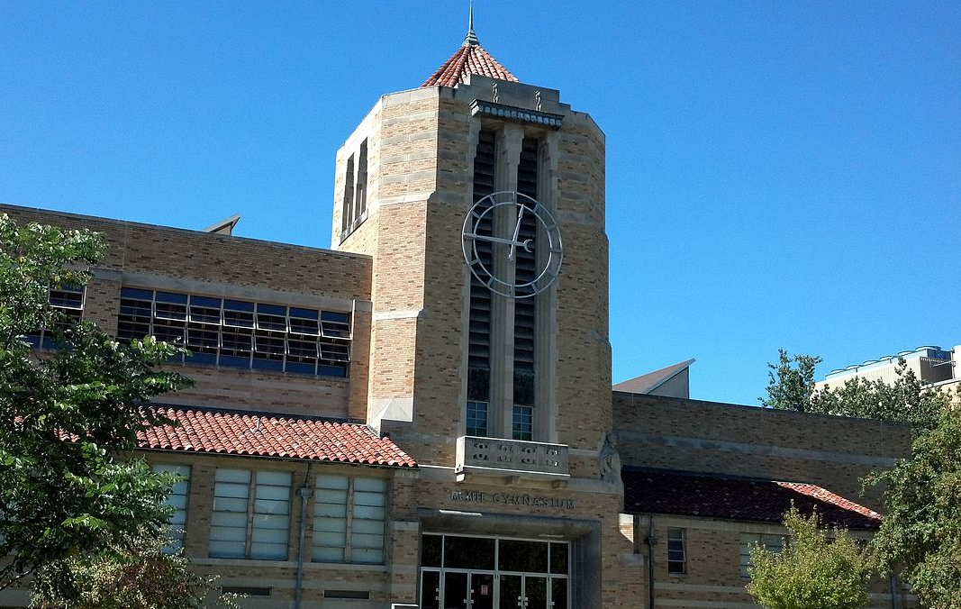
EIU Residency Requirements
30 Semester Hours for Traditional Majors
25 Semester Hours for Organizational Development Major
25 Semester Hours for RN to BS in Nursing
20 Semester Hours for Interdisciplinary Studies Degree

Slide 8
Transfer Scholarships

Slide 9

Transfer Academic Excellence
Tier 1: $5,000 Over 2 years
$2,500 per year divided between fall/spring semesters. Must have minimum 15 transferable hours and a 3.5-4.0 cumulative GPA. Full-time enrollment is required. All majors are eligible.
Tier 2: $3,000 Over 2 years
$1,500 per year divided between fall/spring semesters. Must have minimum 15 transferable hours and a 3.0-3.49 cumulative GPA. Full-time enrollment required. All majors are eligible.

Slide 10
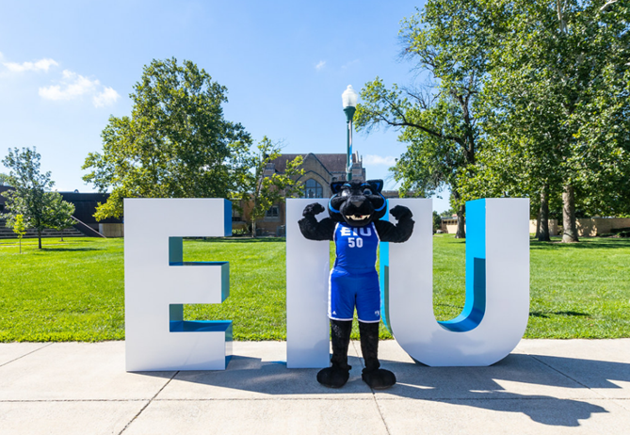
Phi Theta Kappa
$1,000 one-time award
Phi Theta Kappa Members
Awarded for Fall admission
Associates degree required
Minimum GPA of 3.5

Slide 11

Honors Transfer Scholarship
$2,500 per year
Competitive award
Transfer GPA of 3.5
At least 18 hours of transfer
institution’s Honors Program
Applications due by June 1st
Renewable for second year
Participating in EIU Honors
EIU GPA of 3.4

Slide 12

EIU Promise
Reduce the cost of remaining tuition and fees to $0.00
Illinois resident
Family gross income of $66,000 or less
Family assets of less than $100,000
Admitted to EIU as full-time student
Packaged financial aid by June 1
Minimum of 3.0 GPA
Meet AIM HIGH requirements

Slide 13
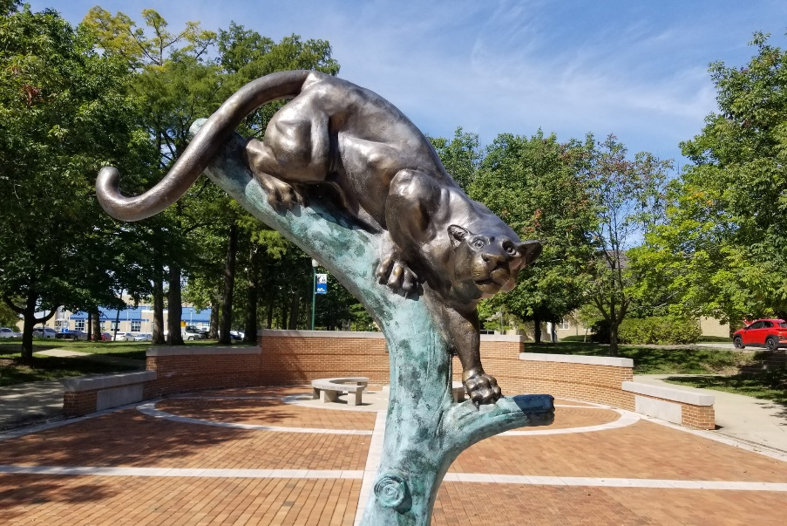
Panther Promise
$2,500 renewable
FAFSA must be filed
Annual household income from $34,000 to $83,000
Maintain full-time, consecutive enrollment
Maintain 2.0 GPA or better
Automatically awarded if criteria is met

Slide 14

Panther Pledge Guaranteed Admission Program
Transfer Planning & Advising
Seamless Transfer
Simple process
Sign up at www.eiu.edu/pantherpledge
Earn an associates degree
Earn a 2.0 GPA

Slide 15

Open House Programs
https://www.eiu.edu/admissions/visit.php
October 10, 2022 (Monday)
November 11, 2022 (Friday)
Transfer Open House
February 3, 2023 (Friday)

Slide 16

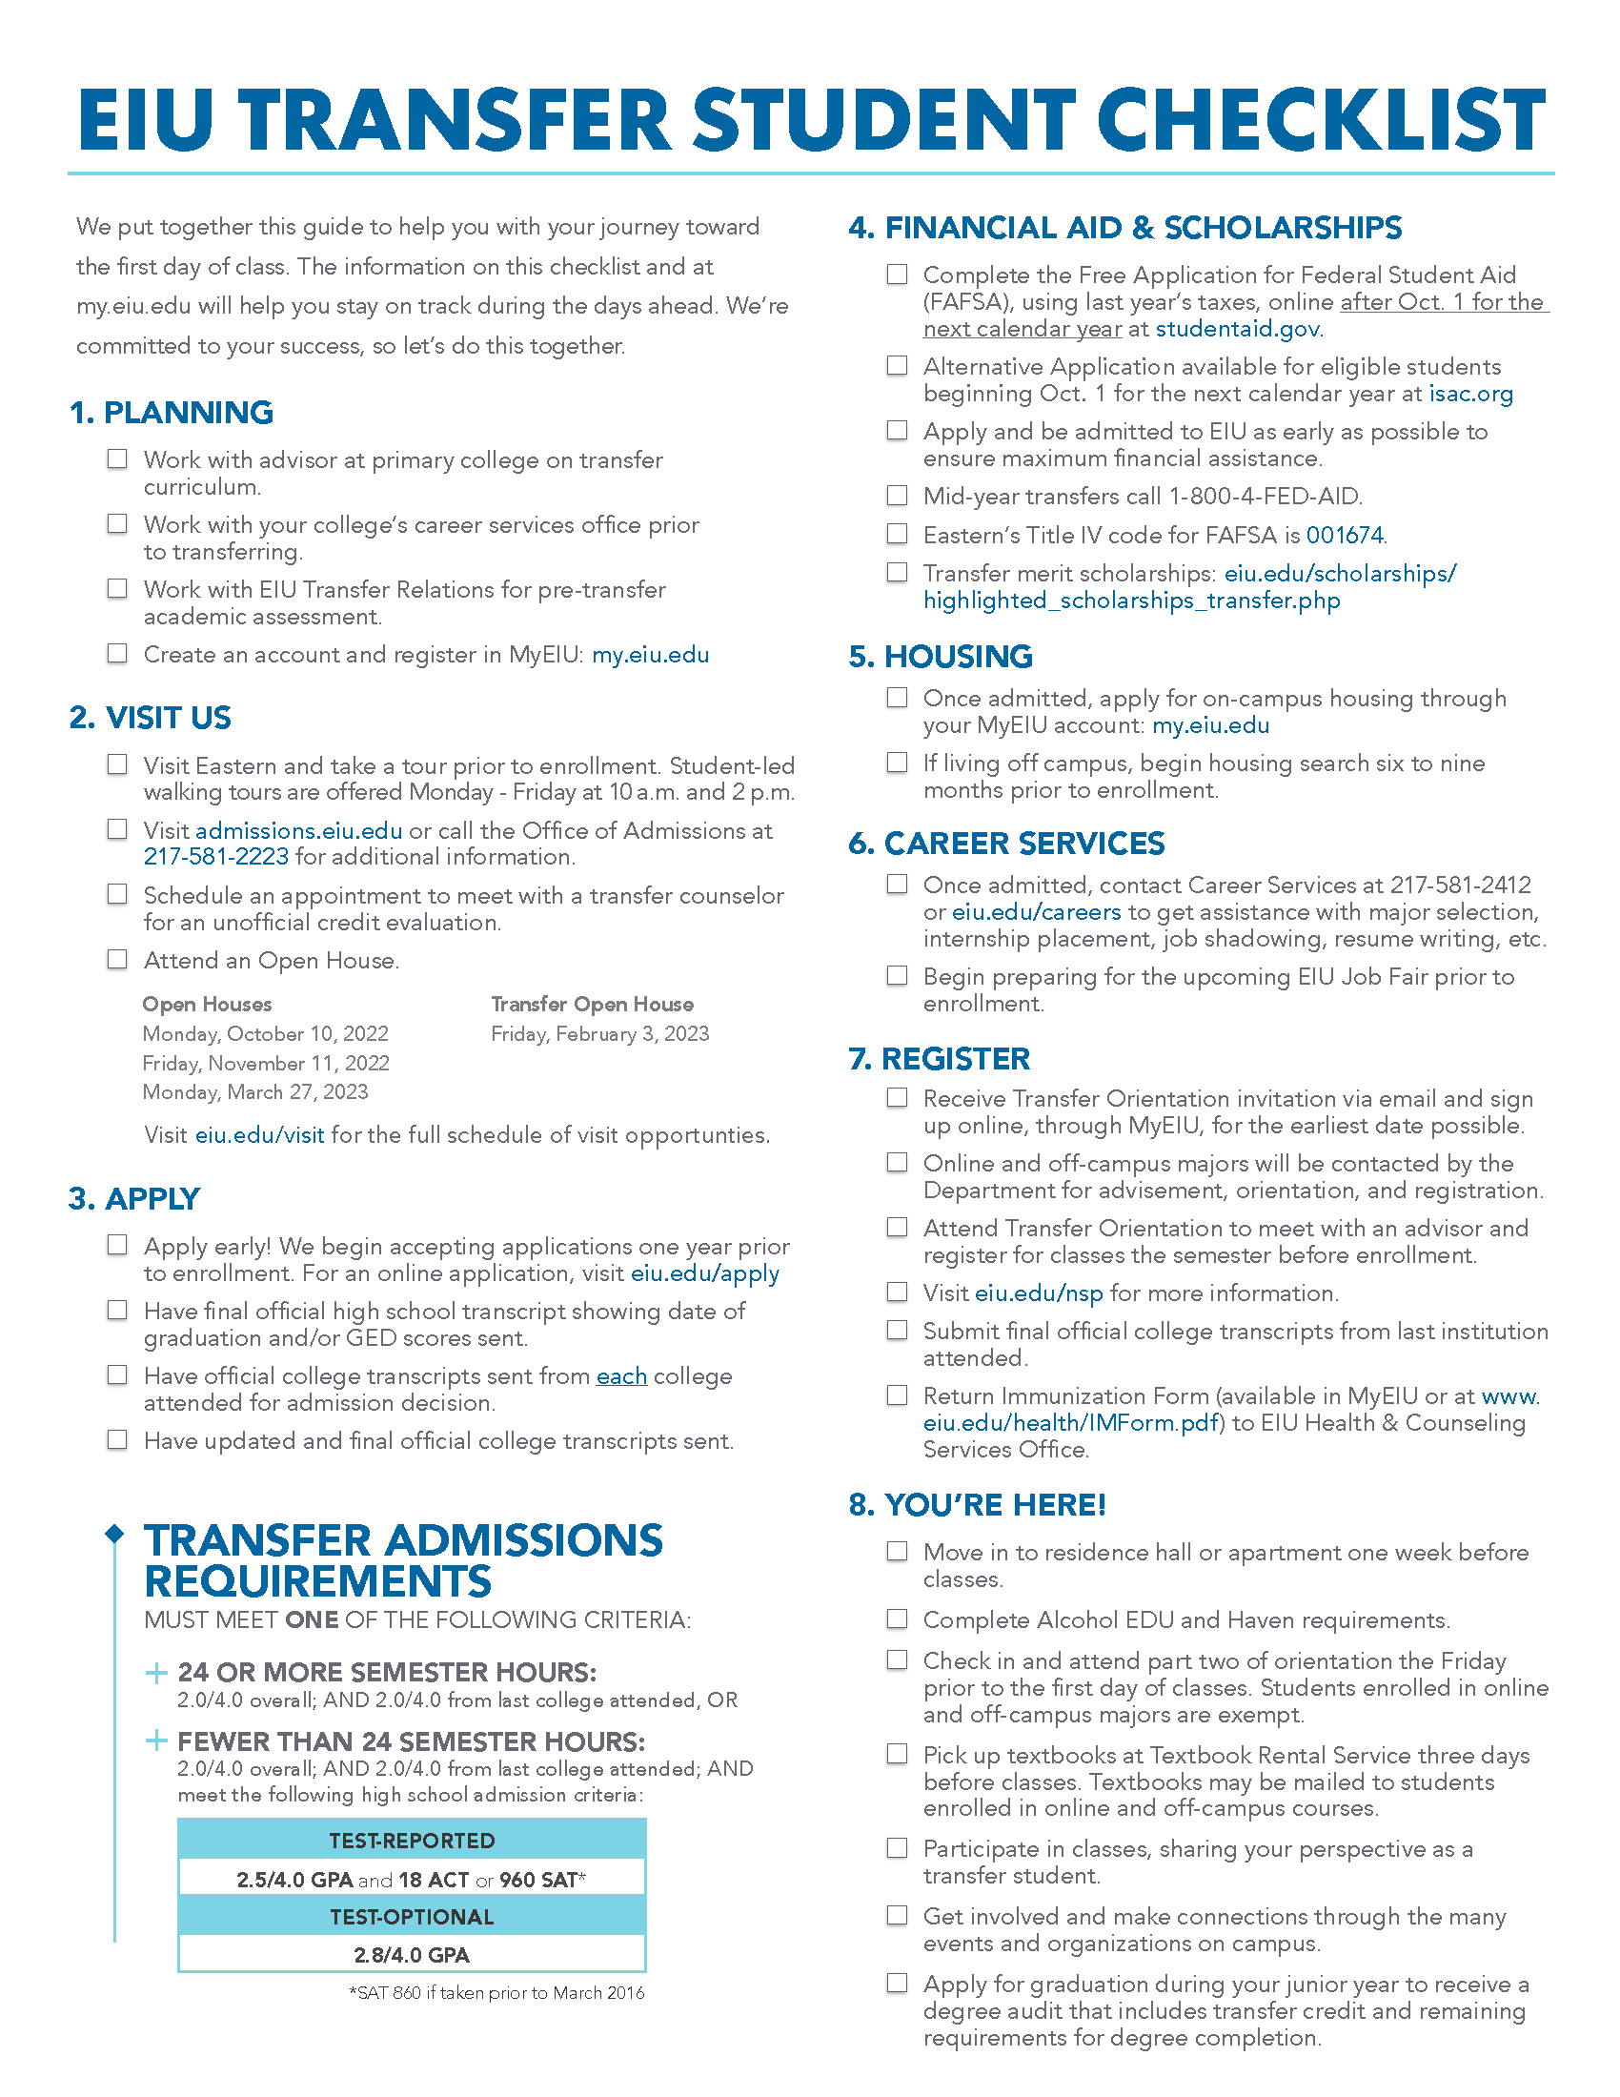


Materials

Slide 17
Evaluation
www.eiu.edu/transfer/articulation2022.php

