Slide 1
Community College Articulation Conference
The Graduate School
Ryan C. Hendrickson
L.M. Hamand Dean of the Graduate School
Acting Dean of Booth Library Services

Slide 2
The Graduate School
Fall 2022 Graduate Student Enrollment
EIU’s Highest Graduate Enrollment EVER!
Previous High = Fall 2008: 1,779 students
Fall 2022 Enrollment = 1,941 students

Slide 3
The Graduate School
Enrollments and Accessibility
Online Options: 19 degree options, 4 certificates
~611 online students = ~43%
“Second Master’s Degree” Pathways
12 hours of previous graduate credit can be applied to 2nd grad degree
38 participants; 11 degrees awarded with 27 in progress
Highest Enrollments: Education/Business and Technology
Accelerated Programs: 14 options
In AY 2021-2022 = 64 students enrolled
9 Hours can be shared between Undergrad + Grad degrees
Human Services and Health Promotion are the EIU leaders
Political Science and English

Slide 4
The Graduate School
International Enrollments = Highest Ever @ EIU!
766 International Students @ EIU
497 students in our Graduate Program in Technology
50+ countries represented
Association of International Students
Indian Student Association
Korean Student Association

Slide 5
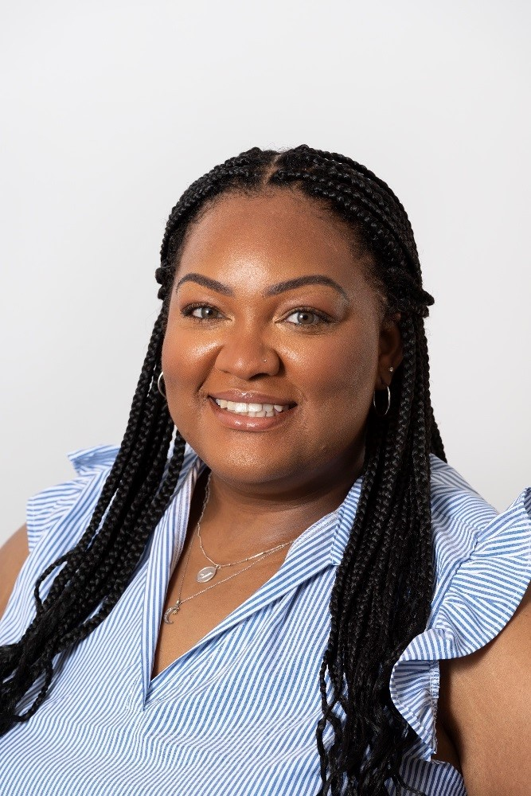
The Graduate School
Diversifying Faculty in Illinois (DFI) Fellowship Award Winner in 2022-2023
Dionne Lipscomb
MS Candidate in College Student Affairs
Graduate Assistant in Student Success Center
$16,500 Fellowship for “traditionally
underrepresented minority group”

Slide 6
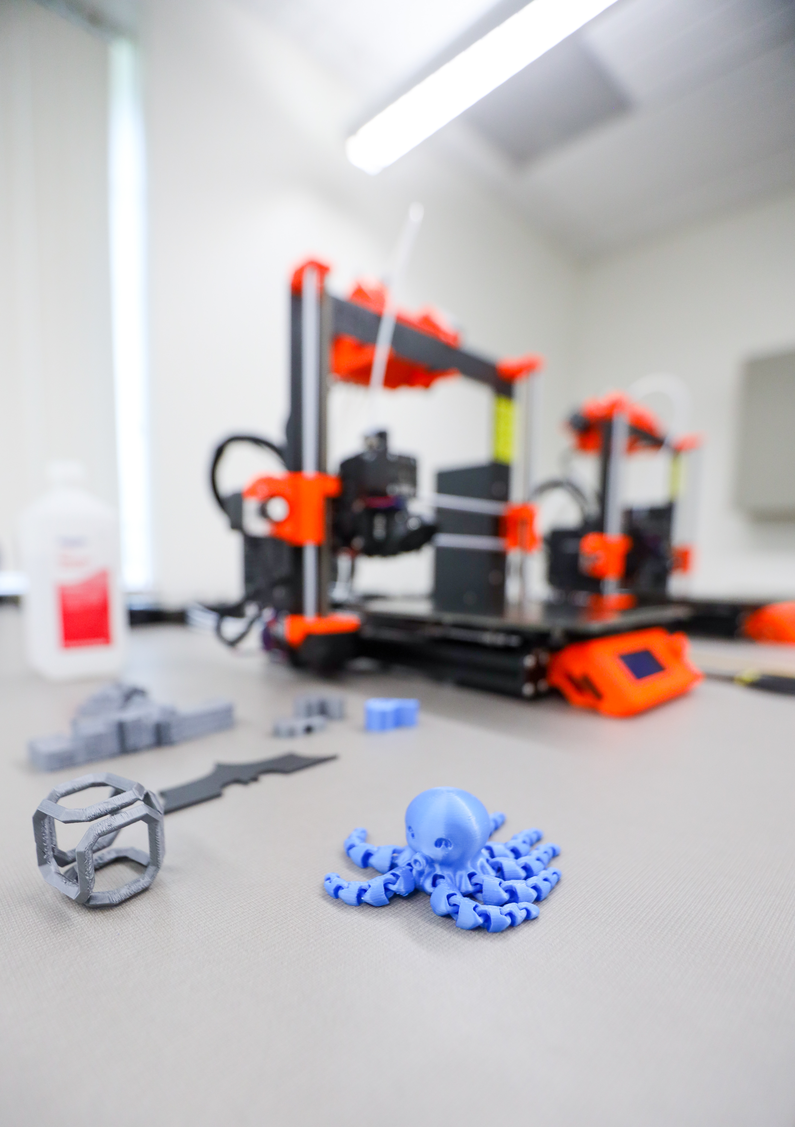
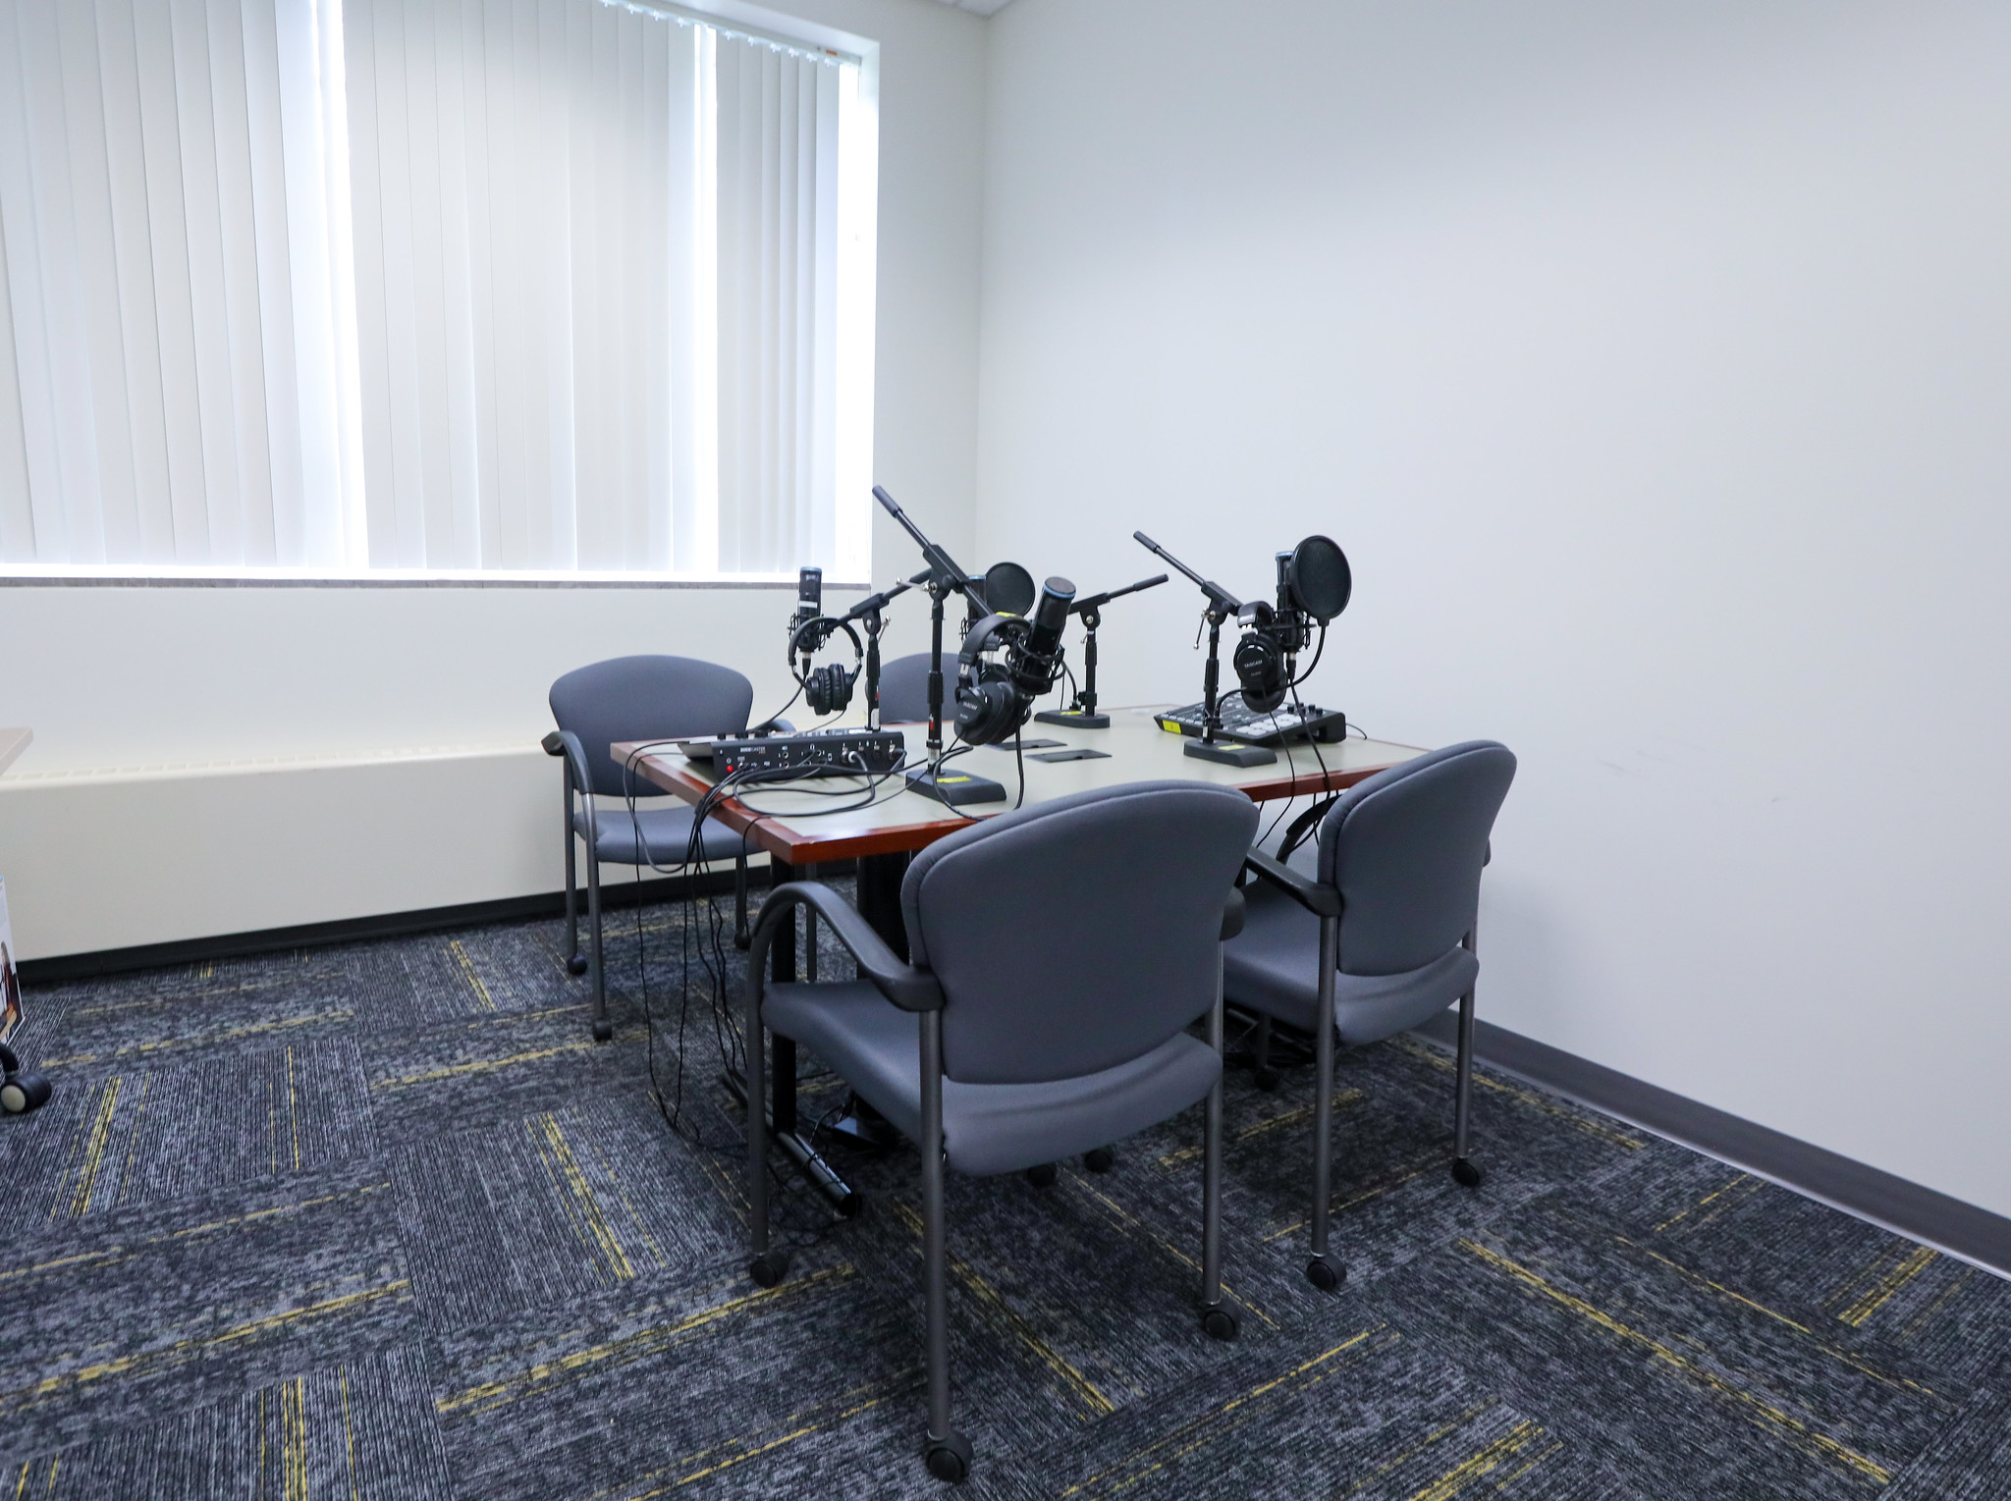
The Graduate School
Booth Library: Center for Student Innovation (CSI)
Student Space to Explore and Utilize New Technologies
Podcasting Studio
3D Imaging and Printers
Virtual Reality Training
Collaborative-Breakout Workspaces for Students

