Slide 1

Dr. Barbara Bonnekessen, Dean
Dr. Michael Cornebise, Associate Dean
Dr. Chris Mitchell, Associate Dean
COLLEGE OF LIBERAL ARTS AND SCIENCES
Exciting new developments
since you last
joined us!

Slide 2
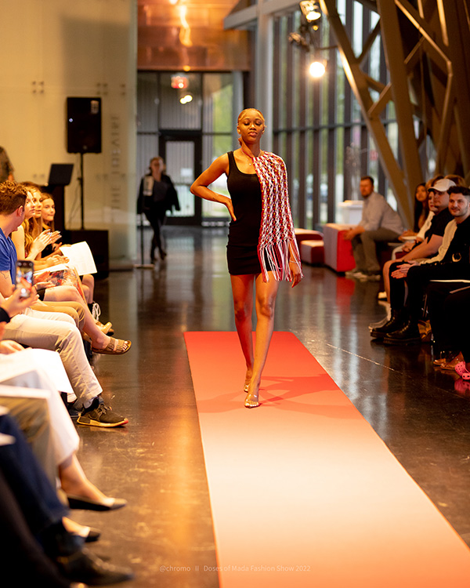
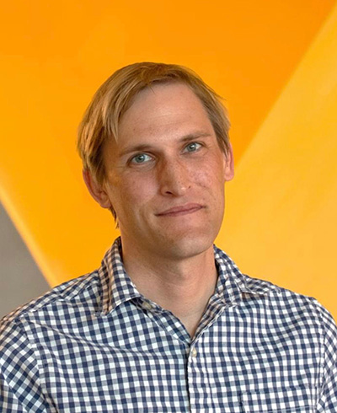
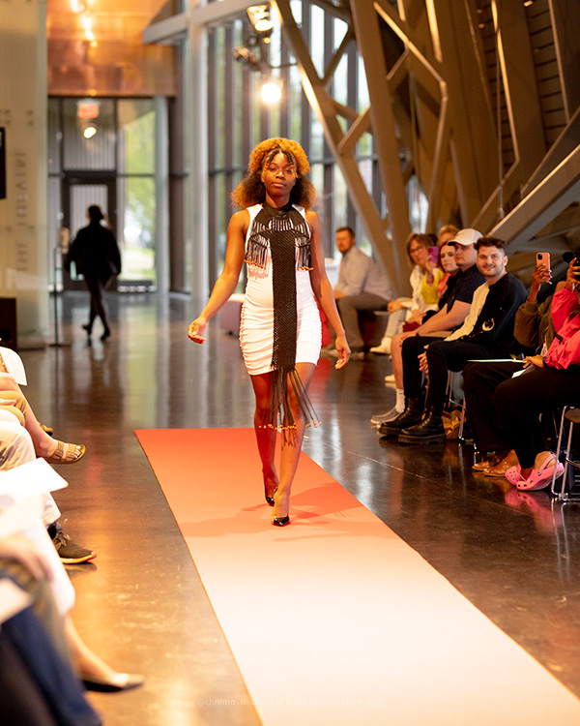
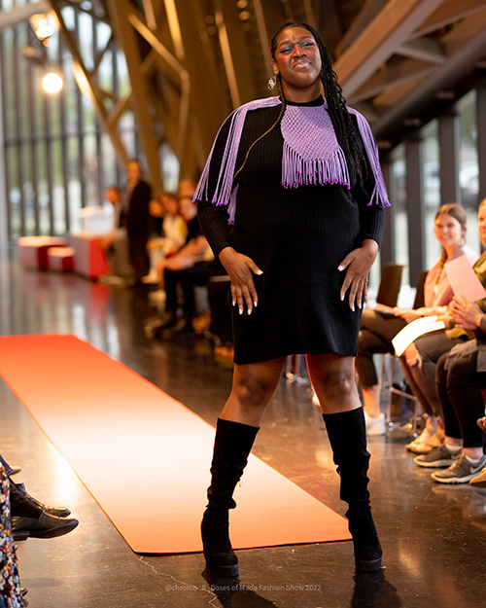
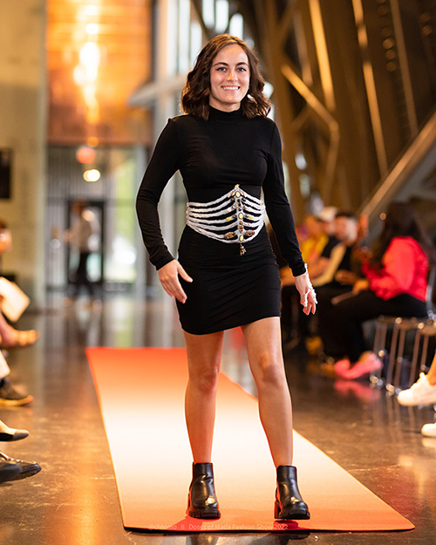
Department of ART + DESIGN
Dr. Bradley Olson Art Education
The Department is pleased to announce Dr. Brad Olson was hired as our new Unit A position in Art Education for Fall 2022. He brings expertise and leadership to the undergraduate and graduate program.
In addition, Dr. Olson was named the Illinois Art Education Association’s Higher Education Art Educator of the Year for 2022.
We are seeing growth in all Majors
Fashion Merchandising was able to host their Biennial Fashion Show (in-person) in the Doudna concourse in Spring 2022.

Slide 3

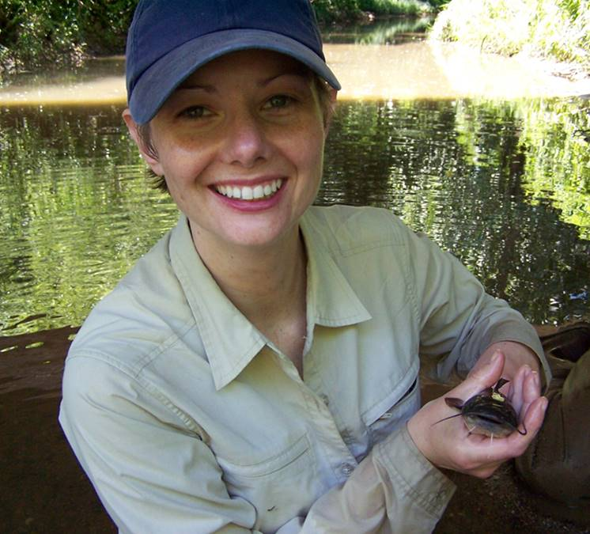
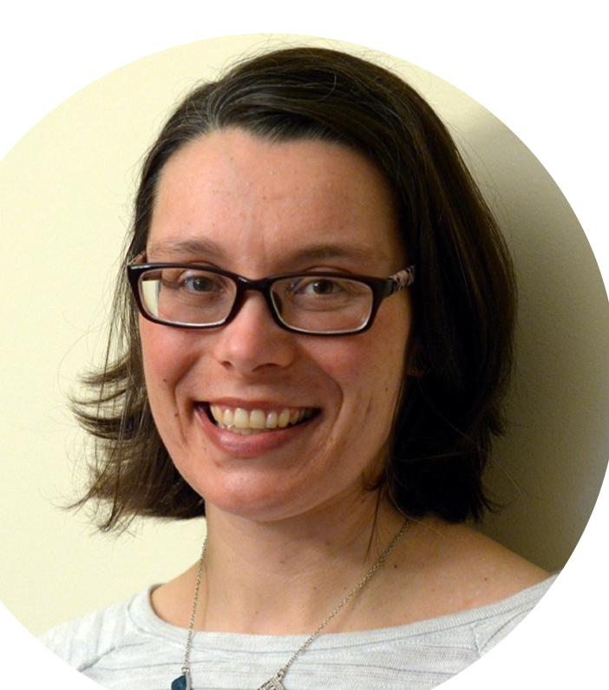
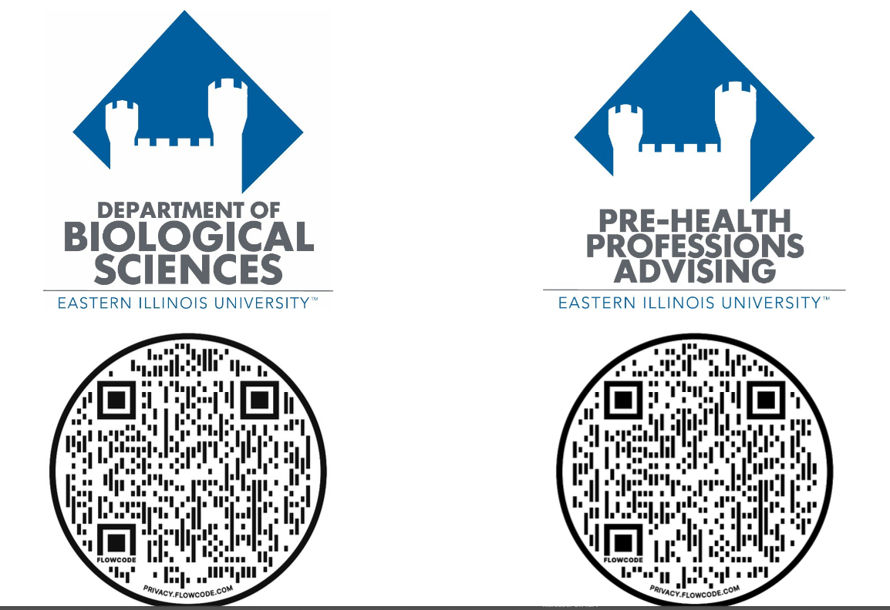
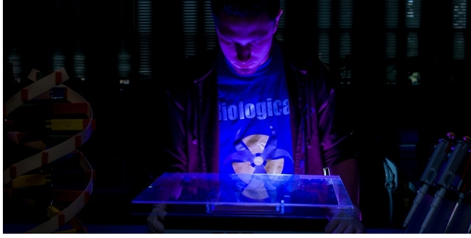
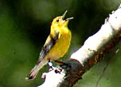

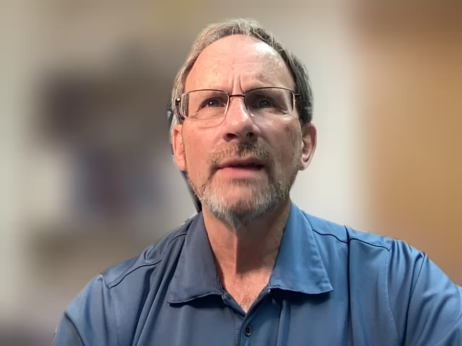
Biological Sciences
New faculty
Curriculum
BIO 2001G Human Physiology replaced with BIO 2005G Human Biology
26 fillable PDF checklists
Biological Sciences
Zoology
Botany
Environmental Biology
Pre-Health- (BIO major or non-major)
Medicine, Dentistry, Pharmacy, Optometry, Chiropractic, Physical Therapy, Physician’s Assistant , Veterinary, etc.
Teacher Certification
Clinical Laboratory Science
16 research-active faculty with broad expertise
Departmental Honors
Undergraduate research opportunities
9 active student clubs
Life Science building remodel near completion
New interdisciplinary science building
Eden Effert-Fanta, PhD
Aquatic Ecologist
Marissa Grant, MS
Instructor-Microbiology

Slide 4
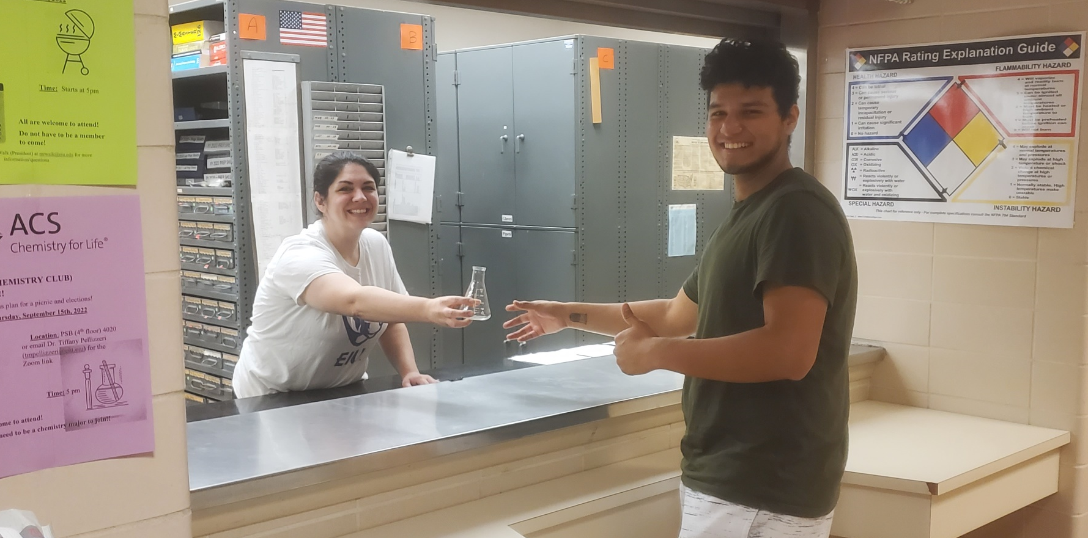
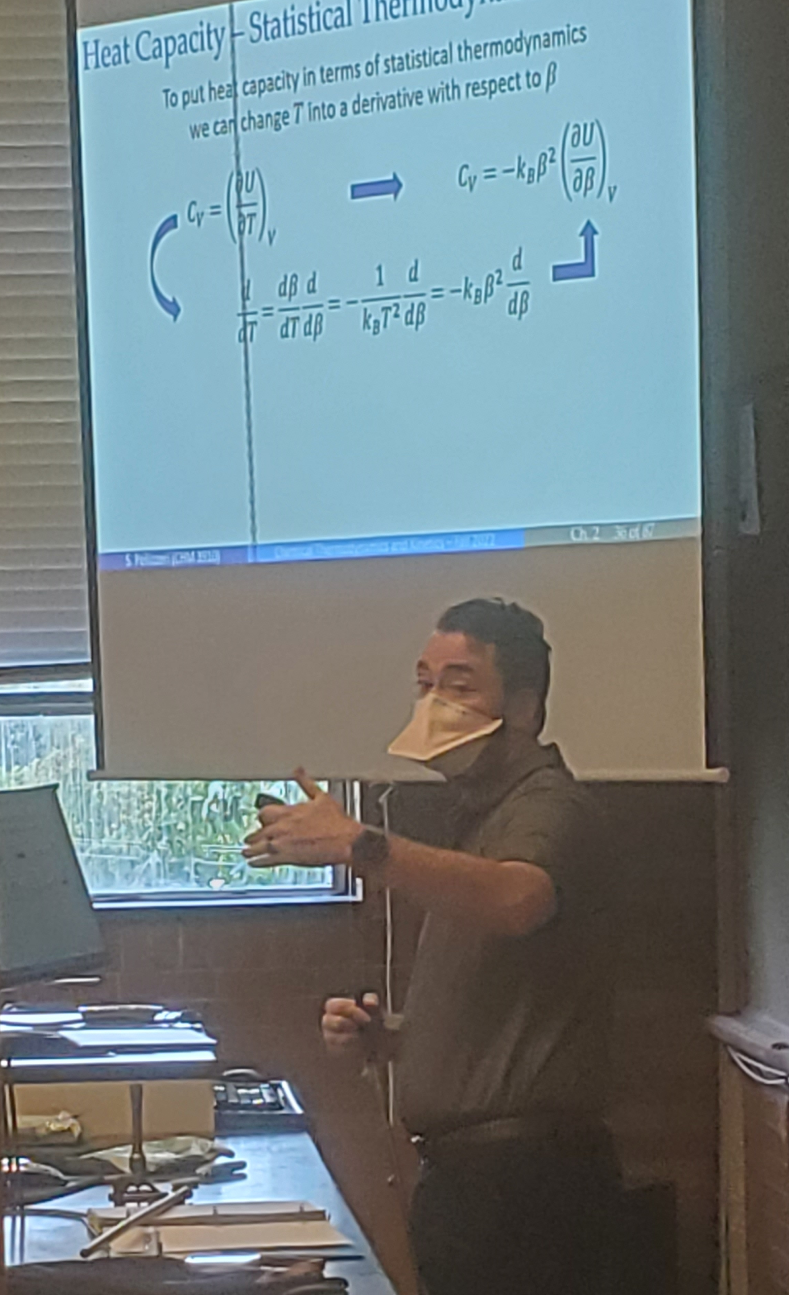
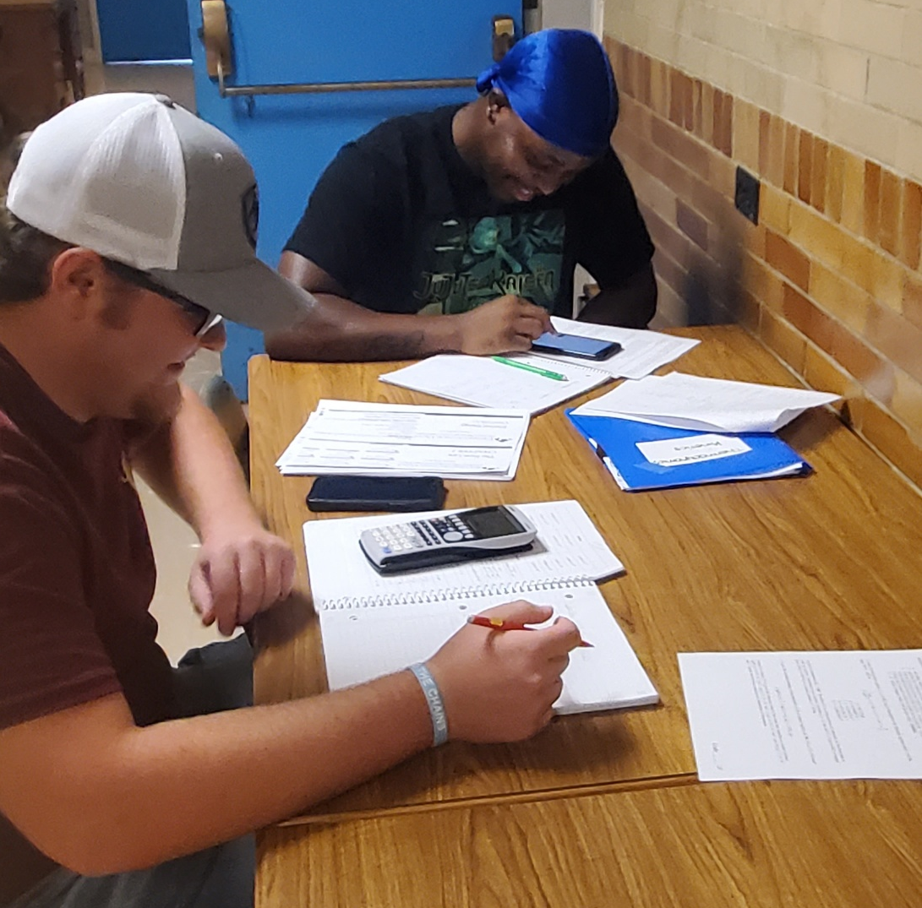
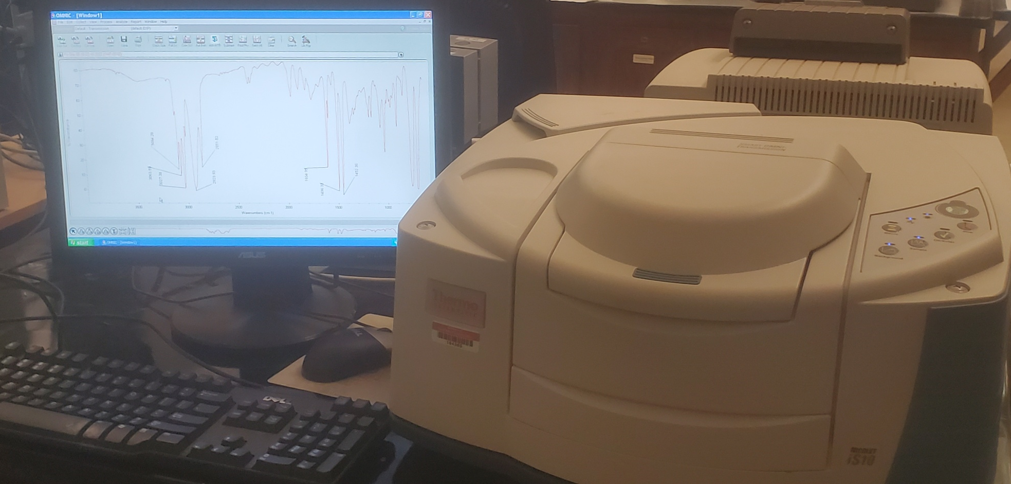
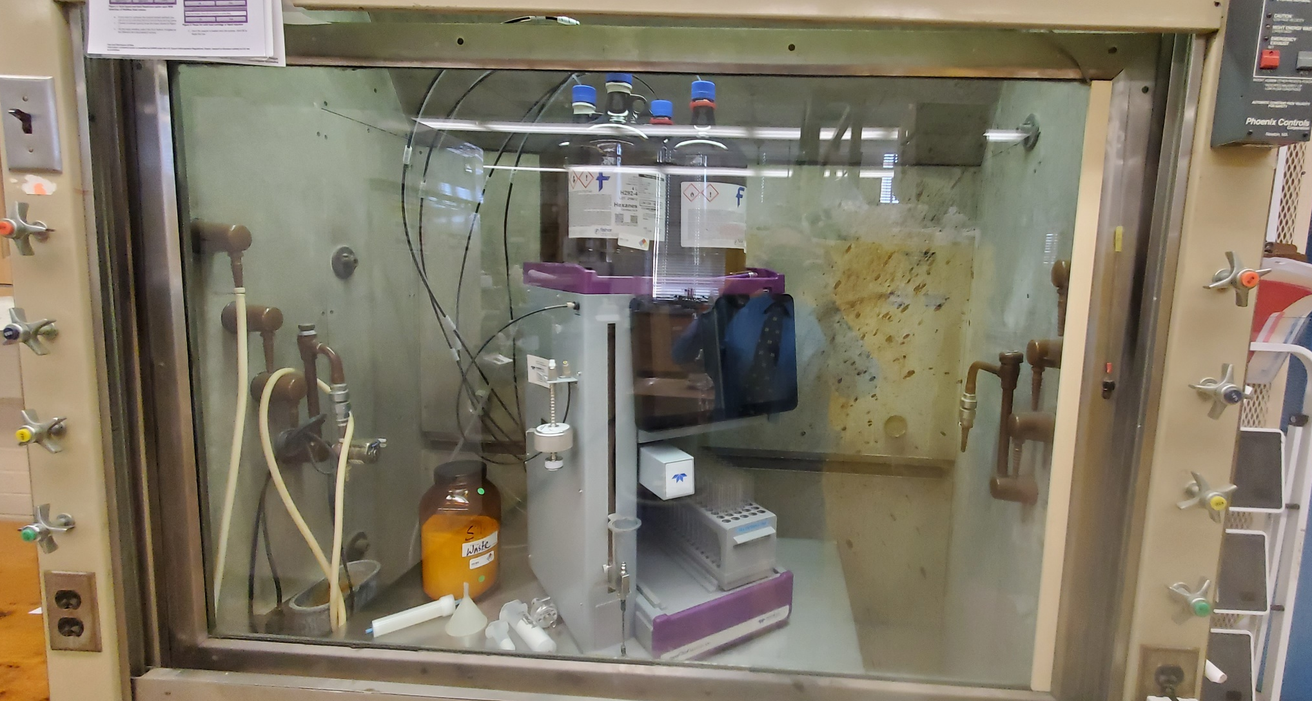
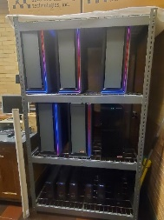
Chemistry and Biochemistry
Programs: B.S. in Chemistry, Biochemistry or Chemistry Management
B.A. in Chemistry, B.S. in Science with Teacher Licensure (Chemistry)
Accelerated BS/MS and BA/MS (5-year program)
Ability to major and pursue pre-health option
Departmental Honors (write thesis on research, take graduate course)
Minor in Chemistry or Biochemistry (2 or 3 courses beyond gen chem & org, with labs)
Special features EIU Chem / Biochem programs:
Student seminar series – majors give two PowerPoint
seminars (including Q&A) to peers and faculty
Student research – have 13 undergrad working in 4
different groups at moment
Student presentation/internship – students present
at National ACS meetings, regional meetings
student had a summer internship at Argonne Natl Lab
Research grants – 4 successful for FY22, over $250K
Major requirements (typically freshman & sophomore classes):
year-long gen chem with labs (not a gen-org-biochem course)
year-long organic chem with lab
our organic II is a continuation of org I, not org I with more detail
Requirements outside major:
Calc I and Calc II
Physics I and Physics II with labs
Calc based preferred, but non-calc base accepted
Is best if these are done BEFORE junior year
(so can take physical chem courses (CHM 3910 & 3920))

Slide 5

A Year in transition
Major Goals for the Year
Name a new chair for the next academic year (Michael Cornebise, Acting Chair for Academic Year 2023)
Plans to reassess (and likely remove) many course prerequisites
Revise the Graduate Program which is currently on a two-year hiatus
Develop Comprehensive Social Media Plan

Slide 6
English
New course: English 2706G, Latin American and Latinx Literature
Our creative writing festival, Lions in Winter, will return to in-person this January and will continue to be free of charge. Community college students and faculty are invited. For more information, email Angela Vietto, arvietto@eiu.edu.
We’ve made a few changes to our curriculum for English majors to help ensure timely graduation, both for teacher certification students and for English majors in literary studies, creative writing, or professional writing.

Slide 7
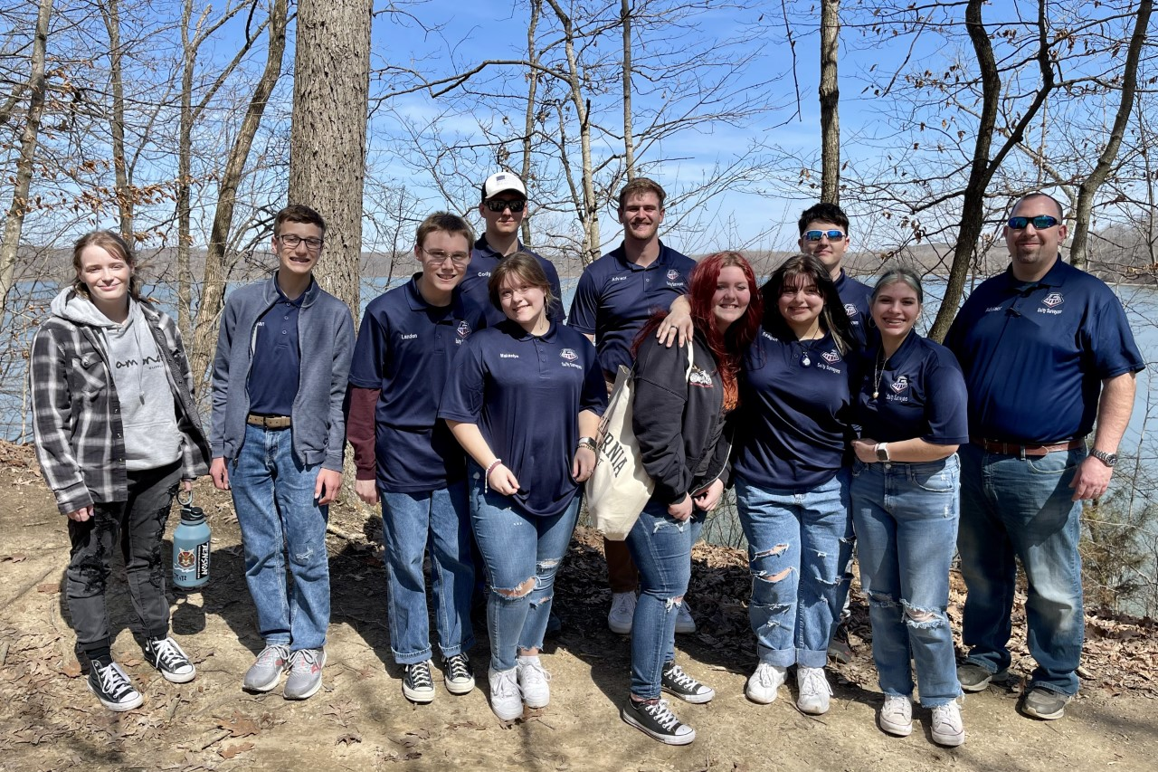
Geology and Geography
Incorporated Garrett HS students into phenology research project. Students work alongside EIU faculty and department majors in an investigation of climate change.
Professional Science Master’s degree (GIS) is now an online program.
Students can use courses from their undergraduate degree to apply to the PSM to accelerate their educational career.
Garrett High School students and instructors at Lake Charleston, Illinois gathering tree data (March, 2022).
Degree programs in: Geology, Geography – Human tract, Geography – Environmental/Physical tract, Environmental Law (in cooperation with NIU), Science Teacher Certification, PSM – GIS

Slide 8
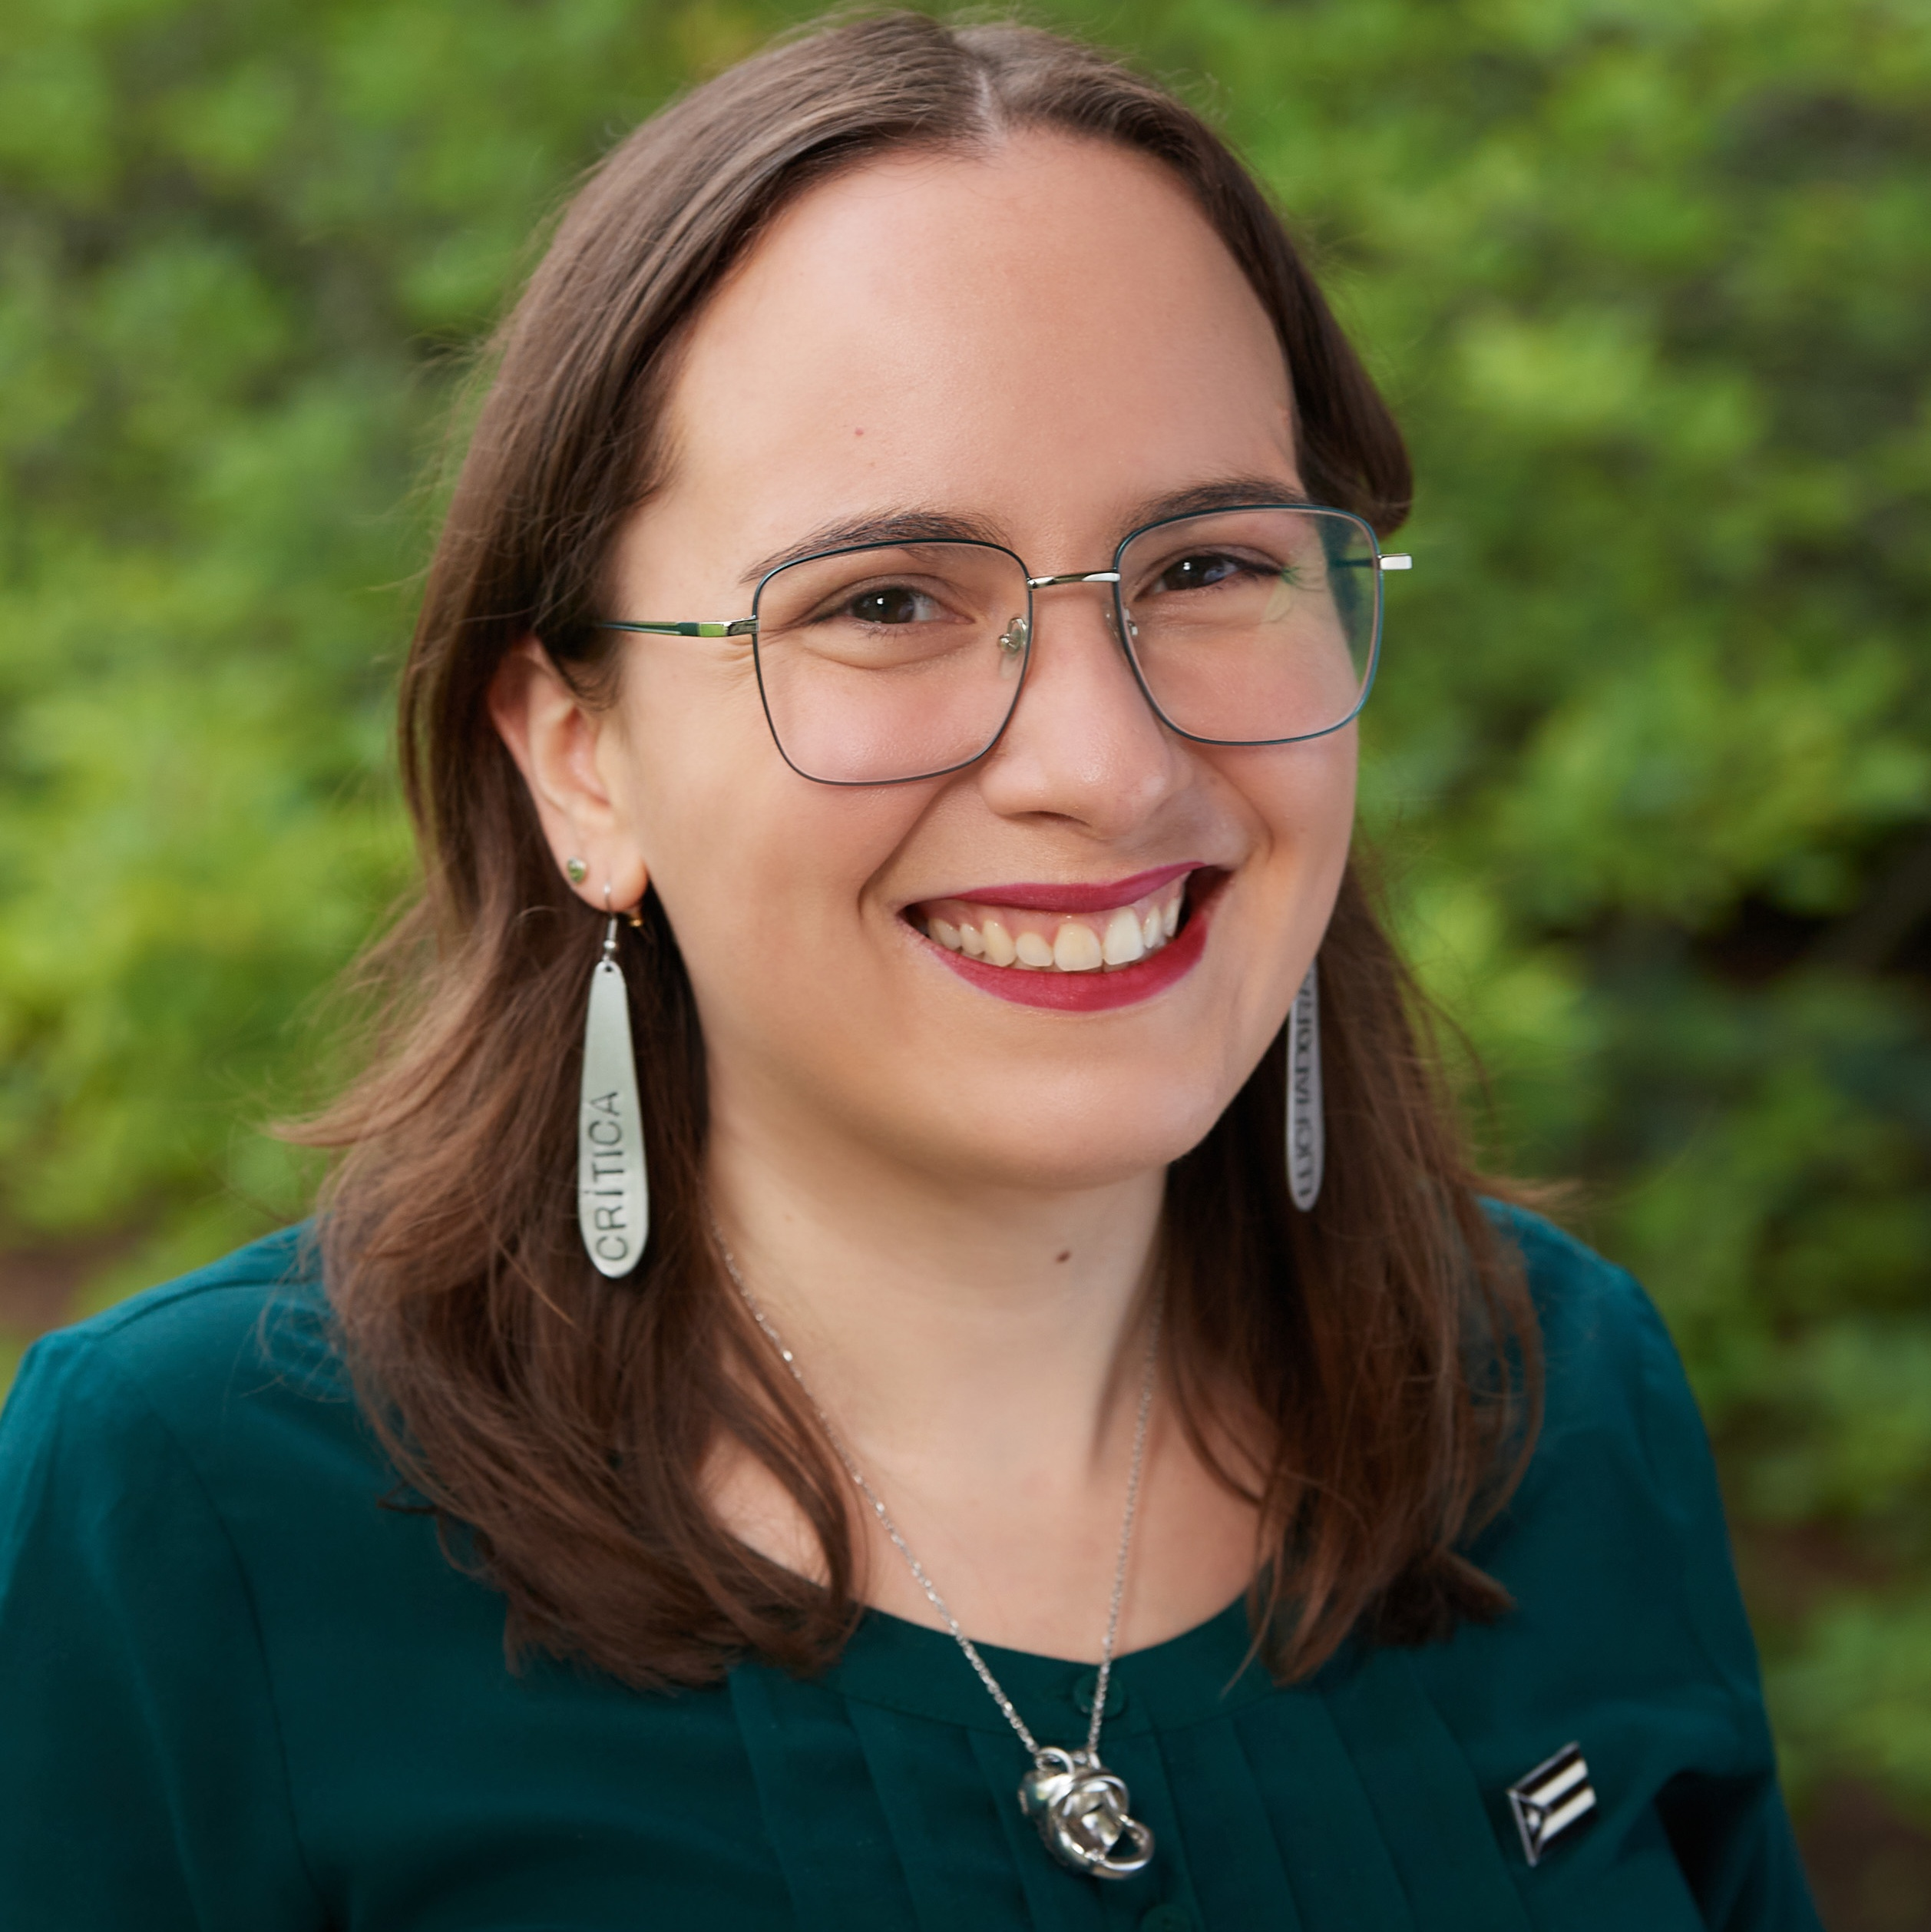
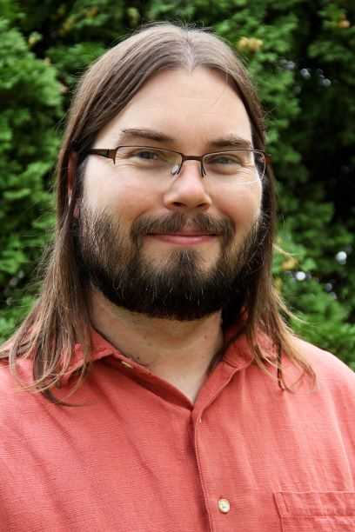
History Department
Dr. Aura Jirau Arroyo, Asst. Professor
Latin American and Latinx History
New Faculty
Dr. Trevor Burrow
Digital Initiatives Coordinator
(Booth Library)
And Instructor of History

Slide 9
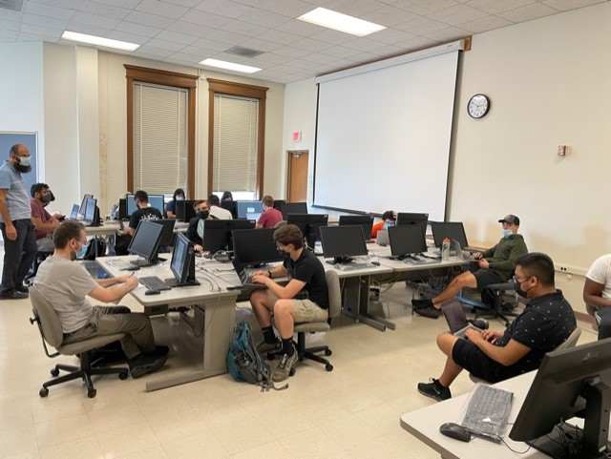
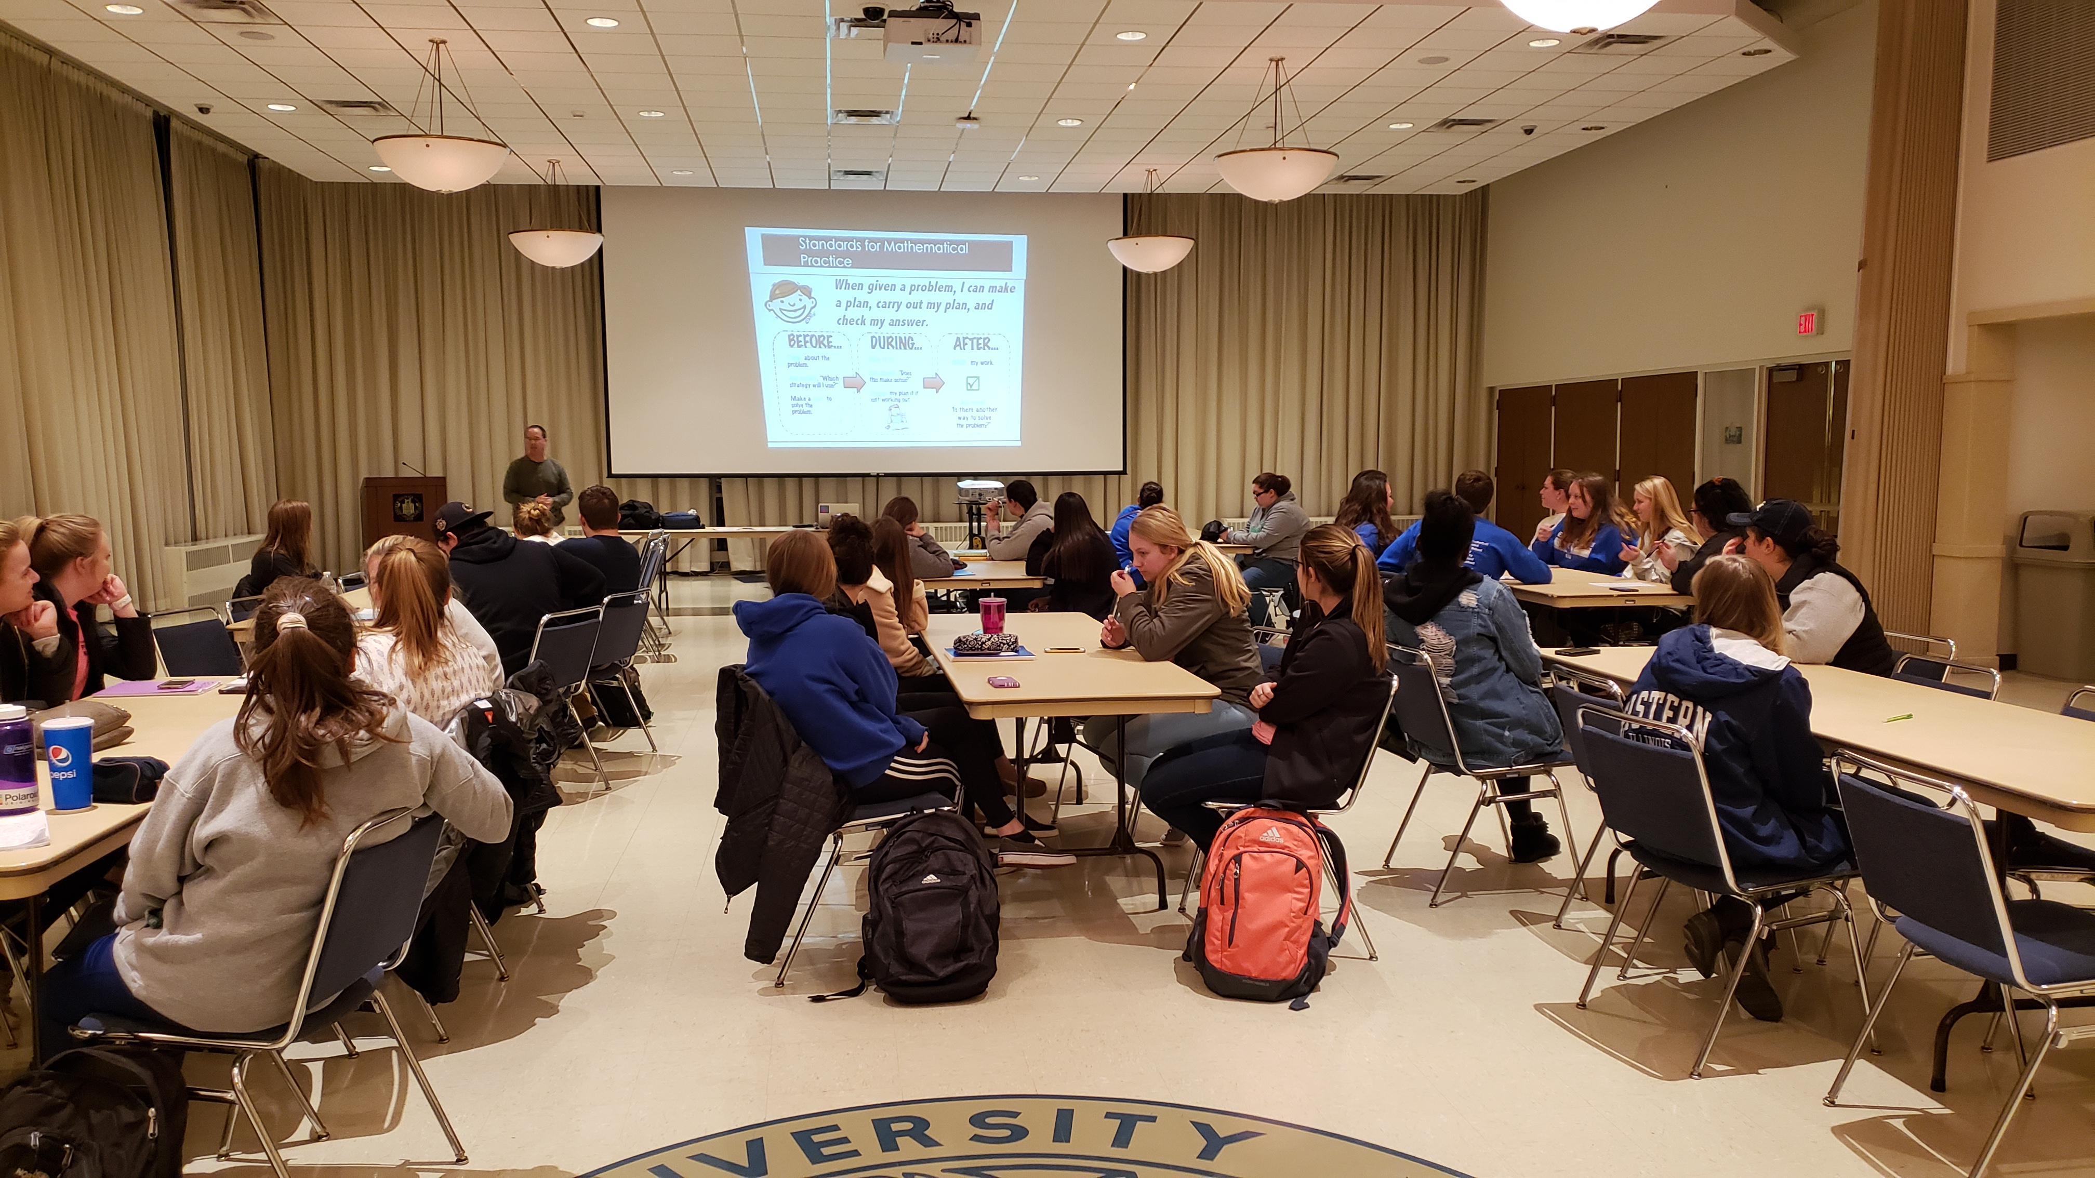
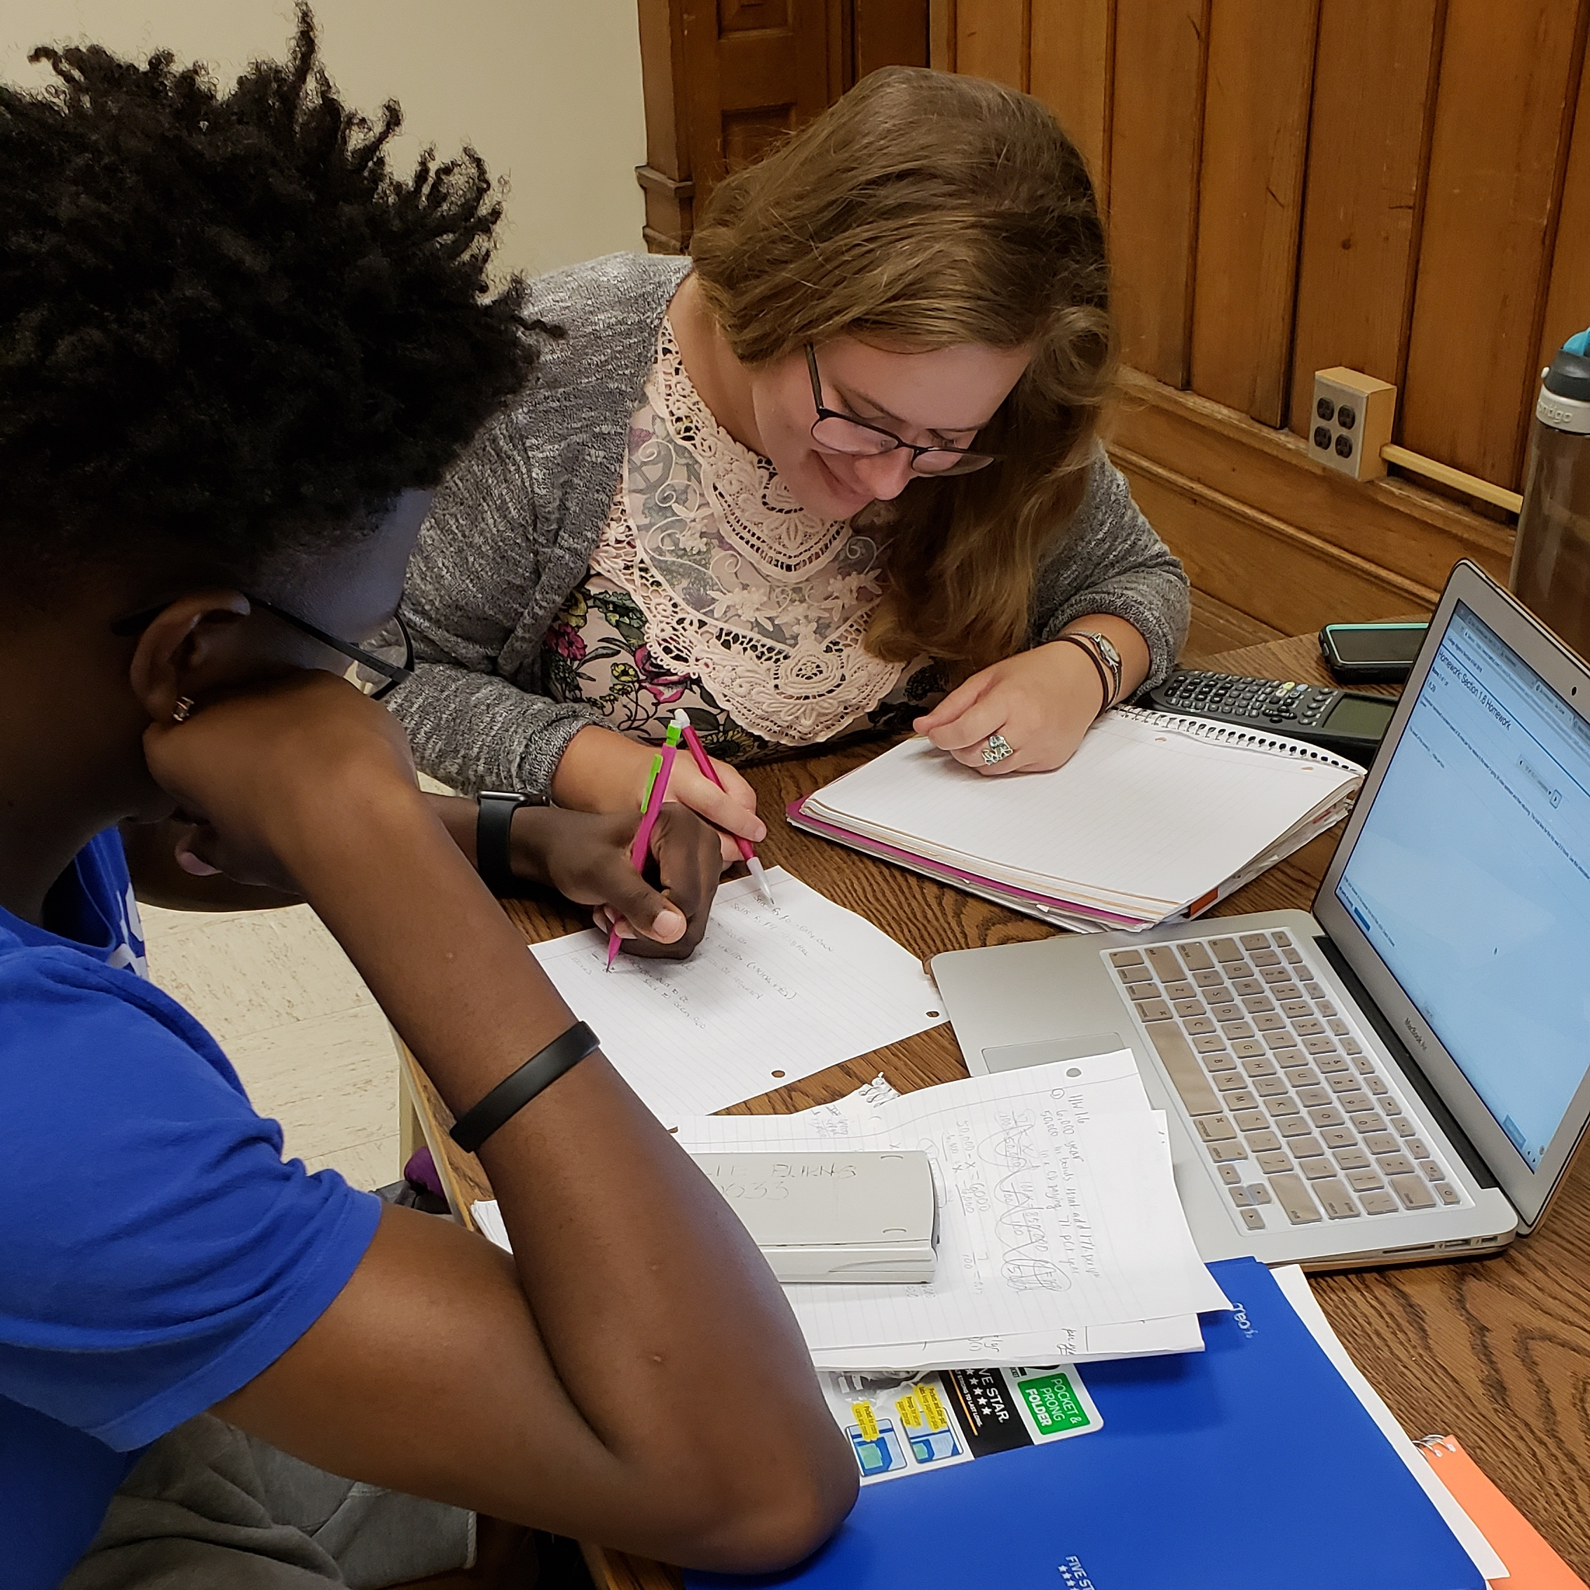
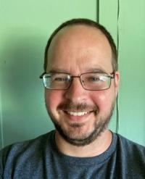
MATHEMATICS AND COMPUTER SCIENCE
Three avenues for math placement, including High school GPA
New Computer Science RSO
Completely online graduate program in Mathematics Education
Four Minors- Computer Science, Computer Science Teacher Licensure, Mathematics, Mathematics Teacher Licensure
Dr. Marshall Lassak, Chair

Slide 10
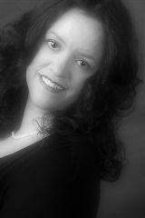
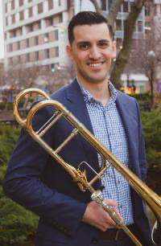
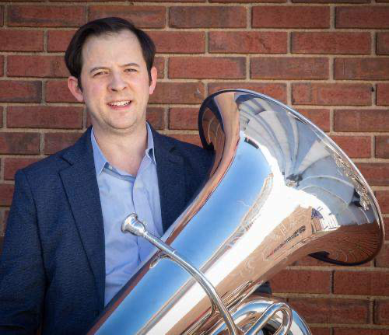
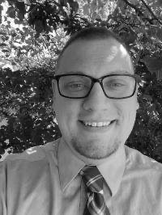
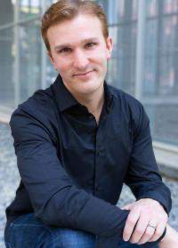
MUSIC
Janet McCumber, Director of Choral Activities
Ben Carrasquillo, trombone and Jazz/Rock
George Alberti, tuba/euphonium
Nolan Vallier, music history
Timothy McGowan, voice
We are thrilled to welcome several new faculty this year! In addition to those pictured above, we will welcomed a new piano technician, Michael Campbell, and Jose Gobbo (guitar) will join us in January.
The Department of Music had an excellent recruitment year, with this year’s entering class approximately doubling last year’s.
With the new BA in Audio and Recording Technology and the new minor in Music Technology are gaining in popularity, we graduate our first class last May and welcomed in a large entering class.
We are always happy to work on articulation agreements with your programs!

Slide 11
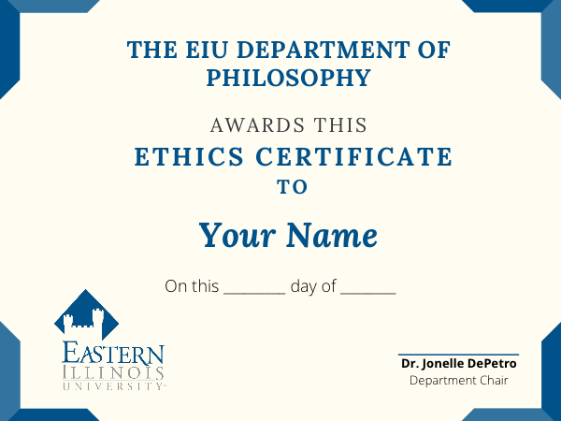


Slide 12
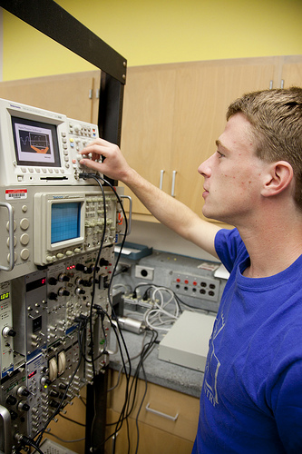
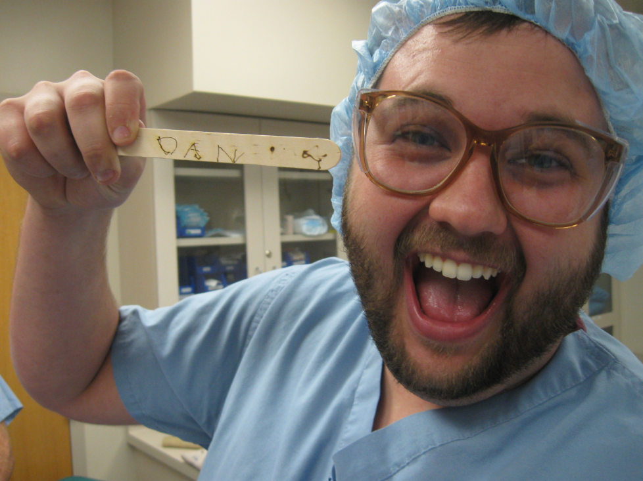
Electrical Engineering:
In our 3rd year and planning to graduate our first class in the spring.
Program is developed and can accept transfer students.
Research Opportunities:
* Paid summer research
* Faculty mentored
research during the year
The EIU Physics Department
Programs Available:
Astronomy
Physics
Computational Physics
Teacher Licensure in Physics
Engineering Physics
Pre-Engineering
Electrical Engineering

Slide 13
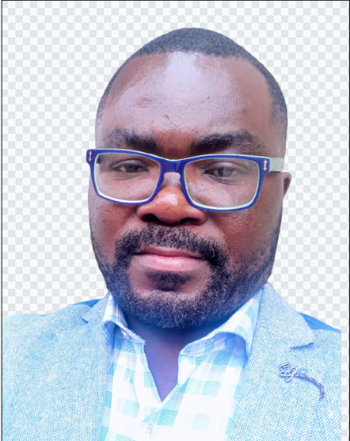
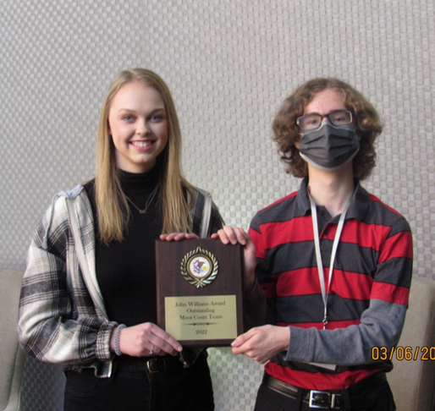
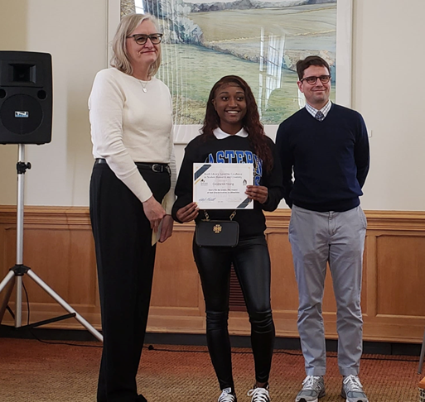
POLITICAL SCIENCE
New Course: Health Politics & Policy
New faculty:
Dr. Daniel Banini
His courses include African Politics, the Politics of Developing Nations, and International Relations.
All Students Participate in Applied Learning:
Moot Court
Model Illinois Government
Undergraduate Research
Internships
Study Abroad

Slide 14
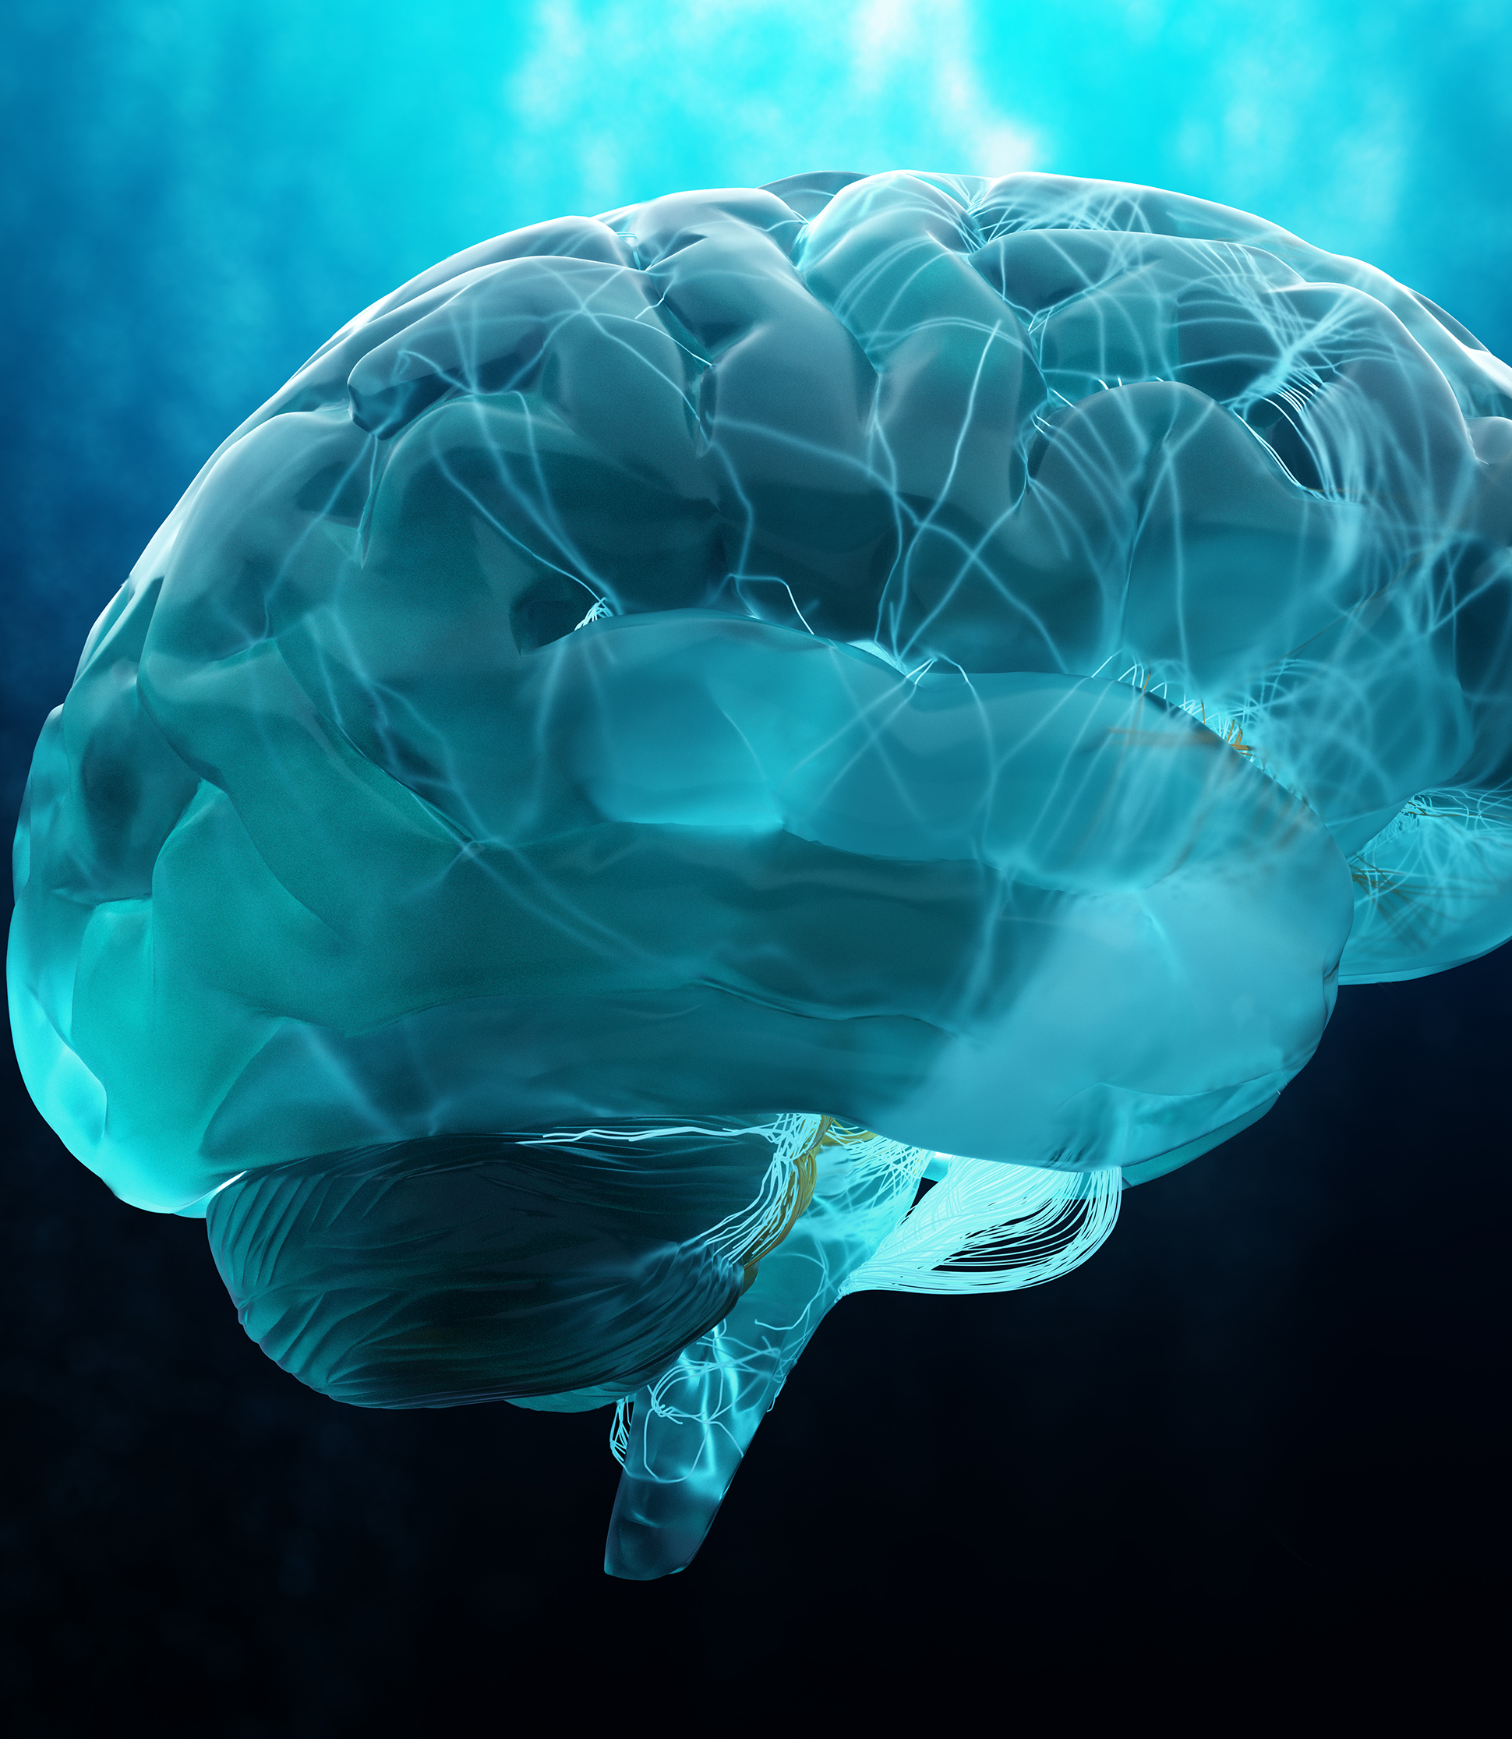
Department of Psychology
Undergraduate Programs
Psychology (n = 242)
Psychology Online (n = 139)
Neuroscience (n = 16)
Graduate Programs
School Psychology
Clinical Psychology

Slide 15
Department of Psychology High-Impact Undergraduate Opportunities
Research methods course
Internship
Undergraduate research
Study abroad to Vienna

Slide 16
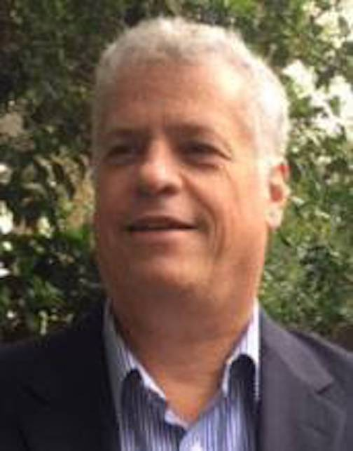
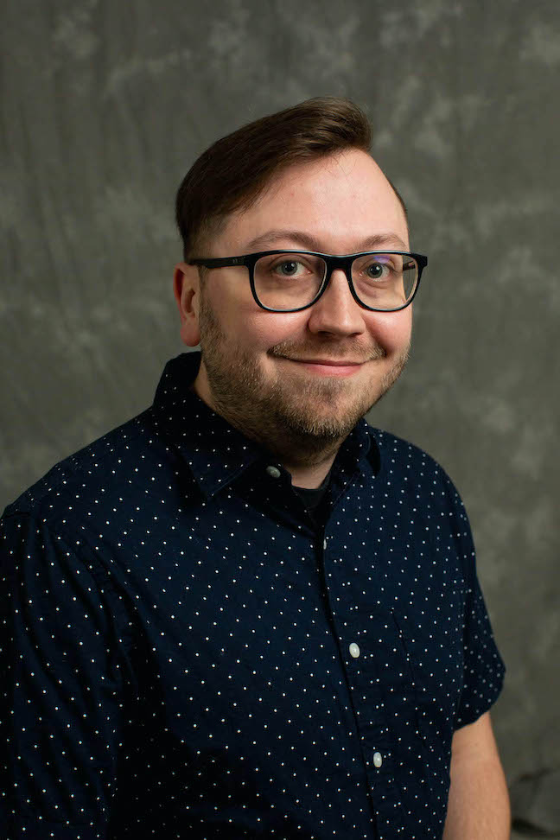
School of Communication & Journalism
New minor in Strategic Social Media Communication
Students learn content creation and the strategic management of social platforms
Journalism major was completely revised including:
A new capstone course
Increased flexibility for students to tailor the major to their career aspirations
Now only 60 required hours and can be completed in two years
SC&J Welcomes Two New Faculty Members
Tim Drachlis, Journalism
Josh Grube, Mass Communication

Slide 17


Slide 18
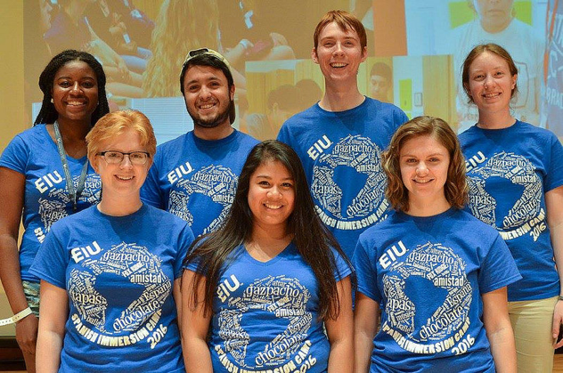
WORLD LANGUAGES AND CULTURES
Flexible Major in Spanish, French & German: 24-26 upper-division hrs & 9 hrs electives
World Language Minor: In the top 5 minors on campus
A growing minor: Latin American & Latinx Studies
Online WLS 1112 Spanish for the Health Professions. Second-semester Spanish course. Meets FLG graduation requirement.
Planned for Spring 2023: WLS 3012 Medical Spanish for Health Care and Allied Fields. Prereq: 4 semesters Spanish, or equivalent proficiency.
WLA 1101 & 1102 American Sign Language I & II

Slide 19
COLLEGE OF LIBERAL ARTS AND SCIENCES

