Slide 1

Dr. Jill Bowers, Associate Dean
jbowers2@eiu.edu

Slide 2
Academic Programs
Communication Disorders & Sciences
Public Health & Nutrition
Human Services
Kinesiology, Sport, & Recreation
Military Science
Nursing

Slide 3
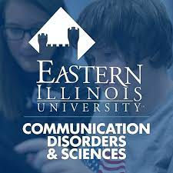

Communication Disorders & Sciences
Careers
Speech-language pathology
Audiology
Alternatives – flexible options for grad school (school counseling or psychology, med school, dental school, OT with intentional minors or electives)
Experiential Learning at EIU
The Autism Program
Undergraduate Clinic
Speech, Language, Hearing Clinic
STEP

Slide 4
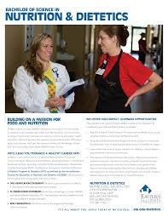
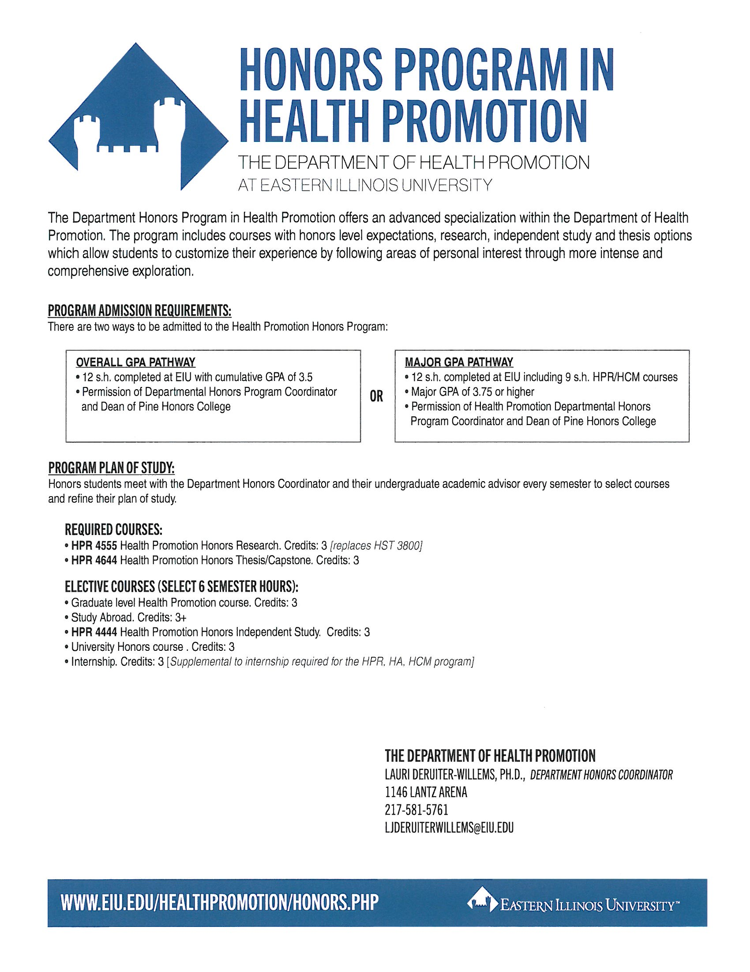
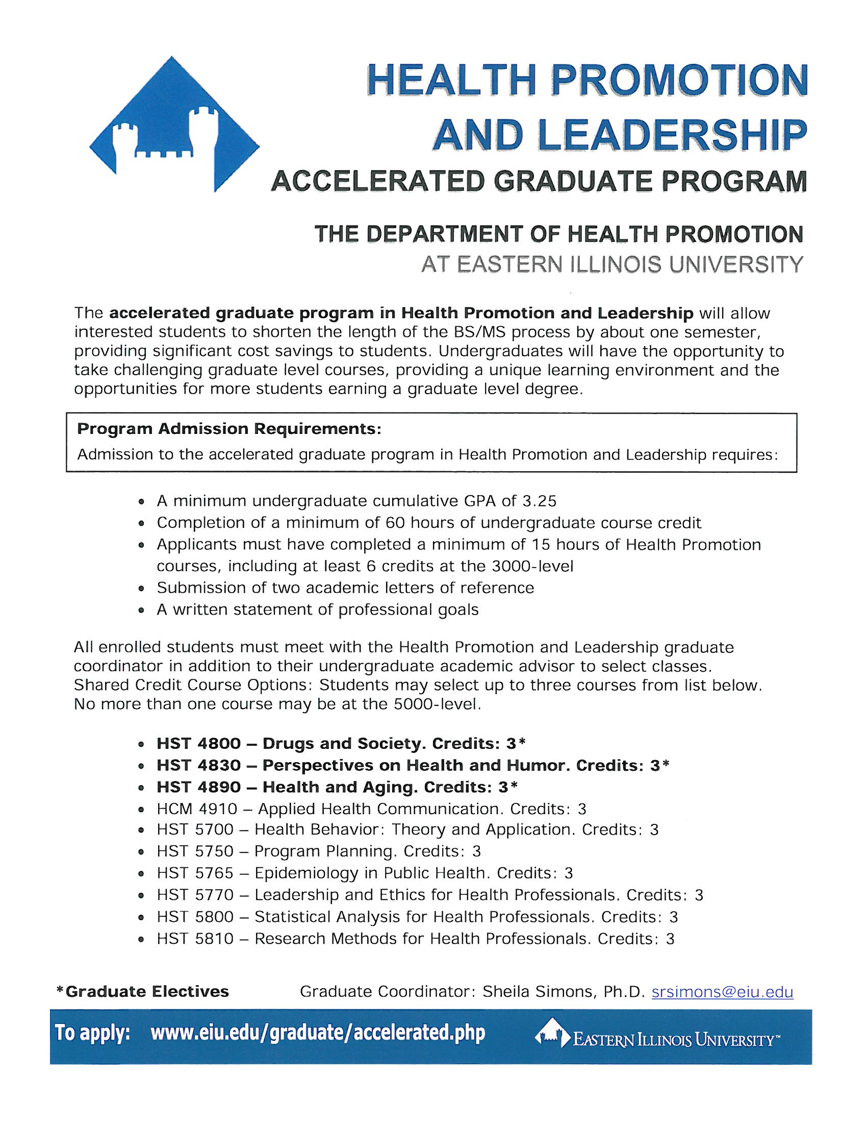
Public Health & Nutrition
Minors
Public health, Health Communication, Workplace Wellness, Public Health for Minor in Teacher Licensure
Careers
Rural health coordinators, substance abuse prevention specialist, community educator (e.g., WIC), health care program coordinator, emergency management specialist
Experiential Learning at EIU
Internships required

Slide 5
Nutrition
Minors
Nutrition & Dietetics, Workplace wellness
Careers
Clinical Dietitian, Clinical Nutrition Manager, WIC Nutritionist, SNAP-Ed Coordinator, Corporate Wellness, Food Service Director
*Some careers require Master’s Degrees
Experiential Learning at EIU
Internships required

Slide 6
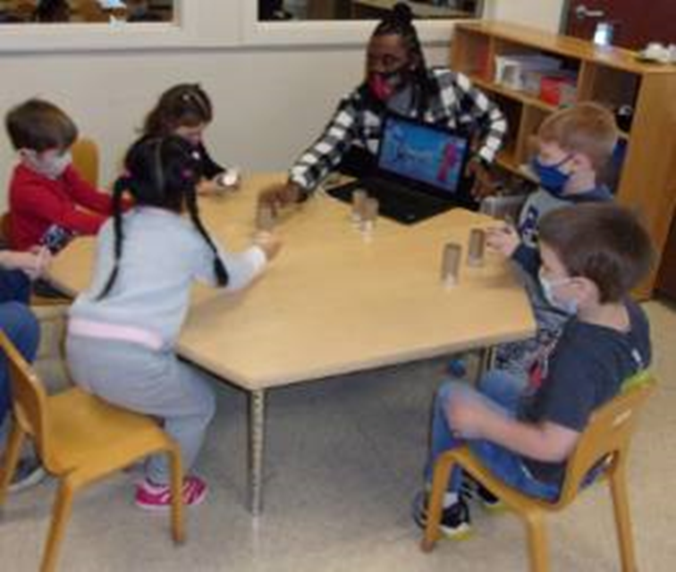
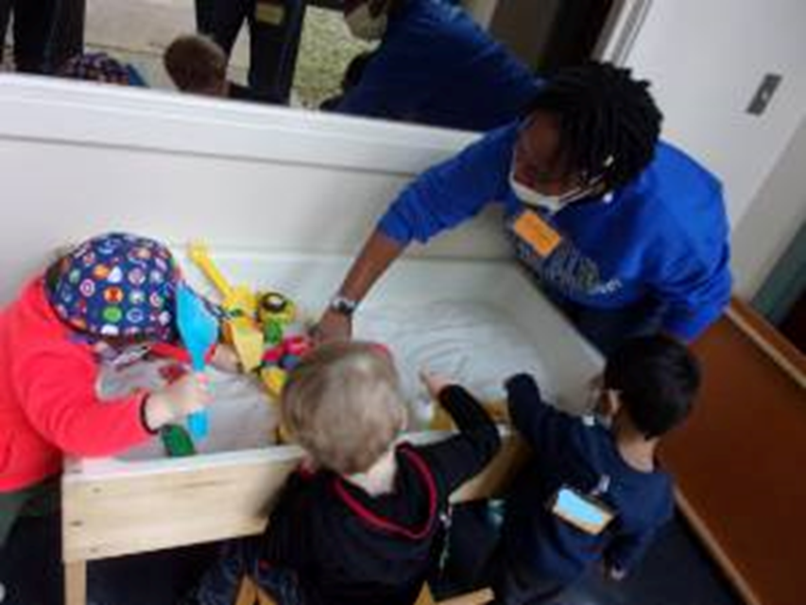
Human Services
Major
Human Services
ECACE – Online Degree Path in Early Childhood
Minors
Aging Studies, Financial Literacy, Human Services, Early Childhood Program Administration
Careers
DHHS Specialist, Family Financial Counselor, Director of Youth Services, Child Welfare, Child Care Provider, Violence or Substance Abuse Prevention and Education
Experiential Learning Opportunities
The Child and Family Life Education Center,
Child Development Practicum, Internships Required

Slide 7
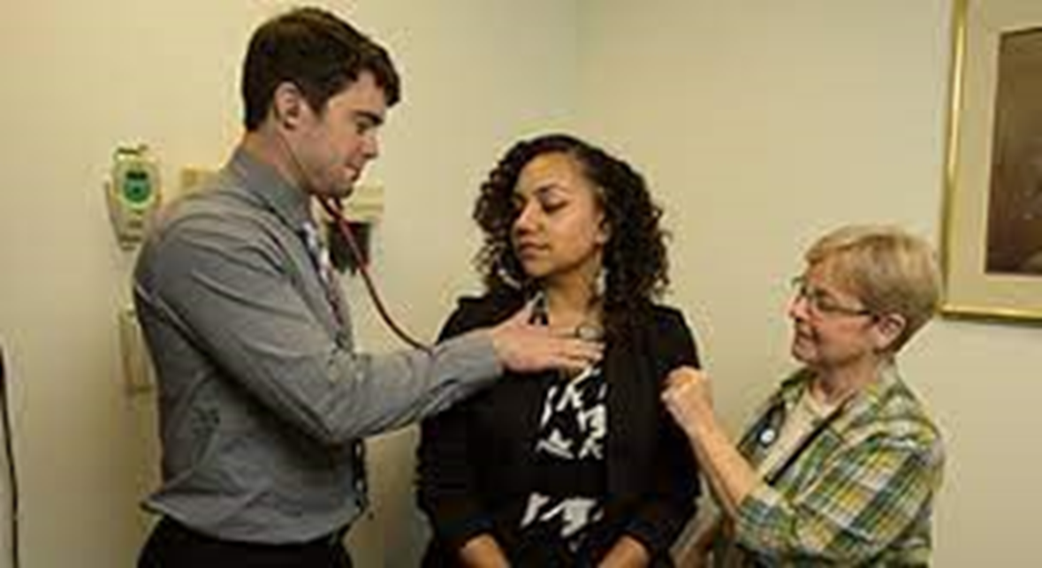
Lumpkin School of Nursing
Majors
Bachelor of Science (BSN)
RN-BSN in Nursing (online)
Programs accredited by the Commission on Collegiate Nursing Education
Experiential learning opportunities
Simulation Center
Clinical Experiences

Slide 8
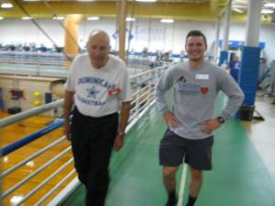
Kinesiology, Sport, & Recreation
Majors
Exercise Science (pre-physical therapy or pre-occupational therapy options)
K-12 Teaching Certifications
Sport Management
Minor
Workplace Wellness
Experiential Learning Opportunities
Adult Fitness Program
Internships

Slide 9
Kinesiology, Sport, & Recreation
Careers
Cardiac Rehabilitation Specialist, Physical And Occupational Therapy, Physical Education Teacher, Parks And Recreation Administrator, Professional Sport Administration, College Athletics Administration, YMCA Sports-fitness Coordinator, Community Sport-Recreation Director
Demo: Chair Pilates/Yoga

