Slide 1
We engage and inspire leaders to improve
the world around them.
Austin Cheney, Dean
Melody Wollan, Associate Dean
John Willems, Interim Chair, School of Business
Isaac Slaven, Interim Chair, School of Technology

Slide 2
2020 - 2021 Highlights
Internships Supported
Undergraduate Research Opportunities
National Student Competitions (virtual)
Accounting Program AACSB Re-accreditation
Launch of new Business Analytics & Information Systems program (formerly Management Information Systems)
eiu.edu/lumpkin

Slide 3
Majors
Accounting
Business Administration
Online completion program
Business Analytics & Information Systems
Finance
Management
Marketing
Hospitality & Tourism
Minors
Accounting
Business Administration
Business Analytics
Entrepreneurship
Finance
Human Resource Management
Management
Management Info Systems
Marketing
Operations & Supply Chain Management
Meeting and Event Management
eiu.edu/business

Slide 4
Majors
Computer & Information Technology
Construction Management
Digital Media Technology
Engineering Technology
Organizational Development
Online completion program
Minors
Digital Media Technology
Engineering Technology
Organizational Leadership (online)
Talent Development (online)
eiu.edu/technology

Slide 5
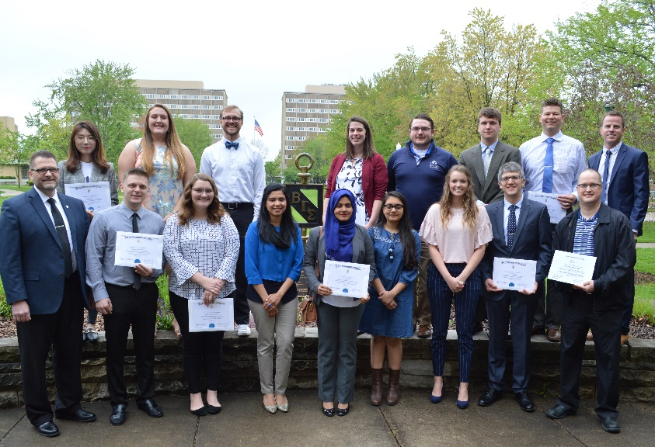
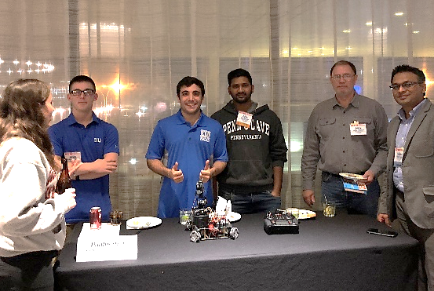
Experiential Learning Opportunities
Students and Faculty Collaborating on Research Projects
Student Organizations
State and National Competitions

Slide 6
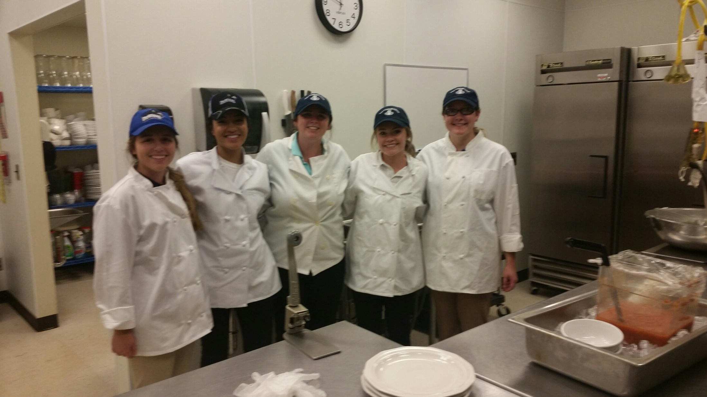
Experiential Learning Opportunities
The Café
Study Abroad
Internships
Industry Speakers

