Slide 1
EIU Community College Articulation Conference
The Graduate School
Ryan C. Hendrickson
L.M. Hamand Dean of the Graduate School
Graduate and International Enrollments
Graduate Diversity Initiatives
Graduate Student Wellness Focus in 2021-2022
Illinois Innovation Network: EIU Hub
Success with Accelerated Graduate Programs
New Online Options

Slide 2
The Graduate School
Graduate Student Enrollment Fall 2021
1661 graduate students = highest enrollment since Fall 2007
41 percent are online graduate students in 18 programs + 4 certificate programs
399 International Students = 2nd highest in EIU History from 51 countries
192 new international students (35 last year)

Slide 3
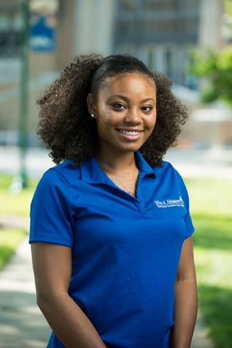
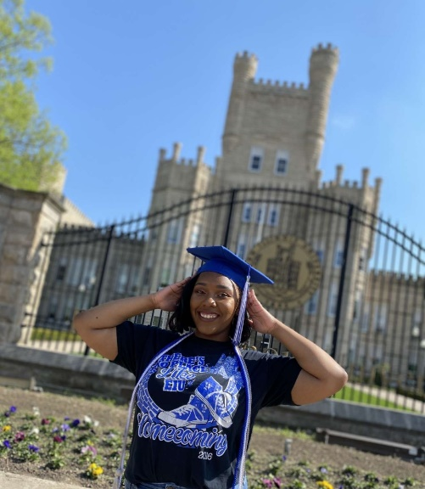
The Graduate School
Diversifying Faculty in Illinois (DFI) Fellowship Award Winners
2 EIU Graduate Student Recipients for 2021-2022
Nyjah Lane and Brandy Matthews
MS Candidates in College Student Affairs
$12,500 Fellowship for each awardee
“traditionally underrepresented minority group”
*Graduate School Diversity Promotion Grant

Slide 4
The Graduate School
Graduate Student Wellness Focus in 2021-2022
New Orientation/Welcome Sessions
Graduate Student Advisory Council
Association of International Students
Mentoring Program with EIU Graduate Alumni

Slide 5
The Graduate School
Illinois Innovation Network East-Central Illinois Hub
$1m grant received from State of Illinois = new classroom space in our Center For Clean Energy Research and Education
Goal = build new partnerships in region to foster economic growth
EIU Partnership with Lake Land College = focus on community sustainability
New Internship program with Rural King
Economic Growth Study of Arcola Illinois

Slide 6
The Graduate School
Accelerated Graduate Programs or “4 + 1” programs
English
Political Science
Health Promotion
Human Services Program Administration
We have 13 Accelerated Programs

Slide 7
The Graduate School
18 Graduate Online Options
Biological Sciences
College Student Affairs: Community College Focus
Business Administration
Art Education
Curriculum and Instruction
English
History for Teachers

