Slide 1
TRANSFER PROGRAM
HIGHLIGHTS FOR 2021

Slide 2
eiu.edu/transferconnect
Notes:
We launched our first cohort of Fall entering Transfers in our Transfer connection for Fall 2022 after the program was such a success for the Fall 2021 Freshman cohort.

Slide 3
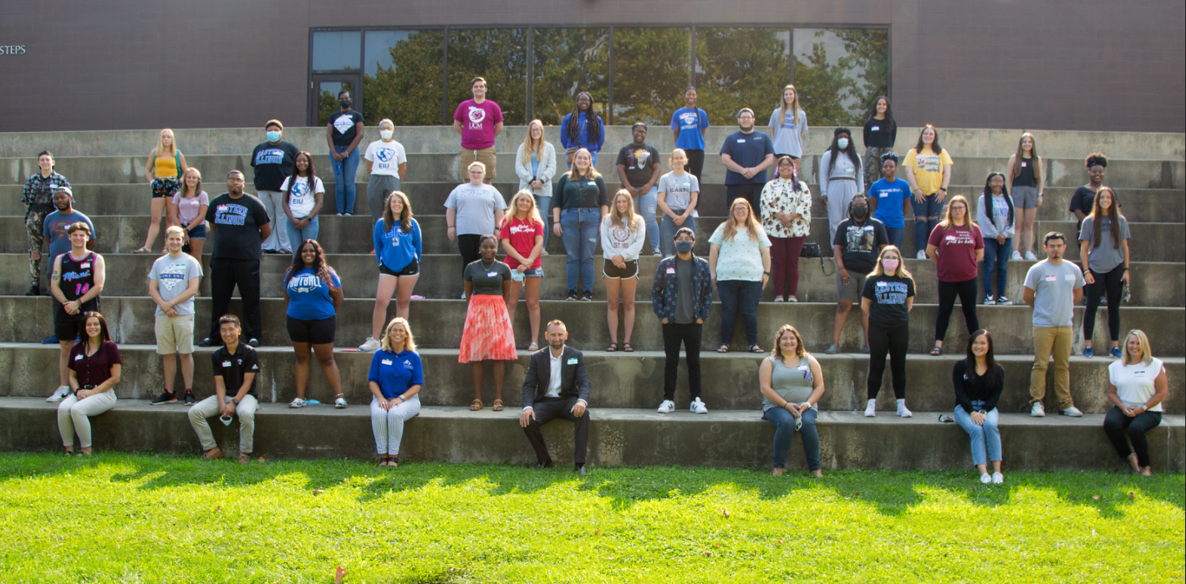
Notes:
The program is lead by Dr. Heidi Larson a faculty member in our department of Counseling and Higher Education. Heidi along with our 5 supporting graduate assistants worked to train and equip our 40 plus volunteer mentors shown here.

Slide 4
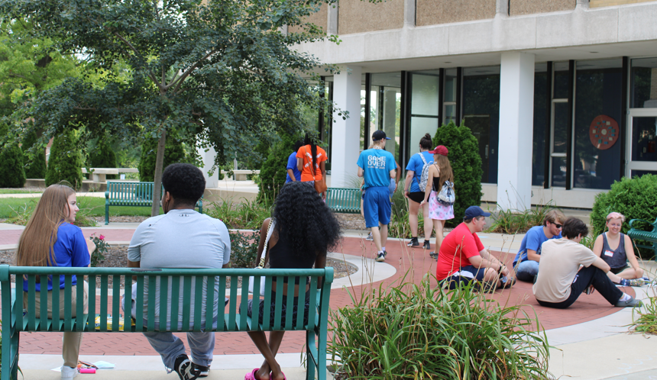
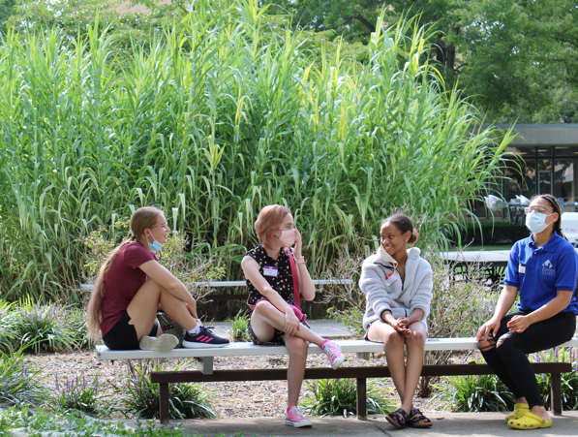
Notes:
Mentors meet with their mentees in groups of 4 to 5 once a week over a free meal. Mentors have meal swipes for themselves and their mentees. This time and support helps your students successfully transition to EIU and helps them navigate issues that could otherwise impede their success without support.

Slide 5
Your student’s application fee will be waived
Your students can work closely with admissions counselors and academic advisors at EIU to ensure seamless transfer earlier in their college career.
Students who take part in Panther Pledge will be eligible to win a scholarship when they attend our Transfer Open House.
The program provides peace of mind for students knowing they have additional support and a guarantee of admission to EIU upon meeting program requirements.
eiu.edu/pantherpledge
Notes:
The Panther Pledge program has been an excellent way for us to support your students earlier then ever, with several benefits for the students but most importantly additional support for your students as they navigate their time at your institution and ultimately their transition to EIU.

Slide 6
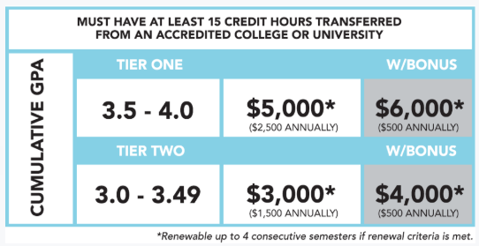
AIM HIGH MERIT BONUS
Notes:
If your students have over 15 credit hours transferred and above a 3.0 GPA, as part of the AIM HIGH program your students will have access to additional merit scholarship funds, up to $6,000 over two years.

Slide 7
QUICK ENROLLMENT STATS

Slide 8
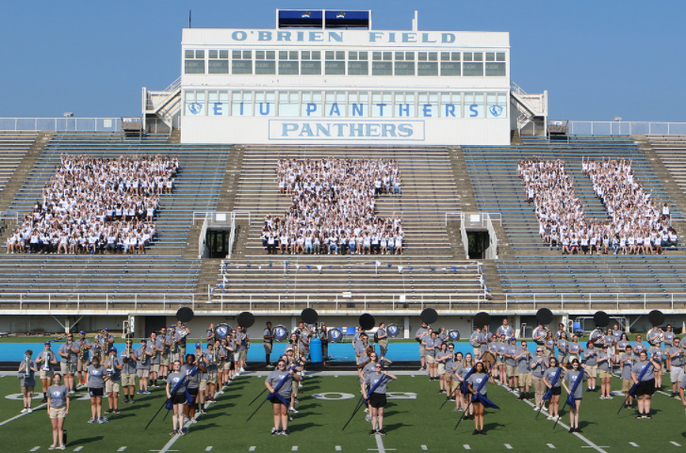
Quick Enrollment Outcomes:
Enrollment was down 18 students (.02%) at 8608 total headcount
5% increase in new transfers at 577 new transfers enrolled.
50% increase in international enrollment overall at 399 students hailing from 51 different countries.
Graduate enrollment up 2.4% overall, the highest enrollment in over a decade at 1661 students.

Slide 9
WHAT ARE YOUR STUDENTS TELLING US THIS YEAR?

Slide 10
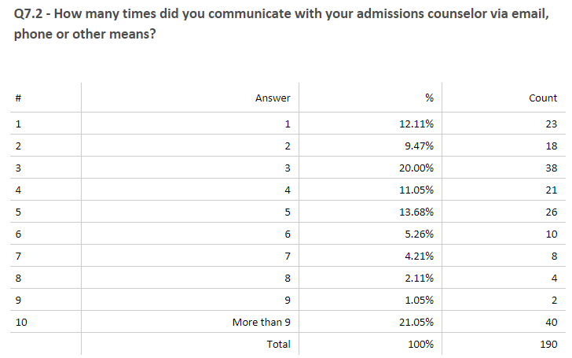
79% of students had contact with their admissions counselor 3 or more times and 28% had contact 7 or more times.

Slide 11
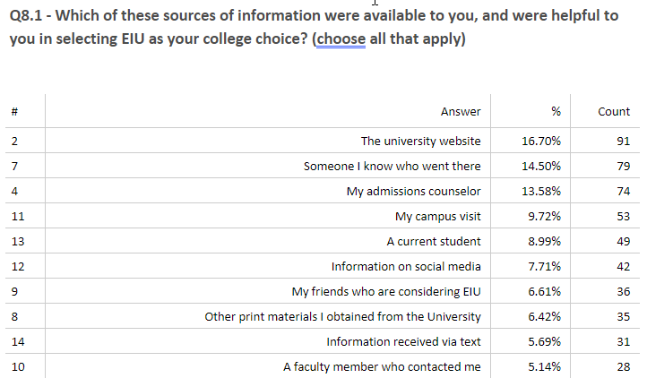
The top three resources your students found helpful were our website, someone they knew who went to EIU, and their admission counselor.

Slide 12
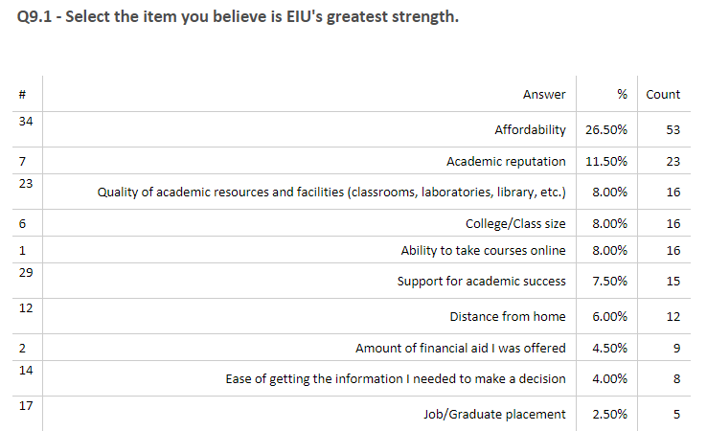
Your students believe our greatest strengths are affordability, academic reputation, and the quality of our academic resources and facilities.

Slide 13
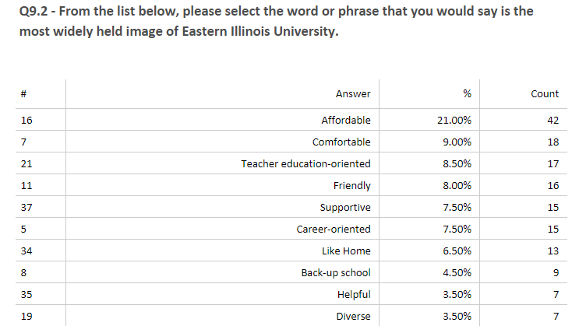

Slide 15
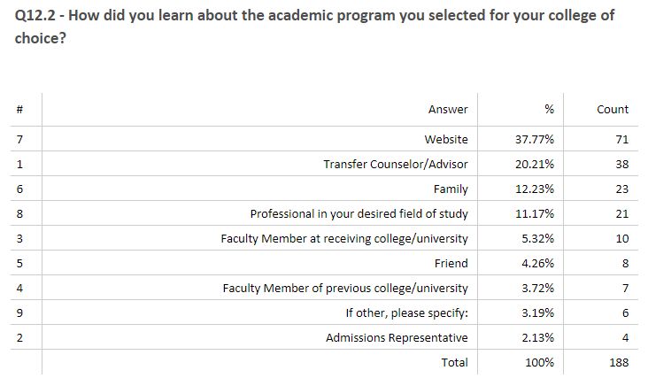

Slide 16
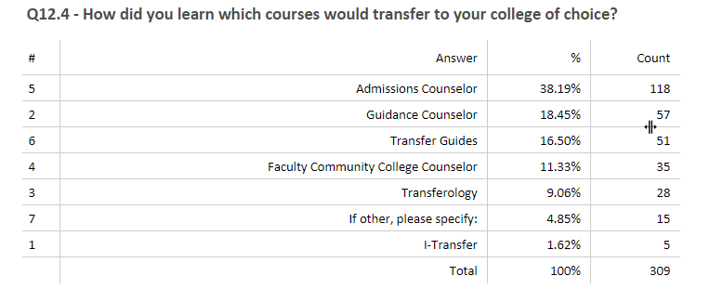
It’s a team effort to help our students understand how their courses will transfer to their college of choice, 68% relied on you or our staff to determine which courses would transfer to their schools of choice.

Slide 17
THANKS FOR ALL YOU DO!
Notes:
Let’s work together and thank you.

