Slide 1
College of Education and School of Extended Learning
Community College Articulation Conference
Laretta Henderson, Dean Stephen Lucas, Associate Dean
September 22, 2021

Slide 2
Commitments
Quality undergraduate and graduate programs
Student success academically, professionally, and personally in and out of the classroom
Maintaining strong relationships with alumni and friends of the College
Serving the professional and personal needs of our community

Slide 3
College of Education Initiatives
Off-Campus Cohorts in Elementary and Special Education
Focus on Paraprofessional → Teachers and Career-Changers
Champaign (ROE 9 / Parkland) – 2021-2024
Decatur (Richland) – 2022-2025
Danville (DACC) – 2023-2026
Online MAT in Secondary Education
One-Year Program
Beginning Summer 2023
Education Pathway Partnerships
Online Early Childhood Education Degree and License
State-wide Consortium focused on Early Childhood Incumbents
Projected start late 2022 / early 2023

Slide 4
School of Extended Learning
Bachelor of Interdisciplinary Studies – www.eiu.edu/ids
Formerly Bachelor of General Studies
New initiative at Danville Correctional Center
Potential new traditional undergraduate student program
Academy of Lifelong Learning - www.eiu.edu/adulted/all.php
Educational opportunities connecting adults with a variety of topics, organizations, and each other
Professional Development Institute – www.eiu.edu/pdi
Professional development for educators
Ongoing training for business and non-profits
Face to face and online programming
Complete services to design, market, deliver, and bill participants

Slide 5
Educator Licensure Programs
Early Childhood (Birth-Grade 2)
Elementary (Grades 1-6)
Middle Level (Grades 5-8)
Language Arts, Mathematics, Science, Social Science
Career & Technical Education (5-12)
Business, Family & Consumer Science, Technology
World Languages (PK-12)
French, German, Spanish
Physical Education (PK-12)
Music (PK-12)
General, Instrumental, Vocal
Visual Arts (PK-12)
Secondary (9-12)
English Language Arts
Mathematics
Science
Biology, Chemistry, Earth Science, Physics
Social Science-History
Administrative
Teacher Leader, Principal, Superintendent, Director of Special Education
School Service Personnel
School Counselor, School Psychologist, Speech Language Pathologist

Slide 6
Changes / Reminders
Elimination of Basic Skills Requirement
edTPA waived for Fall 2021 and Spring 2022
Content test waived for student teaching (but not licensure) for Fall 2021 and Spring 2022
Pathways to adding additional endorsements
18 semester hours plus content test
EIU Rural Teacher Corps
Articulation agreements / transfer guides

Slide 7
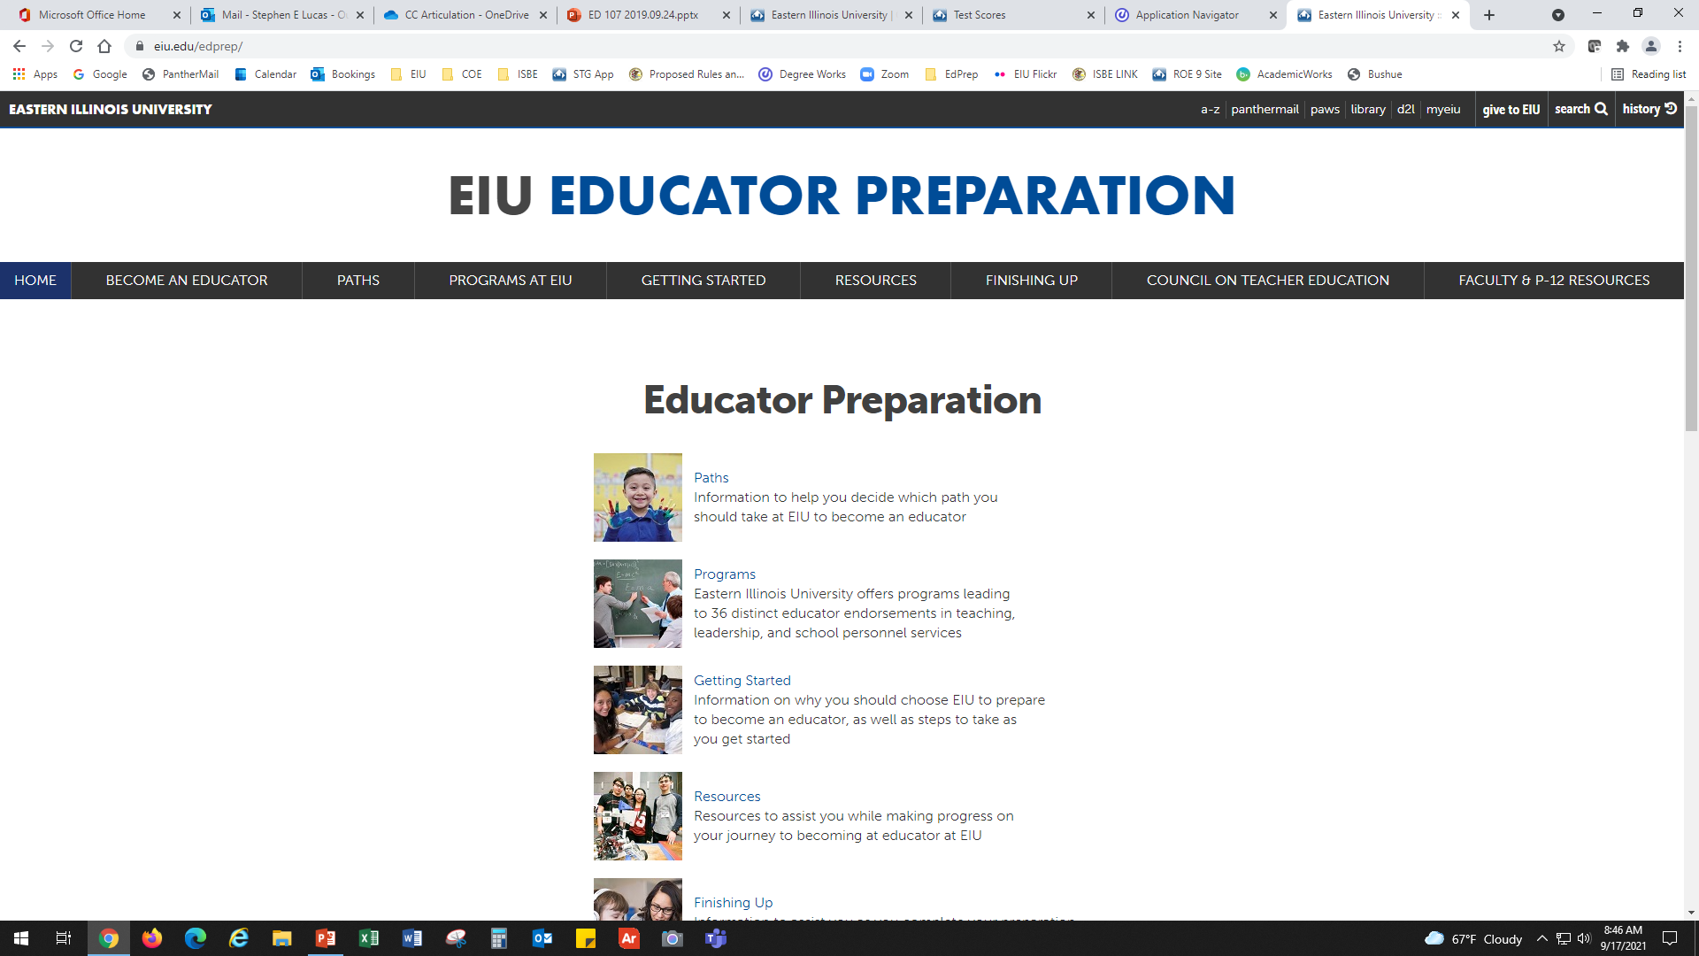
www.eiu.edu/edprep

Slide 8
Thank You
College of Education – coe@eiu.edu / (217) 581-2524
Dean Laretta Henderson – lhenderson2@eiu.edu
Associate Dean Stephen Lucas – selucas@eiu.edu
GYO Grant Director Brian Reid – bdreid2@eiu.edu
Teaching, Learning, and Foundations - www.eiu.edu/eemedu/
Special Education - www.eiu.edu/speced/
Educator Preparation - www.eiu.edu/edprep

