Slide 1

We engage and inspire leaders to improve the world around them.
Austin Cheney, Dean
Melody Wollan, Associate Dean; Chair, Hospitality & Tourism
John Willems, Chair, School of Business
Peter Ping Liu, Chair, School of Technology

Slide 2
2019 Student Engagement
Numerous Guest Speakers (including EIR, Ent. Week, etc.)
Company Sponsored Workshops & Class Projects
Internships Supported
Undergraduate Research Opportunities
National Student Competitions
Student Professional Development Trips
2019 Outcomes
93% Success Rate (Career Placement or Graduate School)
$48,000 Average Annual Starting Salary

Slide 3



Majors
Accounting
Business Administration – 2 + 2 program
  Off Campus (Parkland College)
  Online
Finance
Management
Business Analytics and Information Systems
Marketing
Minors
Accounting
Business Administration
Business Analytics
Entrepreneurship
Finance
Human Resource Management
Management
Management Info Systems
Marketing
Operations & Supply Chain Management
eiu.edu/business

Slide 4
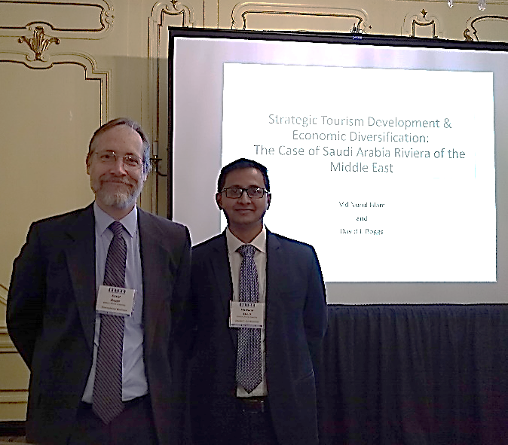
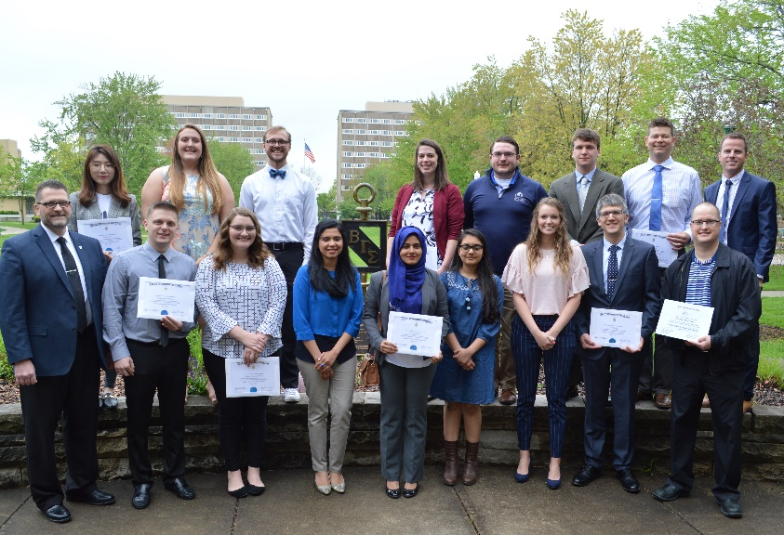
Experiential Learning Opportunities
Top students in business being inducted into the gold standard of honors societies, Beta Gamma Sigma
Students and Faculty Collaborating on Research Projects
eiu.edu/business

Slide 5

Majors
Computer & Information Technology
Construction Management
Digital Media Technology
Engineering Technology
Organizational Development (online)
Minors
Environmental Sustainability
Digital Media Technology
Organizational Leadership (online)
Talent Development (online)
eiu.edu/technology

Slide 6
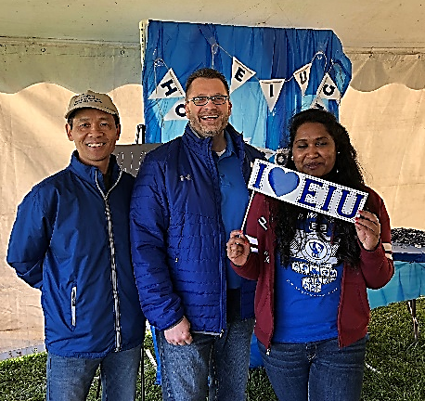
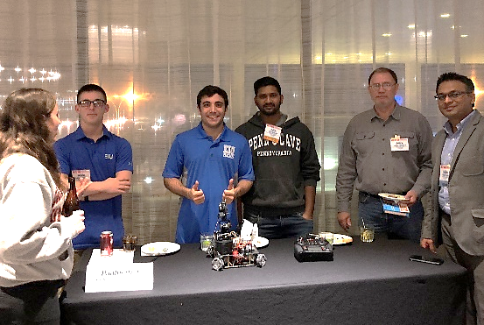

Opportunities for Student Engagement
Successful Career Paths
ATMAE Student Robotics Competition, Charlotte, 2019
Project Manager
IT Professional
Manufacturing Engineer
Media Coordinator
Web and App Developer
eiu.edu/technology

Slide 7

New Degree: BS in Hospitality and Tourism (HTM)
  Management Option or Entrepreneurship Option
New Minor: Meeting and Event Management
  15 hours of HTM, Communication Studies, and Recreation Admin courses
Experiential Learning
  The Cafe
  Beer and Wine Production
  Two Supervised Work Experiences for Credit
Professional Development
  Student Event Planning Association (student organization)
  Hospitality Industry Career Fair in Chicago
  Participation in National Restaurant Association Trade Show
  Field Trips: Wineries, Meeting Venues
eiu.edu/hospitality

Slide 8
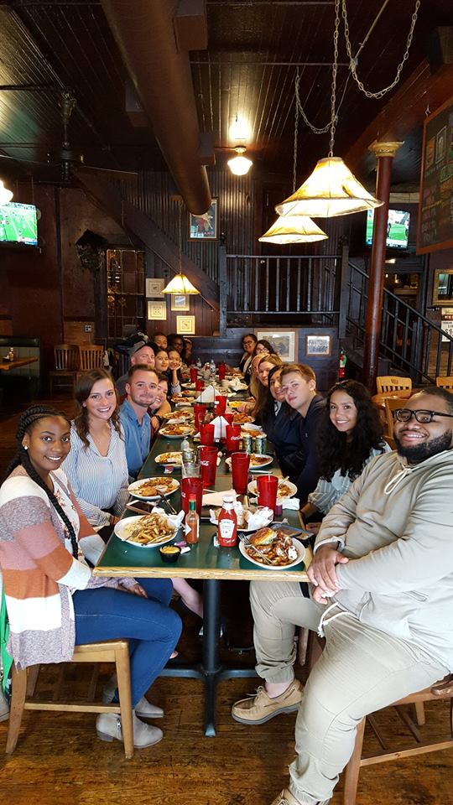
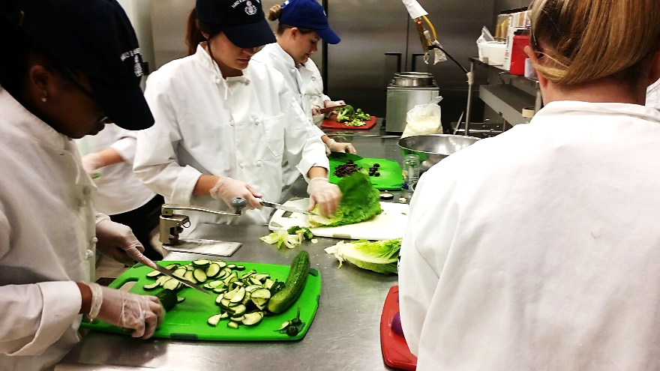
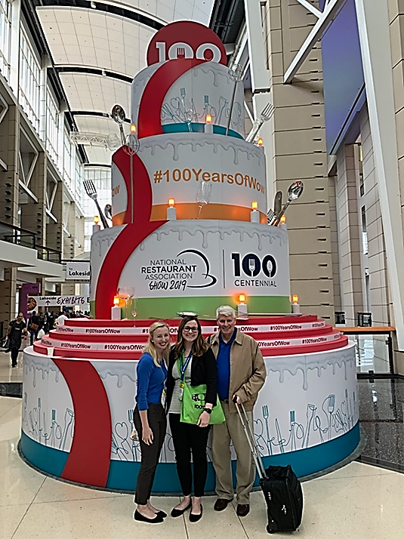
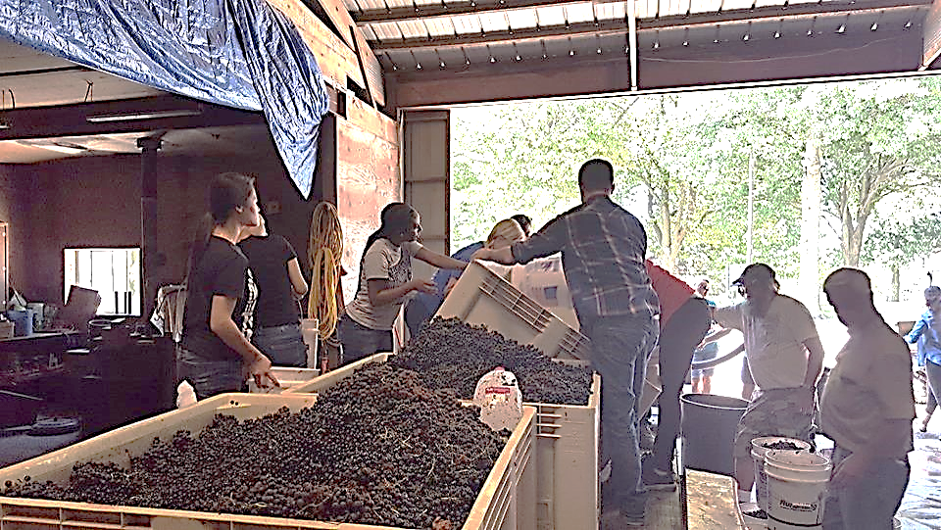
eiu.edu/hospitality

