Slide 1
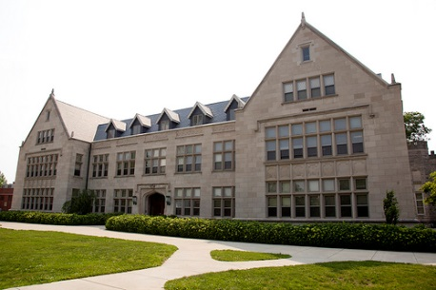
2020 Community College Articulation Conference
Ryan C. Hendrickson
Dean of the Graduate School
41 Degree Programs/Options
Highest Enrollment in Fall 2020 since
2009

Slide 2
EIU Graduate Student Advisory Council
Executive Board + student representatives from each graduate program
Membership Benefits and Student Support Activities:
Networking, collaboration, friendships
Guidance with Career Services
Professional and Research Development Programs
Mental and Health Counseling Support
Student Leadership opportunities

Slide 3
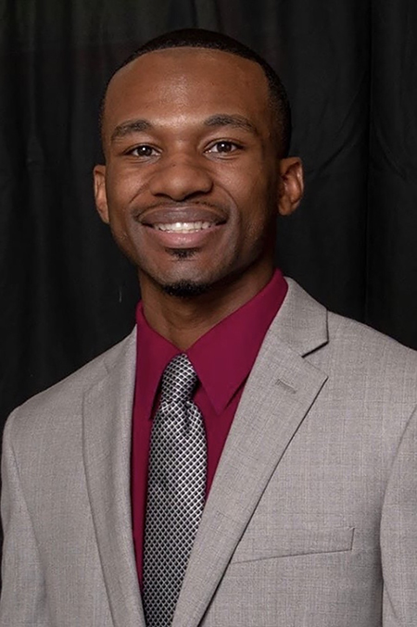
Diversifying Faculty in Illinois (DFI) Fellowships
Ly’Jerrick Ward: 2020-2021 recipient MS Candidate in College Student Affairs
$11,000 Fellowship
“traditionally underrepresented minority group”
Higher Learning Commission:
EIU Quality Initiative = Increase DFI nominations

Slide 4





EIU International Student Enrollment
54 Countries represented
Popular Undergraduate majors for international students
Accounting
Biological Sciences
Computer Science
Construction Management
Management/Management Information Systems
Support and Activities for International Students
Association of International Students, Chinese Student Association, Indian Student Association, Korean Student Association, African Student Association.

Slide 5
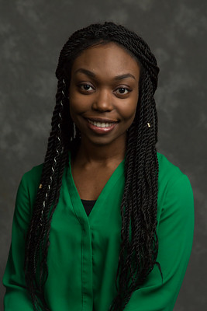
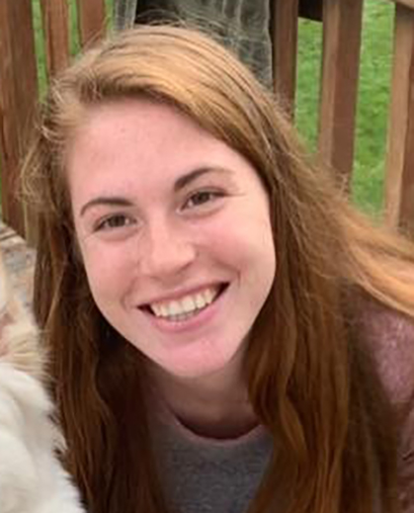
Accelerated Graduate Programs
12 Accelerated Graduate Programs
Summer 2020 Accelerated Graduate Program Alumni
Shirley Mensah: PSM in GIS Halle Stull: MS in Technology

Slide 6
EIU’s Student Research Support
Support for High Impact Student Practices
“Student Impact Grants”: used to support faculty research mentoring activities that lead to external recognition
Chemistry projects
Speech team
School Psychology research programs
Technology—Robotics Competitions
Graduate School Research and Creative Activity Grants

Slide 7
M.S. in College Student Affairs--Online
Option in “Higher Education and Community College”
Started in August 2019
Expansion in August 2020

