Slide 1

Notes:
All of the details for what to include in the portfolio can be found at the Internship website linked to the department webpage. You want to have that document or guidelines next to you as you develop your eportfolio

Slide 2

Department Approval Form

Slide 3

One Note

Slide 4
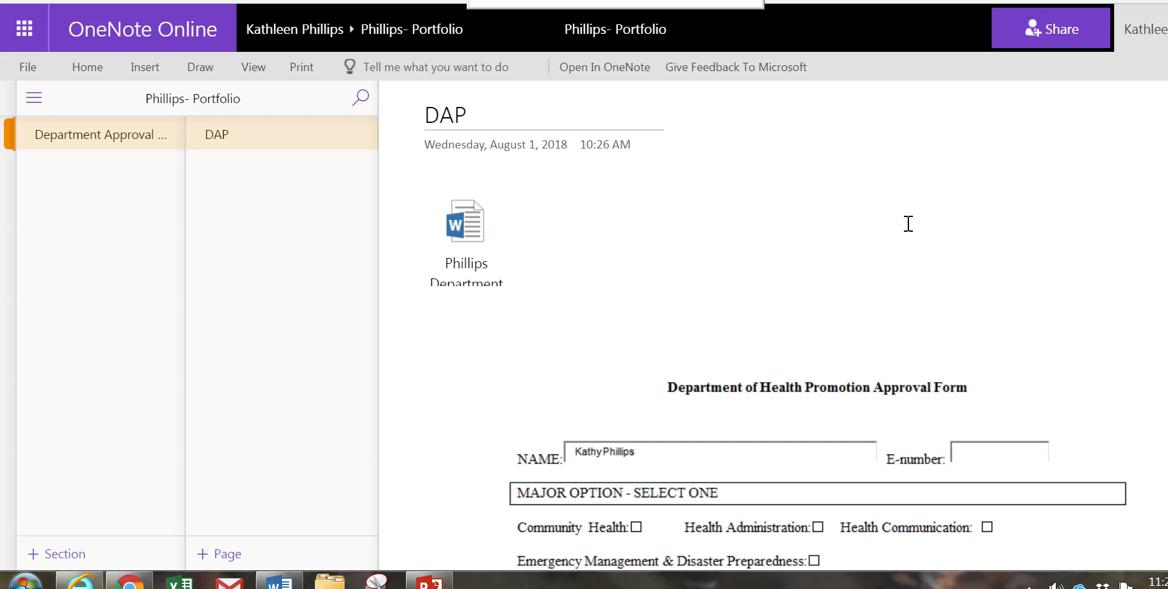
Resume

Slide 5
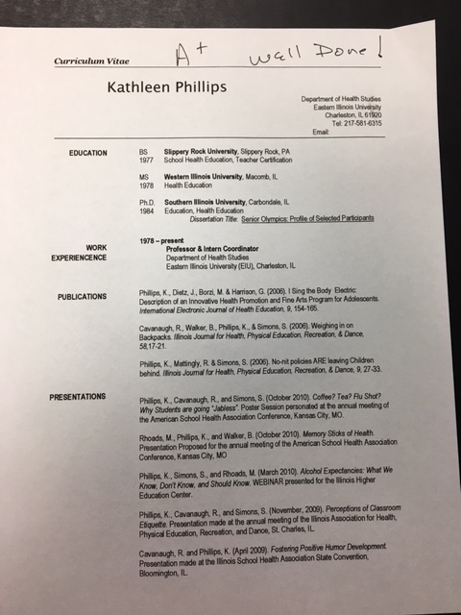
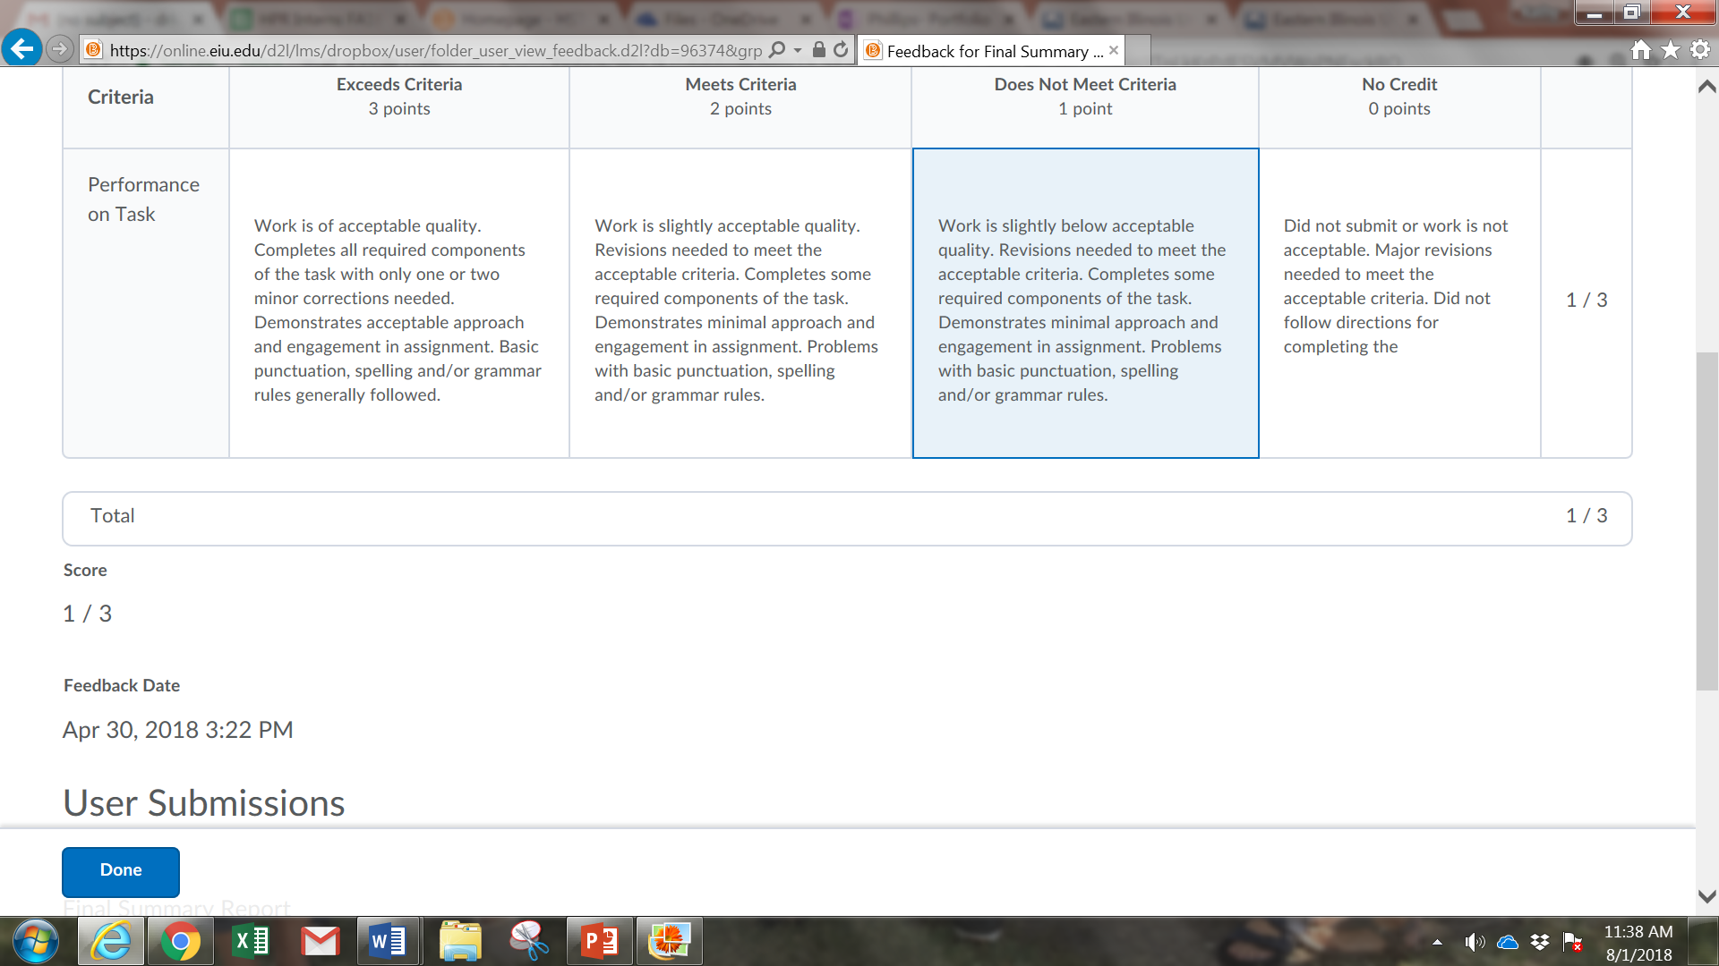

Graded Assignments and Rubrics
Notes:
A requirement for the portfolio is to include a grade or rubric for each of your assignments. If you have an assignment that has comments or a grade written directly on it – just make a copy of it or take a screen shot of it and paste it in the section of the notebook. For example, if you had a resume that was an assignment for a class and it was graded, be sure to include the graded copy. You can also include a corrected copy with it if you want to.
If a rubric was used for the assignment in D2l, you can take a screen shot if it and paste it in the Notebook section. You can see a demonstration on the next slide.

Slide 6
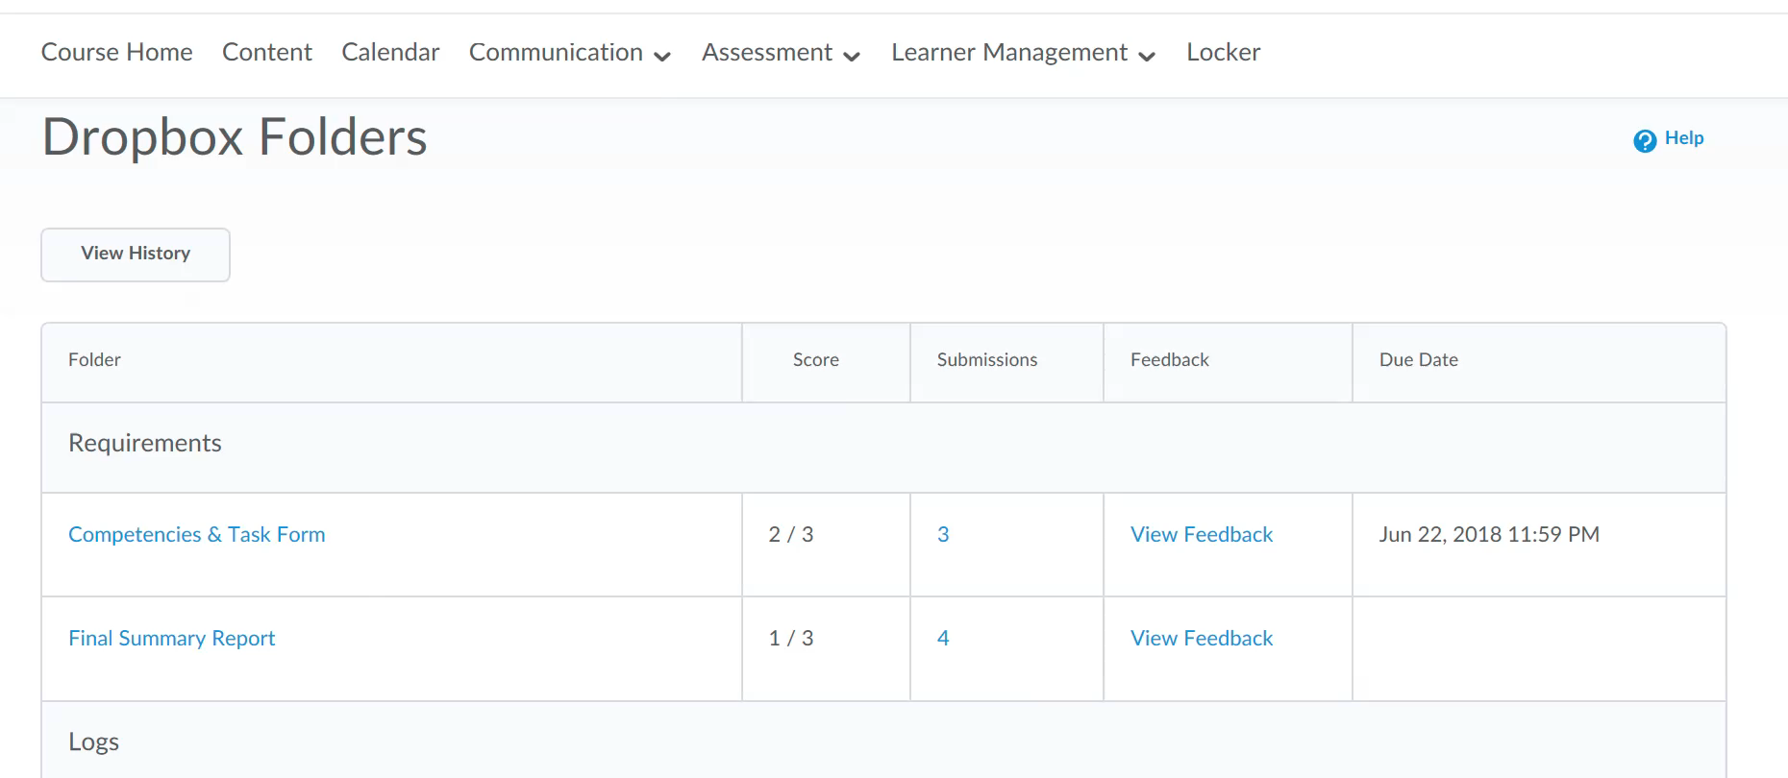

Slide 7
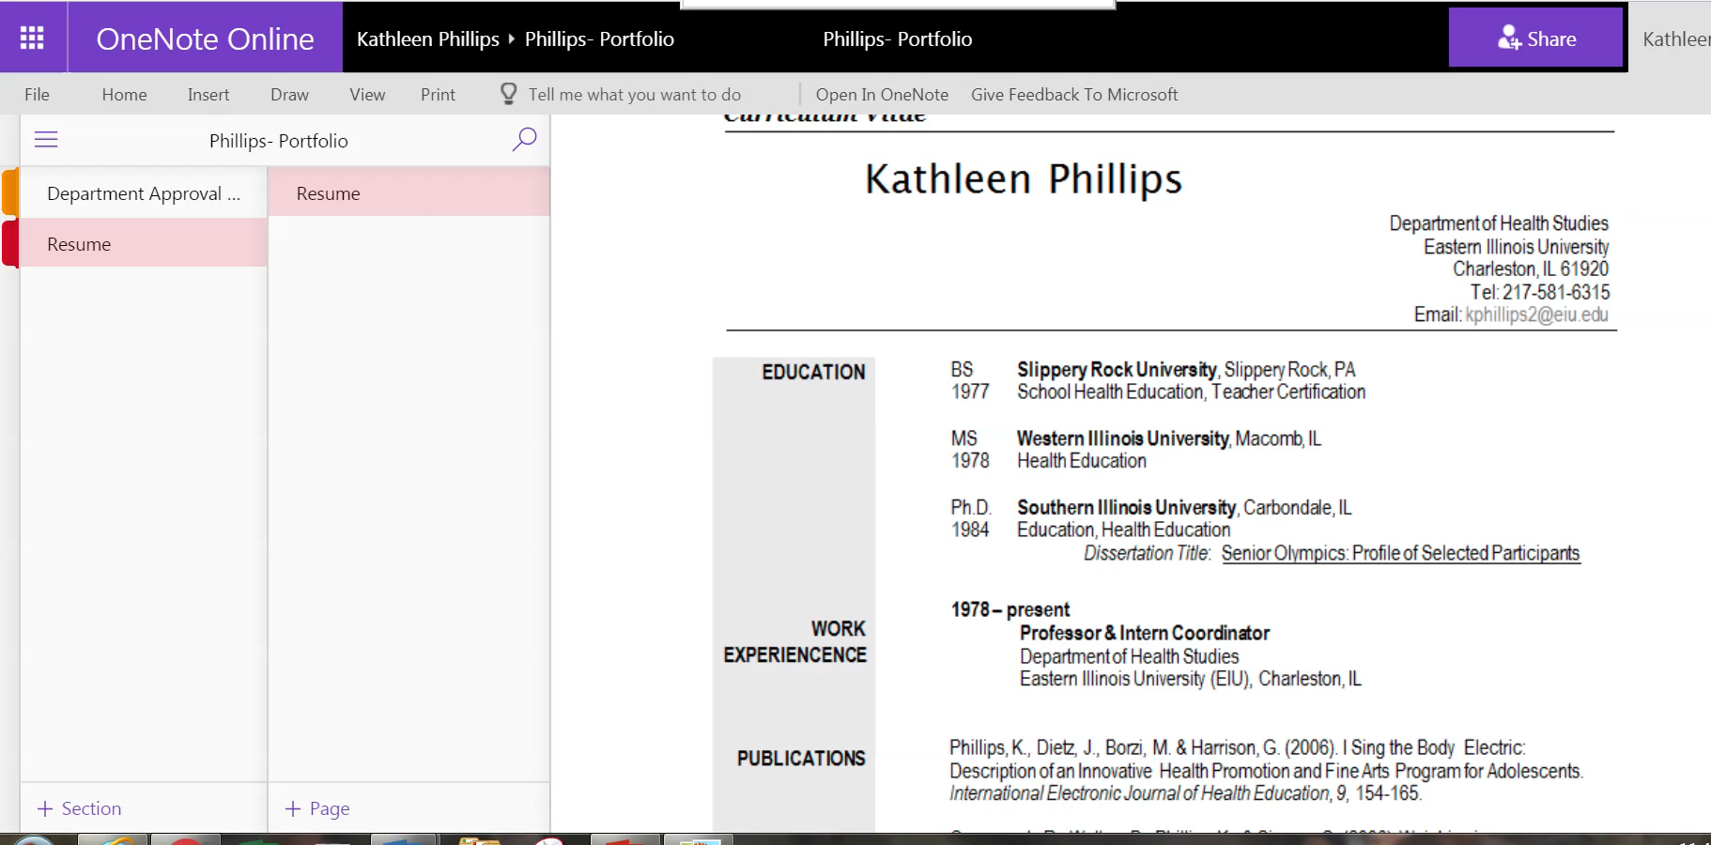

Slide 8
Philosophy Papers
HST 2000, 2270, AND 3700
Instructor-completed Department Rubric
Notes:
The next section will be titled Philosophy
In this section you will include philosophy papers you wrote in 2000, 2270, AND 3700. with the instructor-completed Department Rubric for each paper.

Slide 9
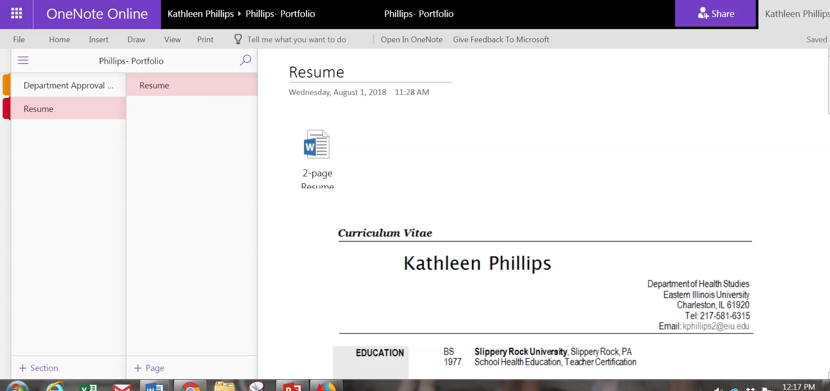

Slide 10
Professional Competencies
Notes:
For the Professional Comp section you will need to include these specific courses. A few have more than one option – you can choose which one you want to use – or use all of them. Just don’t use an assignment more than once in the portfolio.
In addition to the required assignments, each syllabi in you classes will list other assignments that meet specific respon. You can elect to add those to your portfolio also.

Slide 11
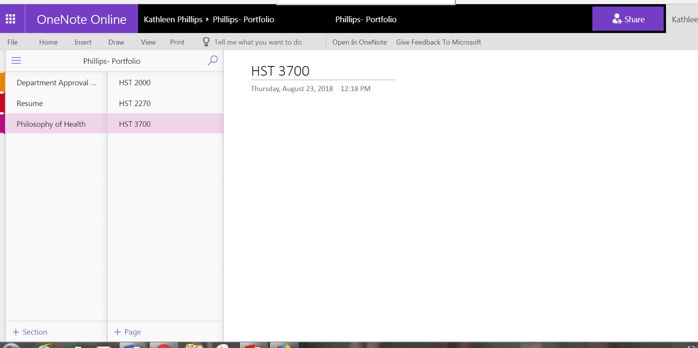

Slide 12

Communication Skills
Written – Choose any written paper completed that has NOT been previously used in the Portfolio
Oral - 4770 Article Presentation
Notes:
For the communication skills remember that you need both written and oral. For Written – you can use any paper you did in the HPR program that you did not already use. For Oral, you will need to submit this assignment.

Slide 13

Professional Involvement
Notes:
Participation and/or involvement in professionally related activities and professional organizations. Both the portfolio presentation and the Portfolio guidelines provided a list of examples for this section

Slide 14

Related Experiences
Optional - But…..
Scholarships
Awards
Recognitions
Certifications
Notes:
This last section is optional but it is a place for you to add good things about yourself that may not have shown up in other parts of the portfolio. You really should try to include something in this area if possible

Slide 15
Cover Page
NAME
Health Promotion Major
Community Health Option OR
Health Promotion Major
Emergency Management & Disaster Preparedness Option OR
Health Administration Major OR
Health Communication Major
Notes:
Now we can add the last piece to the portfolio – the cover page. On it you want to type your name and you major and option which will be one of these four. You can also add a little bio of your self if you want or indicate the semester you hope to graduate. The next slide will show you how to do this

Slide 16
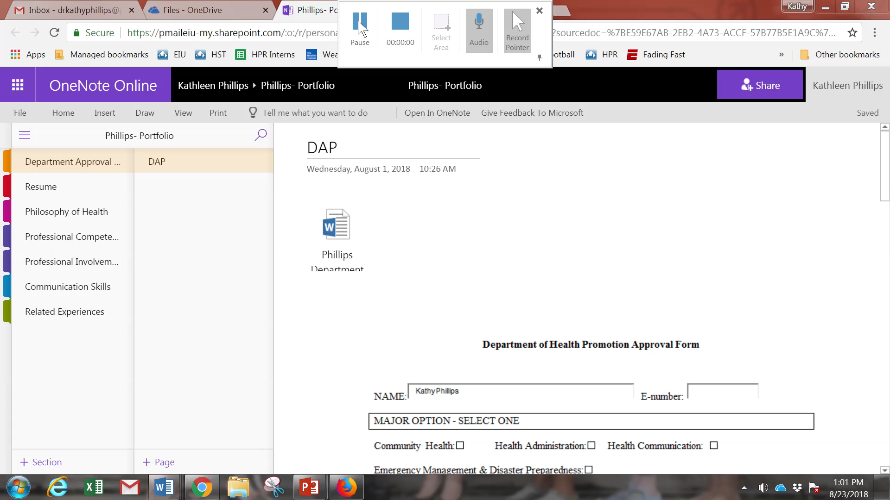


Slide 17
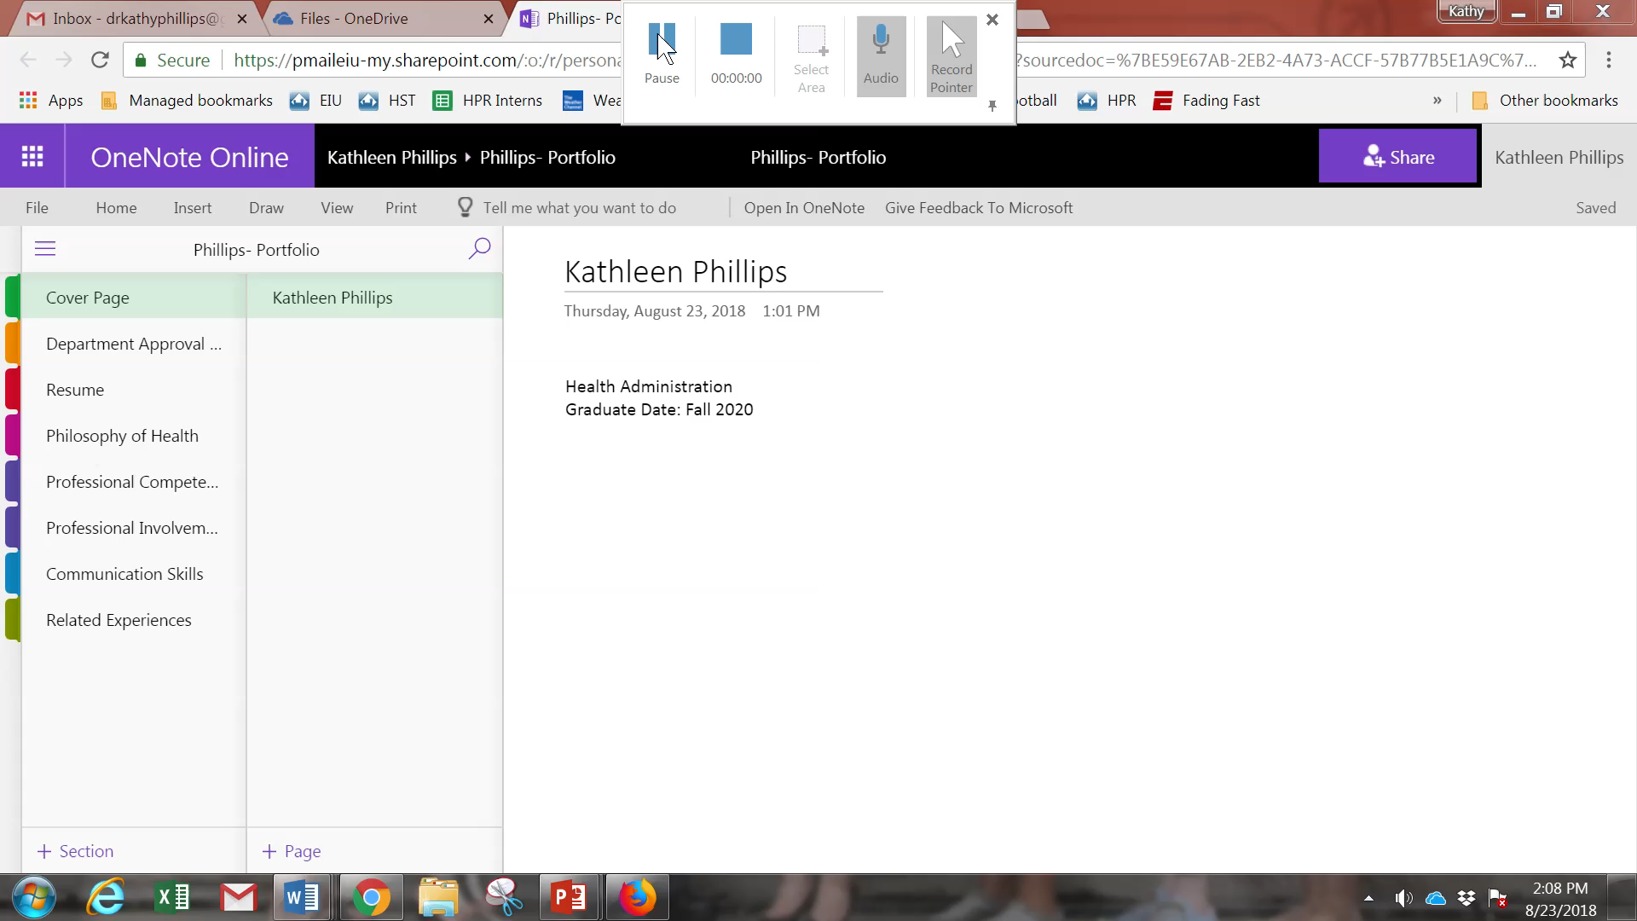
Share Link

