Slide 1
Portfolio Guidelines
Notes:
If you are viewing this – you are a Health Promotion major at EIU – right?
And you discovered that you need to put together a portfolio. And yes -i’s a requirement. And you need to do it to be able to do your required internship in order to graduate.
So – let’s talk about it…

Slide 2
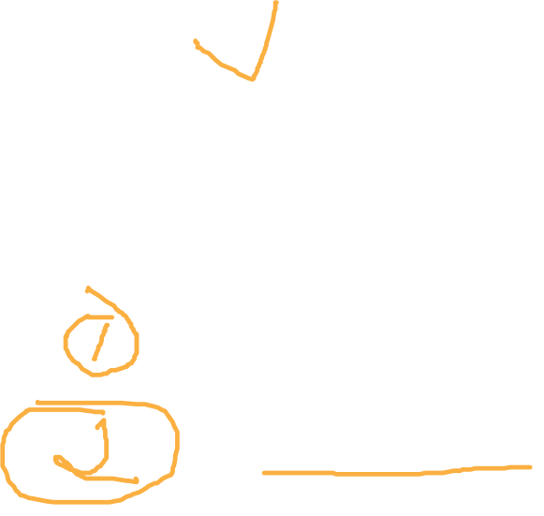
Internship Website
OPTIONS:
Portfolio Guidelines – hard copy
Eportfolio – electronic copy
Notes:
First off – everything contained in this presentation can also be found at the Internship website link. Make sure to visit this site soon! You have the option to do a written, hard copy portfolio or an on-line electronic portfolio. I suggest you go through this power point first before deciding which one to do. This link will take you to a tutorial for the e portfolio

Slide 3

Notes:
But why – you ask yourself…Well – portfolios are designed to showcase your best work, To show what you can do, not what you cannot do. To provide you with a communication vehicle for your accomplishments. And To provide clear examples of your achievement for internships/employers

Slide 4


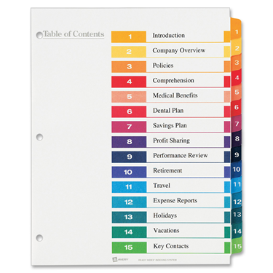

Elements of Portfolios
Notes:
So what do you need? 3-ring binder. Dividers and tabs.

Slide 5
Before you start… Supplies
Binder, one that you can insert a sheet with your name on it
Separators with tabs (12)
  -Resume, philosophy statement, 1 for each Responsibility, Communication, Involvement, Related Experiences
Sleeves (at least 32)
  TOC, Resume, Phil statement (3: description, actual assignment, grading rubric), Responsibilities (21: description, actual assignment, grading rubric, for each Responsibility), Communication (6: description, actual assignment, grading rubric for each method of communication) plus whatever you need for your Professional Involvement and Related Experiences.

Slide 6
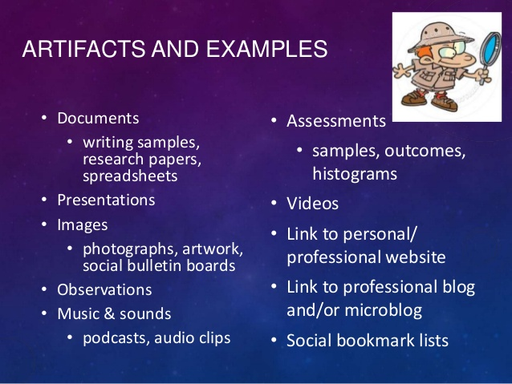

Artifacts
Notes:
“Artifacts” ..tangible objects/items that can represent your accomplishments and qualities…. These are the actual materials you include in the portfolio that showcases your actual work – they will be assignments from classes you have taken and other things that document the quality of your skillls

Slide 7
Artifacts
Describe assignment
  Responsibility
  Course
  Name of assignment
  Directions/objectives
Print copy of assignment
Must be graded assignments
Notes:
For each assignment you include in your portfolio, you will be asked to do these things: More about these a little later

Slide 8
Example
Responsibility 5
    HPR 4250” Program Planning
    Rationale
    This assignment was a 2-4 page paper describing the rationale for a proposed program. The rationale addressed the need for the program by discussing the prevalence of the condition, the significance/seriousness of the condition, the health care system costs, the justification as to why the health issue was a concern to the community, and solutions for the problem.

Slide 9

Table of Contents
  Dept Approval Form
  Resume
  Philosophy of Health
  7 Responsibilities
  Communication - Oral AND Written
  Professional Involvement
  Related Experiences (OPTIONAL)
Notes:
Aside from the artifacts, a major component of the portfolio is the table of contents. It should be as detailed as possible – and follow this order. Check out the example on the next page

Slide 10
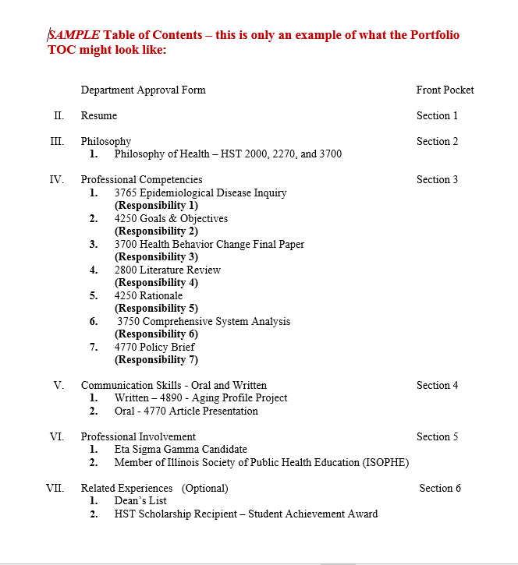
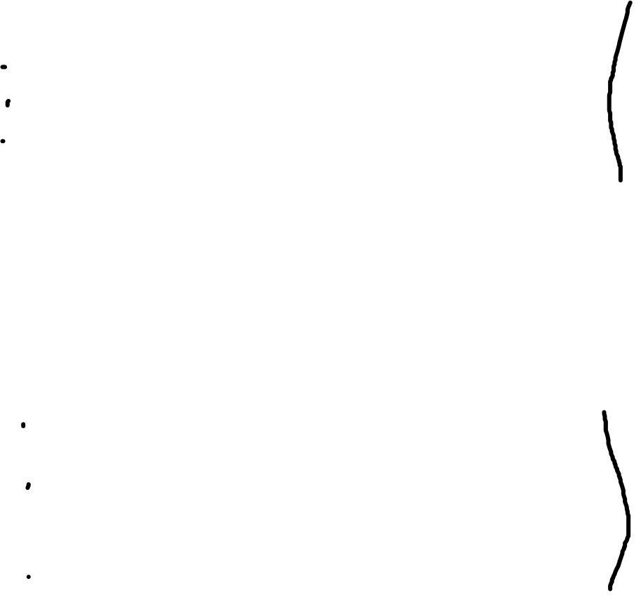
Notes:
Notice on the far right side that instead of page numbers, you will use section numbers. Portfolios are frequently changing and you may a=be adding things as you progress through the program. So the use of page numbers would be cumbersome. On the next few slides – we’ll take a look at each of the required components listed in the table of contents.

Slide 11
Table of Contents
  Dept Approval Form
  Resume
  Philosophy of Health
  7 Responsibilities
  Communication - Oral AND Written
  Professional Involvement
  Related Experiences (OPTIONAL)
Notes:
So – let’s start with the Dept Approval Form

Slide 12

Department Approval Form

Slide 13
Table of Contents
Department Approval Form
Complete all information requested
Put inside front cover of portfolio binder
Notes:
Complete all information requested -
Put inside front cover of portfolio binder

Slide 14
Table of Contents
  Dept Approval Form
  Resume
  Philosophy of Health
  7 Responsibilities
  Communication - Oral AND Written
  Professional Involvement
  Related Experiences (OPTIONAL)
Notes:
Next in line on the TOC contents is the Resume.

Slide 15

Resume
EIU Career Services
Resume
Cover Letter
Notes:
If you don’t already have a resume prepared – you should have! The EIU career services can help tremendously with this task as well as creting a cover letter – which will be required when you start applying for internsips. In the meantime on the next slide is an example of a modified resume for an internship.

Slide 16
Table of Contents
  Dept Approval Form
  Resume
  Philosophy of Health
    HST 2000, 2270, OR 3700
  7 Responsibilities
  Communication - Oral AND Written
  Professional Involvement
  Related Experiences (OPTIONAL)
Notes:
The next section will be titled Philosophy. In this section you will include philosophy papers you wrote in 2000, 2270, AND 3700.

Slide 17

Table of Contents
  Dept Approval Form
  Resume
  Philosophy of Health – HST 3700
  Professional Competencies
  Communication - Oral AND Written
  Professional Involvement
  Related Experiences (OPTIONAL)
Notes:
Now we come to the section called Professional Competencies

Slide 18
Seven Areas of Responsibility
Resp 1: Assess Needs, Assets and Capacity for Health Education
Resp 2: Plan Health Education
Resp 3: Implement Health Education
Resp 4: Conduct Evaluation and Research Related to Health Education
Resp 5: Administer and Manage Health Education
Resp 6: Serve as a Health Education Resource Person
Resp 7: Communicate and Advocate for Health and Health Education
Notes:
This section is based on the seven areas of responsibility. Remember these?? Many assignments you have completed up to this point are connected to one of more of the areas.

Slide 19
Professional Responsibilities/
Competencies
Responsibility | Required Assignments
1 | 2270 Global Health Project 3765 Epidemiological Disease Inquiry 3700 Health Behavior Change Final Paper
2 | 2270 Global Health Project 3700 Health Behavior Change Final Paper 4250 Goals & Objectives
3 | 2270 Global Health Project 3700 Health Behavior Change Final Paper
4 | 2800 Literature Review 3700 Health Behavior Change Final Paper
5 | 4250 Budget 4250 Rationale
6 | 3750 Comprehensive System Analysis
7 | 4770 Policy Brief
Notes:
For the Professional Comp section you will need to include these specific courses. A few have more than one option – you can choose which one you want to use – or use all of them. Just don’t use an assignment more than once in the portfolio.
In addition to the required assignments, each syllabi in you classes will list other assignments that meet specific responsibilities. You can elect to add those to your portfolio also.

Slide 20

Table of Contents
  Dept Approval Form
  Resume
  Philosophy of Health – HST 3700
  7 Responsibilities
  Communication - Oral AND Written
  Professional Involvement
  Related Experiences (OPTIONAL)
Notes:
Communication skills are next

Slide 21
Communication Skills
  Written – Choose any written paper completed that has NOT been previously used in the Portfolio
  Oral – Any oral presentation that you have an eval for.
  If you presented somewhere, you can include if you have feedback from the presentation (otherwise include in Professional Involvement)
Notes:
For the communication skills remember that you need both written and oral. For Written – you can use any paper you did in the HPR program that you did not already use. For Oral, you will need to submit this assignment.

Slide 22



Communication Skills
BOTH Oral & Written
  Written

Slide 23

Table of Contents
  Dept Approval Form
  Resume
  Philosophy of Health – HST 3700
  Professional Competencies
  Communication - Oral AND Written
  Professional Involvement
  Related Experiences (OPTIONAL)
Notes:
Professional Involvement is next on the TOC

Slide 24

Notes:
Involvement in professionally related activities and professional organizations has become more and more important according to employers and internship sites.

Slide 25

Professional Involvement
Membership in professional associations
  Eta Sigma Gamma
  HPR Club
Notes:
Probably the most useful way to show your involvement is through membership in professional organizations. Depending upon your option in in the major, there are many to choose from. It is recommended that you talk to any faculty member In the department to get some advice. One opportunity that we have right here is the local chapter of ESG. Check it out.

Slide 26

Professional Involvement
Participation in health-related events or activities sponsored by organizations
  Honoraries
  Fraternities, sororities
  Athletics
  Faith-based groups
  Other EIU recognized student organizations.
Notes:
Other ways you can show professional involvement is through Participation in health-related events or activities sponsored by organizations. They need to be health related – not just the fact that you might belong to a greek organization or athletic team

Slide 27
Professional Involvement
Involvement in a service or volunteer activities/projects related to the health-field.
Involvement in health, safety or first aid issues as a result of a job
Notes:
Some more ways to engage in professional involvement…

Slide 28

Artifacts for Involvement
Membership verification in organization – receipt (email)
Flyers or agendas of meetings/conferences/seminars attended
Faculty/peer/participant evaluations of activities/presentations
Notes:
So how to you document professional involvement – what kind of artifact can you use? Here are some examples on the next few slides

Slide 29
Artifacts for Involvement
Statement indicating role as a chair/officer in an organization/committee
Written commentaries acknowledging involvement
Letters of appreciation documenting service to an organization
Memos/emails with name and role

Slide 30
Artifacts
Describe assignment
  Name
  Course
  Directions/objectives
  Responsibility
Print copy of assignment
Must be graded assignments
Notes:
Back to the artifact thing – specifically for assignments. For each assignment you include in your portfolio, you will be asked to do these things:

Slide 31

Examples
Describe the Assignment
HST 4250 Timeline
  The purpose of this assignment was to create a Timeline, using a Gantt chart or similar tool, listing and depicting all the tasks or events needed to plan a health promotion program.
  Responsibility xxxx

Slide 32
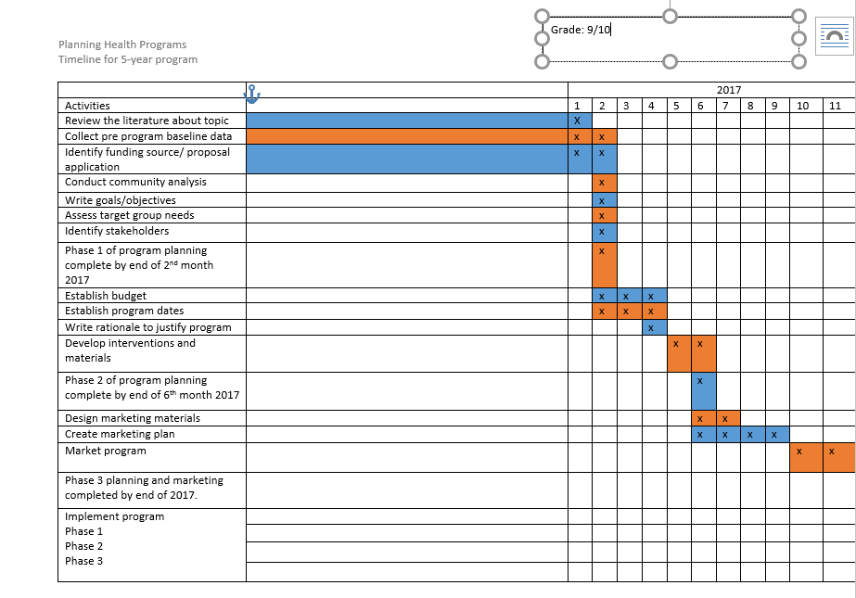
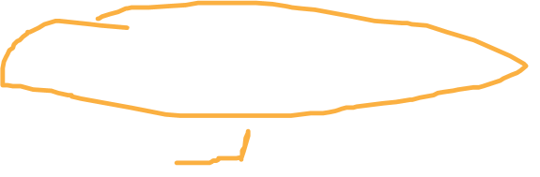
Example
Print copy of graded assignment

Slide 33
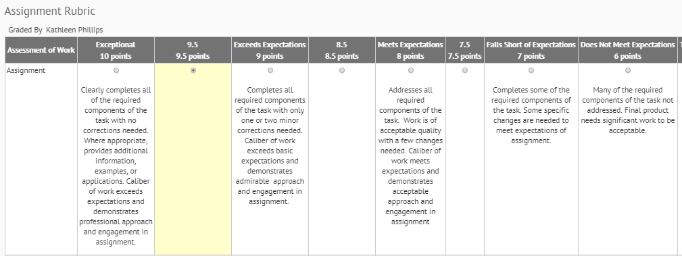
Example
Print copy of assignment and rubric

Slide 34
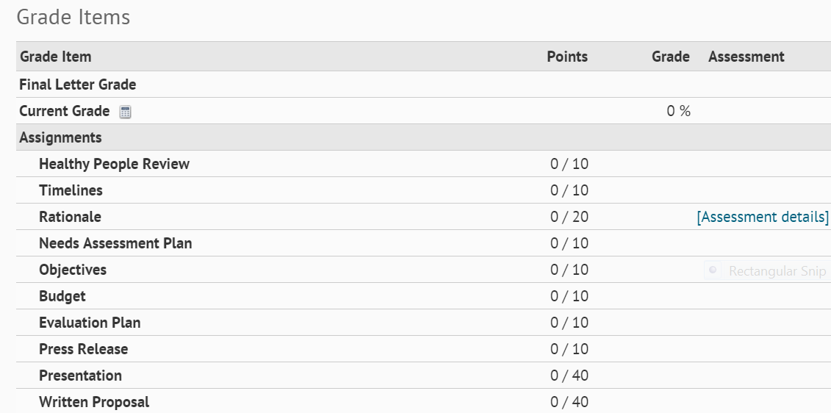

Example
Print copy of assignment with D2L Grade list
Notes:
Highlight grade

Slide 35

Related Experiences - OPTIONAL
Awards
Scholarships
Dean’s List
Recognitions
Other…..

Slide 36

Internship Website
OPTIONS:
Portfolio Guidelines – hard copy
Eportfolio – electronic copy
Notes:
First off – everything contained in this presentation can also be found at the Internship website link. Make sure to visit this site soon! You have the option to do a written, hard copy portfolio or an on-line electronic portfolio. I suggest you go through this power point first before deciding which one to do. This link will take you to a tutorial for the e portfolio

Slide 37
ORGANIZATION IS THE KEY!

