Slide 1
ATP Lab

Slide 2
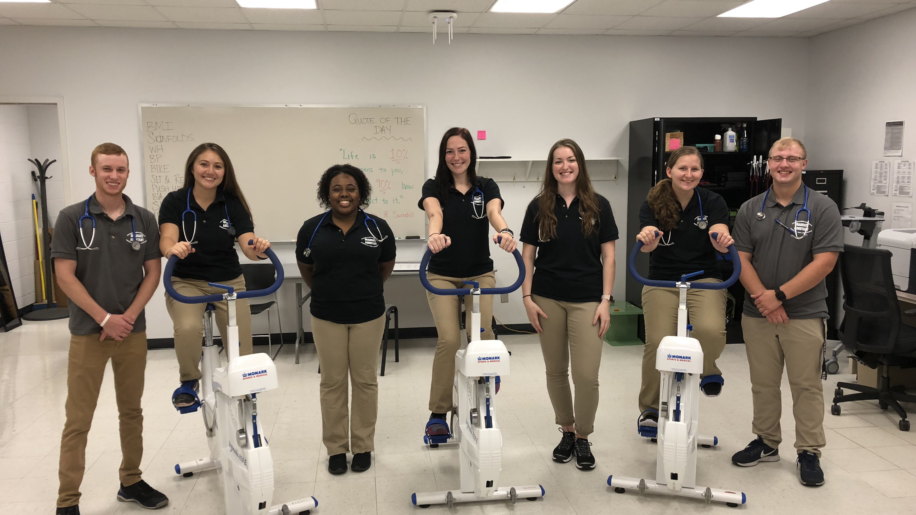
KSR Graduate Assistants

Slide 3
Assessment time!

Slide 12
Come see us!
Stop in to the ATP lab for a full body assessment
OR
Join our Adult Fitness Program!!
We would love to have you!

