Slide 1

WELCOME TO EASTERN ILLINOIS UNIVERSITY
BENEFITS OVERVIEW FOR NEW EMPLOYEES

Slide 2

Human Resources and Benefit Personnel
Linda Holloway – Director of Human Resources
Laura Cobble – HR Assistant Manager
Steven Walker – Benefits Representative
Courtney Jarmon – Human Resource Representative
Teresa Jones – Student Development
Donna Noffke – Employment & Testing
Carol Galey – HR Officer
Cindy Maples – HR Officer
Merry Toberman – Assistant Payroll Manager
Amie Calvert – Labor & Relations
Benefits Office
Old Main Room 2020
600 Lincoln Avenue
Charleston IL, 61920
217-581-5825
Fax: 217-581-3614
benefits@eiu.edu

Slide 3

During this meeting we will discuss the following benefits:
Insurance coverage
Paid time off
Retirement
Additional benefits
Policies and Regulations

Slide 4

BENEFITS MEETING
As a new hire, benefit elections need to be chosen within the first 30 days of employment.
Coverage is effective on the contract begin date.
IMPORTANT: If you do not enroll within this 30 day time period, you will default to single coverage under the Quality Care Plan administered by AETNA and the applicable premiums will be deducted from your payroll check.

Slide 5

Benefits Choice Period
During the month of May of each year, Benefits Choice is held to allow employees to make changes to their current benefits plan
You may add or drop dependents or change your benefit elections
Any changes made during the month of May during Benefits Choice are effective July 1st
Plan only allows for changes during Benefits Choice or if a Qualifying Life Event has occurred
It is the employee’s responsibility to notify the Benefits Office and/or MyBenefits Marketplace if any change in status occurs. Any changes made due to the Qualifying Life Event must be done within 60 days of the event.

Slide 6

Examples of a Qualifying Life Event:
Marriage
Adoption/Adjudication
Divorce
Address Change
Birth
Spouse Employment
Death

Slide 7
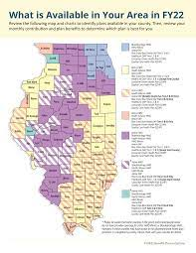
HEALTHCARE PLAN COVERAGE
Each plan provides medical and behavioral health benefits, as well as vision & prescription drug.
When making your choices, consider the following:
Primary Care Physician
Health Status
Coverage Needs
Service Preferences
Dependents mirror Health and Dental plans as the employee under whom they are enrolled

Slide 8
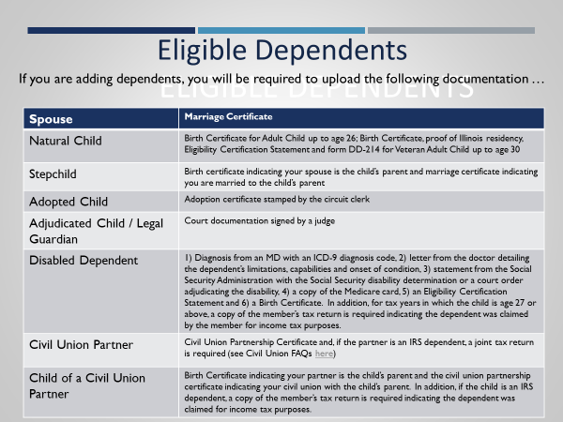
Eligible Dependents

Slide 9

Central Management Services (CMS)
The State of Illinois insurance plan is negotiated and directed by Central Management Services (CMS).
Each plan, providers, and coverages offered, to include costs may change annually.
Employees should refer to the annual Benefit Choice booklet and the Benefits Handbook for more detailed information.
You may also visit the CMS Website for additional resources and information.

Slide 10

MyBenefits Marketplace
The State of Illinois has partnered with Morneau Shepell to offer a new web-based online enrollment platform called MyBenefits Marketplace.
Members can do the following:
  Learn about benefits and update benefits selections.
  Perform benefit changes and learn about their different options.
  Add and/or remove dependents
  Personalize cost comparisons by health needs and preferred doctors.

Slide 11
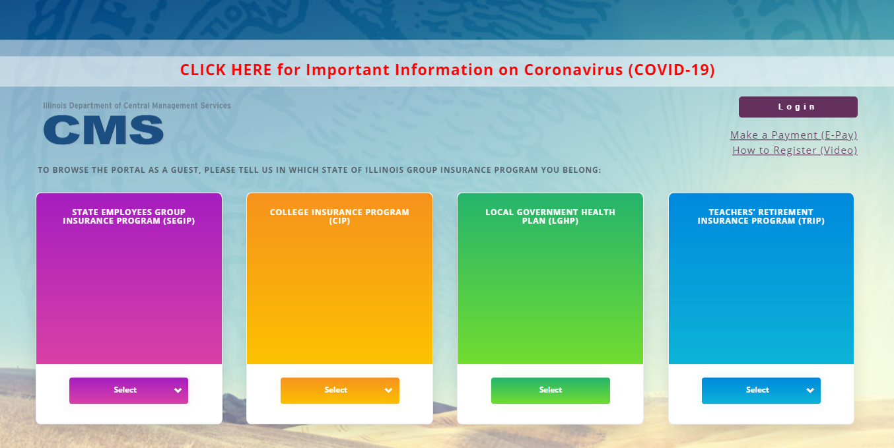
MyBenefits Website
Click -> Link to MyBenefits
Link to Directions -> MyBenefits

Slide 12

Healthcare – Medical Plan Choices
Choose between Managed Care or Traditional Indemnity Plans
Managed Care Plans
Managed Care Plans offer comprehensive coverage.
Advantages include:
  Lower out-of-pocket costs.
  Virtually no paperwork.
Limitations include:
  Geographic availability.
  Defined provider networks.
  Depending upon your residential address, you may choose between several different plans.

Slide 13
Healthcare-Medical Plan Choices
Traditional Indemnity Plan
The Quality Care Health Plan offers a comprehensive range of benefits through AETNA
Advantages include:
  Plan participants can choose any physician or hospital for medical services.
  Lower out-of-pocket costs when receiving services from a QCHP network provider.

Slide 14
Co-payments and Coinsurance & Deductibles

Slide 15
HMO Benefits
Health Maintenance Organization (HMO) members are required to stay within the health plan provider network.
No out-of-network services are available, other than listed below.
Members will need to select a primary care physician (PCP) from a network of participating providers.
HMO Plan Design
Plan Year Out-of-Pocket Maximum
Individual Family
$3,000 $6,000
Hospital Services
Type In-Network Co-Pay Out-of-Network Co-Pay
Emergency Room Services $275 $275
Inpatient Hospitalization $400 per admission Not covered
Inpatient Alcohol & Substance Abuse $400 per admission Not covered
Inpatient Psychiatric Admission $400 per admission Not covered
Outpatient Surgery $300 co-pay per visit Not covered
Skilled Nursing Facility 100% covered Not covered
Diagnostic Lab and X-Ray 100% covered Not covered
Complex Imaging (CT/Pet Scans/MRI’s) $30 co-payment Not covered
For more information on the HMO Plan – click on this link.

Slide 16
Open Access Plan (OAP) Benefits
Open Access Plan (OAP) members will have three tiers of providers from which to choose to obtain services.
Tier I offers a managed care network which provides enhanced benefits and operates similar to an HMO.
Tier II offers an expanded network of providers and is a hybrid plan operating similar to an HMO and PPO.
Tier III covers all providers which are not in the managed care networks of Tiers I or II (out-of-network providers).
Plan Year Out-of-Pocket Maximum
Benefit Tier I Tier II Tier III (Out-of-Network
Per Individual $3,000(includes eligible charges from Tier I and II) Not Applicable
Per Family $6,000(includes eligible charges from Tier 1 and II) $400 per enrollee
For more information on the Open Access Plan (OAP) – click on this link.

Slide 17
Quality Care Health Plan (QCHP)
Quality Care Health Plan (QCHP) members may choose any physician or hospital for medical services; however, members receive enhanced benefits, resulting in lower out-of-pocket costs, when receiving services from a QCHP in-network provider.
It is the member’s responsibility to know and follow the specific requirements of the QCHP.
Plan Year Maximums and Deductibles
Employees Annual Salary Individual Plan Year Deductibles Family Plan Year Deductible Cap
$60,700 or less $425 $1,000
$60,701-$75,900 $525 $1,250
$75,901 and more $575 $1,375
Retiree/Annuitant/Survivor $425 $1,000
Dependents $425 N/A
Out-of-Pocket Maximum Limits
In-Network Individual In-Network Family Out-of-Network Individual Out-of-Network Family
$1,750 $4,375 $7,000 $13,500
For more information on the Quality Care Health Plan – click on this link.

Slide 18
Consumer Driven Health (CDHP) Plan
Consumer Driven Health Plan (CDHP) Benefits This is a high-deductible health plan as defined by the IRS.
Consumer Driven Health Plan (CDHP) members may choose any physician or hospital for medical services; however, members receive enhanced benefits, resulting in lower out-of-pocket costs, when receiving services from a CDHP in-network provider. CDHP has a nationwide network of providers through Aetna PPO.
CDHP is available for active employees only, under the State Employees’ Group Insurance Program.
Plan Year Medical Deductions
In-Network Individual In-Network Family Out-of-Network Individual Out-of-Network Family
$1,500 $3,000 $1,500 $3,000
Out-of-Pocket Maximum Limits
In-Network Individual In-Network Family Out-of-Network Individual Out-of-Network Family
$3,000 $6,000 $3,000 $6,000
For more information on the Consumer Driven Health Plan (CDHP) Pan – click on this link.

Slide 19
Health Savings Account (HSA)
An HSA is like a 401(k) for healthcare, yet the HSA tax benefits are far greater. It is a tax‐favored, interest-bearing account that active State employees can use to pay for qualified medical expenses now, or in the future.
Paired with the Consumer Driven Health Plan (CDHP), an HSA is a powerful financial tool that gives you more control of your healthcare decisions, such as:
An HSA offers triple tax savings. • Pre‐tax or tax deductible contributions
• Tax‐free interest or investment earnings • Tax‐free distributions, when used for qualified medical expenses
The State will contribute a third of the deductible to an active State employee's HSA. Maximum HSA contributions (Employer + Employee) for FY22 will be:
Under Age 55 Age 55 and older
Individual Family Individual Family
Employer Contribution $500 $1,000 $500 $1,000
Employee Contribution $3,100 $6,200 $4,100 $7,200
Max IRS Allowed contribution $3,600 $7,200 $4,600 $8,200
Qualifying for an HSA:
Be covered under a high-deductible health plan
Have no other health coverage (except what is permitted under Other health coverage: https://www.irs.gov/publications/p969#en_ US_2019_publink1000204039)
Not be enrolled in Medicare. This includes Part A
Not be claimed as a dependent on someone else’s tax return
For more information on the Consumer Driven Health Plan (CDHP) Pan – click on this link.

Slide 20
Flexible Spending Accounts
Flexible Spending Accounts provide you with the opportunity to pay certain healthcare and dependent care expenses with pre-tax dollars.
You may contribute a maximum of:
$2700 for Medical Care Plan
$5250 for Dependent Care Plan
Be sure to review the ConnectYourCare website for additional information on this plan and its benefits.
Employees must re-enroll every year during Benefits Choice to continue participation in the plan!

Slide 21
Monthly Premium Example
The State pays most of the costs associated with an employee’s health coverage.
Employees must make a monthly salary-based contribution.
Part-time employees are required to pay a percentage of both the State’s and members contribution.
Please visit the current Benefits Choice booklet to review the salary ranges and associated premiums.
Employee contributions for each plan:
Number of dependents:

Slide 22
Preventive Health
Under the Affordable Care Act, you and your family are eligible for preventative services at no additional cost to you.
Preventive services that have strong scientific evidence of their health benefits must be covered.
Plans can no longer charge a patient a copayment, coinsurance, or deductible for these services when they are delivered by a network provider.
Click here for link to FY2020 preventive services
Please refer to the Benefits Choice slideshow for a Quick Reference Guide.

Slide 23
Prescription Drugs
$150 deductible per person, per plan year applies.
Co-payments (30-day supply)
  $4 Generic prescriptions
  $13 Tier I
  $31 Tier II
  $55 Non-preferred Brand

Slide 24
Vision Benefits
Vision
In-Network Area Providers:
No additional premium cost to member
Exam every 12 months
  $30 co-pay for glasses exam
Glasses/contacts every 12 months
  $30 co-pay for lenses
  $30 co-pay for frames (every 12 months)
  $0 co-pay for contacts ($120 allowance)
Central Illinois Vision – Charleston
Illinois Express – Mattoon
All About Eyes – Mattoon
James Goldstein – Mattoon
Patrick Niebrugge – Casey
Bogart Vision – Shelbyville
Tony Weber – Effingham
Eye Care of Illinois – Effingham
Target Optical
Sears Optical
JCPenney Optical
LensCrafters
BARD Optical
Most PearlVision
Lasik/PRK Benefit
1-877-5LASER6
EyeMed Customer Service
1-866-723-0512

Slide 25
Dental Insurance
Use your Dental Insurance through Delta Dental
Cleanings and X-rays twice a year (preventative)
$175 deductible per person on dental services, excluding:
  Diagnostic
  Preventative
Members can choose any dental provider for services, but may pay less out-of-pocket costs when using an in-network dentist
Schedule of benefits determines payment
  Annual Maximum: $2,500 in-network: $2,000 out-of-network
  Orthodontia lifetime max: $2,000
  Member enrollment = Dependent enrollment

Slide 26
Employee Assistance Program
Phone: 833-955-3400 (TTY: 800-697-0353)
Online: GuidanceResources.com
  Web ID: StateofIllinois
  Mobile app: GuidanceNOW

Slide 27
Other Programs
Please visit CMS Webpage for additional information
Adoption Benefit Program
Employee who adopt a child are eligible for reimbursement of adoption expenses up to a maximum of $1500 for a waiting child and up to a maximum of $1000 for any other child through this program.
CMS LINK
Smoking Cessation Program
Members and their enrolled dependents are eligible to receive a maximum $200 rebate upon completion of an approved smoking cessation program.
Weight-Loss Benefit
Employees are eligible to receive a maximum $200 rebate toward the cost of an approved weight-loss program once very three years.
Disease Management Programs
Utilized by all state health plans as a way to improve the health of plan participants. Members and dependents identified with certain risk factors, have the opportunity too utilize healthcare support 24-7, wellness tools, educational materials, and discounted services.

Slide 28

State Universities Retirement System (SURS)
New employees have six months to make a one-time irrevocable decision in- regards-to, which retirement plan to choose.
If no election is made, the employee will be defaulted to the Traditional Plan.
Three retirement plans to choose from:
Traditional
Portable
Retirement Savings Plan aka Self-Managed
Enrollment Packet will be mailed to your home.
Please visit the SURS website for additional information.

Slide 29
More on Retirement Plans
SURS Traditional Benefit Plan This is the historical SURS defined benefit retirement plan. Until 1998, it was the only SURS plan available. It provides lifetime retirement benefits and provides for a survivor benefit at no additional cost. However, the separation refund feature is not as generous as the Portable Benefit Plan. Video Link : https://vimeo.com/289502162
SURS Portable Benefit Plan This is also a defined benefit retirement plan that has much in common with the Traditional Benefit Plan. It provides a more generous separation refund if you leave the System. However, the provisions for survivor benefits require a reduction to the retirement and death benefits. Video Link: https://vimeo.com/294625496
SURS Retirement Savings Plan (RSP) This is a defined contribution plan that establishes an account in your name into which your contributions and the employer (state of Illinois) contributions are placed. You decide how your funds will be invested, selecting from a variety of mutual funds and variable annuities. Video Link:
Link to SURS Traditional Benefit Plan: https://207ar92ygmcaxw5e93d1in2k-wpengine.netdna-ssl.com/wp-content/uploads/Guide-TRD.pdf
Link to SURS Portable Benefit Plan: https://207ar92ygmcaxw5e93d1in2k-wpengine.netdna-ssl.com/wp-content/uploads/Guide-PRT.pdf
Link to SURS Retirement Savings Plan: https://207ar92ygmcaxw5e93d1in2k-wpengine.netdna-ssl.com/wp-content/uploads/Guide-RSP.pdf

Slide 30
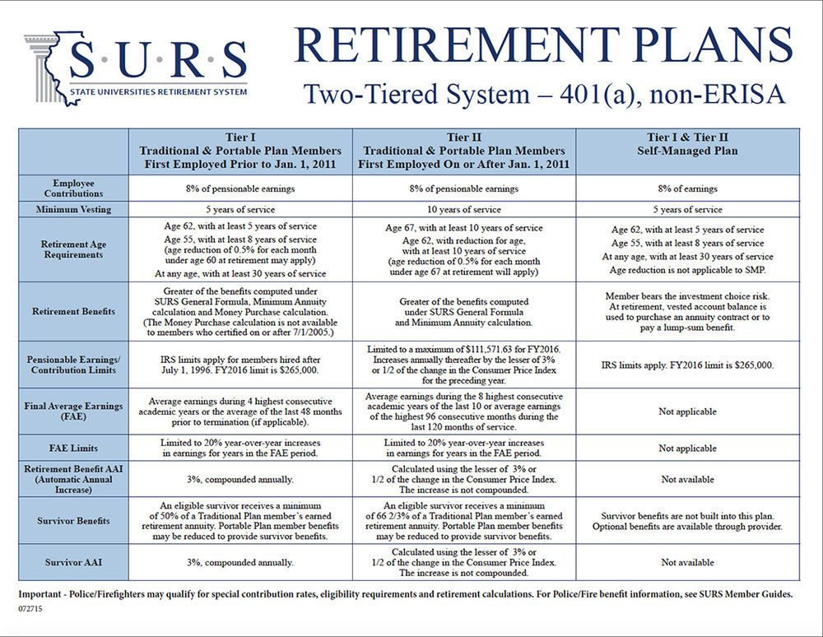

Slide 31

Helpful SURS Videos
Clink on the one you want to watch:
Plan Choice Video for Tier I Members Only Tier I Automatic Annual Increase Buyout
Benefit Estimator Tutorial Member Website Registration Tutorial
Things You Need To Know Before You Retire Death and Survivor Benefit Assistance
Reciprocal Act Vested Inactive Buyout
CONTACTING SURS
Hours of Operation - Monday-Wednesday and Friday: 8 a.m. - 4:30 p.m.
Thursday: 9:00 a.m. - 4:30 p.m.
Telephone and Fax Numbers Direct: 217-378-8800
Toll Free: 800-275-7877
Fax: 217-378-9800 Address SURS 1901 Fox Drive Champaign, IL 61820-7773

Slide 32

Tax Deferred Retirement Plans
In addition to your retirement account with State Universities Retirement System (SURS), you may elect to direct part of your pay to investments intended to build an individual retirement fund.
Choices:
403(b) Tax Deferred Retirement Plan – Enroll anytime
457(b) Deferred Compensation Plan – Enroll anytime – Watch VIDEO
The money you save through both plans is deducted before taxes are calculated on your income. In other words, it lowers your taxable income by the amount you save through the plan(s).
Link to more information about Deferred Retirement Plans
Link to 403(b) enrollment form
Link to 457(b) enrollment – online through T.RowePrice

Slide 33
SURS Disability
Disability benefits for University employees are provided through SURS.
The disability benefits are the same regardless of which SURS retirement plan you choose.
The full cost of the plan is paid by the employee and employer contributions to SURS.
Eligibility after 2 years: Disability benefits may be claimed for an illness after you have accumulated 2 years of service credit in SURS. Injuries as a result of an accident may be automatically eligible.
Waiting Period: 60 continuous calendar days of disability, or after salary or sick leave benefits have exhausted, whichever is later.
Benefit: 50% of your base salary.
Benefit Duration: benefits are payable until the total benefits received equal 50% of earnings while in SURS.

Slide 34

Supplemental Long-Term Disability
This optional plan, administered by Prudential, is designed to act as a supplement to SURS disability.
Prudential will pay a benefit in the event that SURS does not pay, provided you have a qualified disability.
You must be a SURS participant to be eligible for enrollment in this plan.
Employees pay the entire cost for the plan.
Monthly premiums are based on age and salary.
Benefits paid under this plan are coordinated with any SURS Disability payments so that a total of up to 66.7% of your base salary is paid.
Waiting Period: 90 continuous days of disability
Catastrophic Disability: pays an additional 20% if the ability to perform two activities of daily living is lost.
Plan pays 66.7% during the first two years, when there is no SURS benefit payable.
Plan pays 16.7% once SURS disability begins.
Critical Illnness Disability: pays additional 10% if disability is caused by a covered critical illness.
Plan pays 66.7% benefit if disability continues after SURS benefits exhaust.
Survivor Benefit: plan pays lump sum equal to six months of gross disability payments to eligible survivor at death while on continuous disability.

Slide 35
Group Life Insurance
Metlife administers life insurance for the State of Illinois.
All new employees are provided Basic Life Insurance at no cost, with a benefits amount equivalent to their annual salary.
Metlife Link
New employees may elect optional life insurance up to 8 times their salary at a fee based on their age and salary.
Up to four times the basic life amount is guaranteed if elected within 30-day initial enrollment period.
Accidental Death & Dismemberment
Employees may elect AD&D coverage, and if elected, employee may choose Basic or Combined coverage.
Spouse premium is $5.70.mo.
Child(ren) premium is $0.60/mo.
Should a member be diagnosed as terminal, MetLife will pay up
to ½ of the benefit amount prior to the death of the member.

Slide 36

Tuition Waivers
Fulltime status employees of EIU are allowed to take up to six semester hours or two courses (whichever is greater), per semester.
Parttime and Temporary employees may be eligible on a pro-rated basis.
Employees with seven years of qualified employment are eligible for the 50% tuition discount for eligible dependents at any state funded university (excludes spouses).
The State University Civil Service System also mandates additional tuition benefits for Civil Service employees.
Additional tuition benefits are available for Annuitants and eligible survivors.

Slide 37
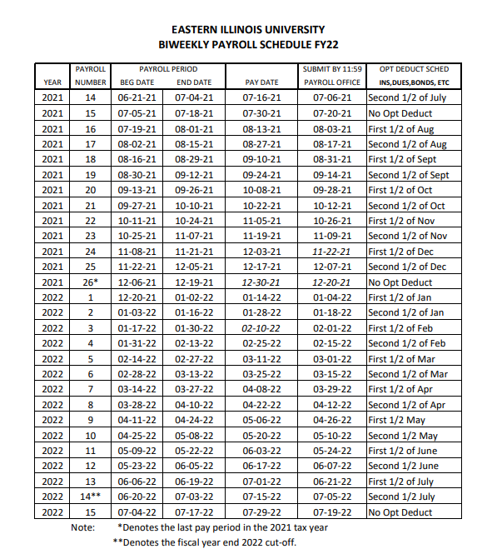
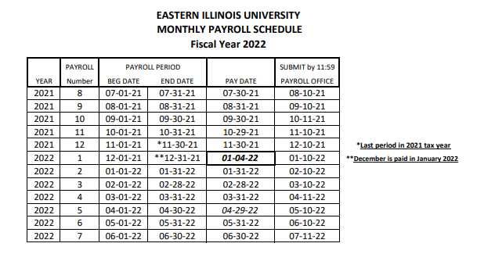
Civil Service Employees
Payroll & Deductions
The Civil Service Payroll Schedule shows what pay period insurance deductions will be taken.
There are two pay period per fiscal year that have no benefit deductions taken (No Opt).

Slide 38

Civil Service Employee Holidays
The Board of Trustees Rules and Regulations state that “All University facilities will be closed except for necessary operations on the following principal holidays:
New Years
Independence Day
Lincoln’s Birthday
Memorial day
Martin Luther King Jr.’s Birthday
Thanksgiving Day
Labor Day
Day after Thanksgiving
Christmas Day
and two supplemental holidays designated as the day before or after New Year’s Day and the day before or after Christmas Day, unless it is necessary to change these days for purpose of academic calendar”.

Slide 39
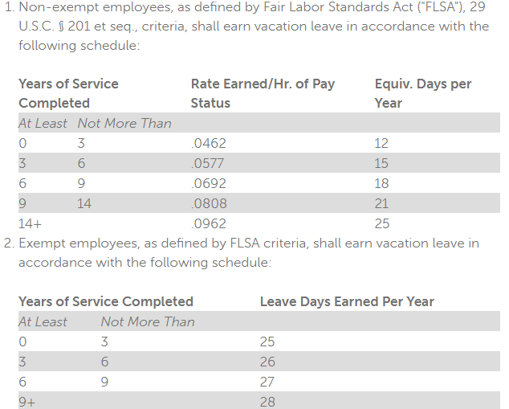
Civil Service Employees
Accrued & Sick Leave Benefits
Civil Service employees accrue benefits based on the rules of the State Universities Service System (SUCSS) and incorporated into the EIU Board of Trustee Regulations for Civil Service Employees.
Please note that for negotiated employees, benefits may be superseded by their Bargaining Agreement. Negotiated employees should contact the Benefits Services Office or Employee Labor Relations for specific information.
Sick Leave Bank
  Enrollment is open to all employees. Participants may draw from the Sick Leave Bank after meeting certain criteria.

Slide 40
Family Medical Leave Act (FMLA)
The Benefit Services Office administers FMLA in accordance with federal law.
Employees are eligible for FMLA at EIU if they meet ALL OF the following requirements:
Have worked for EIU for at least 12 months
Have worked at least 1,250 hours during the 12 months preceding the start date of the requested leave. Changing to 1,000 hours 1/1/2022.
Have not used 12 weeks of FMLA in the past 12 months
Steve Walker
Benefits Office
Old Main Room 2020
600 Lincoln Avenue
Charleston IL, 61920
217-581-2285
Fax: 217-581-3614
benefits@eiu.edu
Generally, employees absent for more than 5 days should contact the Benefits Office for further guidance.

Slide 41

Monthly Paid Employees
Insurance premiums are deducted for the current month (ex. May paycheck pays for May premiums).
Monthly paid employees include:
Faculty – Unit A
Faculty & Academic Support Professionals – Unit B
Temporary Faculty Appointments
Coaches
Administrative & Professional
Civil Service Exempt

Slide 42

Monthly Employee Benefits
Benefits for monthly paid employees are based on position available as follows:
Unit A & B – UPI Agreement(s)
Administrative, Professionals, & Non-Negotiated Temporary Faculty Appointments – Board of Trustee Temporary Faculty Benefits – Non-Negotiated
Civil Service Exempt – Board of Trustee Civil Service Exempt Benefits

Slide 43
EIU Policies
Employees of the University are regulated by the Board of Trustees Rules & Regulations and the Internal Governing Policies.
Each employee should familiarize themselves with both.
Additional policies new employees should familiarize themselves or be aware of:
Policy #8 – IGP: EIU is a drug free campus
Policy #171 – IGP: EIU is a tobacco free campus
Policy #24: Worker’s Compensation – if injured on the job
EIU Worker’s Compensation homepage for additional information or to report an incident or claim.

Slide 44

Civil Rights Policies
Discrimination and Sexual Harassment are both violations of your civil rights!
If you feel your rights have been violated, please contact the Civil Rights Office, located at 1011 Old Main.
Policy #173: Discrimination – Internal Governing Policy
Policy #175: Sexual Harassment – Internal Governing Policy

Slide 45

Other Important Policies
Should you or a dependent lose insurance coverage you may be eligible for COBRA. Public Law 99-272 (COBRA Act of 1985)
Your Health and Dental insurance premiums are pre-tax deductions.
Life insurance premiums under $50,000 are also pre-tax deductions.
        Link – Public Act 84-167
All employees have the Right-to-Know Act if they are working with toxic or hazardous substances and how to work with these substances safely.

Slide 46

Annual Security Report
University Police publishes the Annual Security Report.
This report provides information on the safety of the EIU campus.
In addition, this report also includes some important phone numbers you may need.

Slide 47

Additional Information
Panther Access to Web Services (PAWS)
  An employee can view their payroll information and print W-2’s.
  An employee can view insurance plans and the cost per pay period.
  Review their benefit leave balances.
  Faculty members will use this to access rosters and enter grades.
Staff parking
  Parking permits may be purchased in person at the parking services office or online through your PAWS account.

Slide 48
Welcome to EIU
Remember to do the following:
Log on to MyBenefits.Illinois.gov
In the top right corner of the home page, <click> Login
Enter your login ID and password. If you are logging in for the first time, <click> register in the bottom right corner of the login box and follow prompts.
After logging in, it will take you to the welcome page. You can explore your benefits options by <clicking> on the benefit tiles or using the decision support tool.
After exploring your benefit options and determining which benefits you would like to elect, follow the prompts on the welcome page. PLEASE REMEMBER THAT DOCUMENTATION MAY BE REQUIRED!
Contact MyBenefits Service Center (toll-free) – 844-251-1777 with questions navigating the website or how to elect benefits. Representatives are available Monday-Friday – 8:00a.m. – 6:00p.m. CT.

Slide 49

EIU Forms and Online Applications
Benefits Choice Booklet
Benefit Choice Information Forms
Court Required Service Leave Request Form
Deferred Compensation 457b – Website for T.Rowe Price
Deferred Compensation 457b Enrollment/Re-Enrollment - Website for T.Rowe Price
Dental Claim Form
Employee Request for Accrued Leave Usage During Probation Form
EyeMed Vision Claim Form
Flex Schedule Form – use your EIU ID and Password
FMLA Employee Illness (Family Medical Leave)
FMLA Family Member Illness (Family Medical Leave)
Non-FMLA Approved Leave of Absence
Irrevocable Election to Retire
Life Insurance Beneficiary Form
Sick Leave Bank Online Donation form (Policy) – login using EIU ID and Password
Sick Leave Bank Usage Form
State of Illinois Benefits Form
Tax Deferred 403b (Salary Reduction Form)
Annuitant Tuition Waiver
Child of Employee 50% Tuition Waiver (online application begins with parent’s login)
EIU and BOT Undergraduate Application Waiver
Employee Tuition Waiver (online application)
Graduate School Fee Waiver
Interinstitutional – EIU Employees
Interinstitutional – Other Illinois Public Institution Employee

Slide 50
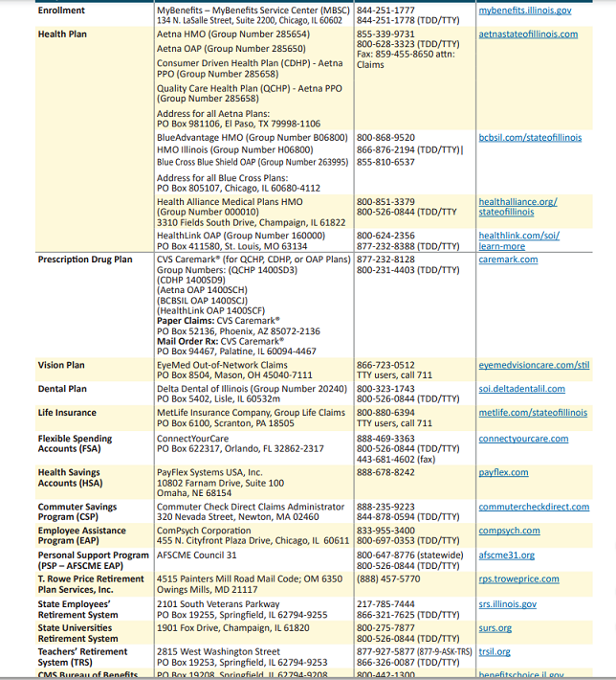
Contacts:

Slide 51
Welcome to EIU

