Slide 1

Activities to do as a family

Slide 2
Activities that Do Not Involve WIFI
Playing Card Games
UNO
Old Maid
Go Fish
Apples to Apples
Playing Board Games
The Game of LIFE
Clue
Monopoly
Do Puzzles
Jigsaw Puzzles
Cross Word Puzzles
Do Art Projects
Coloring
Painting
Make/Play with Play- Doh
Do Safe Science Experiments
Journal

Slide 3
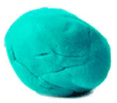
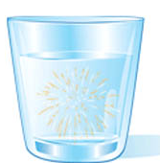
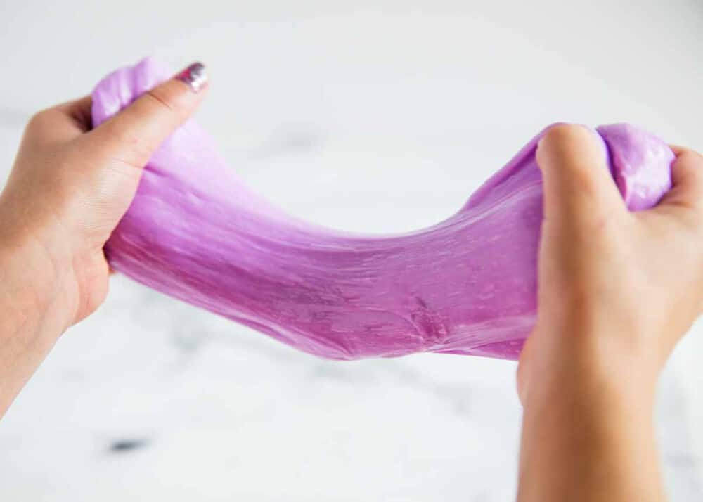
Science Experiments to Try at Home
Homemade Play Dough
Water Fireworks
Homemade Slime

Slide 4
How to Make Play Dough
Ingredients
Instructions
3 cups of flour
1 ½ cups of salt
6 teaspoons cream of tartar
3 tablespoons of oil
3 cups of water
Dissolve salt in the water
Pour all ingredients into a large pot
Stir constantly over medium heat until a ball forms by pulling away from the sides
Knead the dough mixture until the texture matches playdough (1-2 minutes)
Store in a plastic container

Slide 5
How to Make Water Fireworks
Ingredients
Instructions
Water
Oil
Food coloring (any color of your choice)
16 oz clear glass
Another 16 oz clear glass
A Fork
Fill the tall glass almost to the top with room-temperature water
Pour 2 tablespoons of oil into the other glass
Add 2 drops of food coloring to the glass with the oil
Stir the oil into the food coloring using a fork. Stop once you break the food coloring into smaller drops
Pour the oil and coloring mixture into the tall glass
Now watch! The food coloring will slowly sink in the glass, with each droplet expanding outwards as it falls. Looks like fireworks!

Slide 6
How to Make Homemade Slime
Ingredients
Instructions
8 ounce bottle of Elmer’s white school glue
1 ½ - 2 Tablespoons of contact saline solution, more as needed
1 Tablespoon baking soda
Food coloring, optional
Squeeze the bottle of glue into a bowl. Add your food coloring if desired, and stir until combined. Then mix in baking soda
Add 1 ½ Tablespoons saline solution and mix until combined. If its too sticky, add ½ Tablespoon solution at a time. The more you add, the thicker it will be
Using your hands, knead the slime until it holds together. It will be wet and gooey at first, but just keep kneading it
Store slime in a container with a lid

Slide 7
Books to Read as a Family
Reading Books
Chapter Books
The Invisible String
Tacky the Penguin
The Berenstain Bears (Collection)
Stand Tall Molly Lou Melon
Porcupining: A Prickly Love Story
Spaghetti in a Hotdog Bun
The JuiceBox Bully
The Jelly Donut Difference
Dr. Seuss Books
The Magic Treehouse Series
Junie B. Jones
Bridge to Terabithia
Matilda
A Series of Unfortunate Events
Because of Winn-Dixie
Charlotte’s Web
Holes
Sarah, Plain and Tall
Stink

Slide 8

Movies to Watch as a Family
The Goonies
The Incredibles
Moana
The LEGO Movie
Wreck-It Ralph
The Secret Life of Pets
Inside Out
Frozen I and II
COCO
Spies in Disguise
Playing with Fire
The Lion King
Toy Story Series

Slide 9
Outside Activities to do as a Family
Go for a walk
Ride Bikes
Fly a Kite
Blow Bubbles
Go on a Nature Scavenger Hunt
Have a picnic at a park or in your backyard
Build a campfire and make s’mores
Play Whiffle Ball or Kickball
Draw with side walk chalk
Plant flowers/vegetable garden
Play Flashlight tag
Play hide and seek in the dark with Flashlights

Slide 10
Have Fun and be safe!

