Slide 1

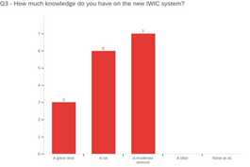
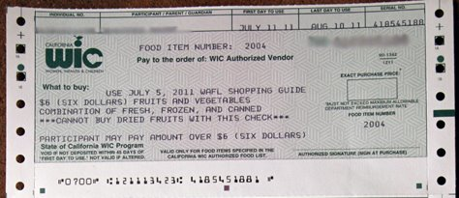
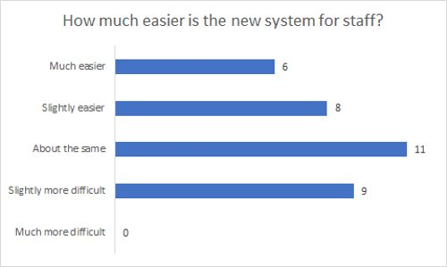
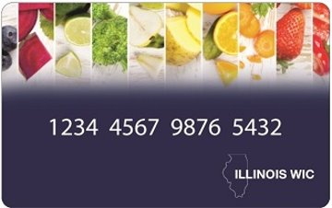
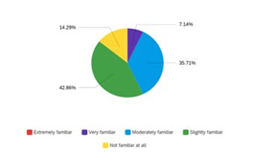
EASTERN ILLINOIS UNIVERSITY College of Health and Human Services Transitioning to EBT for WIC: Staff Perspectives
Joey Kiegher, Public Health, Undergraduate Student; Kassandra Garcia, Human Services, Undergraduate Student; Nikki Hillier, Public Health, Associate Professor, Jill Bowers, Ph.D., Human Services Instructor;
Julie, Harper, M.S., Human Services Instructor
Background
The purpose of the WIC program is to provide income eligible pregnant or breast feeding women, infants, and children up to age 5 with nutrition education, breast feeding education and support, case management, and supplemental food.
WIC vouchers are similar to food stamps or LINK cards, except a specific battery of food is prescribed for a pregnant or nursing mother, an infant, or child up to age 5.
Historically, IDHS has offered WIC food instruments to clients by printing paper vouchers and distributing to clients during their appointments.
Recently, IDHS started to pilot the use of Electronic Benefit Transfer for WIC. After the pilot sites implemented the new system, IDHS rolled out the program to the rest of their Illinois WIC sites.
To observe some of the issues, concerns, and benefits, we surveyed clients (ongoing) and staff at 2 WIC clinics to assess the transition from the staffs’ perspective.
Research Design
Research Question: What are the benefits and challenges to the new IWIC EBT system according to the WIC staff who use it?
Sample: 16 WIC staff participants from two WIC clinics (Douglas County Health Department and the Champaign-Urbana Public Health District)
Instrumentation: Staff survey through Qualtrics
Data collection: Staff were sent an email from supervisors with a link in Qualtrics (100% response rate)
Conclusions and Other Findings
A majority WIC staff found that the transition to IWIC was beneficial to their clients.
A majority of WIC staff are confident navigating the new IWIC system.
A majority of WIC staff are not very knowledgeable about the BNFT app.
A majority of WIC staff feel the BNFT app is beneficial to their clients.
A majority of the WIC staff felt that the transition is running smoothly for WIC clients.
WIC staff want to be able make changes and updates to client files and the like themselves.
The transition seems to be going well for staff and clients according to the staff, the system seems to have improved the WIC experience for everyone.
Main Findings
WIC staff felt pretty
knowledgeable
on the WIC system.
Most WIC staff felt the new IWIC system was much easier than the previous system.
A majority of WIC Staff are only
slightly familiar or not familiar at
all with the BNFT app.
Recommendations and Next Steps
Continue to have the remote recertification in the future for clients
Staff like the idea of virtual certification.
Improve the training processes by having more opportunities from trained professionals, especially for long-term staff members transitioning from paper vouchers/checks/coupons WIC to IWIC.
Possibly reach out to the WIC BNFT app producers to make the app available for staff
Develop training modules for the WIC app, BNFT to staff
Make the system more accessible so end users (Case Managers) can make simple updates
Ask clients and vendors about their experiences and perspectives
We currently are collecting surveys from WIC clients, but we are still waiting on responses.
Vouchers vs. EBT
Vouchers:
WIC food items needed to be
separated
Go back through the store to find eligible item
All food items listed on the voucher must be purchased in one transaction (Hanks et al.).
Items might be forfeited
Stress and Stigma (Tracey, 2019; Hanks et al., 2019)
EBT System
No separate food items
Flexibility in redemption
Less stigma
Complete reference list available upon request

