Slide 1
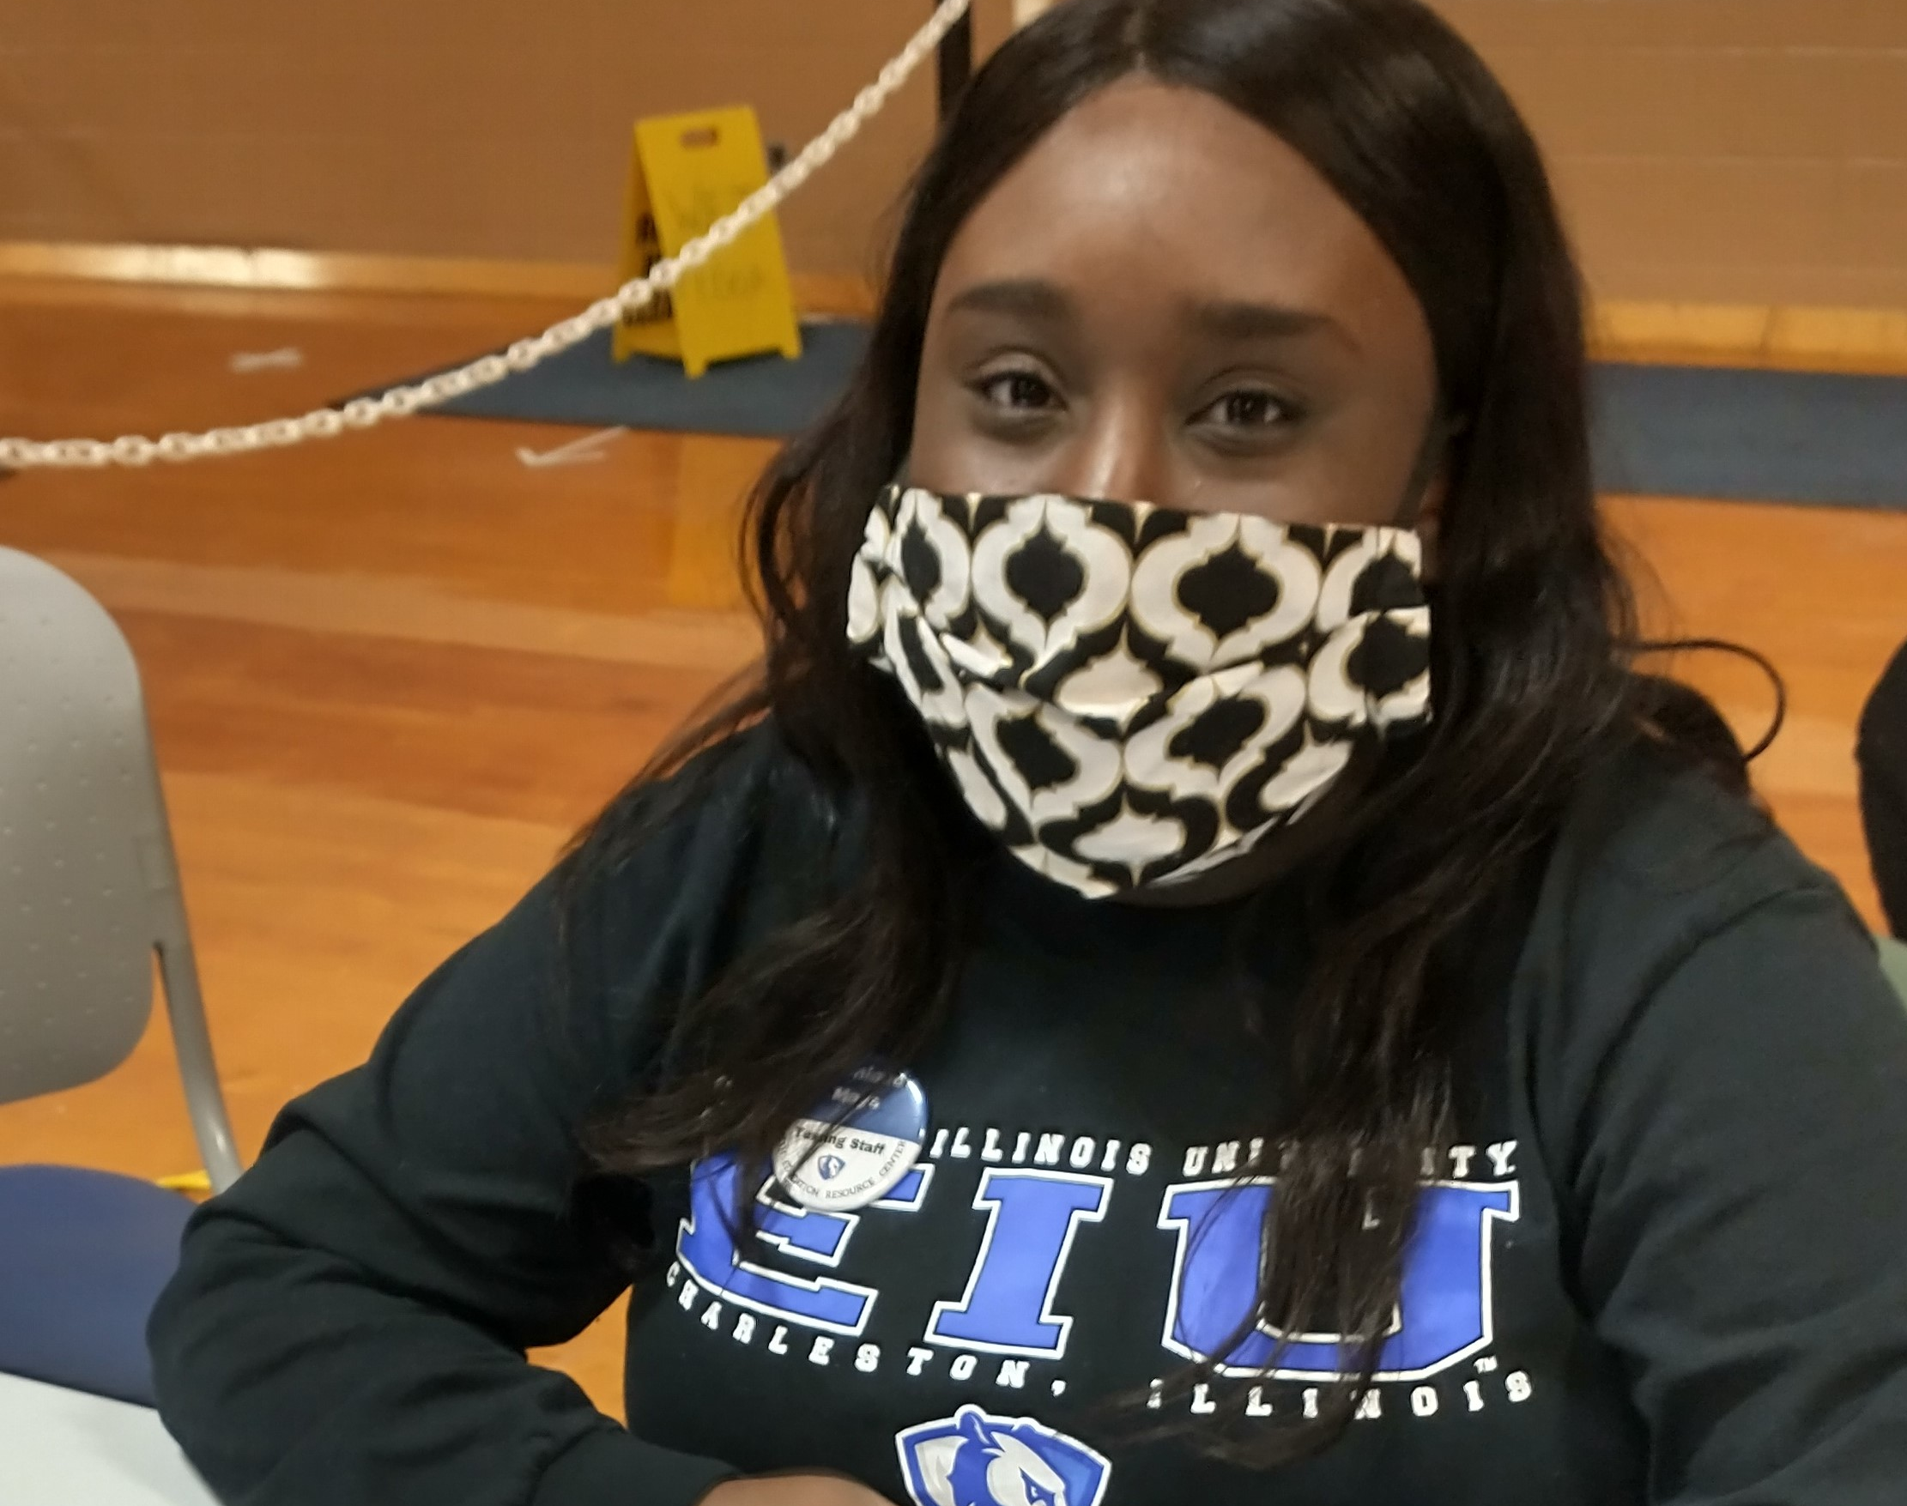
Engaging Students in the Community: Experiential Learning in Public Health
Dr. Nikki Hillier
Dr. Lauri DeRuiter-Willems
Public Health @ Eastern Illinois University
Notes:
Here we can talk about who we are and we can ask who is here.

Slide 2
Session
Objectives
LIST
LIST THREE IMPORTANT PARTNERS FOR HEALTH IINITIATIVES
ANALYZE
ANALYZE TWO APPROPRIATE WAYS COMMUNITY HEALTH ISSUES CAN BE USED TO DEVELOP THE NEXT GENERATION OF THE PUBLIC HEALTH WORKFORCE
EXPLAIN
EXPLAIN THE ROLES FOR EACH PARTNER WHEN ADDRESSING HEALTH EFFORTS

Slide 3

Public Health Departments Vary
Needs
Different structures
Different infrastructure
Different funding mechanisms
Notes:
It's to our benefit to partner with community agencies- as faculty it keeps us connected to the community and the field. But it is essential because we have to connect our students with opportunities for community engagement, service and experiential learning, and their required internships.

Slide 4

Pandemic
Challenging time for agencies and public health
Public Health agencies were focusing efforts on COVID-related work (testing, contact tracing, logistics, enforcement of crowd limits, etc.)
We had students willing and interested (in some cases required) to help
Definite community needs
Other standing programs and services were on the back burner
Individuals were unsure if they should go to regular health care appointments
Public Health staff has different priorities.
Uncertainty with health news
Older adults were lonely, needed resources
Limited time to supervise students.
Notes:
We didn't want to miss this as an opportunity to train up the public health workforce- all the leaders responding to the pandemic right now are going to die or retire by the next one (except Fauci), so we wanted to include, them, but initially- they didn't want them in the way, and they were trying to limit exposure.

Slide 5
Students Need Experience
Provides help to agencies with extra needs
  Day-to-day tasks
  Wish list projects
Allows to students to develop disciplinary-specific skills
  While learning to understand perspectives, priorities, and vocabulary of other disciplines
Offers the opportunity to figure out what you like/don’t like
  Work
  Environment
Bolsters the workforce

Slide 6
Pandemic-Related Service Learning
On-campus Student health services
Local health departments
County Agency on Aging

Slide 7
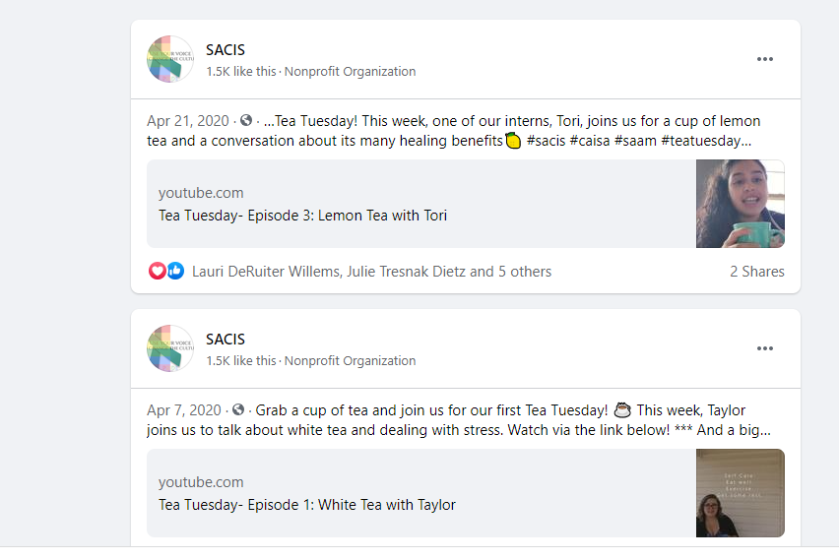
Typical placements
(Unrelated to Pandemic)
SACIS - Sexual Assault Counseling & Information Services (other social service and advocacy agencies)
Chamber of Commerce – Farmer's Market
Digital Health Literacy training for local libraries
Community access and social services at local library
Healthcare facilities
Notes:
Even our ttypical placements had to be creative- some of these ideas weren't ours... when our sacis interns had to move to work from home- two of my sites, do a lot of 1) outreach, and 2) fundraising- some had fundraisers planned for April 2020... So what can they do now? Outreach... they know more about social media than we do, so let them figure it out.

Slide 8
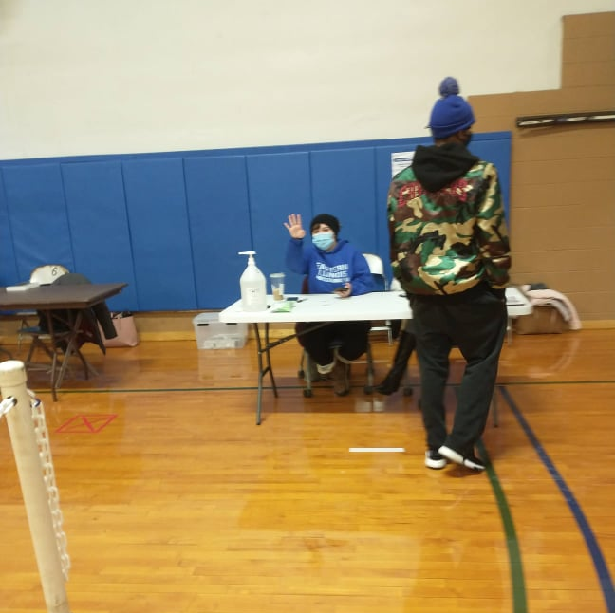
Activities/Programs
Staying In Touch
Contact Tracing
COVID Testing Clinic
Immunization Clinics
Organizing Fundraisers
Coordinating our local farmers markets
Planning and promoting blood drives on campus
Vaccine promotion and education

Slide 9
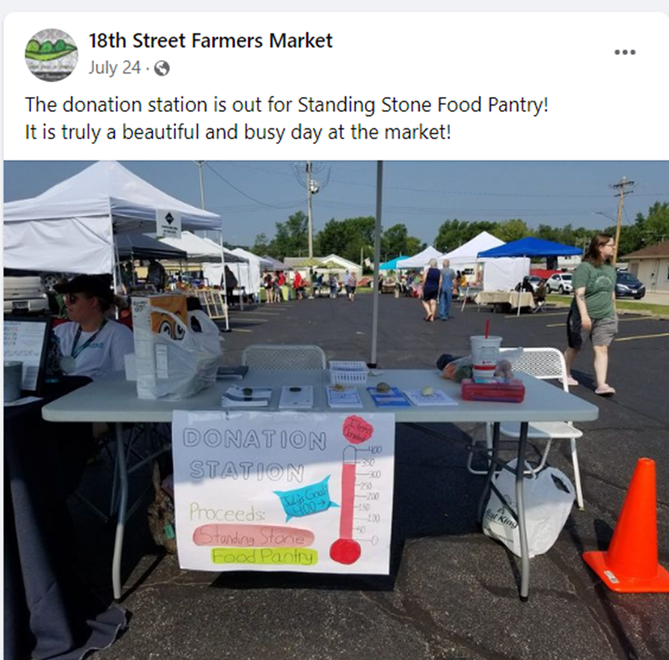
Build Partnerships/Strengthen Collaborations
Knowledge
Keeping up-to-date with best practices and challenges in the field
Preparation
Preparing workforce
Connection
Connecting classrooms to careers
Support
Filling gaps at organizations

Slide 10
How to Approach Community Partners
If time, money and staff were abundant, what projects or programs would be at the top of your list?
In reality, what are at the top of your list, but don't get the attention needed?
What organizations can you connect with to offer these opportunities?

Slide 11
Best Practices
State clear goals for experience
Set realistic expectations
Include student in planning the experience
Establish regular check-ins
Offer autonomy

Slide 12
Tools for Reflections
Videos, prompt: What did you do? What did you like about your internship? What did you dislike about your internship? Finally, tell us what kind of a person this internship is best suited for (personality, skills, they should like to…) and anything else you think a potential intern should know. Let me know if you DON'T want me to share your video with future interns.
In one word, summarize your week of experiences. Then, explain why you selected that one word. You will need to provide examples of experiences/activities that support the word.
Describe a situation in which you took initiative in resolving a problem.
Describe a situation in which you were provided constructive criticism by a supervisor and how you responded to the criticism.
Explain one professional skill or attribute that you have but didn’t realize it until this internship experience. For example, you didn’t think that you would like working with children, but the internship experience has highlighted to you that you really do and this why.
Briefly reflect on your experience so far (how are you being treated, do you feel comfortable/confident, challenges, etc.)
Meetings

Slide 13
Ideas for Partners
Inside the Box
Outside the Box
S.A. Crisis Agencies
Public Health Departments
Hospitals
Student Health Centers
Area Agency on Aging
YMCAs
Park Districts
Dance Studios
Art Museums
Dental Offices
Chamber of Commerce
Transportation Agencies
MYO: Patchwork
Anywhere: every agency can use help with employee wellness/community engagement
Other ideas?

Slide 14
Accounting for Hours
Weekly logs/reflections
Supervisor
Ask for hours, hop on Teams/Zoom, etc.
Give them estimates of how long you think a given project will take
Check in midway
Supervisor evaluations

Slide 15
Some More Opportunities for Discussion
What challenges have you had in helping students with these opportunities?
What agencies could you partner with?
What are your students' capabilities?

Slide 16
Questions or Comments...
Nhillier@eiu.edu
Ljderuiterwillems@eiu.edu

