Slide 1

Partnering with Colleges for Contact Tracing: Win-Win
Dr. Sheila Simons
Dr. Nikki Hillier
Public Health @ Eastern Illinois University
This Photo by Unknown author is licensed under CC BY-ND.
Notes:
Here we can talk about who we are and we can ask who is here.

Slide 2
Session Objectives
LIST
LIST THREE IMPORTANT PARTNERS FOR HEALTH IINITIATIVES
ANALYZE
ANALYZE TWO APPROPRIATE WAYS COMMUNITY HEALTH ISSUES CAN BE USED TO DEVELOP THE NEXT GENERATION OF THE PUBLIC HEALTH WORKFORCE
EXPLAIN
EXPLAIN THE ROLES FOR EACH PARTNER WHEN ADDRESSING HEALTH EFFORTS

Slide 3
Public Health Departments Vary
Needs
Communities
Governing Structures
Infrastructure
Funding mechanisms
Notes:
It's to our benefit to partner with community agencies- as faculty it keeps us connected to the community and the field. But it is essential because we have to connect our students with opportunities for community engagement, service and experiential learning, and their required internships.

Slide 4
Pandemic Issues and Opportunities
Our campus wanted to reopen
Training the next generation of public health workforce
Pandemic-related service learning
Campus and Community

Slide 5
Build Partnerships/Strengthen Collaborations
Knowledge
Keeping up-to-date with best practices and challenges in the field
Preparation
Preparing workforce
Connection
Connecting classrooms to careers
Support
Filling gaps at organizations

Slide 6
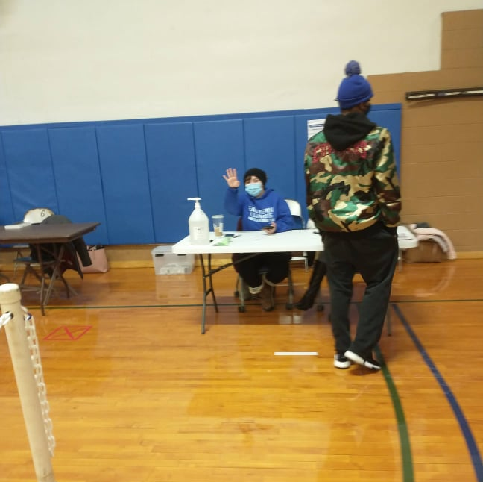
Activities/Programs
Contact Tracing
COVID Testing Clinic
Immunization Clinics
Vaccine Promotion and Education

Slide 7
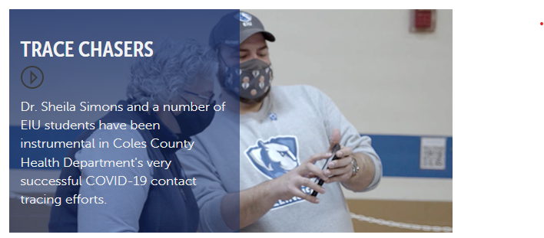
Contact Tracing Team

Slide 8
Partners
Housing & Dining
health services
academics
Athletics
Local Government
Local Health Department

Slide 9
Discussion Questions
What organizations can you connect with to offer experiential learning opportunities?
What challenges have you had in helping students with these opportunities as an educational or community agency?

