Slide 1
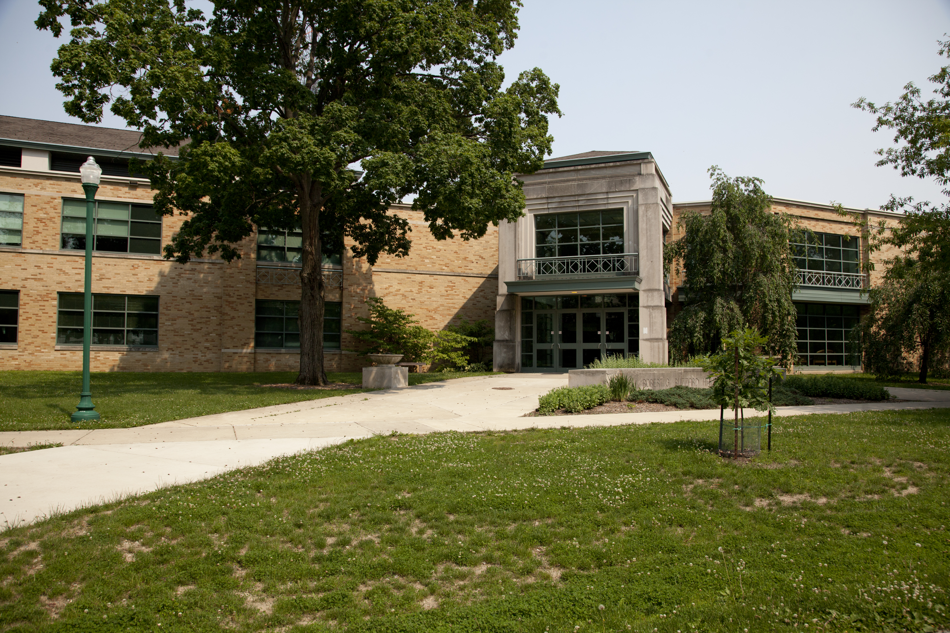
First Choice Program Review
Master of Science in Education:
Elementary Education
November 5, 2013
Dr. Joy Russell, Department Chair
Dr. Linda Reven, Graduate Coordinator
Department Graduate Assessment Committee
Dr. John Bickford III
Dr. Sham’ah Md-Yunus
Documentation Website:
http://www.eiu.edu/elegrad/reports/FirstChoiceReports.php

Slide 2




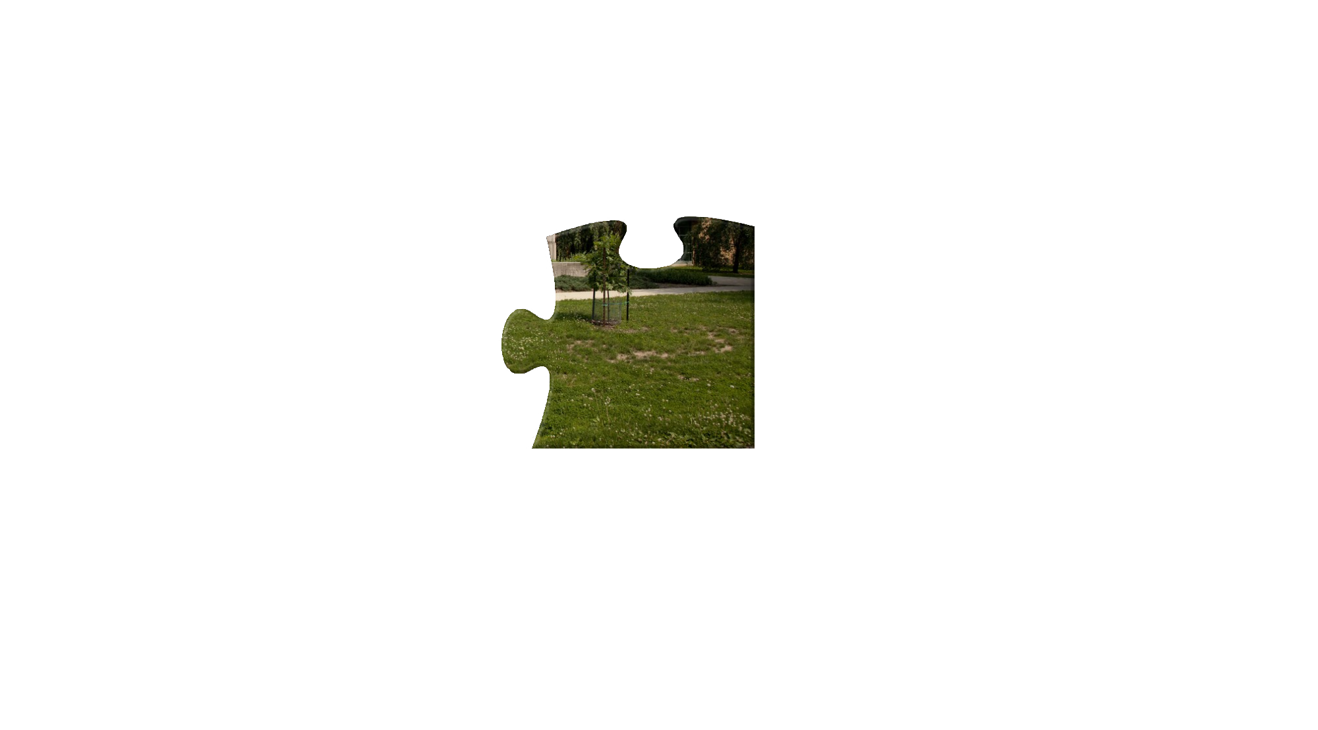
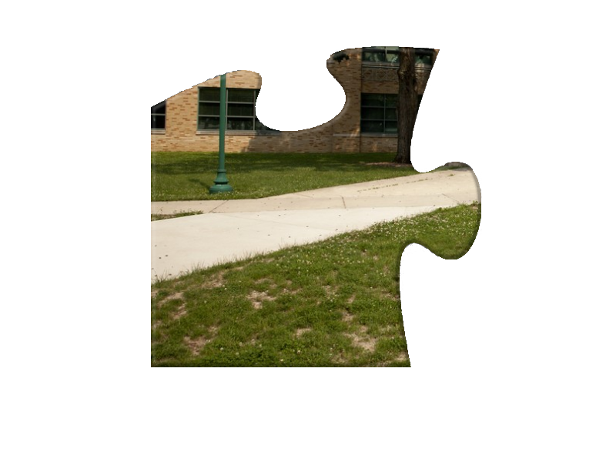
Criterion 1
Criterion 5
First
Choice
Criterion 4
Criterion 2
Criterion 3

Slide 3
Criterion 1
First
Choice

Slide 4
Enrollment Management
The MSED program is designed to meet the needs of currently employed certified professionals.
The program also mentors non-certified candidates and offers opportunities to pursue both a teaching certificate and master’s degree.
Criterion 1

Slide 5

Recruitment Plan
Technological Tools
Networking
Graduate Website
http://www.eiu.edu/elegrad/
On-line Journal
http://eiu.edu/researchinaction/index.php
Integrative Graduate Mentoring-EIU video
http://www.youtube.com/watch?v=pWazZY3dlY8
On-campus graduate coordinator
Off-campus graduate cohort liaison
Faculty interactions during professional conferences
Graduate School Information Day
Brochure distribution to prospective students during off-campus visits
Off-campus presentations for potential cohorts
Personal communication (phone calls, letters, or e-mails) with prospective students
Undergraduate advisors purposefully detail coursework that can be used to fulfill the requirements for the Reading Teacher Endorsement

Slide 6
Enrollment Data
 | MSED | Reading Certificate | Total
Semester Average Fall 2009 – Summer 2013 | 57 | 9 | 64
Fall 2013 Enrollment | 51 | 9 | 60
EPS Enrollment Goal Fall 2013 | 66 | 12 | 78
NOTE: The program also provides coursework to non-degree seeking graduate students in order for them to qualify for Middle Level Endorsements (i.e., an average of 39 endorsements have been earned in each of the past three years).

Slide 7
Enrollment Management
Demonstrate diversity in regard to:
Undergraduate institution (25.9% graduated from non-EIU domestic undergraduate universities),
Ethnicity (3.7% represent persons of color), and
Gender (4.9% are males).
NOTE: International students or students outside of Illinois may not qualify for the graduate program if they do not hold a current teaching certificate.
Criterion 1

Slide 8
Enrollment Management
2012 Illinois School
Report Card Data reveals…
Regional schools represent districts/communities of varying sizes that enhance the diversity and broaden the perspectives of the MSED candidates.
MSED students are more diverse in regard to ethnicity/race than the general population of teachers within regional schools.
Criterion 1

Slide 9
Enrollment Management
Selection Criteria
The Entry Level Data Committee reviews the application materials and rates the candidate using the Advanced Candidate Assessment #1 – Entry Level Rubric in order to arrive at an appropriate admission decision.
Application Materials
Transcripts showing the required 3.0 GPA within the last 60 hours of undergraduate study [or 3.0 GPA in the first 12 hours of graduate coursework];
Current teaching certificate [the applicant, if not appropriately certified, must complete the necessary undergraduate course work];
Two letters of recommendation from professional sources;
Professional resume;
Formal letter of application; and
Completed Advanced Candidate Self-Assessment form.
Criterion 1

Slide 10
The MSED Program admits candidates
throughout the academic year.
Graduate Admission Data Fall 2009 – Summer 2013
Average Number of MSED Applications (per semester) | 14
Average Number of Admission Offers (per semester) | 9
Average Yield (per semester) | 7
Average Number Denied (per semester) | 6
NOTE: The graduate coordinator monitors the progress of students who are provisionally accepted to the program and offers degree candidacy only if the students satisfy the program requirements (including earning the required 3.0 on their first 12 hours of graduate study).

Slide 11
Assistantship/Scholarship Management
Annual Awards
The MSED program is allotted six graduate assistantships each year.
It has been a program goal to award these assistantships to MSED in Elementary Education candidates.
This goal has been achieved and sustained since 2011 (i.e., 2011-2013).
Criterion 1

Slide 12
Assistantship/Scholarship Management
MSED Graduate Assistants Instructional Assistance
ELE 2000 – The Teacher and the School (an introductory course for majors with an average enrollment of 100 undergraduate students each semester) and
GST 1000 – Reading and Study Improvement (a service course addressing efficient study skills with an emphasis on reading improvement that has an average enrollment of 63 undergraduate students per semester).
Criterion 1

Slide 13
Assistantship/Scholarship Management
MSED Graduate Assistants Research Assistance
Graduate assistants assigned to provide research assistance support faculty research efforts in regard to data collection and analysis.
Graduate students who were surveyed remarked that:
It was an “amazing opportunity to work with….instructors in the education department” and
They “found the connections [that were] formed with the faculty members in the department to be invaluable”.
Criterion 1

Slide 14
Assistantship/Scholarship Management
MSED Graduate Assistants
Supervised Service
The Reading Center houses graduate assistants who provide:
Monitored study hours for undergraduate students enrolled in the Gateway Program (i.e., an average of 1143 hours of support for Gateway students each term);
Basic Skills/TAP Testing Support for students within the College of Education and Professional Studies (i.e., an average of 211 hours of Basic Skills/TAP Testing Support each semester).
Criterion 1

Slide 15
Assistantship/Scholarship Management
Competitive Awards
The Carol Helwig Award (sponsored by an emeritus graduate faculty member) has been awarded annually since 2005.
The Sabina L. McNutt and James L. McNutt, Sr. Education Scholarship (sponsored by the family of an alumnus of the graduate program) was first awarded in 2012.
Criterion 1

Slide 16
Matriculation Management
MSED in Elementary Education
Graduates 2010 – 2012*
Number of Graduates: 50
Mean Number of Semesters to Degree Completion:
7.46 semesters (Range 5 – 11)
Mean Number of Years to Degree Completion:
3.04 years (Range 1⅓ – 6)
*Includes 11 members of the Decatur Cohort.
Criterion 1

Slide 17
Matriculation Management
MSED in Elementary Education
Graduates 2010 – 2012
Twenty-four students(48%) completed the degree in two or fewer years.
Twenty-six students (52%) required more than two years to complete the program.
NOTE: These completion percentages are meaningful considering that approximately 90% of the students are full-time practicing teachers who must pursue a master’s degree as part-time graduate students.
Criterion 1

Slide 18
Matriculation Management
MSED in Elementary Education
Graduates 2010 – 2012
It is quite common for unemployed individuals to begin graduate study in order to acquire additional endorsements or teaching credentials to make themselves more marketable and enable them to secure a teaching position.
Once established in a school system, these individuals most often return within six years to complete their graduate degrees.
Criterion 1

Slide 19
Graduate Placement
The program values developing highly qualified, educated teachers who accept regional classroom positions where their newly generated skill set meets specific professional demands.
Accomplishments include:
pursuit of advanced degrees,
students’ job placements,
earning of credentials, and
societal contributions.
The majority of our graduates are full-time practicing teachers who pursue the degree to obtain employment and/or hone their classroom instructional skills.
Criterion 1

Slide 20
Graduate Placement
Alumni Survey
(2010 – 2012 Graduates)
80% of the respondents indicated they were employed as full time educators upon completion of the MSED degree;
40% revealed they were considering pursuing another advanced degree; and
95% of the respondents reported that their graduate study at EIU had a positive impact on their classrooms.
Criterion 1

Slide 21
Graduate Placement
Alumni Survey
(2010 – 2012 Graduates)
90% of the graduates indicated they had shared their research with peers;
50% indicated they had presented their research findings to their school board/district administration.
Criterion 1

Slide 22
Criterion 1
First
Choice
Criterion 2

Slide 23
Assessment
Graduate Assessment Plan
Direct Measures
Advanced Candidate Assessment #1 – Entry Level Rubric
Advanced Candidate Assessment #2 – Mid-point Rubric
Advanced Candidate Assessment #3 – Completion Rubric
Illinois Licensure Testing System (ILTS) Reading Teacher Content Area Test (#177)
Criterion 2

Slide 24
Assessment
Graduate Assessment Plan
Indirect Measures
MSED Exit Survey is used to obtain students’ perceptions about the program’s efficacy and its impact on professional advancement and growth.
Reading Teacher Survey was developed to capture student perceptions about their preparation in regard to the Illinois Reading Teacher Standards.
Criterion 2

Slide 25
Assessment Results Documented by CASA
Objectives for the program encompass all the learning goals established for graduate programs;
Objectives for the program were clear and measurable;
Assessing students at multiple points in the program provides formative and summative assessment data;
Plan incorporates both direct and indirect measures;
Expectations for each objective are distinguished;
Results are collected, analyzed, and reported back to the faculty; and
A feedback loop is in place.
Criterion 2

Slide 26
Assessment Results Documented by the Graduate School
Multiple direct and indirect measures
Rubrics to ensure validity and reliability
Clear interpretation of each data point
A clear organizational structure
A summary of actions in response to the plan including:
-the development of Research in Action, an on-line journal, and
-modification of the mission statement.
Criterion 2

Slide 27
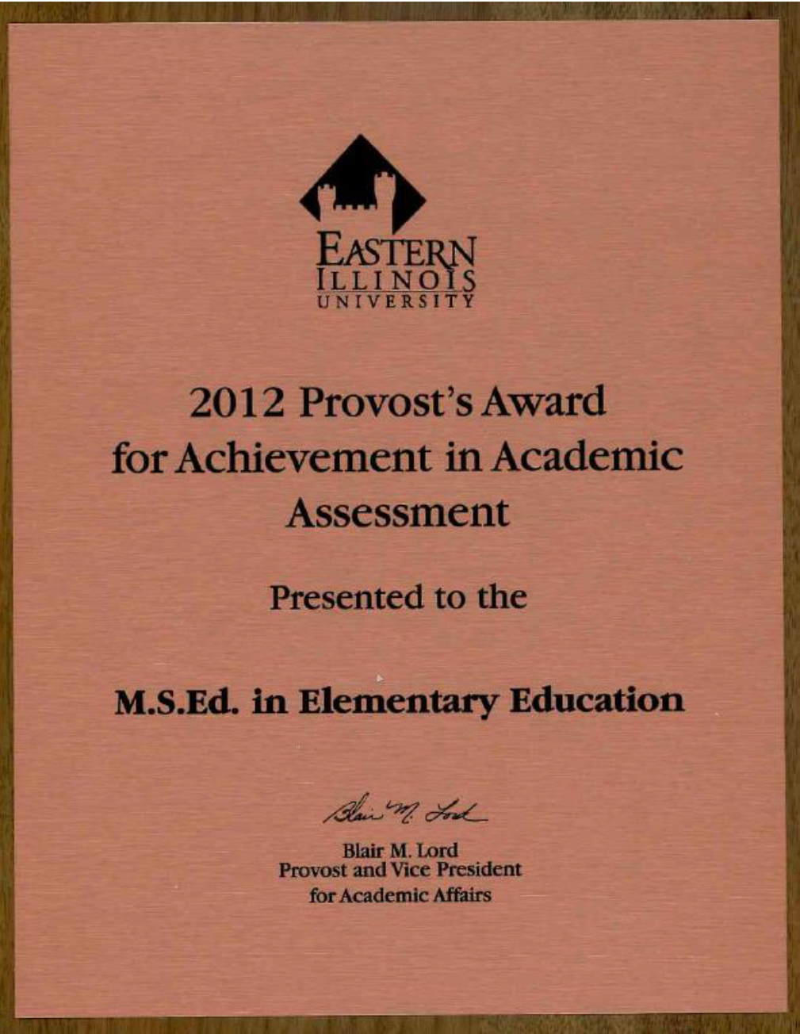
Provost’s Assessment Award

Slide 28
Criterion 1
First
Choice
Criterion 2
Criterion 3

Slide 29
Mission and Planning Leadership
Mission
The Graduate Program in Elementary Education
advances scholarly preparation by
providing quality teaching and promoting excellence in research/creative activity
in order for graduate students to
exemplify best teaching practices
for children from birth through age fourteen.
The graduate curriculum encompasses
comprehensive content knowledge and
promotes the use of critical thinking and
problem solving to
cultivate teacher-researchers who are
empowered to serve as leaders in the profession.
Faculty members challenge students to
bridge the gap between theory and practice as
they develop the skills required for
ethical and effective
collaboration and communication within the
local school community and a culturally diverse,
technologically advanced global environment.

Slide 30
Administrative Leadership

Slide 31
Graduate Faculty Leadership
Graduate Faculty Committees
Graduate Assessment Committee
Graduate Awards Committee
Graduate Entry Level Data Committee
Graduate Mid-point Data Committee
Action Research/Thesis Committee(s)
Graduate Research Courses Committee
Graduate Online Journal Committee
Criterion 3

Slide 32
Graduate Faculty Leadership
Results…
Adoption/implementation of the Graduate Assessment Plan (2008),
Creation of generic graduate course syllabi (2009),
Revision of the graduate research sequence within the program (2009),
Completion of the Collaborative Institutional Training Initiative (CITI) by the entire graduate faculty (2009),
Development of a Handbook for Action Research (2010),
Budget realignment to include resources for student travel for research presentations and graduate awards (2010),
Establishment of Research in Action (2012) an on-line journal to provide a forum for student research,
Active support of a graduate faculty research/ creative activity agenda, and the
Developmental work to generate a Graduate Certificate in English As A Second Language/English Language Learners (in progress).
Criterion 3

Slide 33
Curricular Leadership by External Review
External Reviews
National Council for Accreditation of Teacher Education (Fall 2010);
Illinois Board of Higher Education (2012);
Graduate students’ pass rate on the Illinois Reading Teacher Content Test:
2009-2010 = 100%,
2010-2011 = 93%,
2011-2012 = 100%; and
Annual feedback from the EC/ELE/MLE Advisory Committee
Criterion 3

Slide 34
Capstone Leadership
The program’s compulsory capstone project illustrates graduate students’ critical, rigorous, and data-based examination of a relevant, student-generated question:
- Action Research (ELE 5900) or
- Thesis (ELE 5990).
The program’s students produced a yearly average of 15 capstone projects and a range of 6-23 capstone projects.
The department celebrates exceptional capstone projects through the journal of Research in Action.
Criterion 3

Slide 35
Student Leadership
Graduate Student Contributions:
Service as student representatives on the Graduate Student Advisory Council
Service as a Student Dean (2010)
Recipient of the Thesis Award of Excellence for the College of Education and Professional Studies (2011)
Recipient of the King-Mertz Research/ Creative Activity Award of Excellence for the College of Education and Professional Studies (2011)
Criterion 3

Slide 36
Alumni Leadership
Sabina L. McNutt and James L. McNutt, Sr. Education Scholarship (2011)
Initiation of the Departmental Outstanding Graduate Alumni Award (2011)
Program’s graduates’ nomination (2011) and receipt (2008, 2009, 2012, and 2013) of the Graduate School Outstanding Graduate Alumni Award
Student travel awards sponsored by alumni
Alumni participation in Study Abroad
Role as course instructors
Involvement with accreditation reports
Participation on the Advisory Committee
Regular hiring of our graduates
Criterion 3

Slide 37
External Partnerships
ELE 5520 - Supporting High Quality Instruction Across All Content Areas (a partnership with Educational Leadership and the Charleston School District);
ELE/EDF 5310 – Foundations: ESL-Bilingual Education (a partnership with Secondary Education and Foundations);
Professional service work such as the Curriculum Committee (which includes public school personnel);
East Central - EIU Reading Council (a professional organization where leadership roles are assumed by members of the graduate faculty and professional educators from the community);
Program offers courses to meet the needs of other departments (e.g., ELE 5520, MLE 5270);
Graduate student study plans incorporate courses from other departments (EDF 5500, EDF 5510, EDP 5300);
Graduate faculty from other departments serve on thesis committees for students pursuing the MSED in Elementary Education;
Departmental faculty serve on thesis committees for graduate candidates in other graduate programs; and
Graduate cohorts are offered in collaboration with Regional Offices of Education and the Office of Continuing Education based upon identified needs within specific geographic areas.

Slide 38
Criterion 1
First
Choice
Criterion 4
Criterion 2
Criterion 3

Slide 39
Student Research Leadership
The program has cultivated a culture of research across the graduate curriculum by producing research through one of two capstone projects: thesis and action research.
The program’s students produced a yearly average of 15 capstone projects and a range of 6-23 capstone projects.
In addition, graduate students produced nine publications or presentations with faculty during the period under review.
The program’s students have co-authored a peer-reviewed article (2012) and presented at various state, national, and international conferences such as the Illinois Association of Teacher Educators (IATE), Association of Teacher Educators (ATE), and International Reading Association (IRA) Annual Conference.
The program aims for student research production and engagement to average two theses, ten action research, and three non-capstone projects (publications, presentations) annually.
NOTE: During the period under review, the department is satisfied that it is moving toward achievement of the stated goals.

Slide 40
Student Research Leadership
Peer-reviewed Article:
Schmitz, M., Hoffmann, M., [graduate student] & Bickford, J. H., III (2012). Identifying cyberbullying, connecting with students: The promising possibilities of teacher-student social networking. Eastern Educational Journal, 41(1), 16-30.
Presentations*:
Dale, C. & Helregel, M. [graduate student] (2010, October). Why we need cooperating teachers. Fall Institute, Regional Office of Education #11, Charleston, IL.
Dale, C., & Reed, A. [graduate student] (2010, August). The disposition to teach: Challenges in teacher preparation. Association of Teacher Educators Summer Conference. Kansas City, MO
Padmaraju, K., Anderson, L. & File, J. [graduate student] (2010, November). Fostering desirable dispositions in teacher candidates. Illinois Association of Teacher Educators 40th Annual Fall Conference, Charleston, IL.
*NOTE: The remaining presentations are listed below under Williams Travel Awards and CEPS Research Fair.
Criterion 4

Slide 41
Research and Travel Grants
Williams Travel Awards:
Reven, L., Reid, D., Flood, A. & Bengtson, K. [graduate student] (2012, April). Constructing meaning with a focus on generating inferences: A working model, research evidence and practical classroom applications to support the differentiation of comprehension instruction. 57th Annual Convention of the International Reading Association, Chicago, IL.
Reven, L., Reid, D. & Snyders, K. [graduate student] (2008, May). Using quality children’s literature to engage readers and differentiate comprehension instruction. 53rd Annual Convention of the International Reading Association, Atlanta, GA.
CEPS Research Fair:
Bengtson, K., Blackwell, M., Damron, N., Dowell, S., Evans, P., Field, N., . . . Dale, C. [ELE 5250 graduate students] (2012, February). To what extent might prior knowledge and experience of elementary teachers aid in the implementation of common core? College of Education and Professional Studies 15th Annual Research Fair, Charleston, IL.
Lambert, S., [graduate student] (2008, February). The effect of comic books on students’ reading attitudes. College of Education and Professional Studies 11th Annual Research Fair, Charleston, IL.
Lockart, G., & Snyders, K. [graduate student] (2008, February). Implementation of computer technology in reading programs: Perceived and real effects on middle level students. College of Education and Professional Studies 11th Annual Research Fair, Charleston, IL.
Criterion 4

Slide 42
Showcasing Graduate Scholarship/Creative Activity
College of Education and Professional Studies (CEPS) Graduate Showcase (2010, 2011, 2012, and 2013)
Graduate Student Expo Poster Sessions (one each in 2008 and 2009; three each in 2010 and 2011; two in 2012)
Research In Action is the department’s annual journal of reviewed theses and action research manuscripts that was launched in 2012:
- In the spirit of a teaching hospital, this scholarly teaching journal demonstrates the program’s local commitment to the global academic community.
- Research In Action celebrates the transformation of quality teachers into teacher-researchers who explore the rich and authentic interconnections between teaching and learning, methodology and assessment, and innovation and reflection in early childhood, elementary, and middle level classrooms.
Criterion 4

Slide 43
Award Program Participation
Graduate School Annual Awards:
- College of Education and Professional Studies Master’s Thesis Award of Excellence (2011)
- College of Education and Professional Studies King-Mertz Research/Creative Activity Award (2011)
- MSED Distinguished Graduate Student Awards (2008-2013)
Two graduate students have also received special recognition from the Graduate Student Advisory Council (GSAC) for their exemplary poster presentations during the Graduate Student Expo (2009 and 2010).
Through the Graduate School’s Outstanding Graduate Alumni Award, the department’s alumni have been recognized for their achievements (2008, 2009, 2012, and 2013).
Criterion 4

Slide 44
Award Program Participation
Departmental Annual Awards:
Thesis Award of Excellence
Distinguished Research and Creative Activity Award
Distinguished Graduate Student Award(s)
Graduate Showcase Series Award
Departmental Outstanding Graduate Alumni Award (established in 2011)
NOTE: Members of the graduate faculty recognize the award recipients during the Recognition Ceremony that is held annually each spring.
Criterion 4

Slide 45
Criterion 1
Criterion 5
First
Choice
Criterion 4
Criterion 2
Criterion 3

Slide 46
Coordinator Leadership
Graduate Coordinator Service
Awards/Recognition
Graduate Faculty Member (1990-Present);
Graduate Coordinator (2008-Present);
Graduate Assessment Committee (Co-Chair 2008-2009, Fall 2009; Chair Spring 2010-Present);
Council on Graduate Studies (Member 1998-2002; 2004-2005; April 2013);
Member (2009-2010) and Chair (2012-2013) of the Council on Graduate Studies Scholarships Committee;
Member (2009-2010, 2011-2012, 2012-2013) and Chair (2010-2011) of the CEPS King-Mertz Research/Creative Activity Screening Committee; and
Member (2010-2012) of the Council on Graduate Studies Enrollment Quality and Diversity Board.
At the Spring Graduate Leaders Seminar (January 17, 2012) Dr. Reven was recognized for outstanding service to the graduate community for participation as a member of the Enrollment Quality Diversity Board and her contributions to the development of The Integrative Graduate Studies Institute.
In 2013, Dr. Russell and Dr. Reven garnered the Graduate School Leadership Award for work accomplished during this evaluation period.
Dr. Reven also received the Illinois Reading Council Educator of the Year Award (2012), the first college professor to do so.

Slide 47
Graduate Faculty Research and Creative Activity (2009-2012)
 | 2009 | 2010 | 2011 | 2012 | Total
Article Publication* | 3 | 6 | 5 | 7 | 22
Book Publication* | 0 | 0 | 0 | 1 | 1
Grants | 2** | 2 | 5*** | 8**** | 17
Conference Presentations* | 35 | 33 | 23 | 19 | 110
Service to Practicing Teachers | 1 | 8 | 1 | 2 | 12
Service to Pre-service Teachers | 6 | 1 | 2 | 2 | 11
*Indicates blind, peer-reviewed, academic venues (i.e., journals, publishing companies, conferences).
**One grant involved extra-mural funding by the Illinois Reading Council.
***Two grants involved extra-mural funding by the Illinois Association of Teacher Education and the Illinois
Board of Higher Education.
****Two grants involved extra-mural funding by the Illinois Board of Higher Education.

Slide 48
Graduate Faculty Leadership
Service to Graduate Education
International Education Committee
(Dr. Daniel Carter, 2011-Present)
Institutional Review Board
(Dr. John Bickford III, 2012-Present)
Council of Faculty Research
(Dr. Sham’ah Md-Yunus, 2009-2011)
Council of Graduate Studies, Vice Chair
(Dr. Carrie Dale, Fall 2012)
Graduate Student Advisory Council, Faculty Advisor
(Dr. Carrie Dale, Fall 2011-Fall 2012)
Integrative Graduate Studies Institute, Board Member
(Dr. Kiran Padmaraju, Fall 2012–Present)
Criterion 5

Slide 49

EIU
Criterion 1
Criterion 5
First
Choice
Criterion 4
Criterion 2
MSED in Elementary Education
Criterion 3

