Slide 1
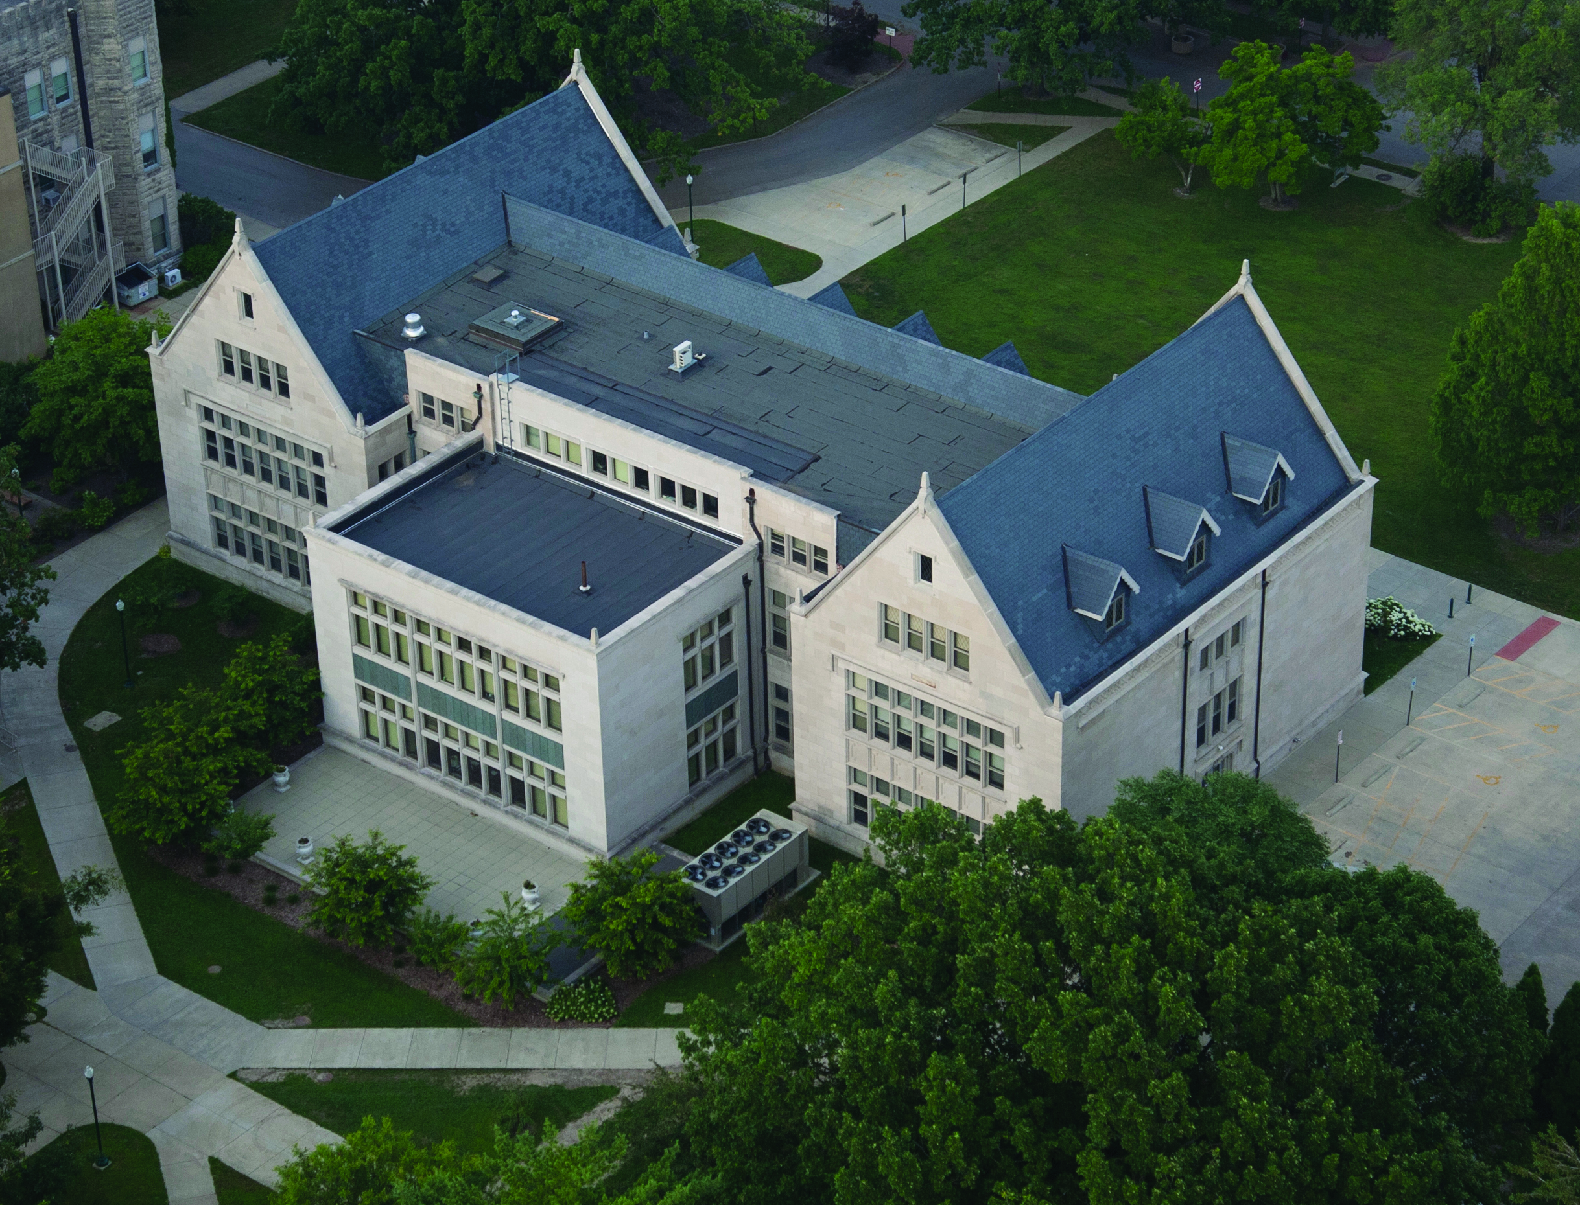
Advancing Graduate Study at Eastern
Opportunities for Graduate Coordinators, Chairs, & Deans

Slide 2
EIU Mission
Superior graduate education
Accessible graduate education
Arts, sciences, humanities, professions
Teaching, research, service
Responsible citizenship

Slide 3
Graduate Mission
Enrollment Quality & Diversity
Assessment
Curriculum Rigor
Student Scholarship
Faculty Scholarship & Mentoring

Slide 4
CGS Awards Committees
Thesis & King-Mertz Awards: Dr. Beebe/ENG
  King-Mertz Screening Committees
Williams Travel Grants: Dr. Upadhyay/ECN
Research Grants: Dr. Reven/ELE
Scholarships: Dr. Jones-Bromenshenkel/SPE
Weller Award: Dr. Daniels/PHY
Bear McClay Award: Dr. Wiles, MAT
Hamand Society: Dr. Kahler/ART
Ranes Award: Drs. Colombo/BIO & Key/HIS

Slide 5
CGS Boards
Executive Board (4): Chair, Vice Chair, Dean, CGS Assistant
Integrative Institute (7) Ms. Henderson
PSM Board (7): Drs. Gaines & Cornebise
Interdisciplinary Board(11): Dean Augustine
On-Line Board (14) Dean Augustine
Literacy in Financial Education (21) Dr. Simpson
Sustainable Energy Board (16): Dr. Liu

Slide 6
CGS Liaison Committees
Textbook Advisory/Dr. Laingen
Library Advisory/Dr. Wehrle
ATAC/Dr. Boggs
Honorary Degree/Dr. Frank
Council on Assessment/Dr. Padmaraju

Slide 7
Fall 2014 Excellence Cultivation Programs
First Choice Program & Resources: Dean Elliott (ETS/MAGS Award 2011)
Integrative Institute: Ms. Lori Henderson (ETS/CGS Award 2011)
Literacy in Financial Education Center: Dr. Linda Simpson (TIAA-CREF/CGS Award 2013)
Fall Leadership Conference: 4:30 September 2
GRE Prep Workshop: Noon September 9
Homecoming Reunion/Tent City: October 25
Enrollment Practices Workshop/Appreciation: 10:00 October 16
Graduate School Fair: 10:00 October 15, Grand Ballroom
Presidential/Provost GA Luncheon: Noon

Slide 8
Spring 2014 Excellence Cultivation Programs
Spring Leadership Seminar: February 19, 1895 Room
Spring Showcase Series: April 7 and 8, Doudna Lecture Hall
Distinguished Student Awards Program: 3:00 April 9 Dvorak Concert Hall Stage
Outstanding Graduate Alumni Program: 5:00 April 10 Dvorak Concert Hall Stage
Graduate School Philanthropy Board: TBD

Slide 9
Graduate Student Commencement Speaker
Fall 2014 Commencement Ceremony
Graduation Criteria
  Degree audit verifies eligibility to participate in commencement
Scholarship Criteria
  3.25 CGPA or higher for courses completed at Eastern Illinois University at time of essay submission

Slide 10
Student Commencement Speaker Theme
The Things that Matter are the Things that Last: What educational experiences mattered to you while at Eastern Illinois University that made a difference and will follow you into your future?

Slide 11
Time Table
July 1 through September 30 Essay Competition
  Deadline 4:30 p.m. September 30
September 25, Noon Commencement Board Workshop
September 30 through October 17 Essay Assessment
  Notification October 17
October 18 through October 24 Oral Assessment
  Notification October 24
October 25 through 31 Speaker/Alternate Speaker Ranking
  Notification October 31
December 19 Reception Speakers, Mentors, & Families
December 20 Commencement

Slide 12
Graduate School Institutes and Centers
Integrative Graduate Studies Institute
Literacy for Financial Education Center

