Slide 1

Robert M. Augustine
Dean
Fall 2014
Graduate Summit
Fall 2014
Graduate Enrollment Review

Slide 2
Fall 2014
Graduate Summit

Slide 3

College of Sciences
Profile
Fall 2014
Graduate Summit
241 Fall Enrollment
  -4% Fall 2013 (250)
  10% Increase Fall 2014 Goal (219)
  17% Increase from 10-year Mean (206)
Programs Exceeding Goals
  23 Economics
  28 Political Science

Slide 4
College of Sciences
Profile Continued
Fall 2014
Graduate Summit
Programs Meeting Goals
  CDS & CDS Online
  PSM/GIS
  Mathematics
  Clinical Psychology
  School Psychology

Slide 5
College of Sciences
Profile Continued
Fall 2014
Graduate Summit
Impact of Diverse Graduate Offerings
  35-40 Additional Graduate Candidates
  Certificates PLS
  Interdisciplinary Degrees PSM/GIS, GER, SUE
  Professional Science Masters GIS
  Online/Hybrid Options CDS
  International Interest ECN
Emerging Programs 2015
  MS Bio Med/Bio Tec Interdisciplinary
  2nd CDS Online Cohort

Slide 6
Fall 2014
Graduate Summit

Slide 7
Fall 2014
Graduate Summit

Slide 8
Fall 2014
Graduate Summit

Slide 9
Fall 2014
Graduate Summit

Slide 10
Fall 2014
Graduate Summit

Slide 11
Fall 2014
Graduate Summit

Slide 12
Fall 2014
Graduate Summit

Slide 13
Fall 2014
Graduate Summit

Slide 14
Fall 2014
Graduate Summit

Slide 15
Lumpkin College of Business & Applied Sciences Profile
Fall 2014
Graduate Summit
412 Total Enrollment
  8% Increase Fall 2013 (382)
  6% Increase 2014 Goal (387)
  15% Increase 10-Year Mean (356)
  Fulbright Scholar MS Sustainable Energy
  Visiting International Scholar MBA

Slide 16
College of Business & Applied Sciences Profile Continued
Fall 2014
Graduate Summit
Programs Exceeding Goals
  86 Business Administration
  188 Technology/Certificates
  18 Sustainable Energy/Dual Degrees
Programs Meeting Goals
  81 FCS/FCS Online
  29 Dietetics

Slide 17
College of Business & Applied Sciences Profile Continued
Fall 2014
Graduate Summit
Impact of Diverse Graduate Offering
  70+ Additional Candidates
  Certificates TEC
  Interdisciplinary Degrees SUE
  Dual Degrees TEC, SUE
  Online/Hybrid Options, FCS
Emerging Programs 2015
  Joint MBA Degree China Partnership
  Gerontology Online/Hybrid

Slide 18
Fall 2013
Graduate Summit

Slide 19
Fall 2014
Graduate Summit

Slide 20
Fall 2014
Graduate Summit

Slide 21
Fall 2014
Graduate Summit

Slide 22
Fall 2014
Graduate Summit

Slide 23
Fall 2014
Graduate Summit

Slide 24
Fall 2014
Graduate Summit

Slide 25
College of Education & Professional Studies Profile
Fall 2014
Graduate Summit
379 Total Enrollment
  -30% Fall 2013 (547)
  -21 Fall 2014 2014 Goal (400)
  -48% 10-Year Mean (729)

Slide 26
College of Education & Professional Studies Profile
Fall 2014
Graduate Summit
Exceeding Goals
  52 Elementary Education
  8 Reading Certificate
Meeting Goals
  57 College Student Affairs

Slide 27
College of Education & Professional Studies Profile
Fall 2014
Graduate Summit
Impact of Diverse Graduate Offerings
  8 Additional Candidates
  Certificates, ELE
Emerging Opportunities
  Health Leadership/Promotions
  KSS Online Courses/Options

Slide 28
Fall 2014
Graduate Summit

Slide 29
Fall 2014
Graduate Summit

Slide 30
Fall 2014
Graduate Summit

Slide 31
Fall 2014
Graduate Summit

Slide 32
Fall 2014
Graduate Summit

Slide 33
Fall 2014
Graduate Summit

Slide 34
Fall 2014
Graduate Summit

Slide 35
College of Arts & Humanities Profile
Fall 2014
Graduate Summit
157 Total Enrollment/Largest in History
  11% Increase Fall 2013 (141)
  8% Increase Fall 2014 Goal (149)
  6% Increase 10-Year Mean (135)
Programs Exceeding Goals
  Art & Art Education Online
  Music & Music Education Online

Slide 36
College of Arts & Humanities Profile
Fall 2014
Graduate Summit
Programs Meeting Goals
  Communication Studies
  History & Historical Administration
Impact of Diverse Graduate Offerings
  20 Additional Candidates
  Certificates, ENG
  Interdisciplinary Degrees, ENG, CMN
  Online/Hybrid Options, ART, MUS

Slide 37
Fall 2014
Graduate Summit

Slide 38
Fall 2014
Graduate Summit

Slide 39
Fall 2014
Graduate Summit

Slide 40
Fall 2013
Graduate Summit

Slide 41
Fall 2014
Graduate Summit

Slide 42
Fall 2014
Graduate Summit

Slide 43
Fall 2014
Graduate Summit

Slide 44
Creating Opportunities
Fall 2014
Graduate Summit
Enrollment Practices Workshop
  10:00 AM October 16, 1895 Room
Online Board
  3:00 PM 3rd Tuesdays
  8/26, 9/23, 10/28, 1/27, 2/24, 3/24, 4/28
Interdisciplinary Board
  2:00 PM 2nd Thursdays
  9/11, 2/12

Slide 45
Creating Opportunities
Fall 2014
Graduate Summit
PSM Board
  2:00 PM 2nd Thursdays
  10/9, 3/5
Certificates, Dual Degrees, Joint/Dual International Degrees
  Arrange Consultations
Other Boards
  LIFE Center Board
  Sustainable Energy Board

Slide 46
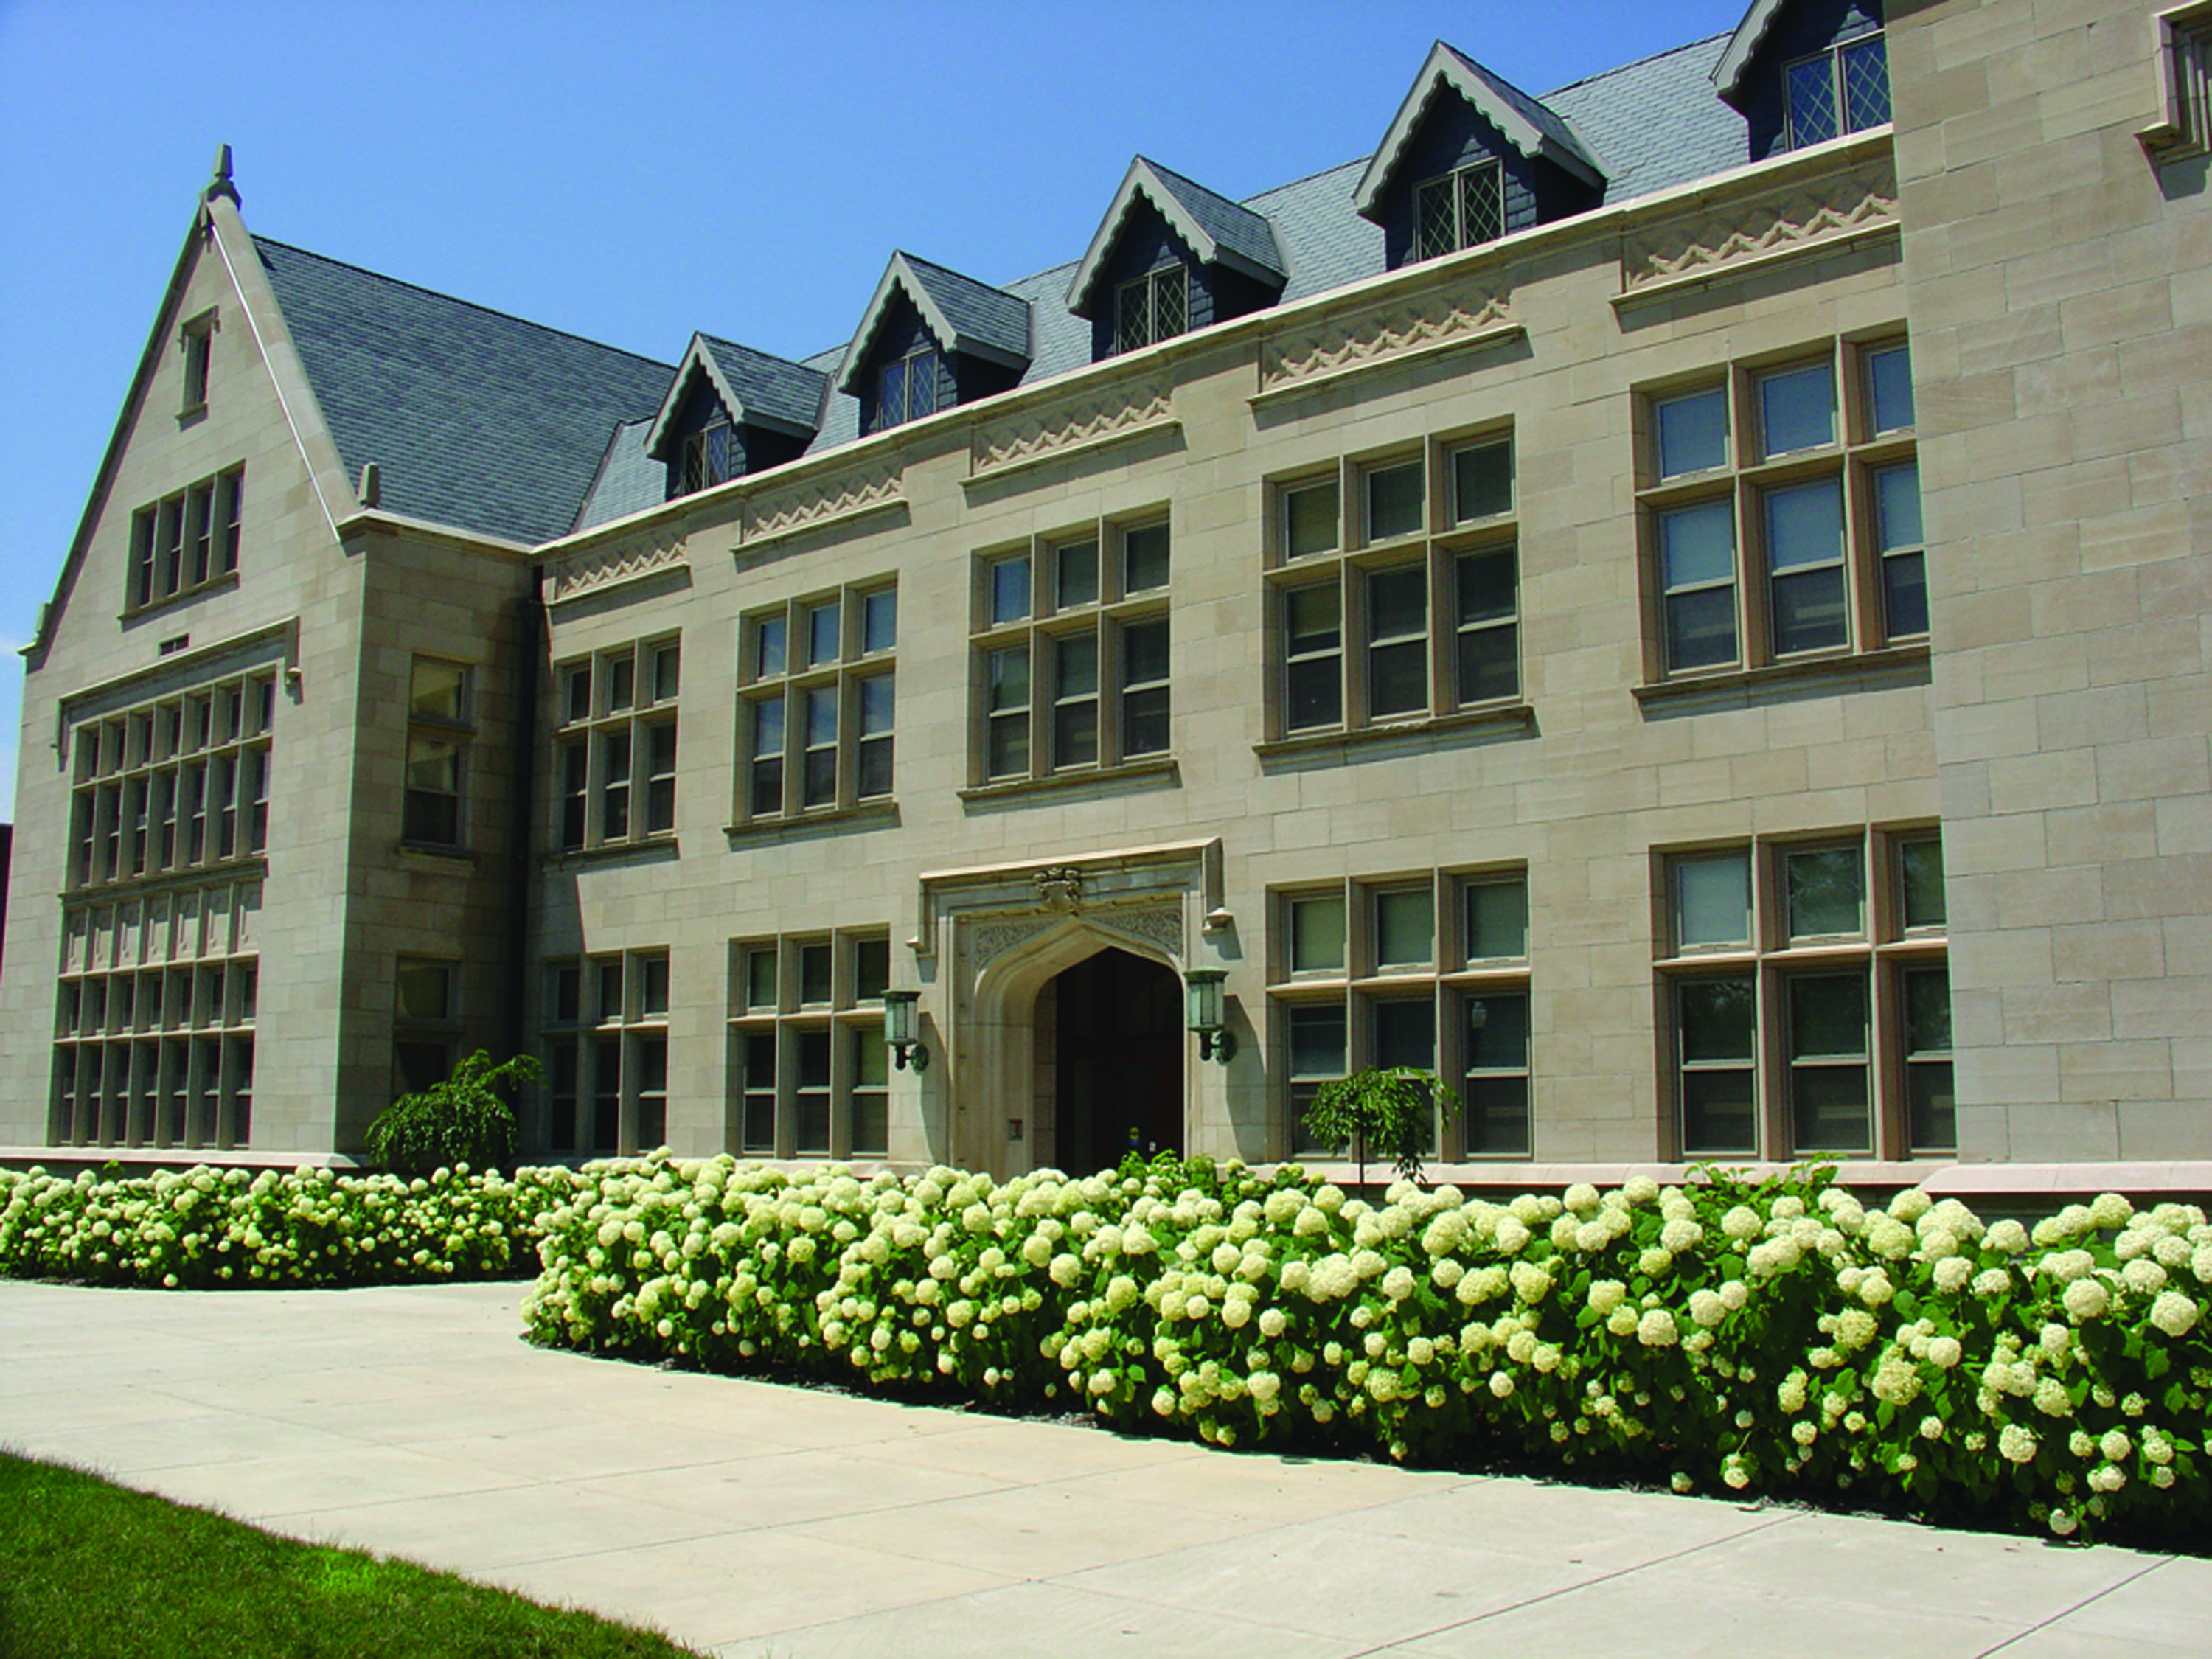
Questions
Fall 2014
Graduate Summit
Discussion

