Slide 1

Robert M. Augustine,
Ph.D., Dean
Fall 2012
Graduate Summit
Annual Enrollment Review

Slide 2

Fall 2012
Graduate Summit

Slide 3
Fall 2012
Graduate Summit

Slide 4
Fall 2012
Graduate Summit

Slide 5
Fall 2012
Graduate Summit
EIU | 2012 | 2011# | 2011 % | 2013 Goal | 2013 # | 2013 %
Degree | 1319 | -48 | -4% | 1400 | 81 | 6%
N-Degree | 171 | -26 | -13% | 200 | 29 | 17%
Total | 1490 | -74 | -5% | 1600 | 110 | 7%
Non Degree | 2012 | 2011# | 2011 % | 2013 Goal | 2013 # | 2013 %
NDG | 64 | -19 | -23% | 84 | 20 | 31%
SBS | 56 | 15 | 37 | 56 | 0 | 0%
PBT | 51 | -15 | -23% | 60 | 9 | 18%
ABS | 0 | -7 | -100% | 0 | 0 | 0%
Total | 171 | -26 | -13% | 200 | 29 | 17%

Slide 6
Fall 2012
Graduate Summit

Slide 7
Fall 2012
Graduate Summit

Slide 8
Fall 2012
Graduate Summit

Slide 9
Fall 2012
Graduate Summit

Slide 10
Fall 2012
Graduate Summit

Slide 11
Fall 2012
Graduate Summit

Slide 12
Fall 2012
Graduate Summit

Slide 13
Fall 2012
Graduate Summit

Slide 14
Fall 2012
Graduate Summit

Slide 15
Fall 2012
Graduate Summit
SCI Programs | 2012 | 2011# | 2011 % | 2013 Goal | 2013 # | 2013 %
MS BIO | 34 | 1 | 3% | 35 | 1 | 3%
MS CHM | 13 | 0 | 0 | 14 | 1 | 8%
MS CDS | 57 | 0 | 0 | 57 | 0 | 0%
OL CDS | 14 | 14 | 100% | 14 | 0 | 0%
MA ECN | 17 | -2 | -11% | 20 | 3 | 18%
MS GIS | 7 | 7 | 100% | 10 | 3 | 43%
MA MAT | 6 | -4 | -40% | 10 | 4 | 67%
MA PLS | 25 | 1 | 11% | 25 | 0 | 0%
MA PSY | 30 | 3 | 14% | 30 | 0 | 0%
SSP PSY | 24 | 3 | 6% | 25 | 1 | 4%
College | 229 | -13 | -4% | 240 | 11 | 6%

Slide 16
Fall 2012
Graduate Summit
SCI Summer | 2012 | 2011# | 2011 % | 2013 Goal | 2013 # | 2013 %
MA MAT E | 17 | -4 | -.19 | 21 | 4 | .25
MS NS | 25 | -5 | -.20 | 30 | 5 | .25

Slide 17
Fall 2012
Graduate Summit

Slide 18
Fall 2012
Graduate Summit

Slide 19
Fall 2012
Graduate Summit

Slide 20
Fall 2012
Graduate Summit

Slide 21
Fall 2012
Graduate Summit

Slide 22
Fall 2012
Graduate Summit

Slide 23
Fall 2012
Graduate Summit
LBAS Programs | 2012 | 2011# | 2011 % | 2013 Goal | 2013 # | 2013 %
MBA | 70 | -3 | -4% | 85 | 15 | 21%
MS FCS | 66 | -4 | -6 | 75 | 9 | 14%
MS DET | 29 | 2 | 7% | 29 | 0 | 0%
MA GER | 19 | -5 | -21% | 23 | 4 | 21%
MS SER | 4 | 4 | 0% | 10 | 6 | 150%
MS TEC | 133 | -6 | -4% | 133 | 0 | 0%
TEC-CR | 5 | 0 | 0% | 5 | 0 | 0%
College | 324 | -11 | -3% | 360 | 36 | 11%

Slide 24
Fall 2012
Graduate Summit

Slide 25
Fall 2012
Graduate Summit

Slide 26
Fall 2012
Graduate Summit

Slide 27
Fall 2012
Graduate Summit

Slide 28
Fall 2012
Graduate Summit

Slide 29
Fall 2012
Graduate Summit

Slide 30
Fall 2012
Graduate Summit

Slide 31
Fall 2012
Graduate Summit
EPS Programs | 2012 | 2011# | 2011 % | 2013 Goal | 2013 # | 2013 %
MS CSA | 46 | 6 | 15% | 46 | 0 | 0
MS COU | 70 | -3 | -4% | 75 | 5 | 7%
MSED EDL | 272 | -13 | -5% | 273 | 1 | .04%
EDS EDL | 81 | -17 | -17% | 82 | 1 | 1%
MSED ELE | 52 | -14 | -21% | 66 | 14 | 27%
ELE-CRT | 12 | 5 | 71% | 12 | 0 | 0%
MS KSS | 59 | -6 | -9% | 65 | 6 | 10%
MSED MT | 18 | -1 | -5% | 18 | 0 | 0%
MSED SPE | 12 | 0 | 0% | 13 | 1 | 8%
College | 623 | -44 | -7% | 650 | 27 | 4%

Slide 32
Fall 2012
Graduate Summit

Slide 33
Fall 2012
Graduate Summit

Slide 34
Fall 2012
Graduate Summit

Slide 35
Fall 2012
Graduate Summit

Slide 36
Fall 2012
Graduate Summit

Slide 37
Fall 2012
Graduate Summit

Slide 38
Fall 2012
Graduate Summit

Slide 39
Fall 2012
Graduate Summit
A&H Programs | 2012 | 2011# | 2011 % | 2013 Goal | 2013 # | 2013 %
MA ART | 9 | -7 | -44% | 12 | 3 | 33%
MA CMN | 26 | -2 | -7% | 30 | 4 | 15%
MA ENG | 41 | 3 | 8% | 41 | 0 | 0%
MA HIS | 33 | 0 | 0% | 33 | 0 | 0%
MA HHA | 21 | 1 | 5% | 21 | 0 | 0%
MA MUS | 13 | -1 | -7% | 14 | 1 | 8%
College | 143 | -16 | -4% | 151 | 8 | 6%
Program | 2012 | 2011 # | 2011 % | 2013 Goal | 2013 # | 2013 %
MA ART E | 2 | 0 | 0% | 6 | 4 | 200%

Slide 40
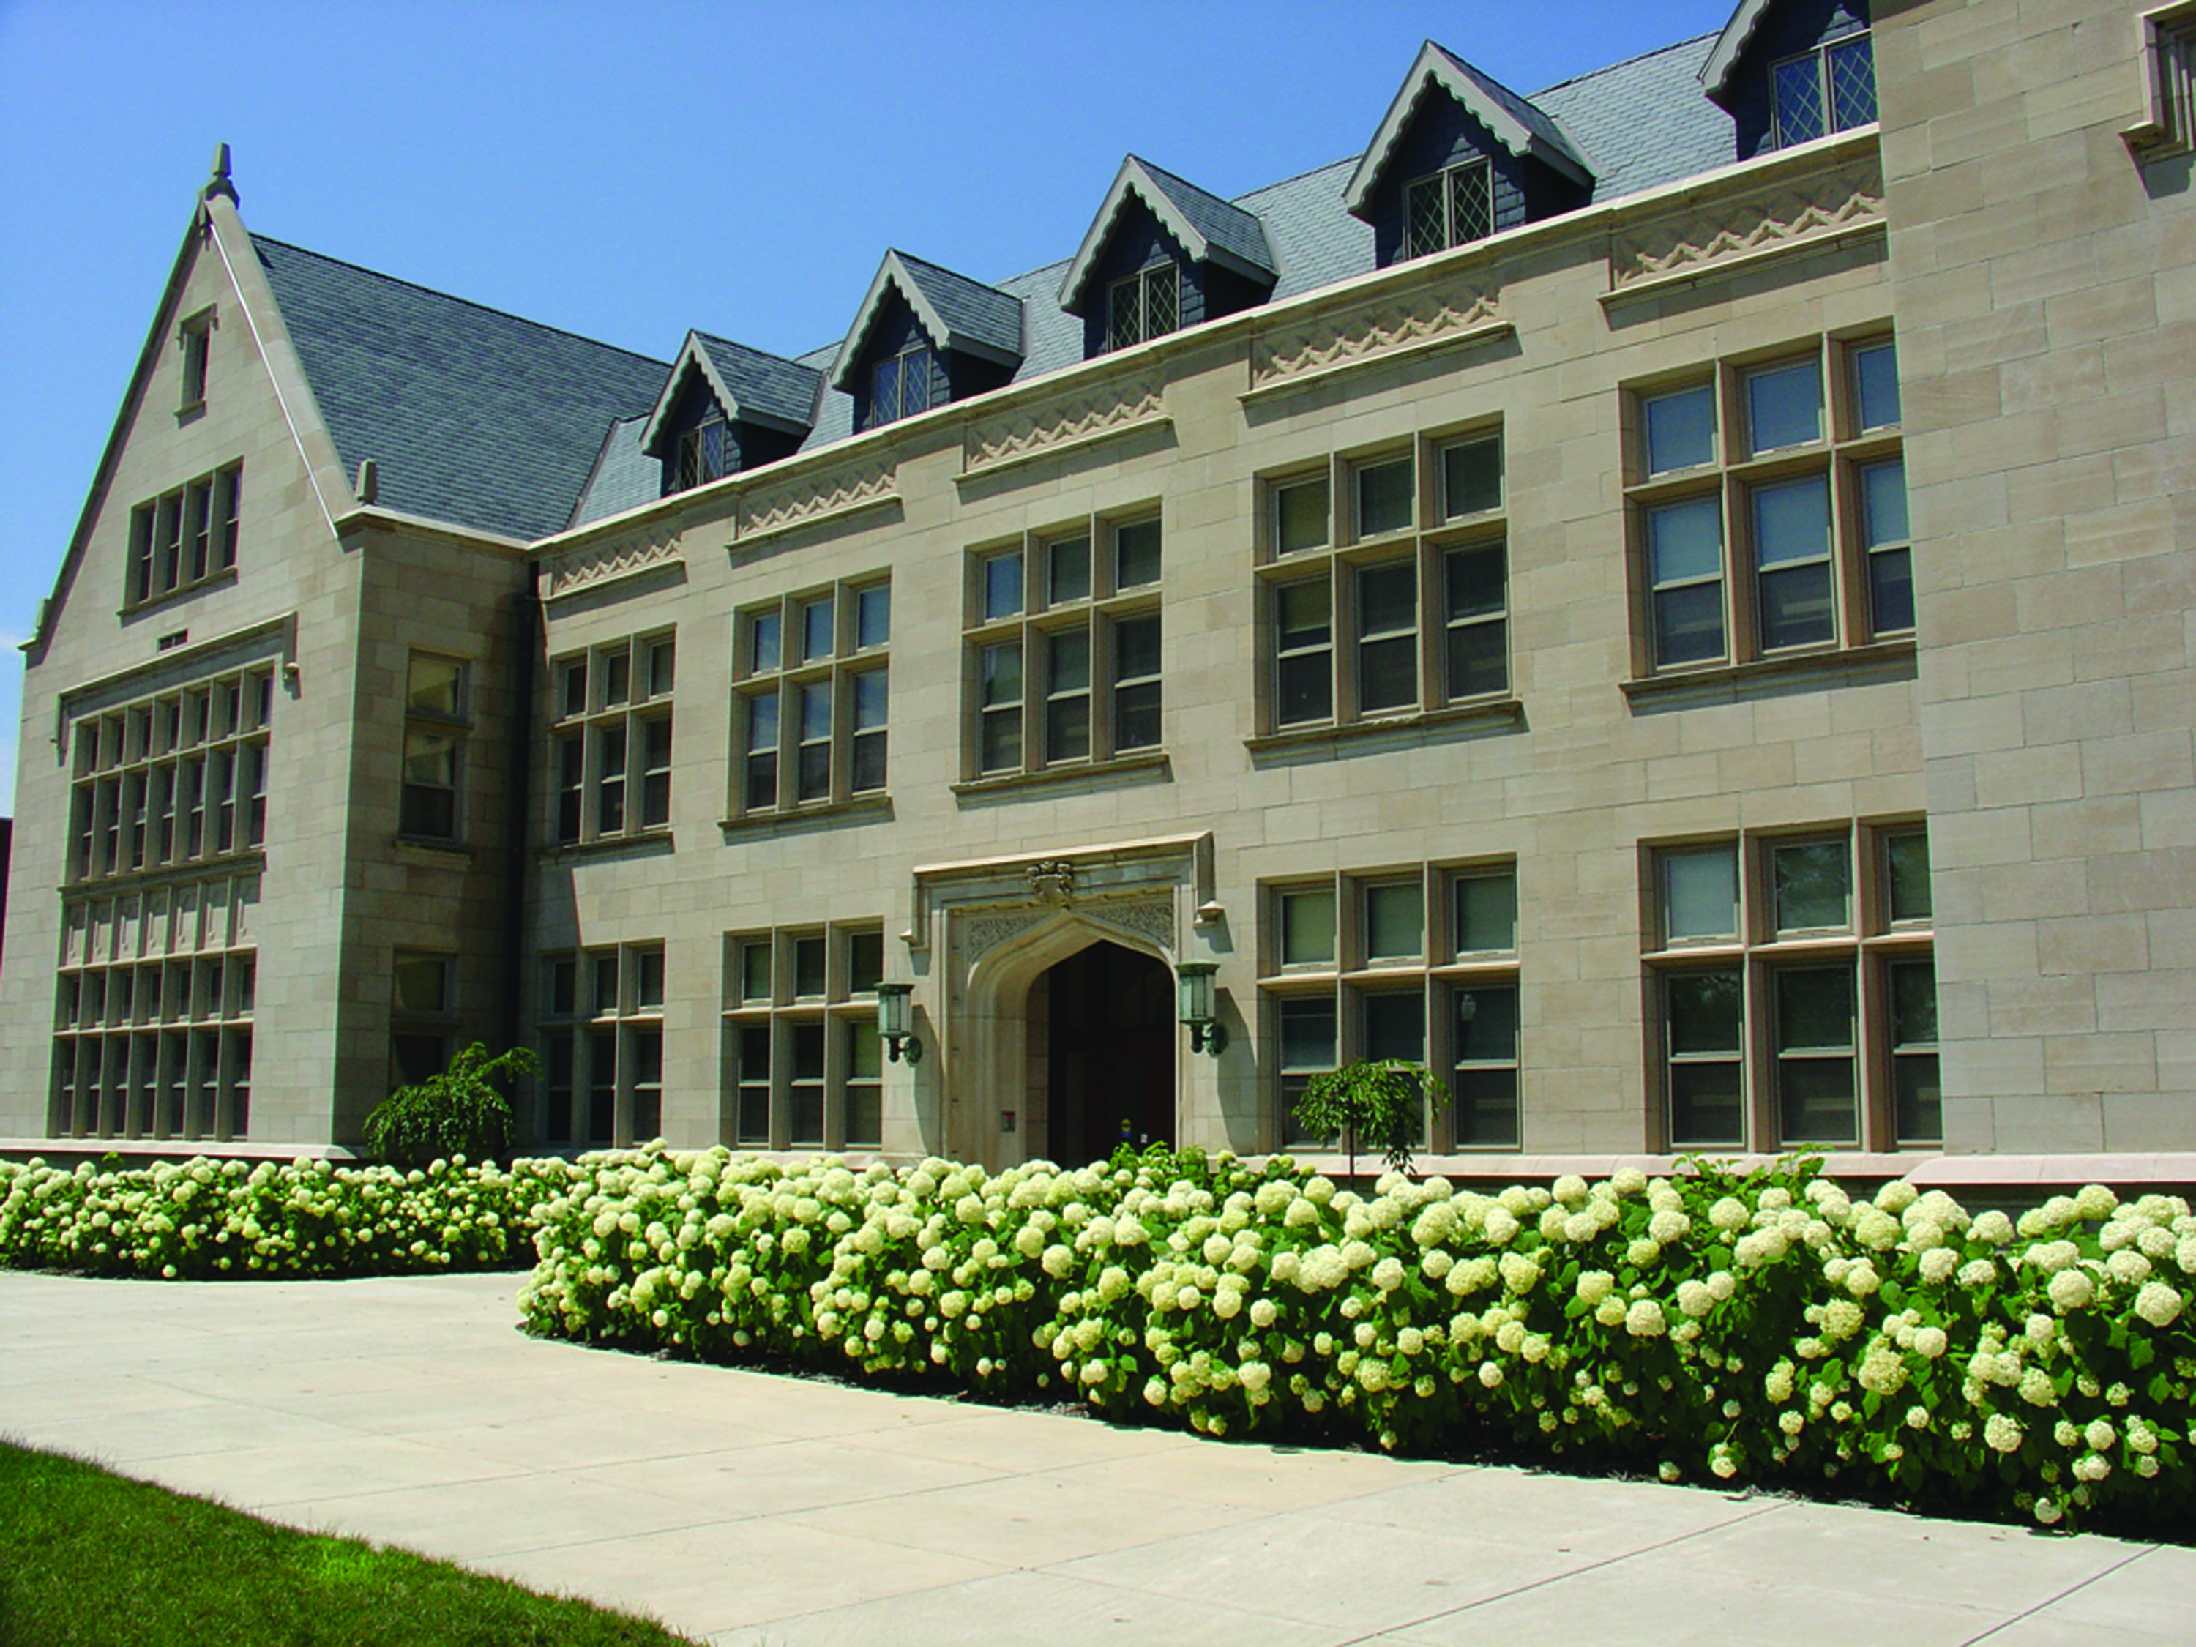
10:00 A.M.
October 19
3108 Blair Hall
MAGAP 2012
Summer Workshop
Graduate Recruitment Workshop

