Slide 1
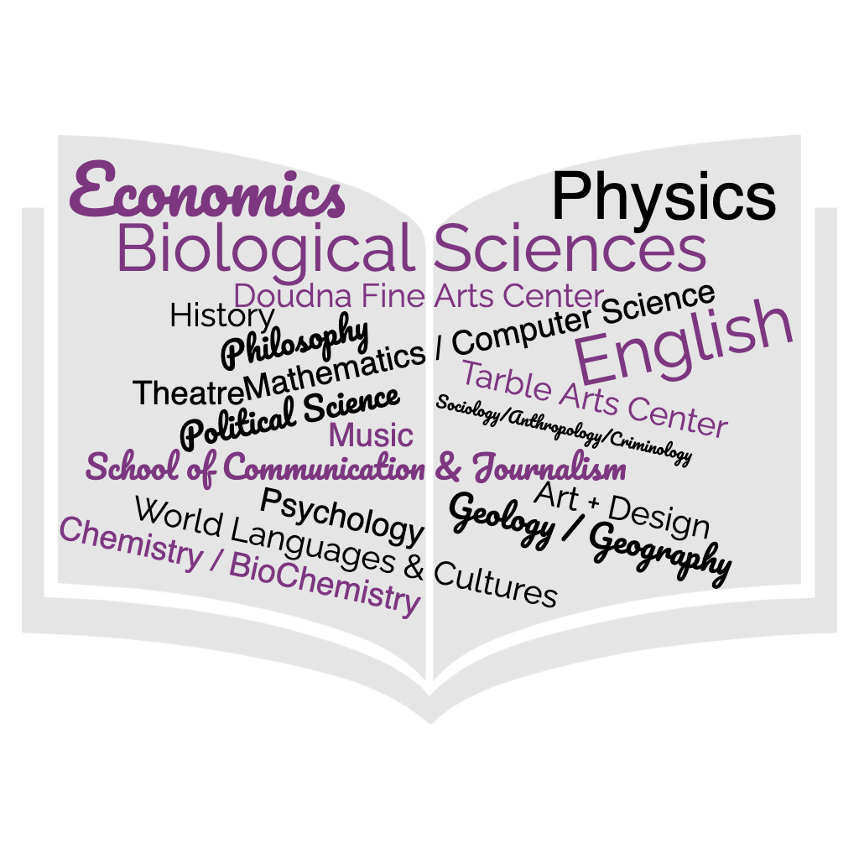
College of Liberal Arts & Sciences

Slide 2
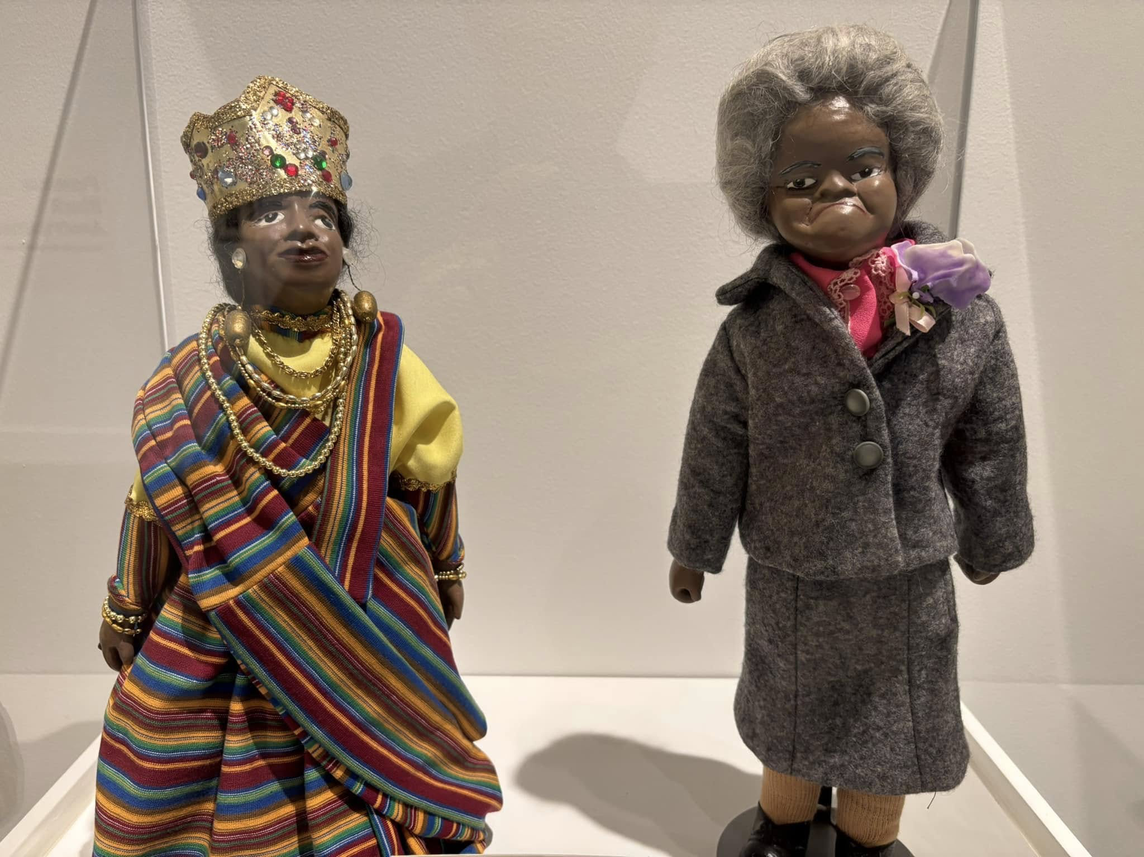
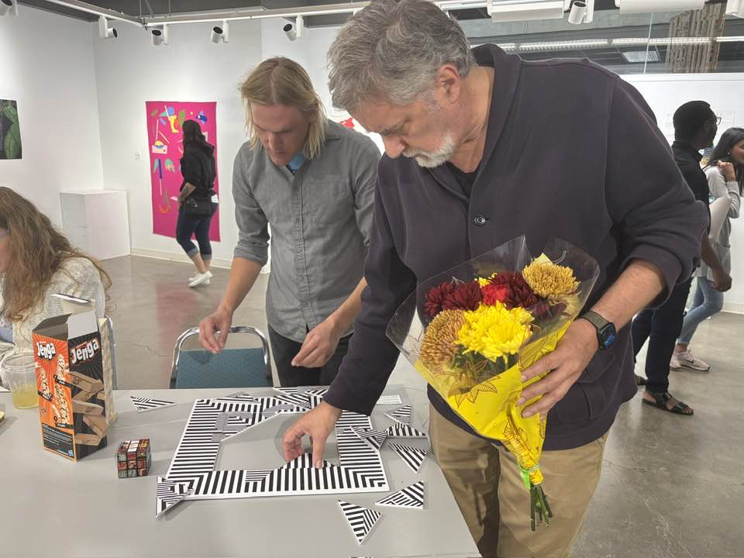
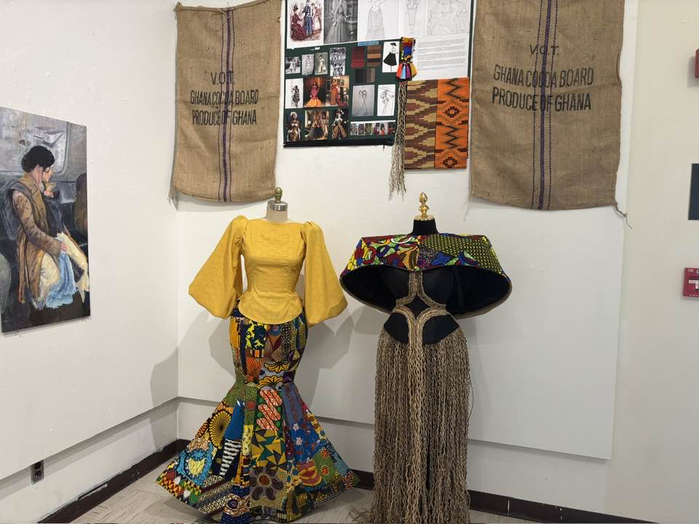
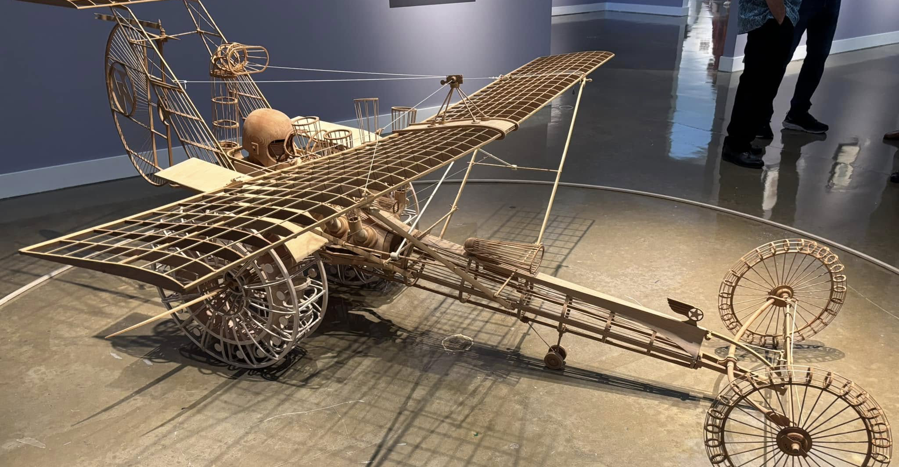
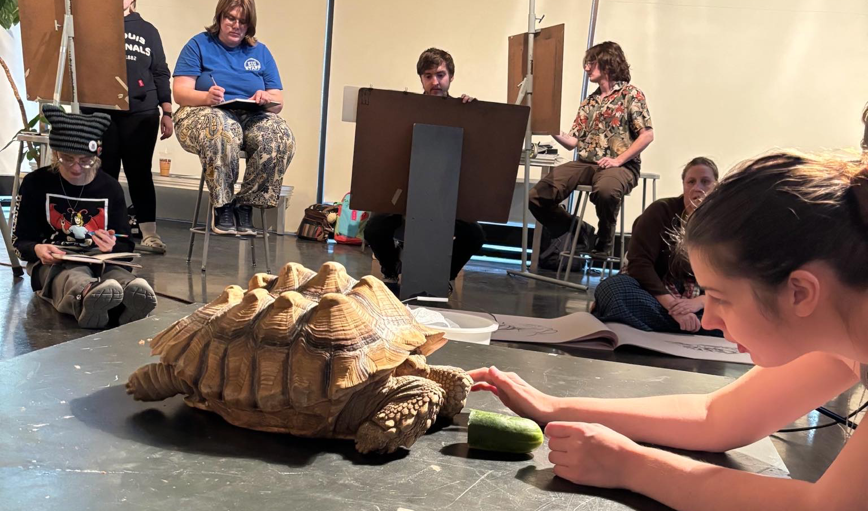
Art + Design and Tarble Art Museum

Slide 3
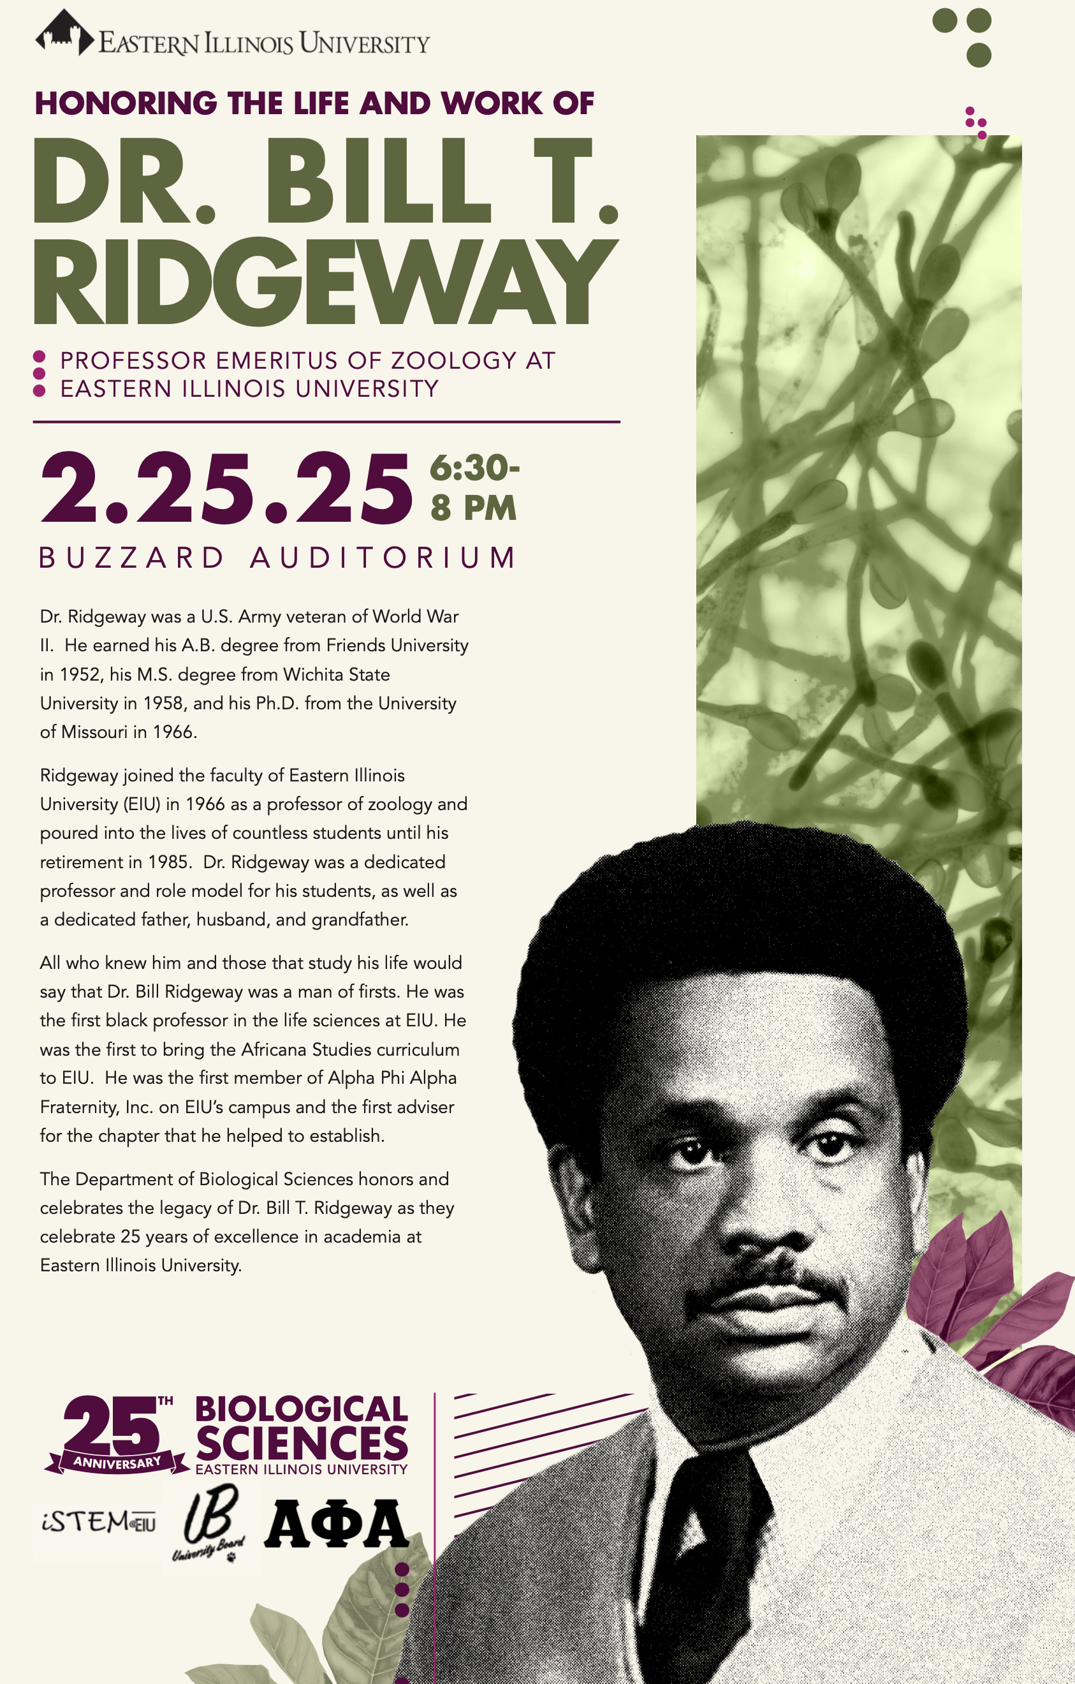
Biological Sciences
Several new and updated ecology and wildlife courses (from our new hires in this area – Drs. Amberleigh Henschen and Elizabeth Peterson)
New Science Building plans are being finalized with groundbreaking planned for late this year
  In collaboration with Chemistry & BioChemistry
Pre-Health student population remains very strong with several students admitted to top medical programs each year
Our department is celebrating our 25th anniversary after the merger of Botany and Zoology
During Black History Month we are posthumously celebrating our professor emeritus, Dr. Bill Ridgeway, who was the first black professor in our department and a true pioneer on our campus
External Connections:
  MOU with University of Illinois Chicago Herbert M. and Carol H. Retzky College of Pharmacy to offer a 3+4 pathway into the Doctor of Pharmacy program
  New pathways to certification from the American Fisheries Society and The Wildlife Society (these might become official concentrations under the Environmental Biology major)
  EIU’s new roll-out of Kaplan’s test preparation resources will be tremendously impactful for the professional development of our students
  We continue to administer 100s of thousands of dollars of state and federal grants, which help support our robust undergraduate and graduate research efforts

Slide 4

Economics
Dr. Linda Ghent published a 2nd edition of "Seinfeld and Economics: Lessons on Everything from the ‘Show about Nothing” and was celebrated at Authors@EIU.
Dr. Ahmed Abou-Zaid was awarded an FDIC grant to redesign ECN2801 Principles of Macroeconomics.
Andreea Chiritescu was awarded an FDIC grant to redesign ECN2802 Principles of Microeconomics.
Dr. James Bruehler is zealously advocating for an alternative grading scheme across campus.

Slide 5

English
New minor in Teaching English as a Second Language includes quite a few Gen Ed offerings, so students can start it early if they're interested.
ENG 2705G African American and Africana Literatures and ENG 2706G Latin American and Latinx Literatures (a) have only ENG 1001 as a prereq and (b) apply to the Africana and Latin American Studies minors. Open to both first- and second-year students. Students with dual credit for 1001 can jump in their first semester if they want.
World Languages & Cultures
The department received approval to charge course fees that will cover online workbooks starting Fall 2025
  this will decrease the costs to the students!
American Sign Language next offering Fall 2026
Online Spanish 1101 & 1102 not open to first year students

Slide 6
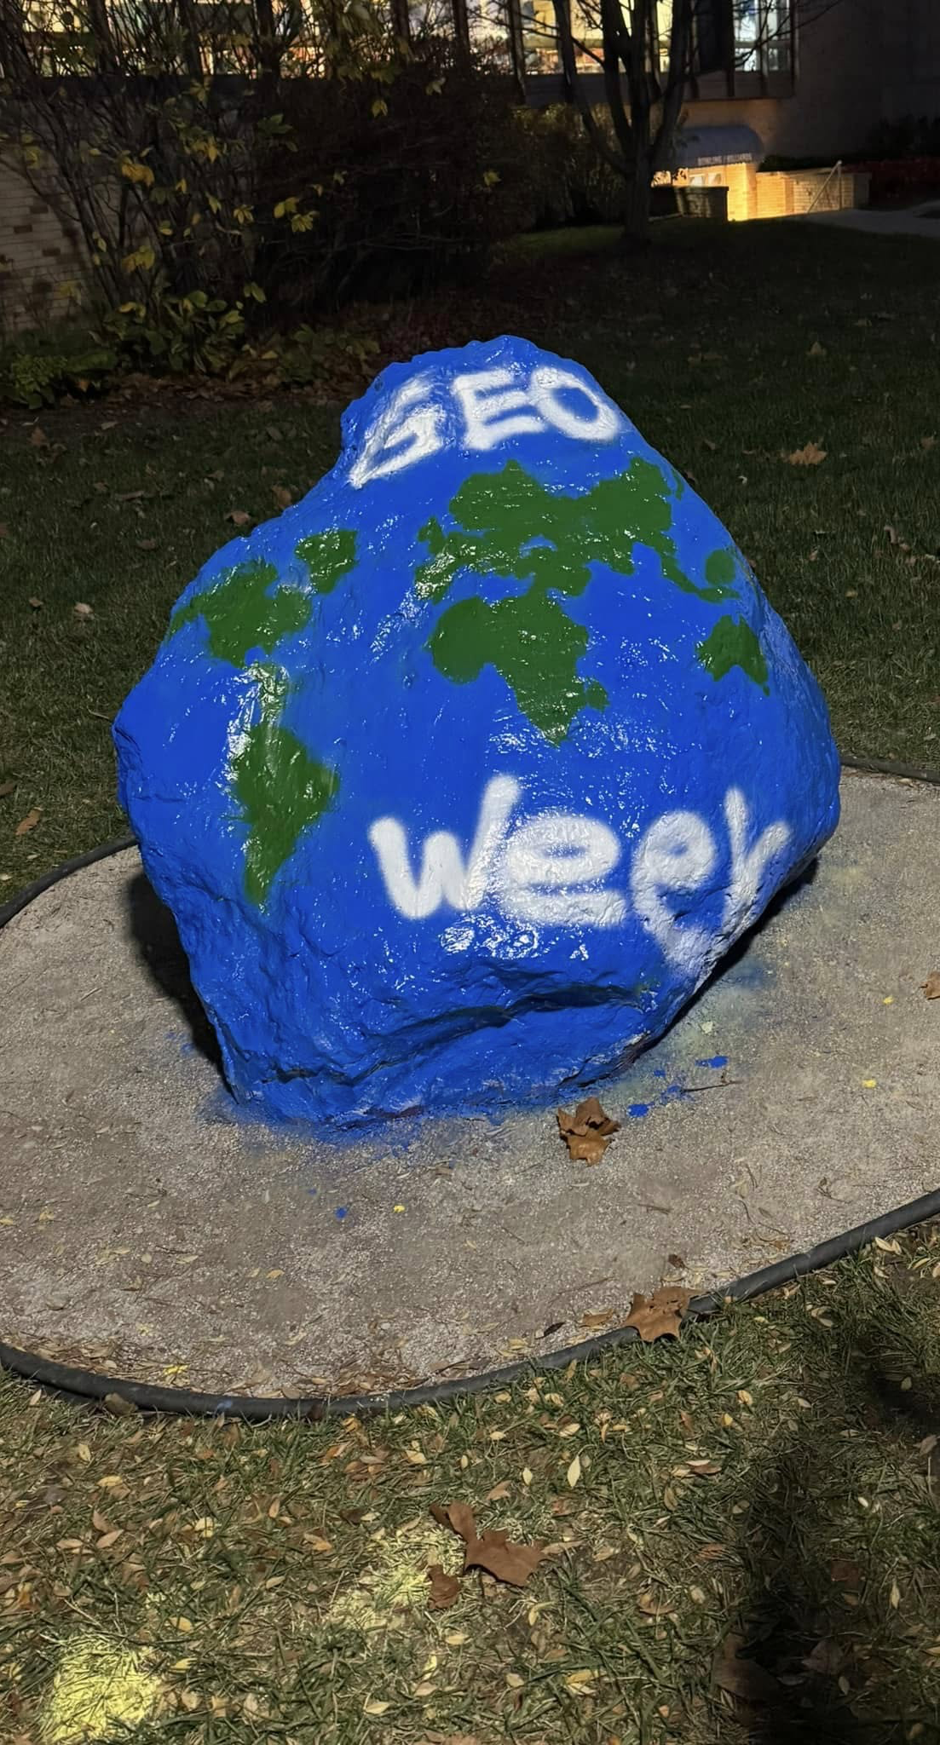
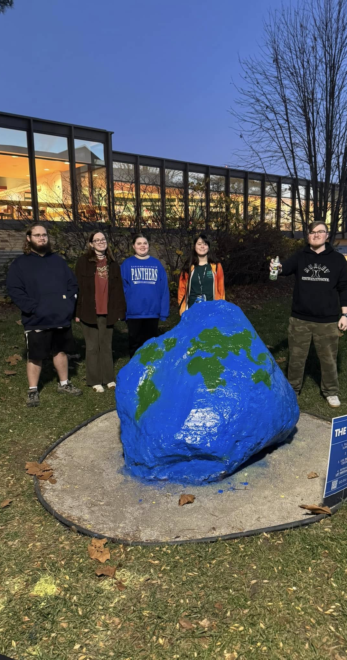
GEO (Geology & Geography)
First annual Summer Learning Experience will be sponsored by GTU national honor society this May. Drs. Viertel and Davis will be leading a 3 week field trip on historic Route 66 this May.
Students continue to receive internship opportunities locally, nationally, and internationally.
Dr. Jake Crandall continues to work on research funded by NASA
Broadcast Meteorology program was recognized by the National Weather Service for over 15 years of weather observations

Slide 7
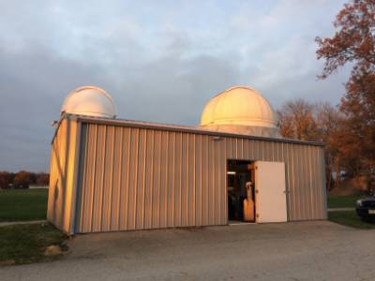
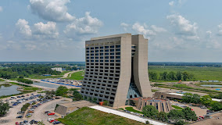
Physics / Electrical Engineering
Mathematics / Computer Science
Astronomy News: We replaced the dome on the Observatory this year. The shiny new dome will be linked with the telescope and the new weather station so that the Observatory can be operated remotely and safely (not yet ready but soon).
Physics News:
  We installed 2 beam parts from Fermi Lab that are on permanent display in the Physical Sciences Building. These items were part of the Fermi Lab Accelerator where groundbreaking experiments on particle physics earned a Nobel Prize.
  We now have a large endowment fund that gives us enough scholarship money to distribute to most of the Physics majors at EIU. While we don’t expect to do this every year, last year we gave 3 of our majors $10,000 each in scholarship money.
Engineering News: the new Computer Engineering degree was approved by IBHE!
  In collaboration with Mathematics / Computer Science
Fermi National Accelerator Laboratory, Batavia, IL

Slide 8
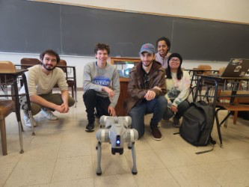
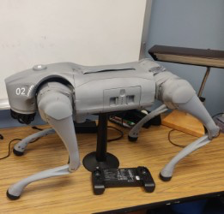
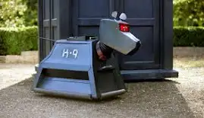
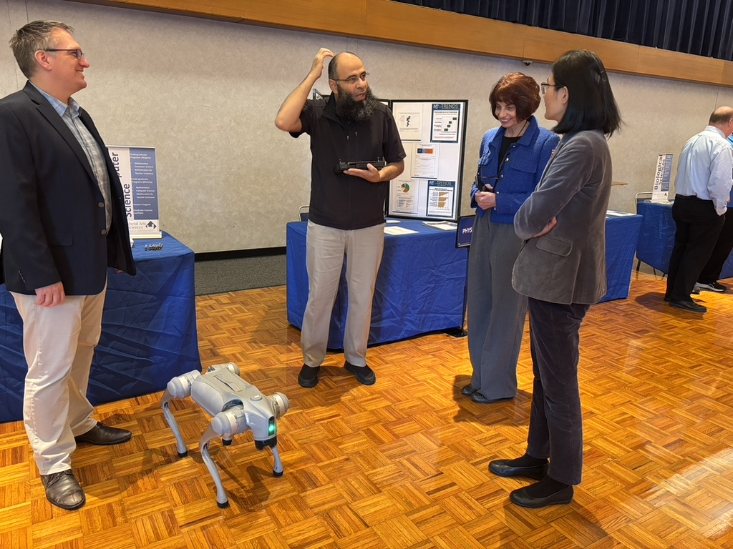
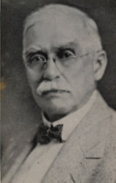
Computer Science got a new puppy!
The K9 Livingston (Unitree Go 2) is a next-generation quadruped robot designed for versatility, agility, and intelligence. K9 Livingston features advanced AI-driven capabilities, and enhanced mobility. It is equipped with a high-performance motor, 5D LiDAR for navigation, and voice interaction, making it suitable for various applications, including research, security, inspection, and personal assistance.
With its autonomous obstacle avoidance and high-speed movement, K9 Livingston can traverse complex environments with ease. It also supports custom programming via open-source SDKs, allowing developers to extend its functionality. K9 Livingston is a significant step forward in quadruped robotics, offering a blend of affordability and high-end performance.
Dr. Abdul Moh’d
Livingston C. Lord, First EIU President

Slide 9

Political Science
The Interdisciplinary Minor in Civic & Nonprofit Leadership has been approved for Fall 2025
This is a major reworking of what had been an internal minor within Political Science.
The new minor involves 11 departments and will focus on nurturing state and local leaders in the public and non-profit sectors.

Slide 10
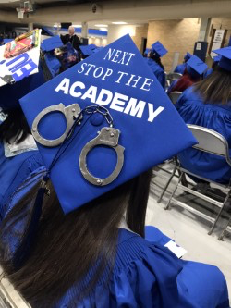
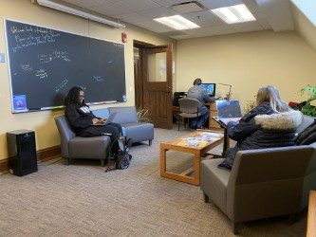
Sociology / Anthropology / Criminology
Faculty searches in
  Criminology
  Social Work
    In collaboration with the College of Health and Human Services

Slide 11
Theatre
Brought in four guest artists to design/direct aspects of our mainstage season and brought in four guest lectures for departmental workshops in the 24-25.
Produced six One-Acts that were written, directed, designed, performed, and executed by EIU Undergrad and Grad Students in the 24-25 season.
Will provide two current undergraduate students the opportunity to direct full productions in the 25-26 Departmental Season.

Slide 12
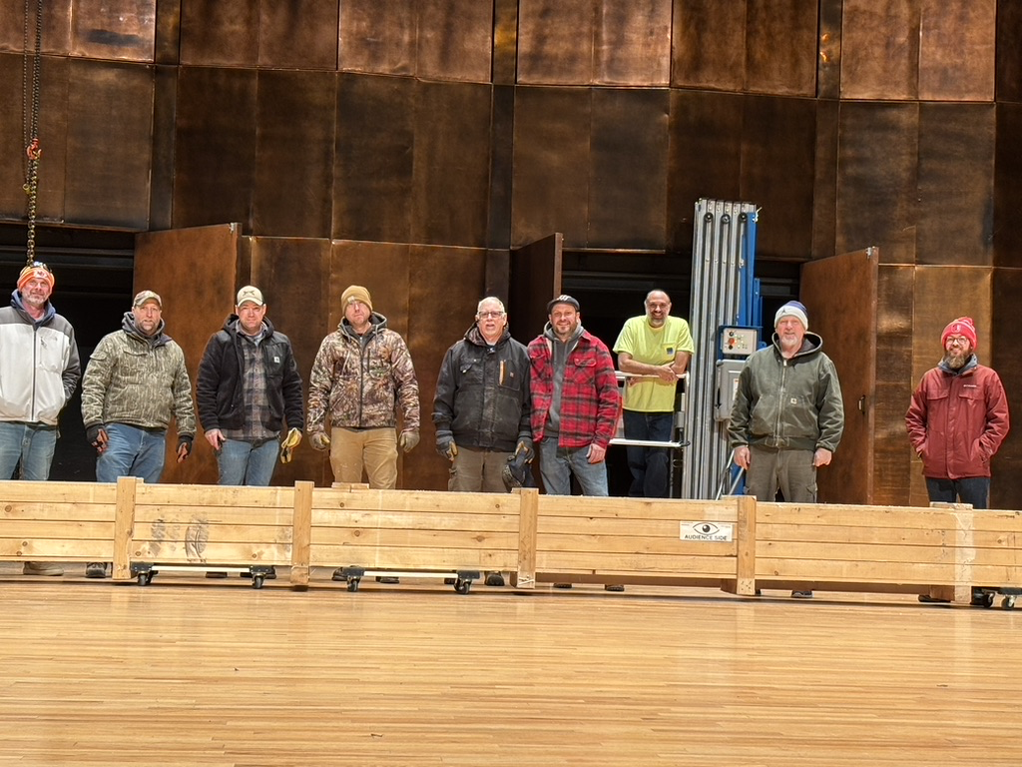
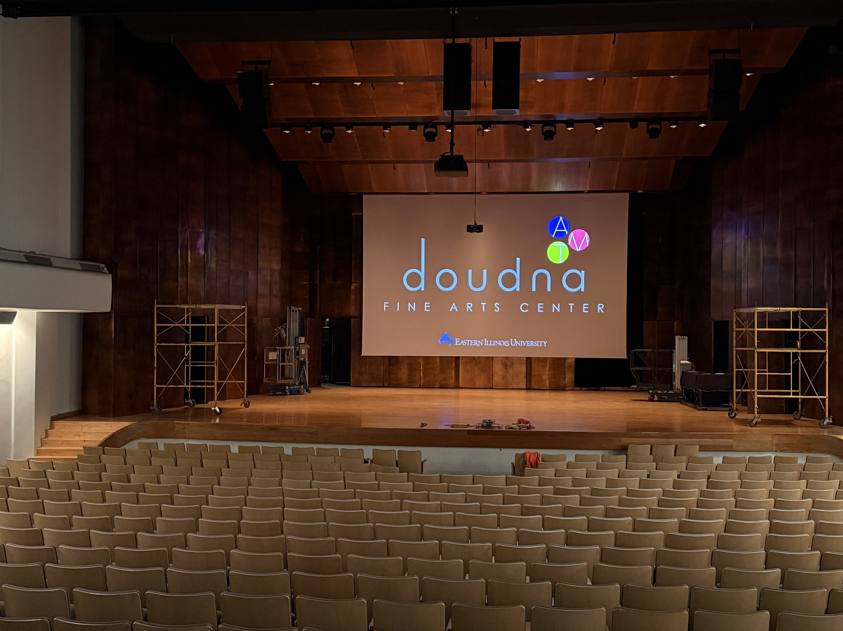
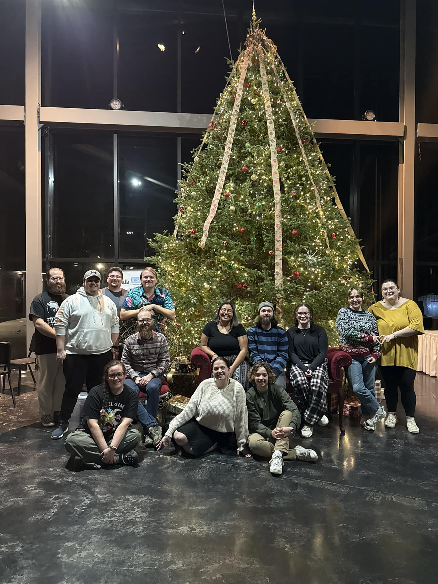
Doudna Big News – the Dvorak got a new screen!

Slide 13
And finally:
Thank you for all you do!
A video with all updates as of September 2024 is available at https://www.eiu.edu/clas/news.php
Our interdisciplinary programs are at https://www.eiu.edu/clas/interdisciplinary.php

