Slide 1
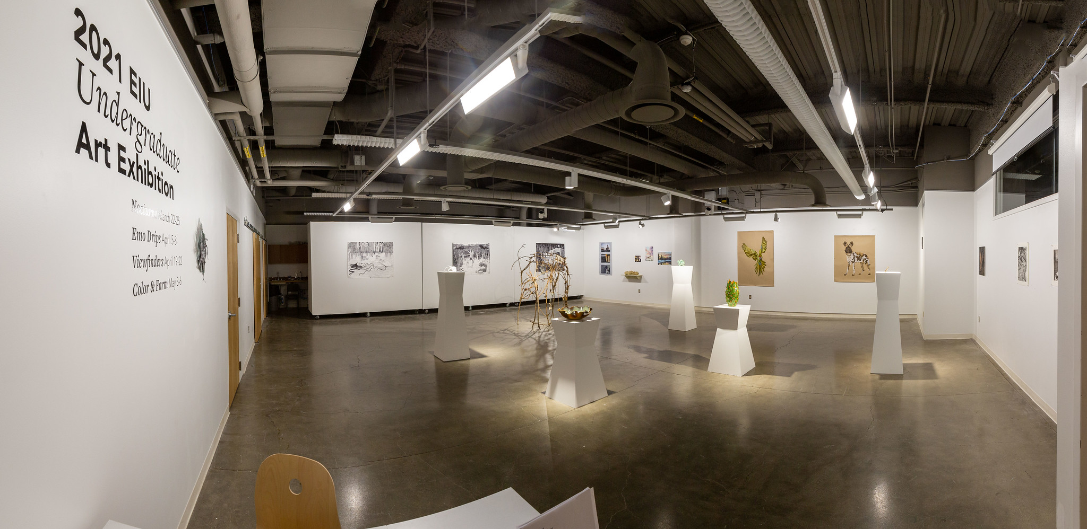
2021 EIU All-Student Show
Department of Art + Design
Awards

Slide 2
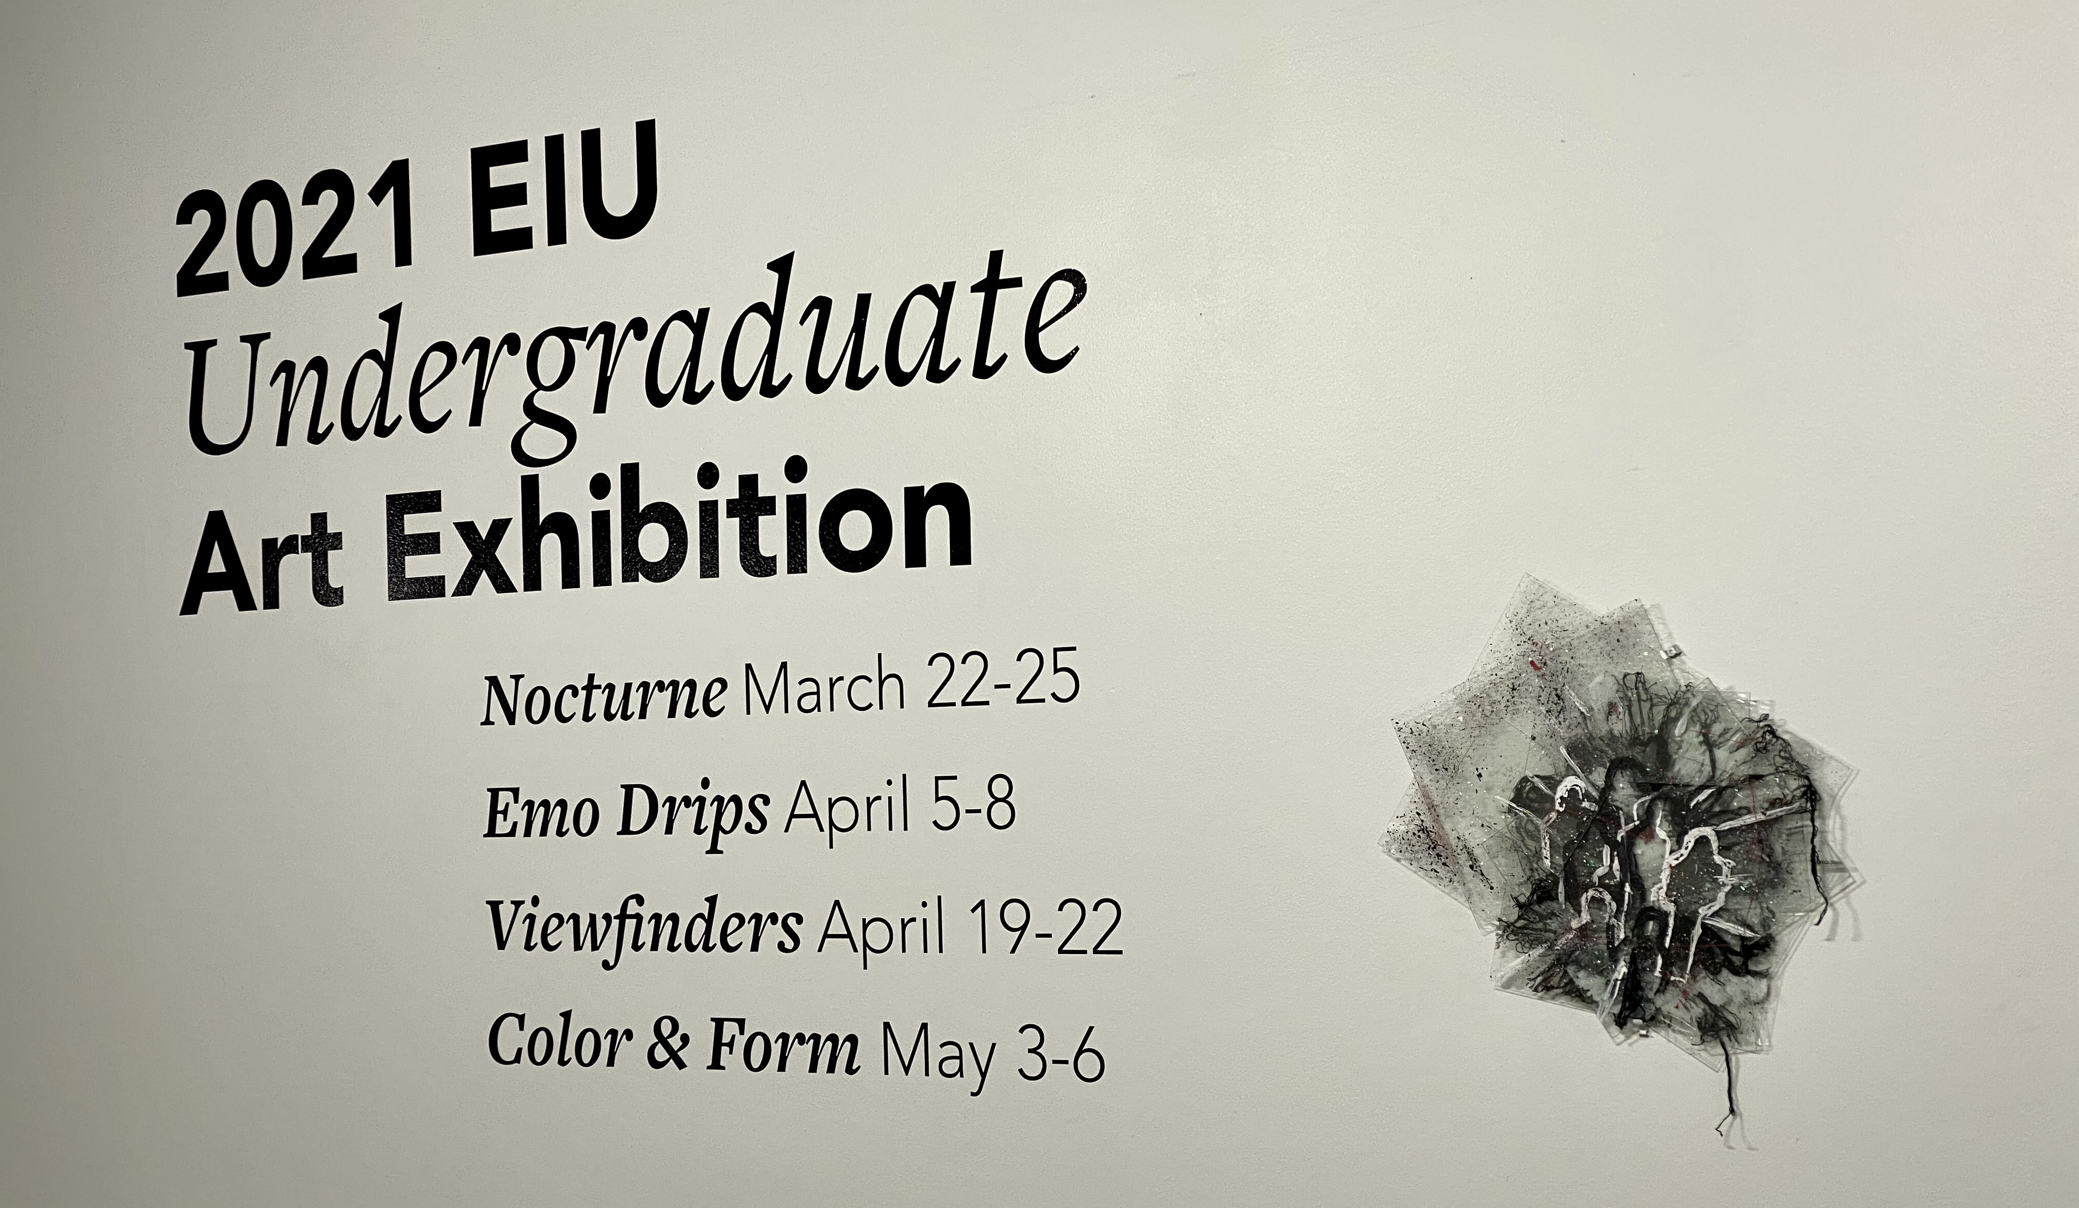
Congratulations to all the participating Artists!
On behalf of the faculty, we are so proud of our students and all their hard work this year. Special thanks goes to the Director, Jennifer Seas and Assistant Director, Mike Schuetz of the Tarble Arts Center for their curatorial vision of putting together four exhibitions displaying all the works juried into this year’s show.
The works were curated into these four shows: 1 – Nocturne 2 – Emo Drips 3 – Viewfinders 4 – Color & Form

Slide 3
We encourage you all to go to the following website to view and download pictures from each of the shows: https://www.flickr.com/photos/iameiu/albums/72157718784220383

Slide 4
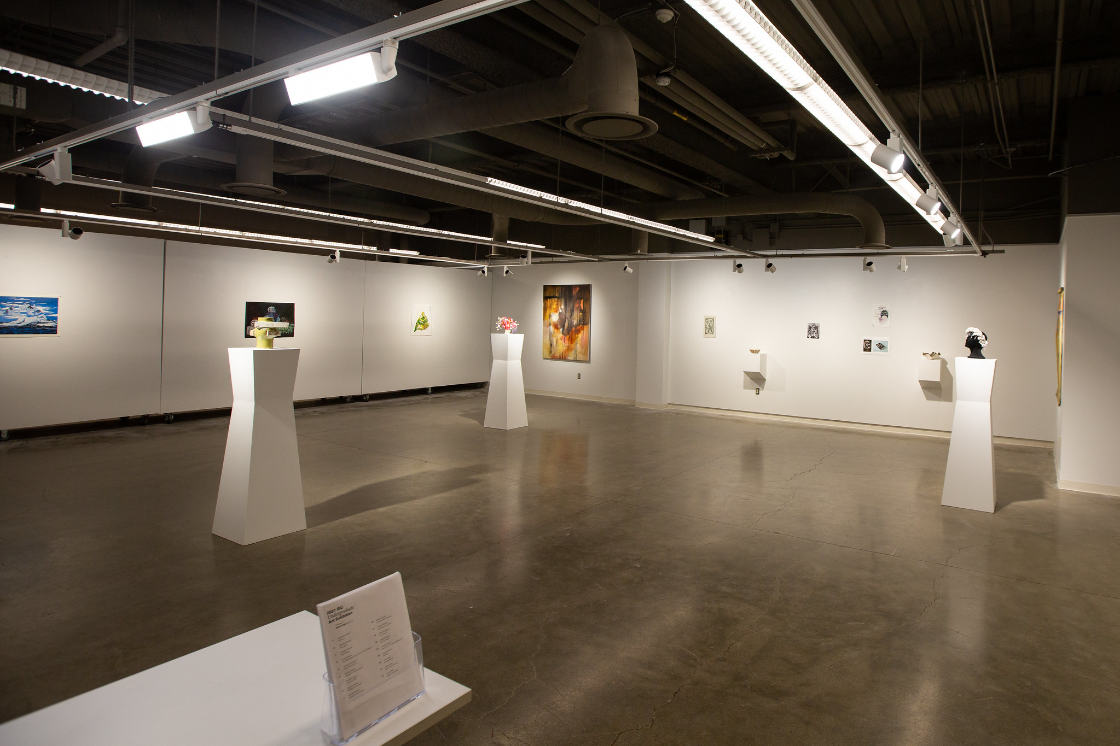
Exhibition Awards

Slide 5
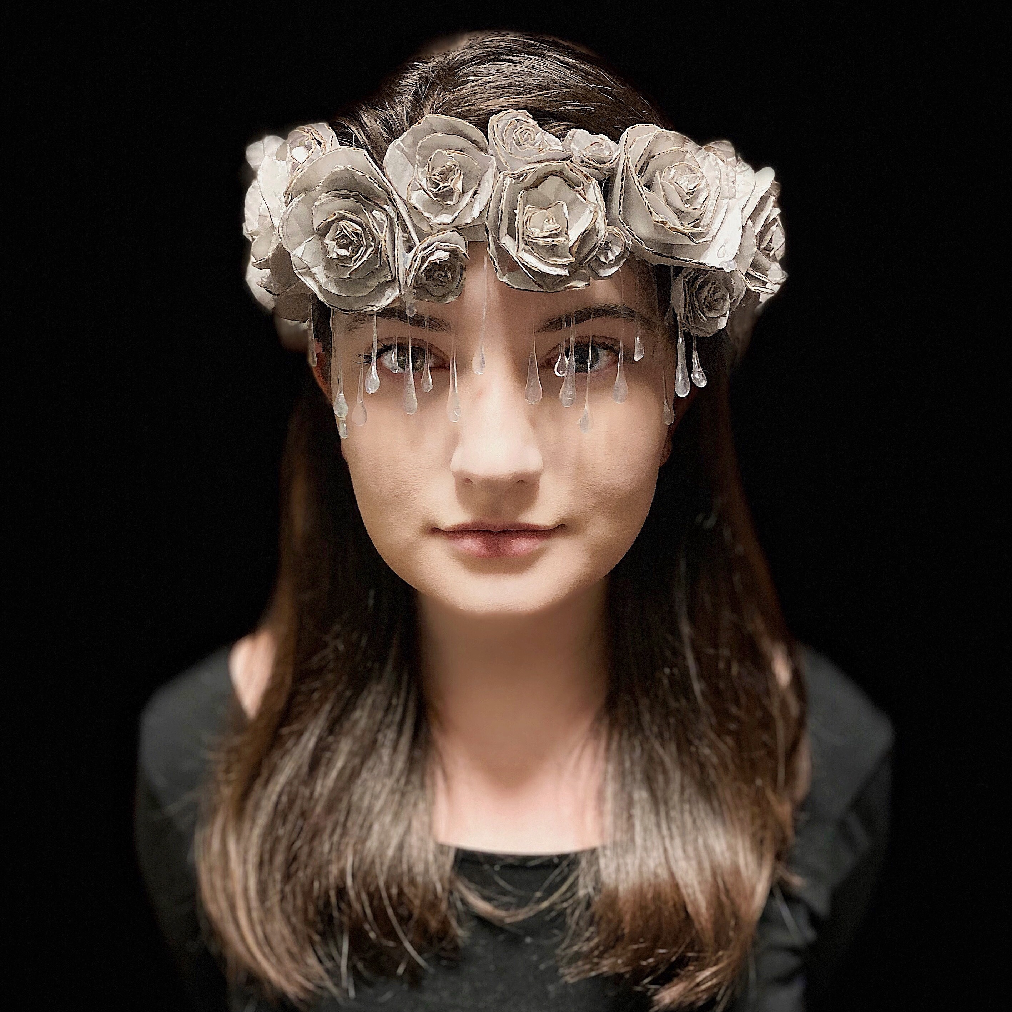
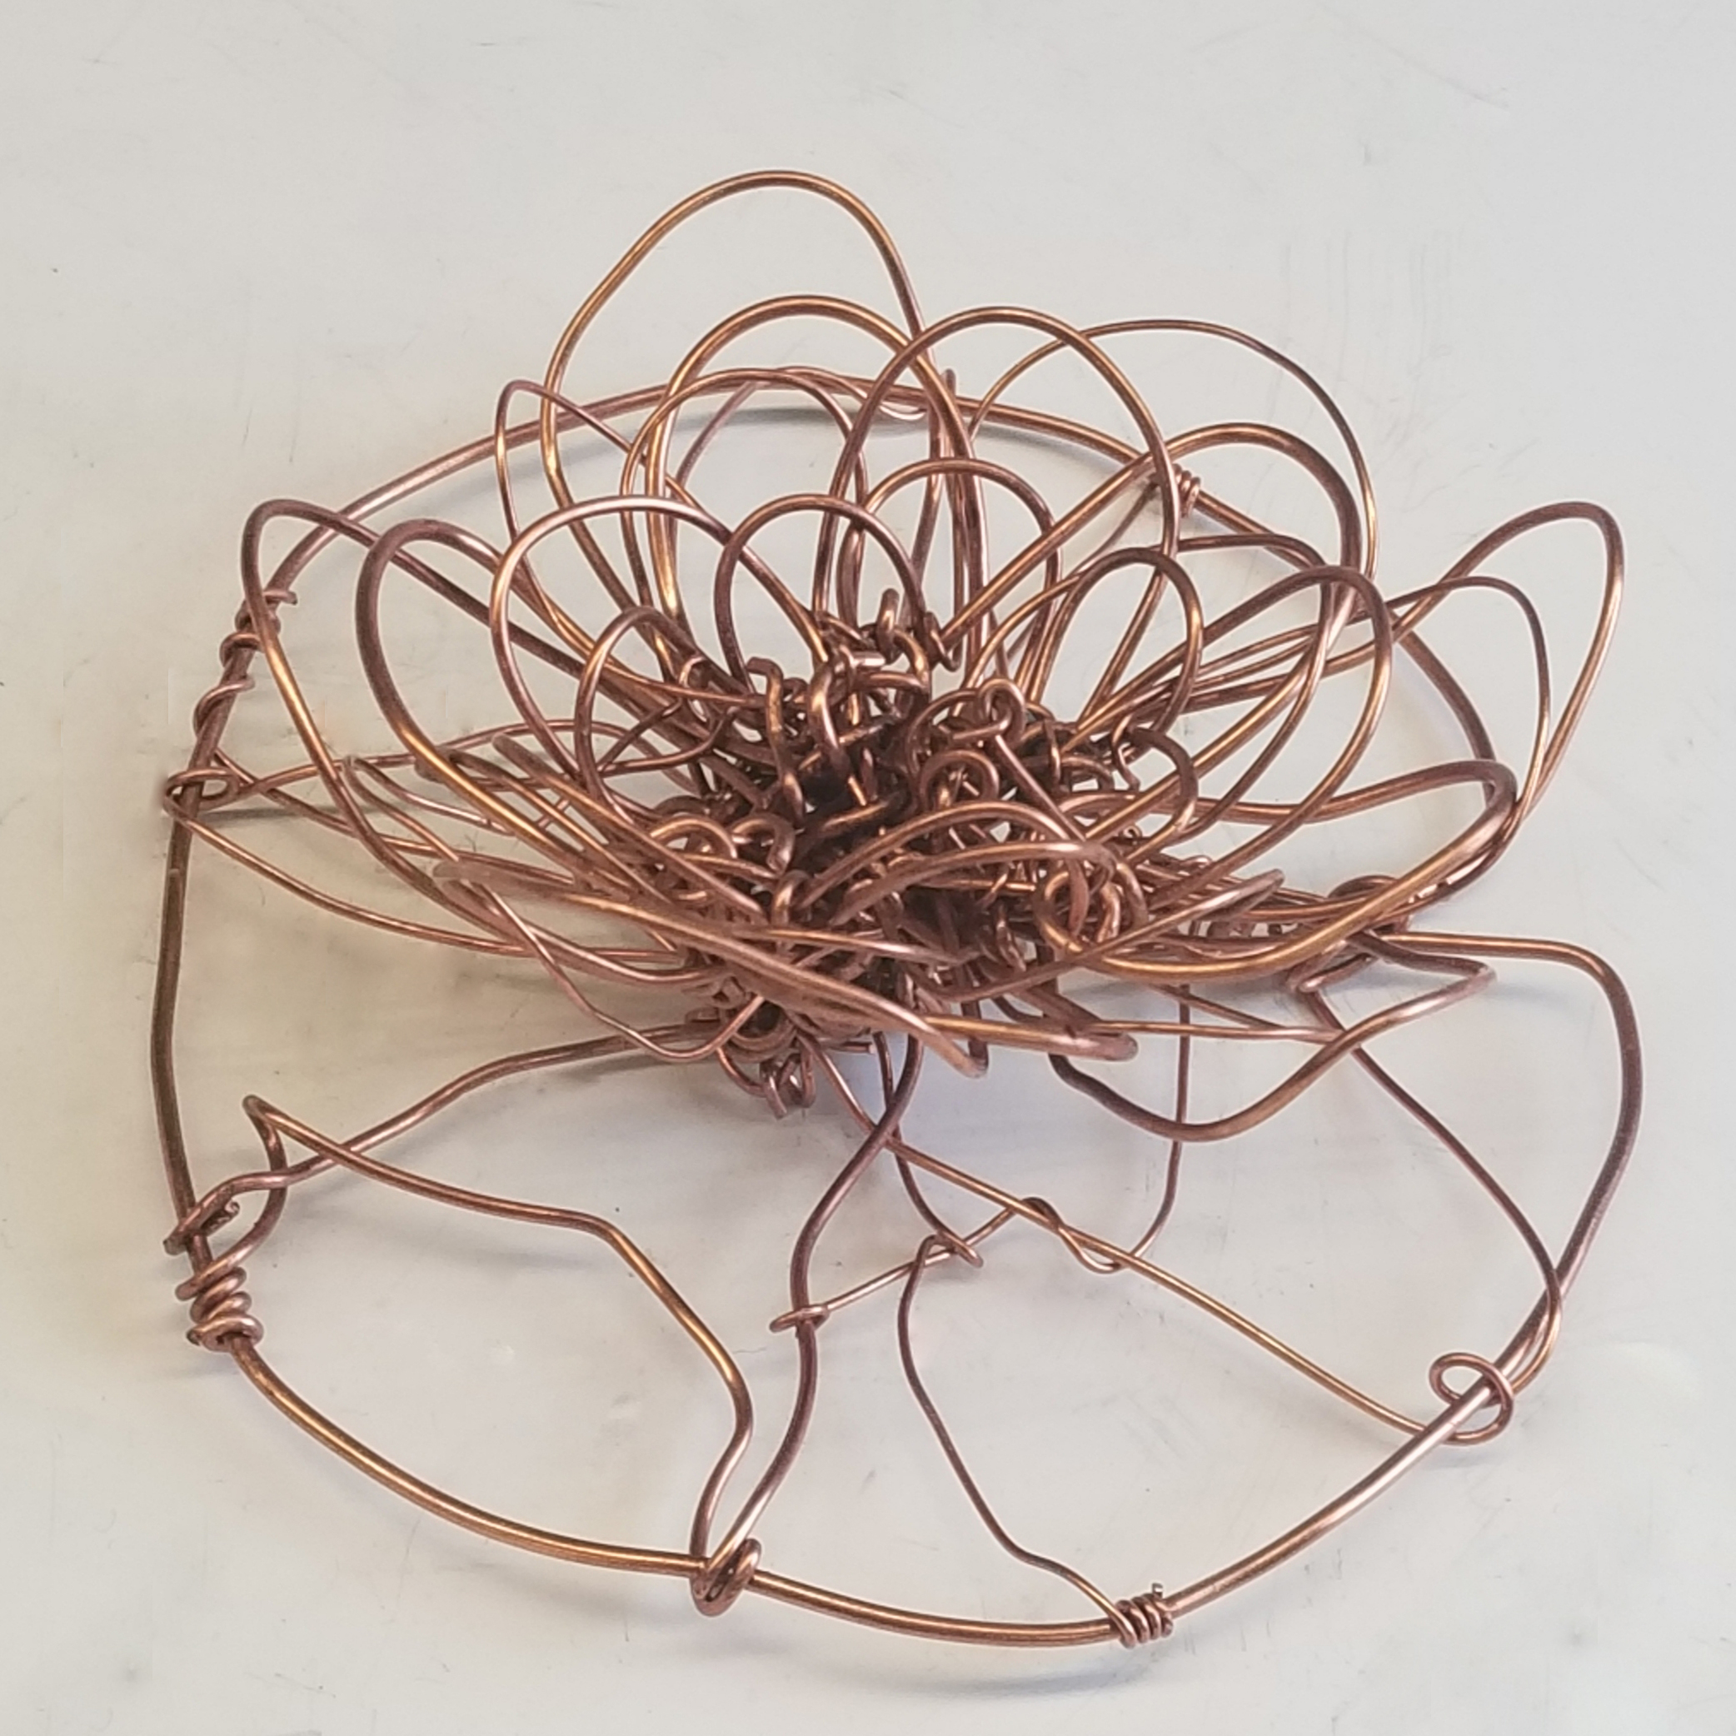
Honorable Mention
2D & 3D Foundations
Crying Beauty by Eva Weber
Water Lilly by Rachel Mette

Slide 6
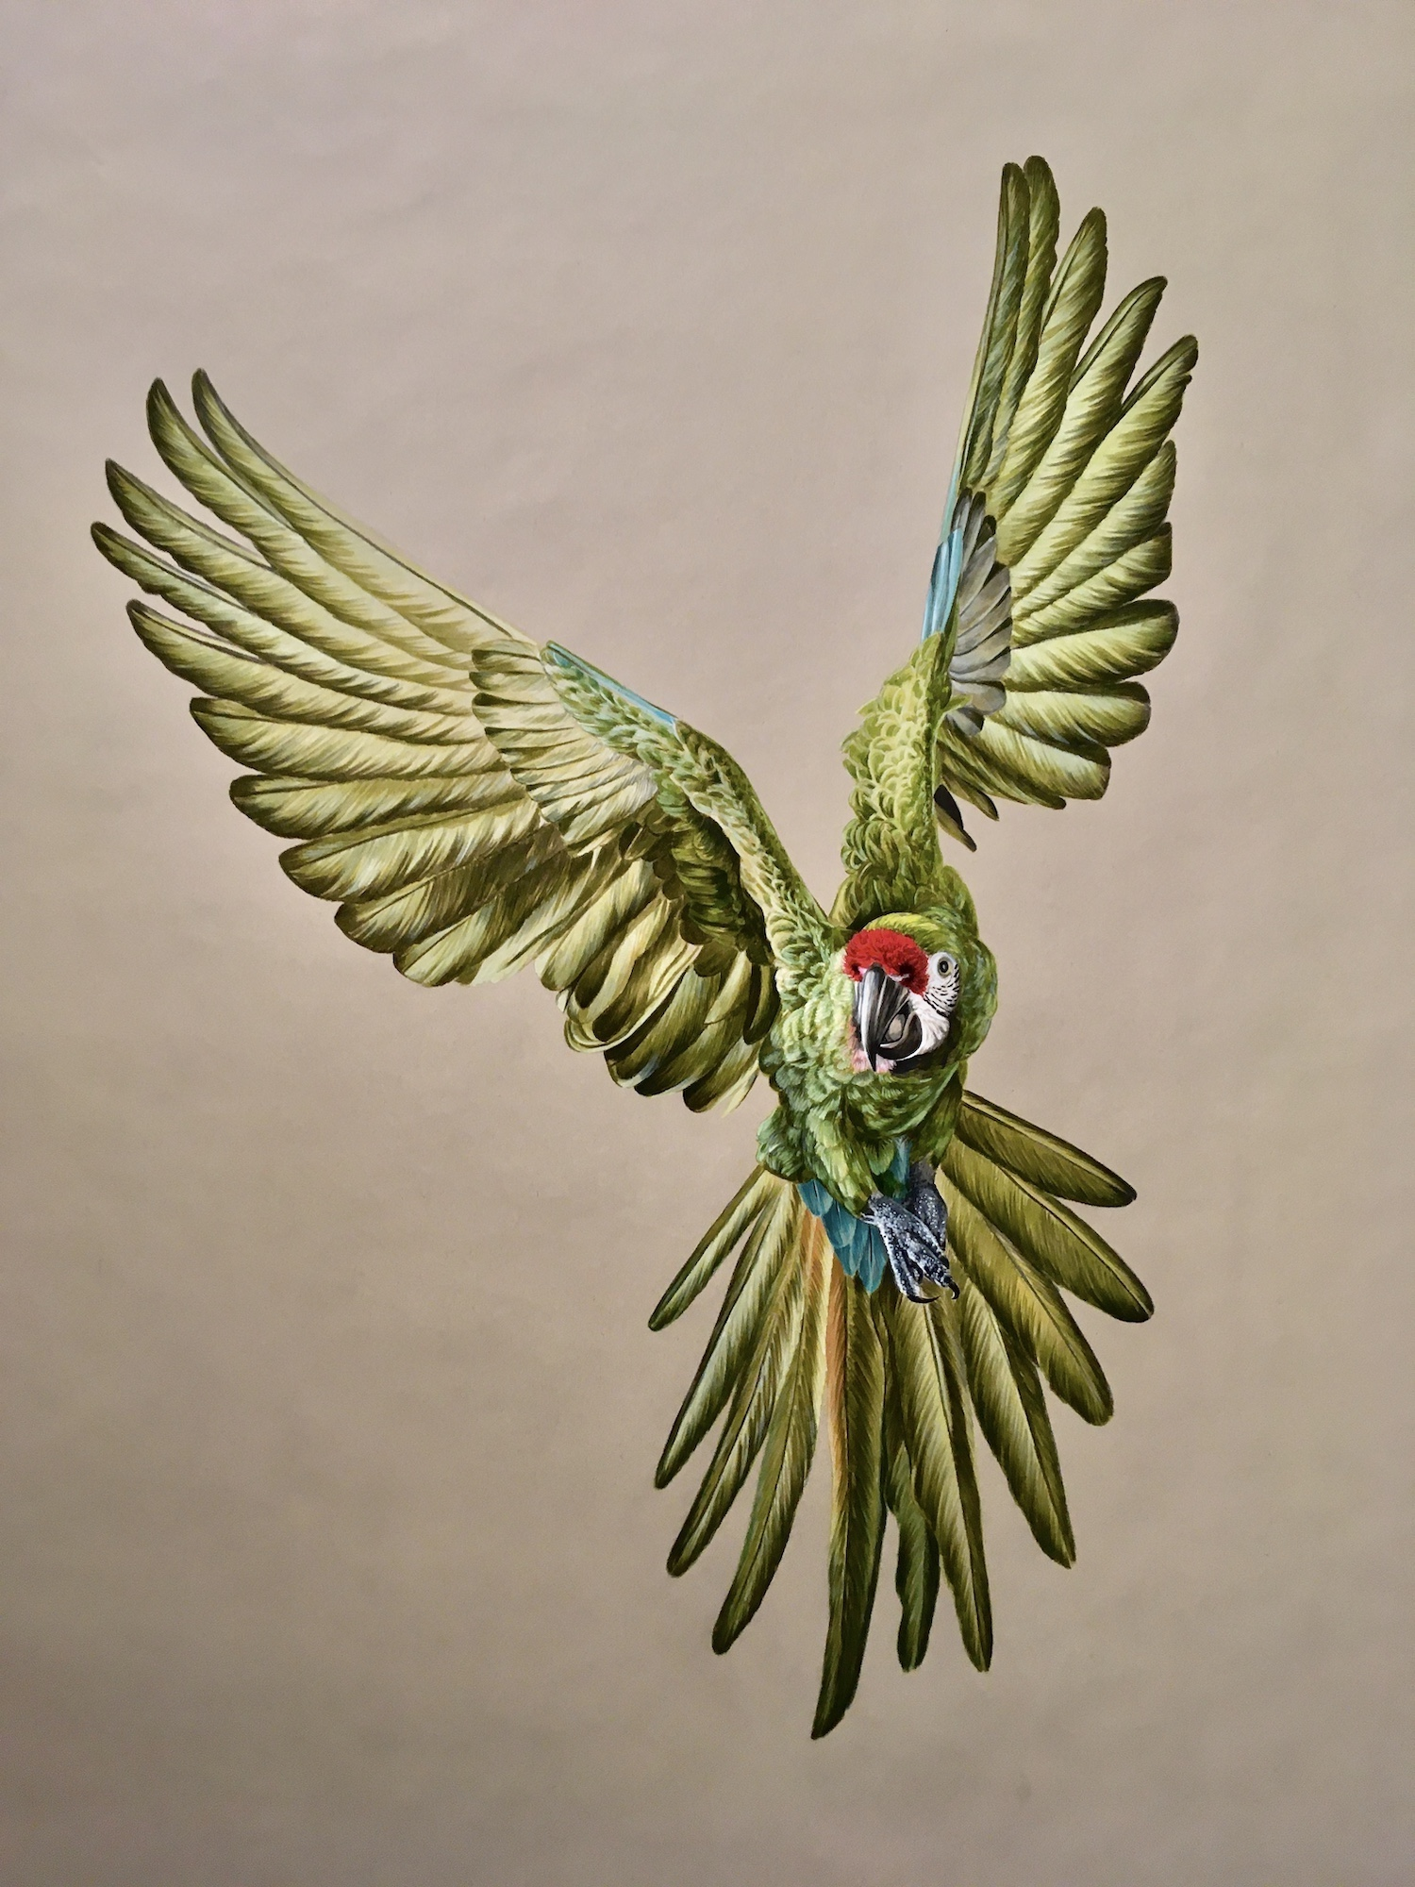
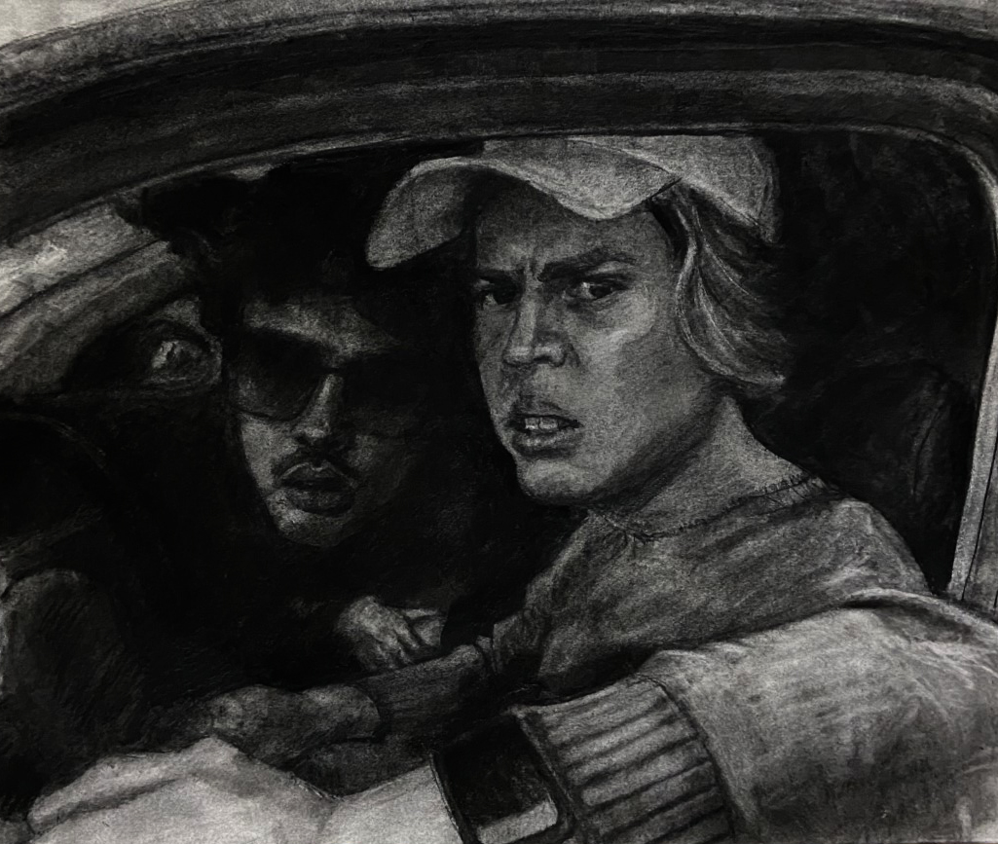
Honorable Mention
Advanced Drawing
Ara Militaris by Anna Brown
Judgement’s Throne by Zachary Berger

Slide 7
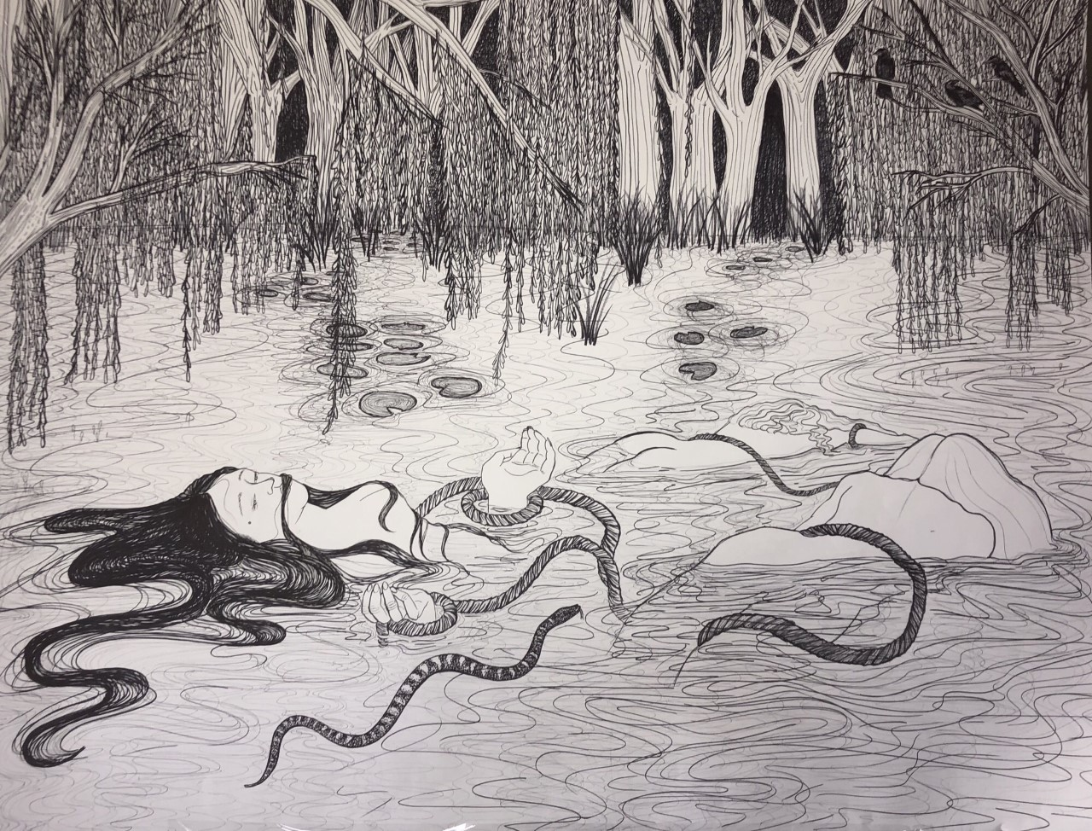
Honorable Mention
Advanced Drawing
Women of the Woods Woe, Part 3 by Lilly Ames

Slide 8
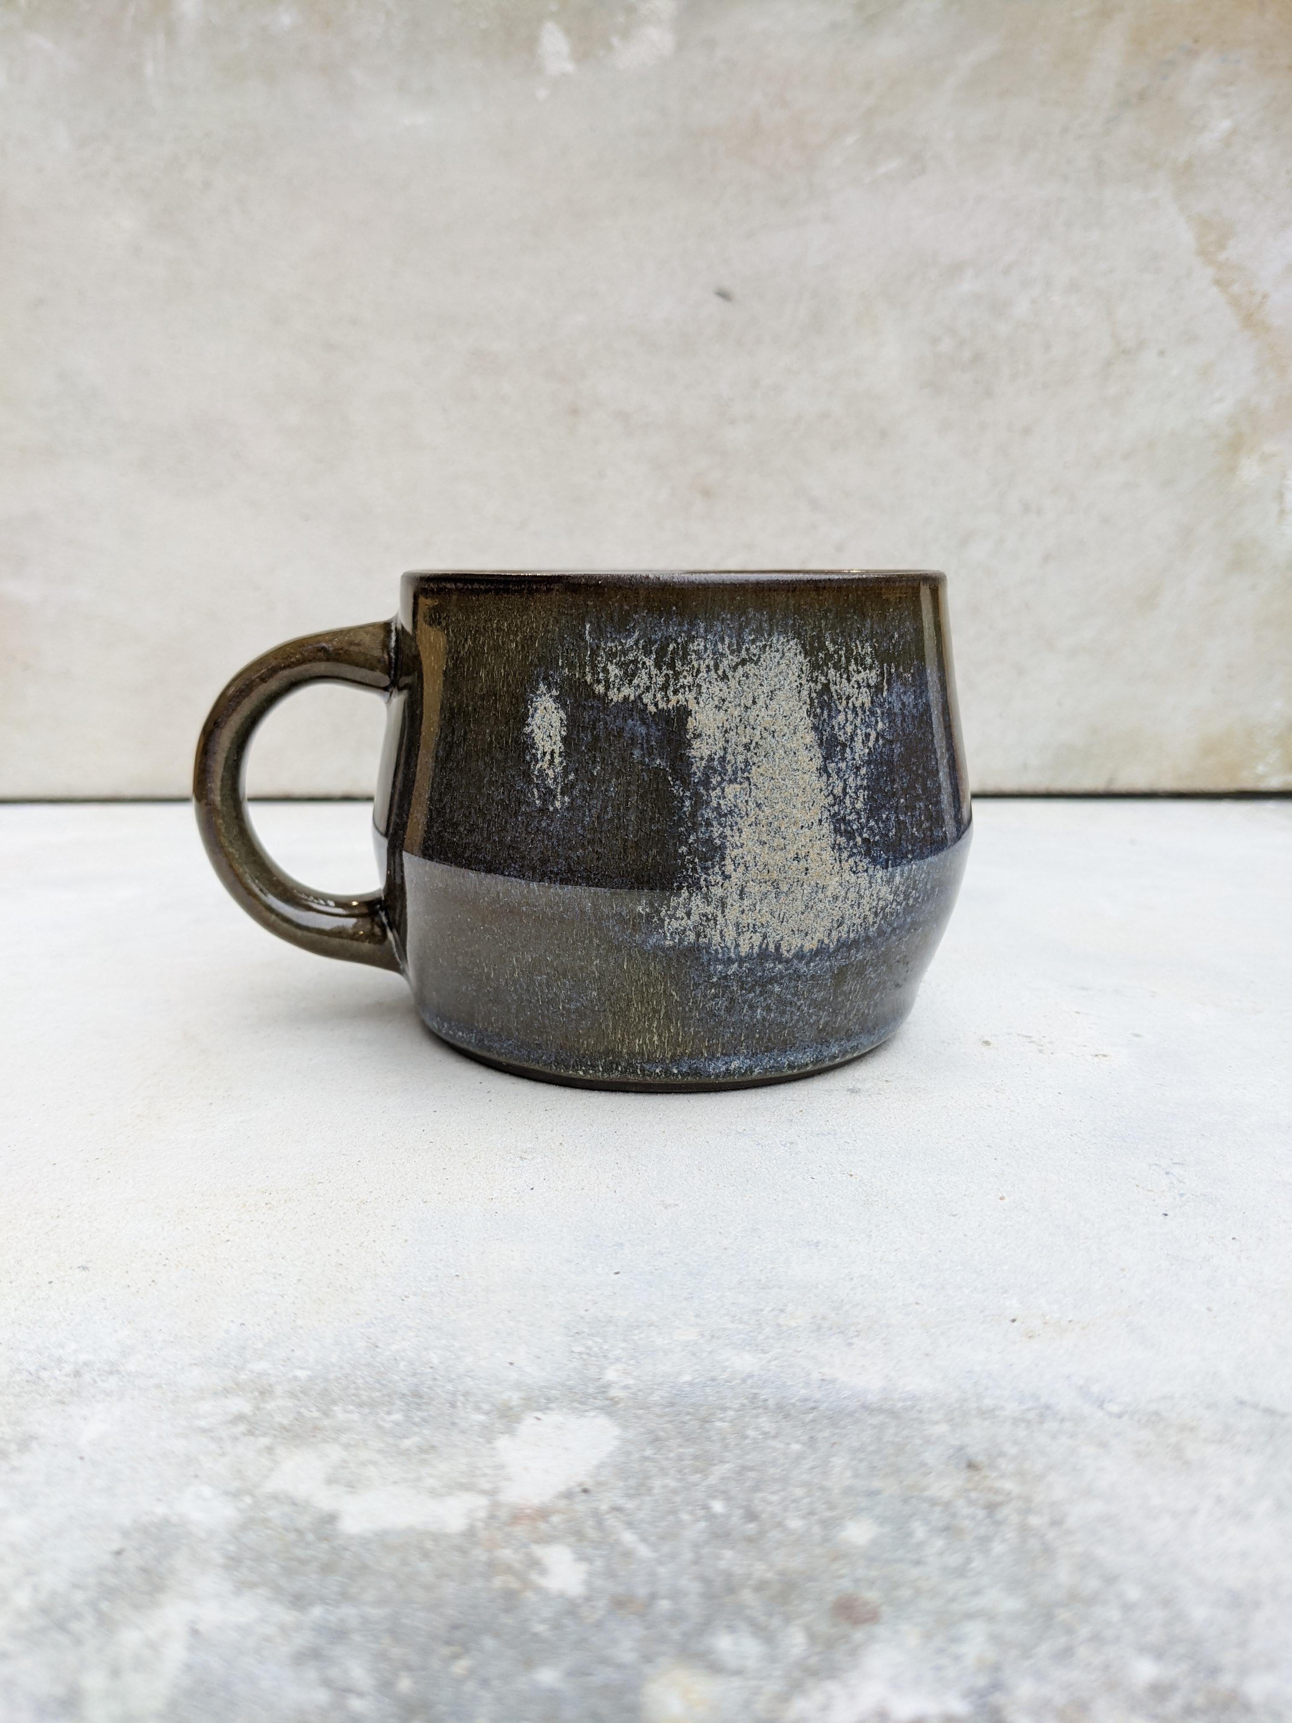
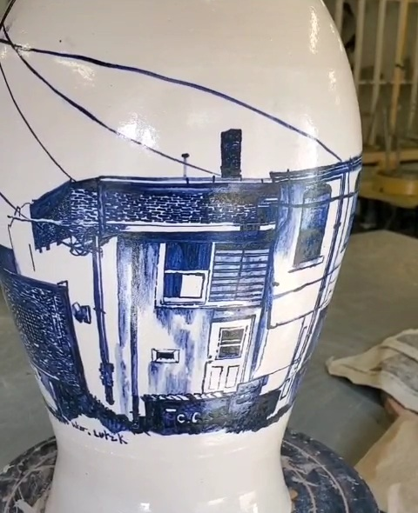
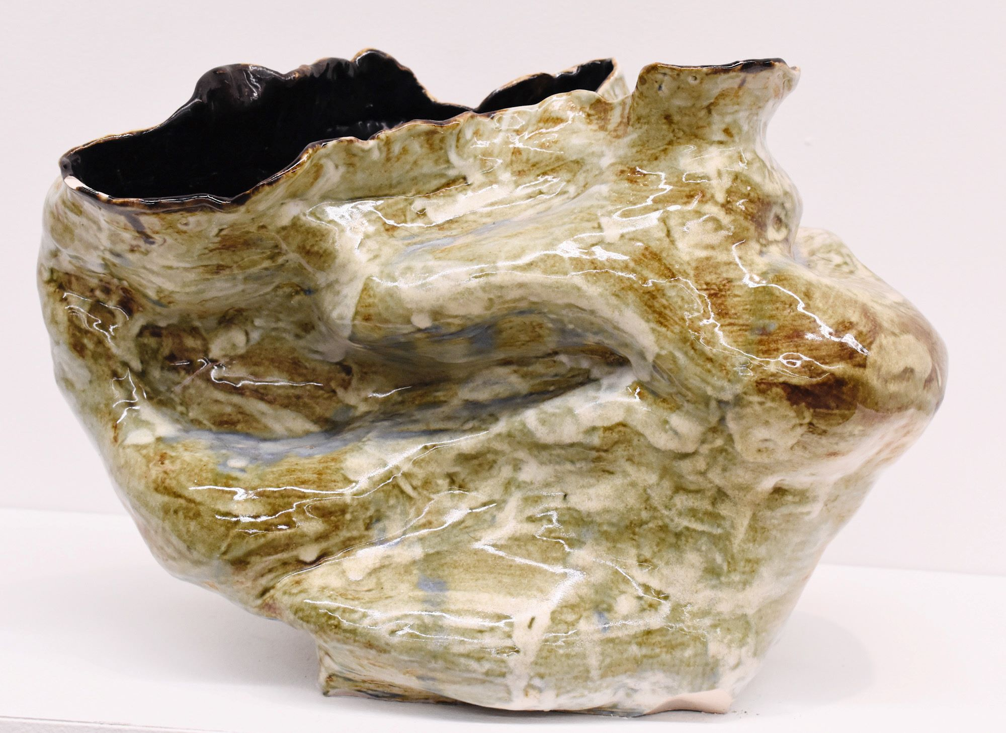
Honorable Mention
Just Right by Catrina Oberfeldt
Ceramics
Talk on the Street by Grace West
Untitled One by Ashlynd Riley

Slide 9
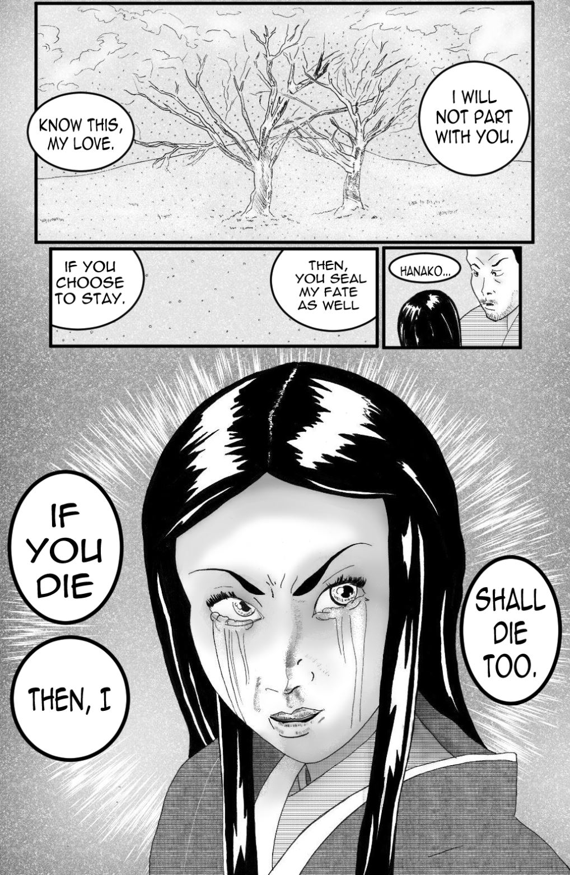
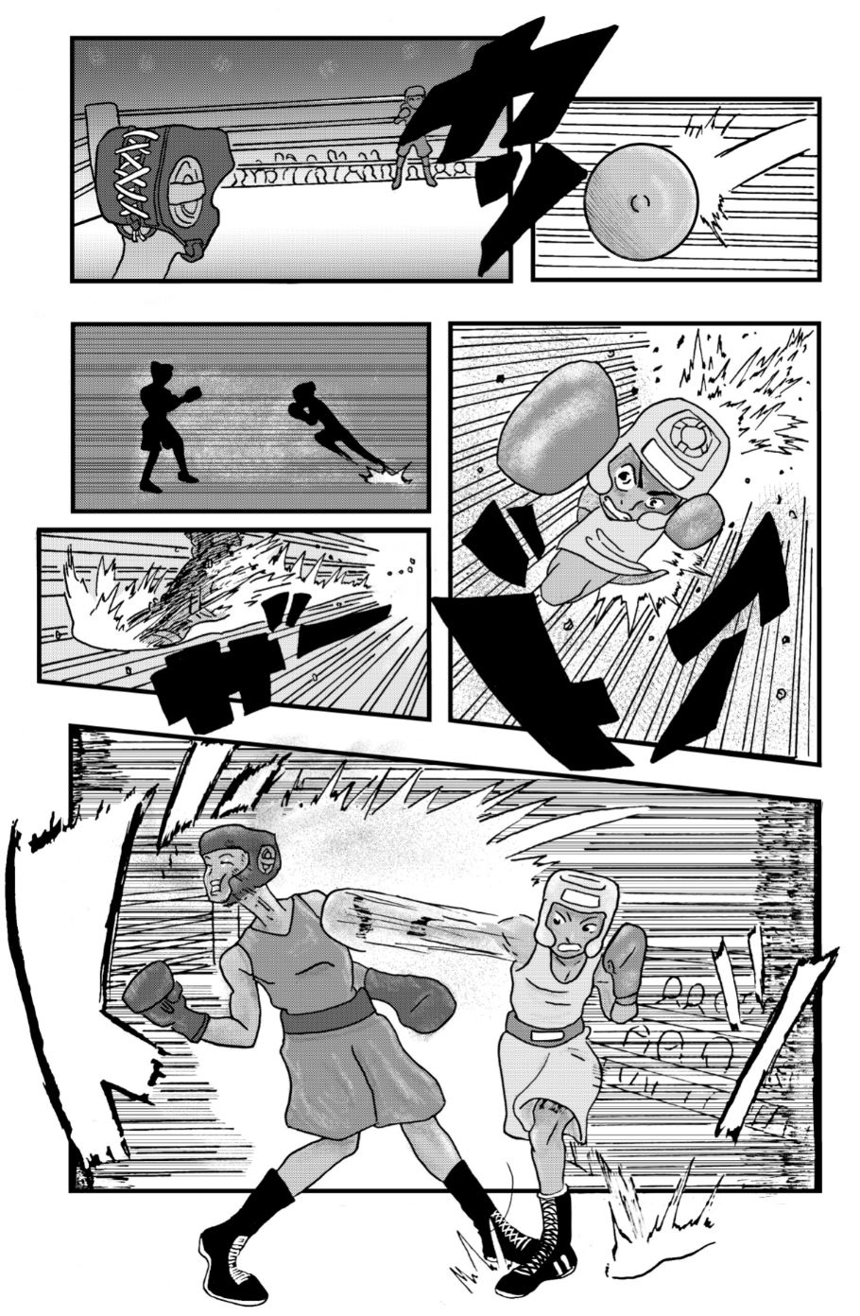
Honorable Mention
Digital Art – Image/Video/Sound
Hanako’s Resolution by Kofi Bazzel-Smith
Rush! by Kofi Bazzel-Smith

Slide 10
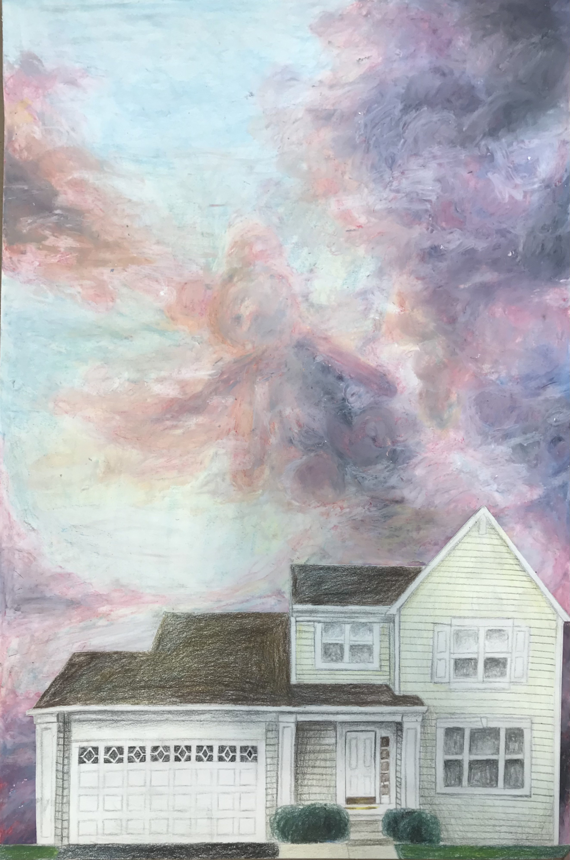
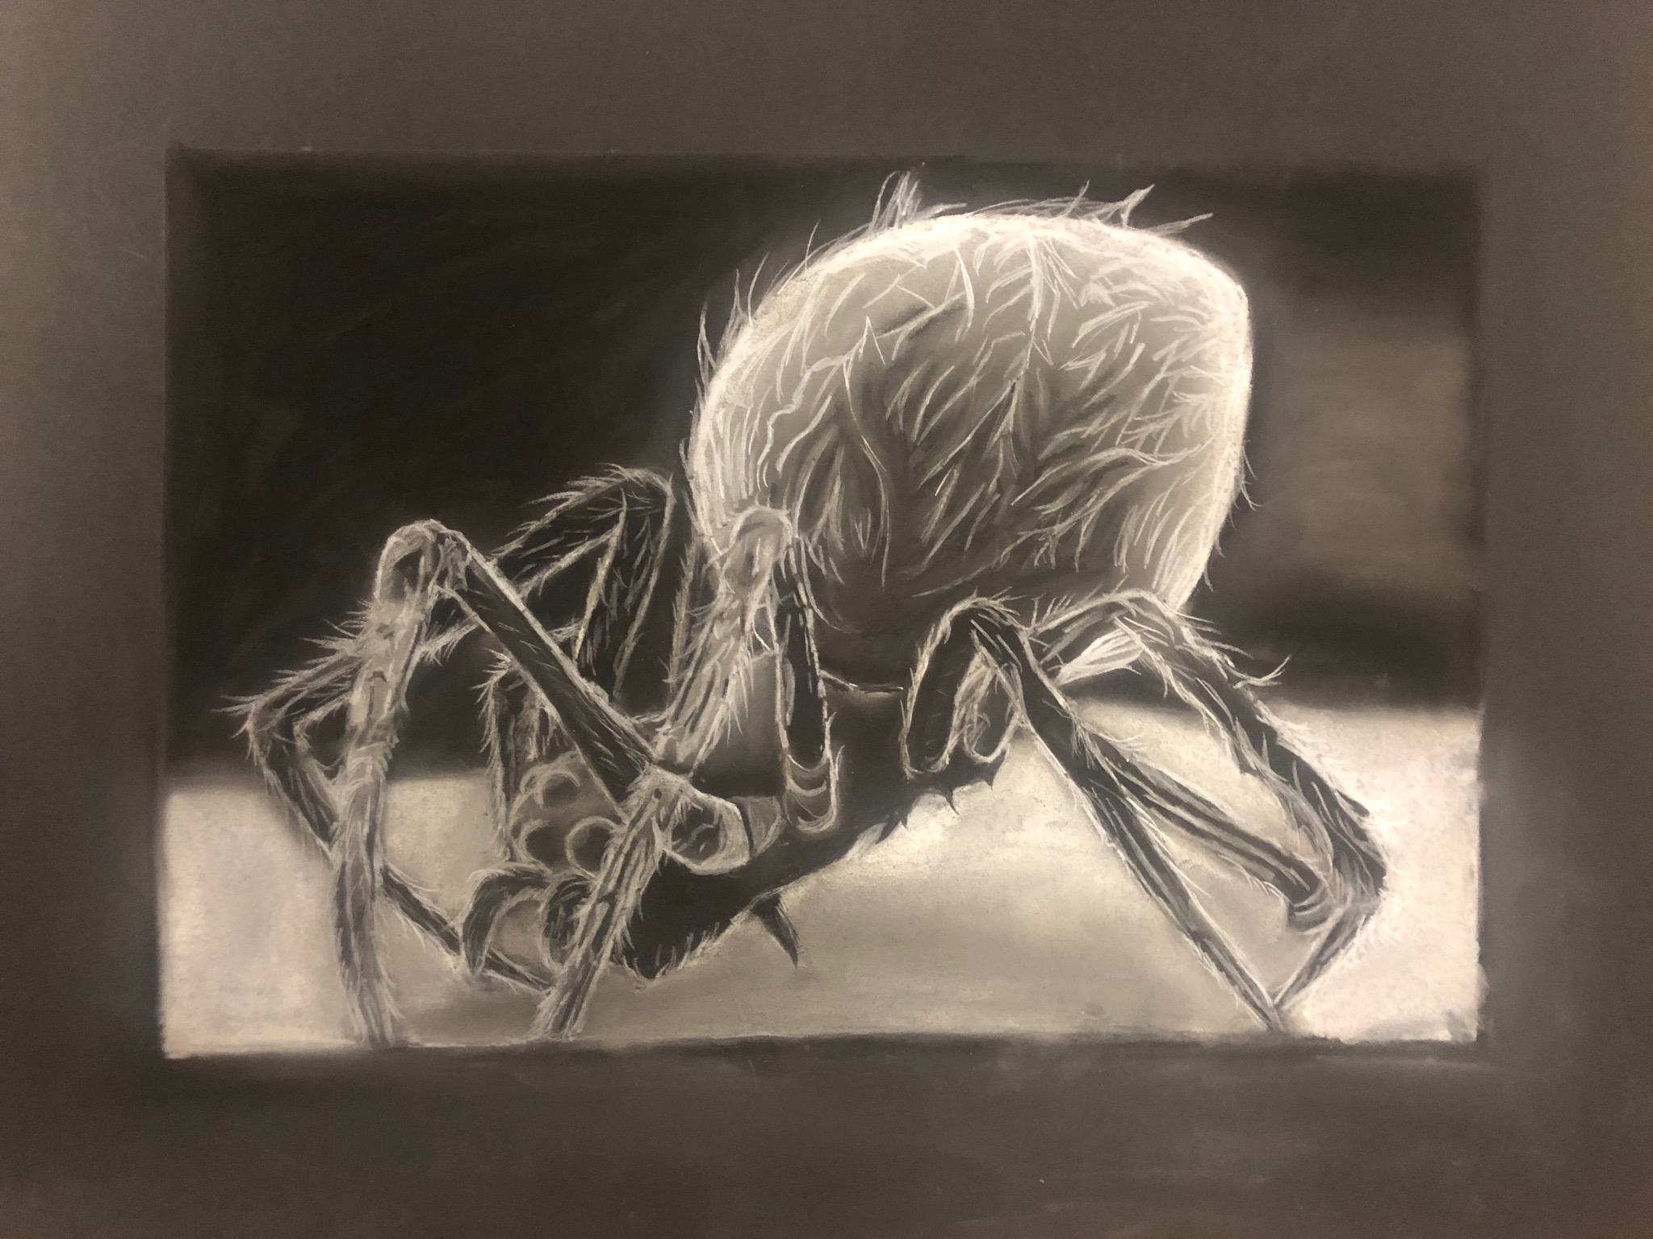
Honorable Mention
Foundations Drawing
Where You Can’t See by Kaelyn Albert
Our House by Arietta Rivera

Slide 11


Honorable Mention
Graphic Design –
Visual Communications
Camp Flog Gnaw by Nick Paul
Gift of Nature by Ashley Winowiecki

Slide 12

Honorable Mention
Graphic Design –
Visual Communications
Personal Brand Packaging Design Poster
By Caixia Liu

Slide 13
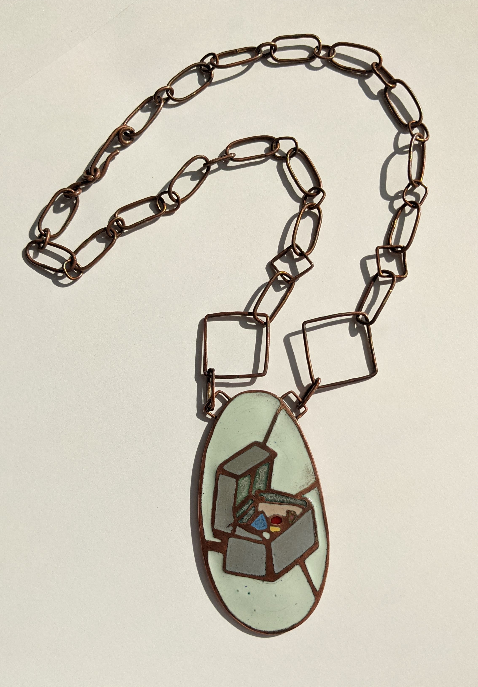
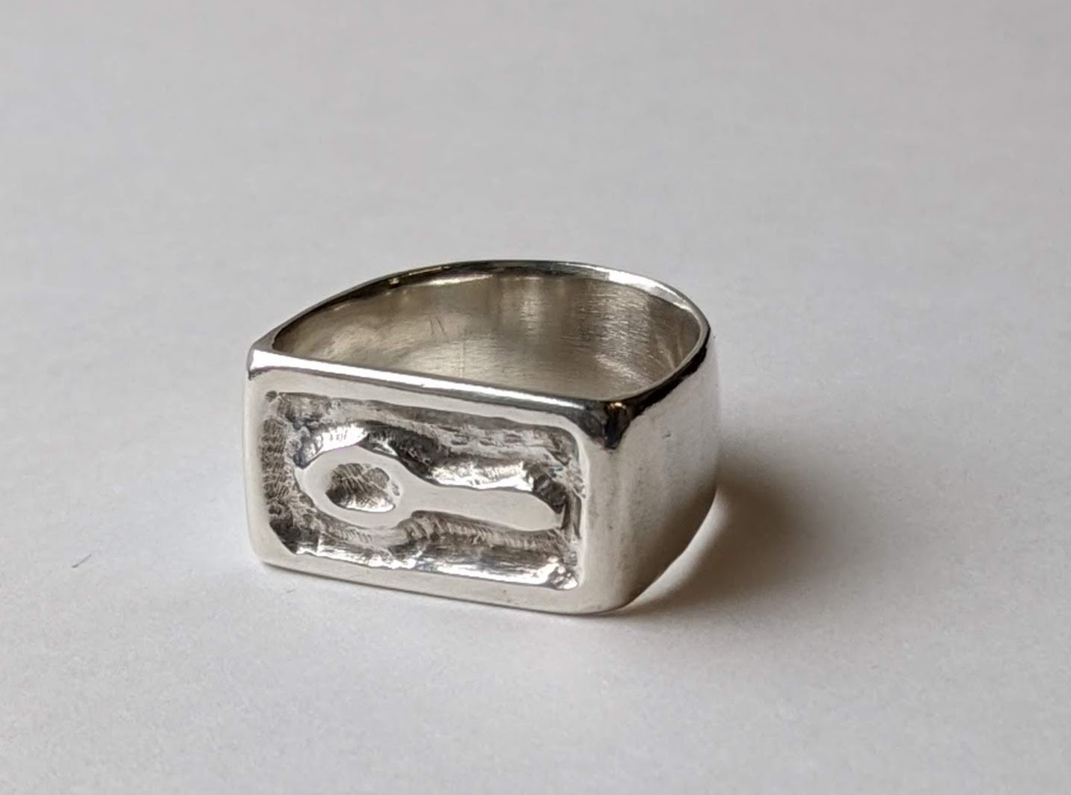
Honorable Mention
Jewelry/Metalwork
Silver Spoon by Catrina Oberfeldt
Treasure Found by Catrina Oberfeldt

Slide 14
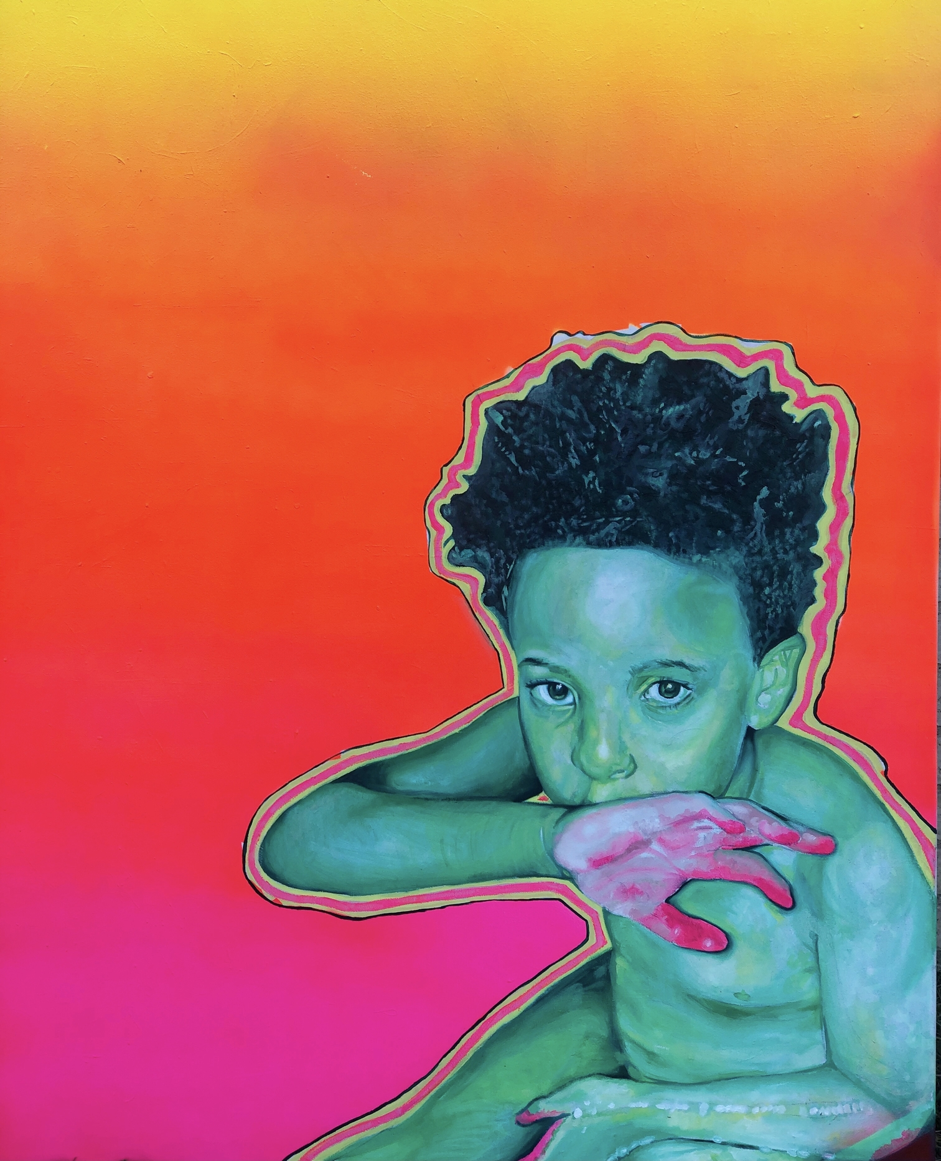
Honorable Mention
Painting
Hezekiah by Kyniesha Overall

Slide 15
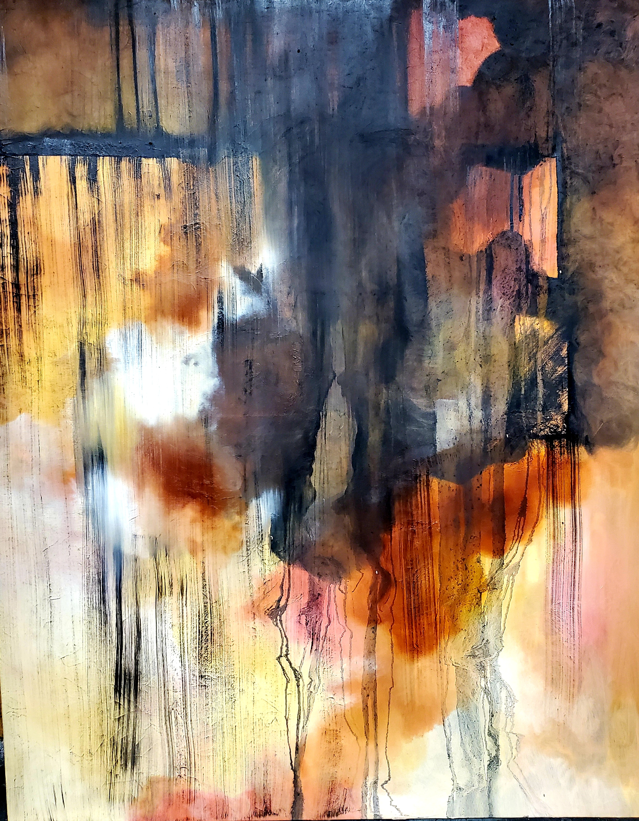
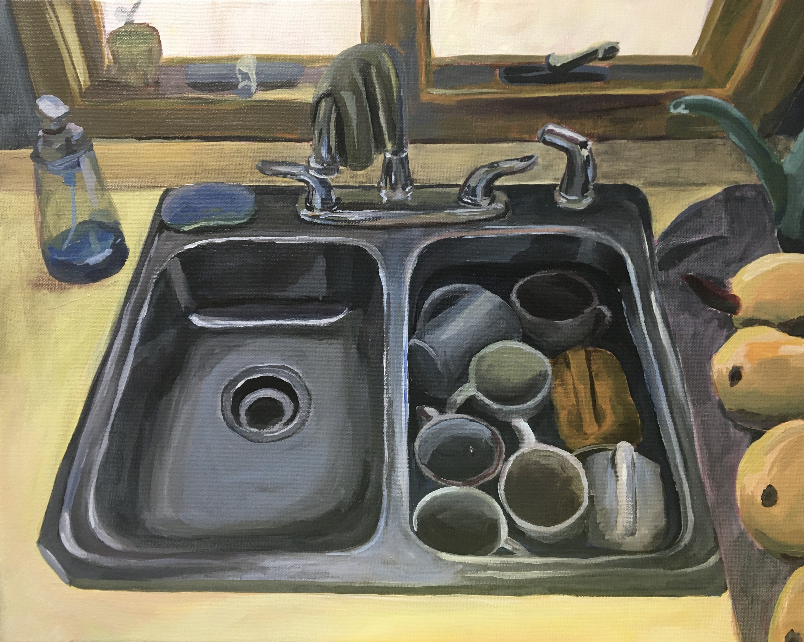
Honorable Mention
Painting
Grandma’s Sinks #2 by Grace Walker
Edge of Darkness by Grace West

Slide 16
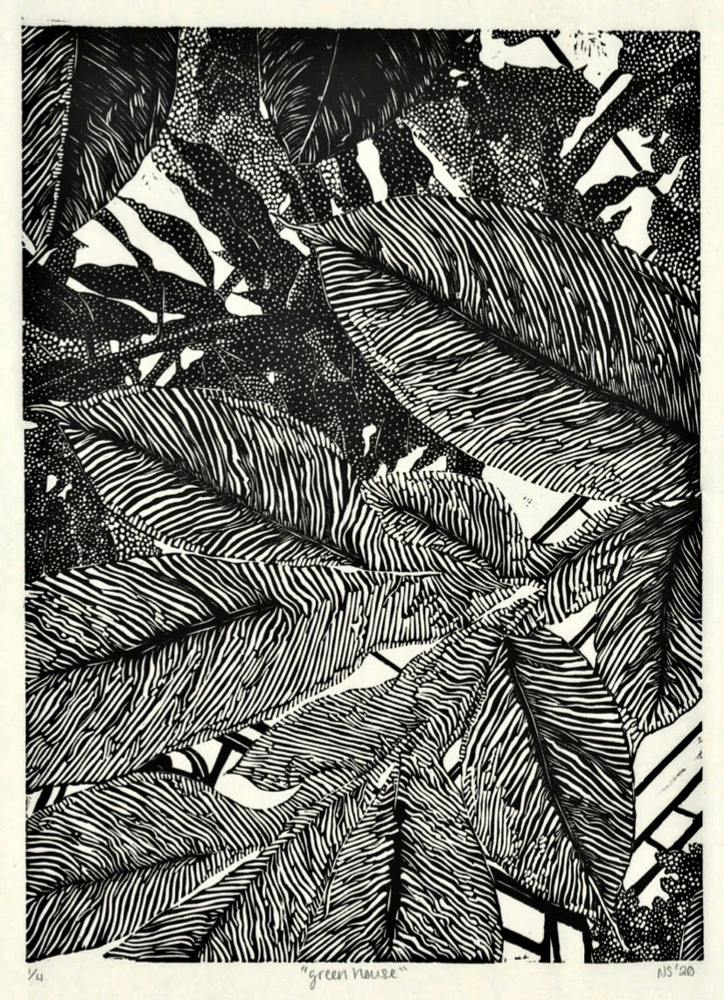
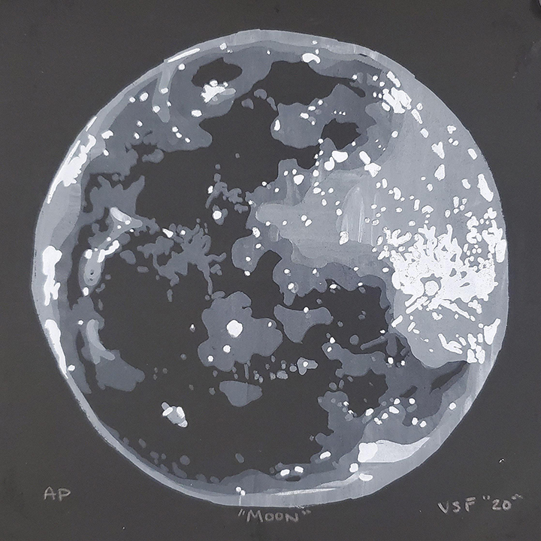
Honorable Mention
Printmaking
Greenhouse by Noelle Stoops
Moon by Valen Fulton

Slide 17
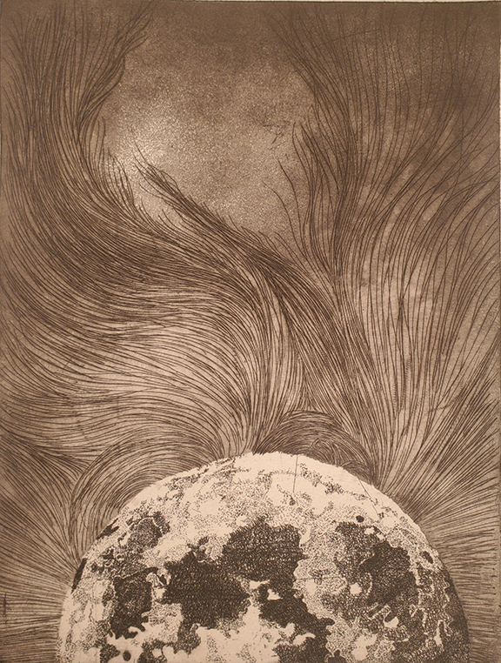
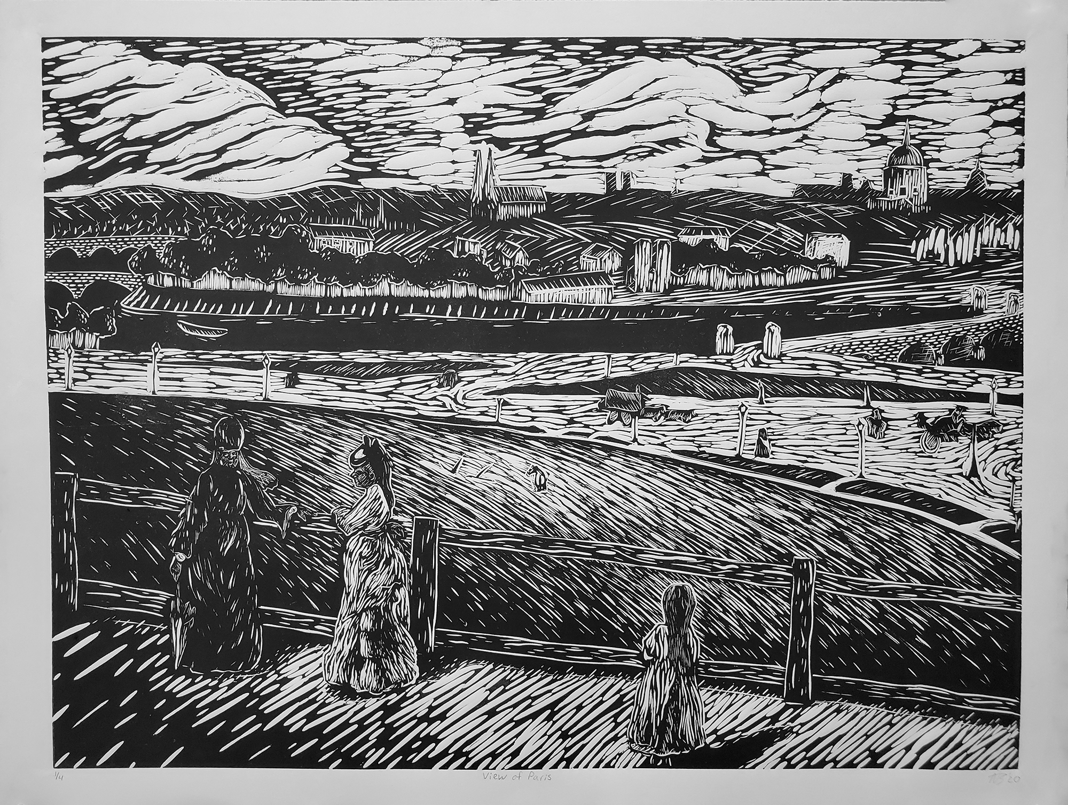
Honorable Mention
Printmaking
View of Paris: After Morisot
by Austin Baker
8.21.2017 by Valen Fulton

Slide 18
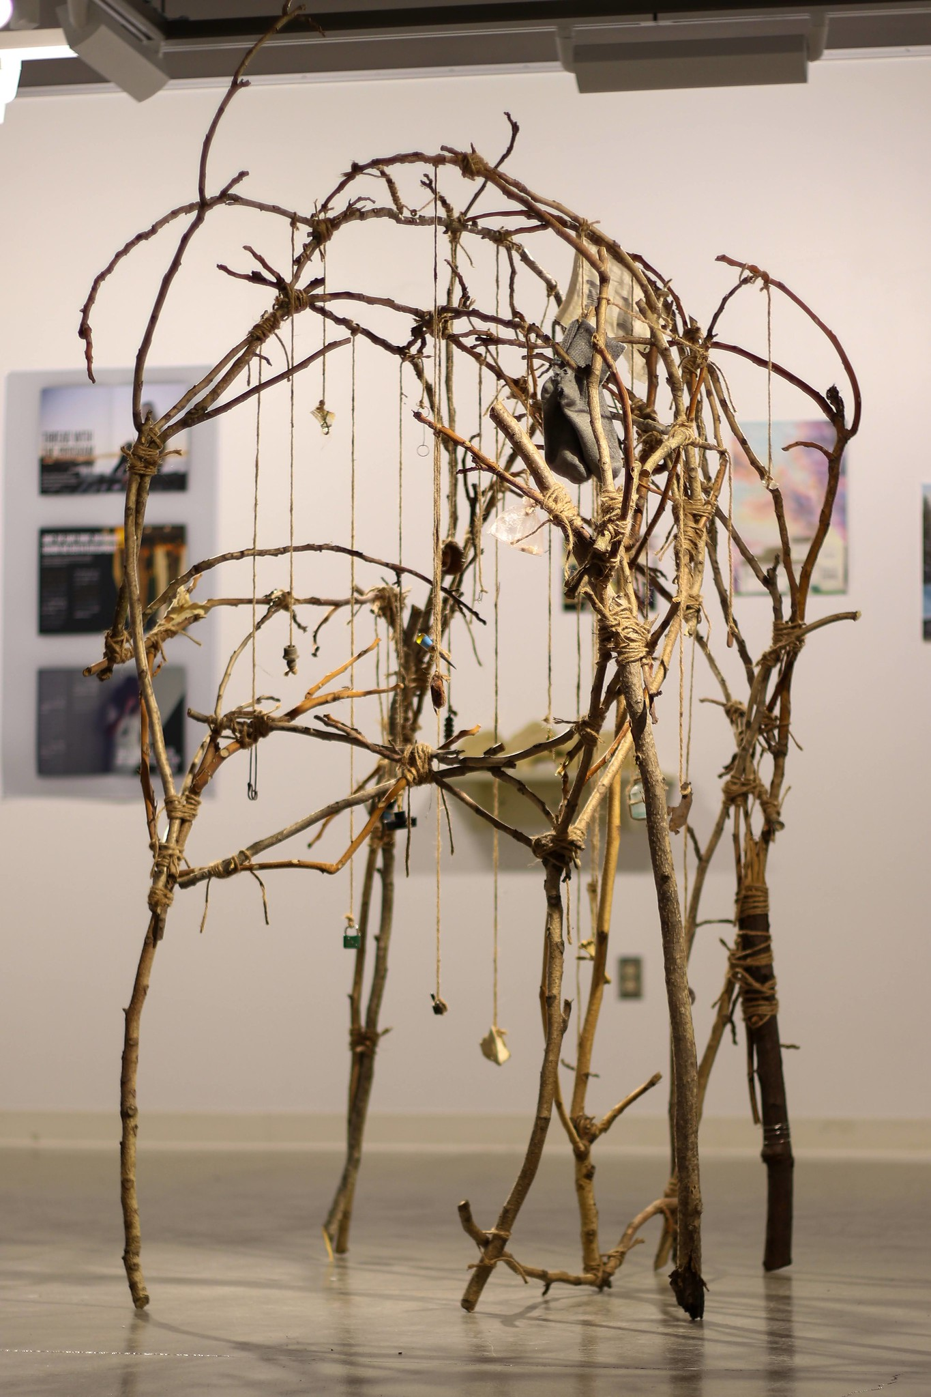
Honorable Mention
Sculpture
Kinship by Catrina Oberfeldt

Slide 19
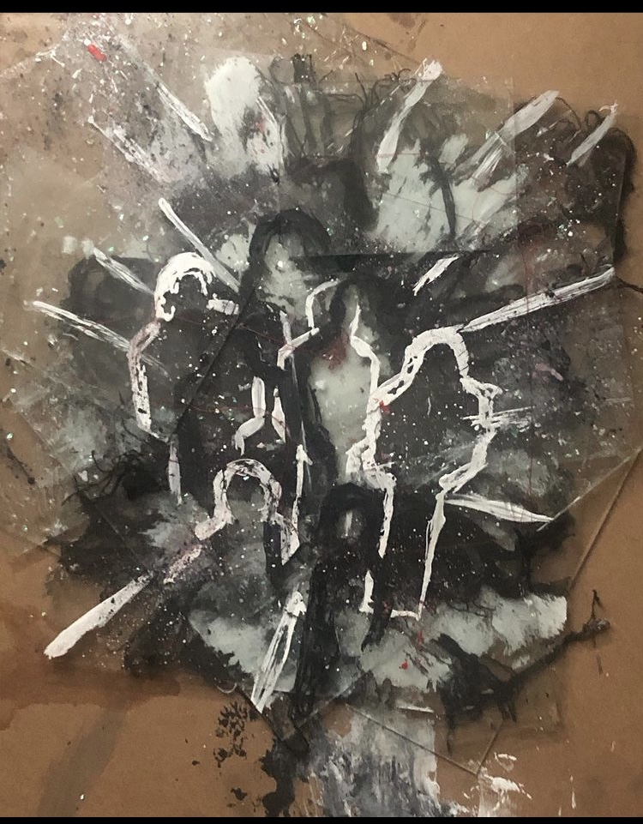
Honorable Mention
Sculpture
Isolated Fracture by Savanna Henderson

Slide 20
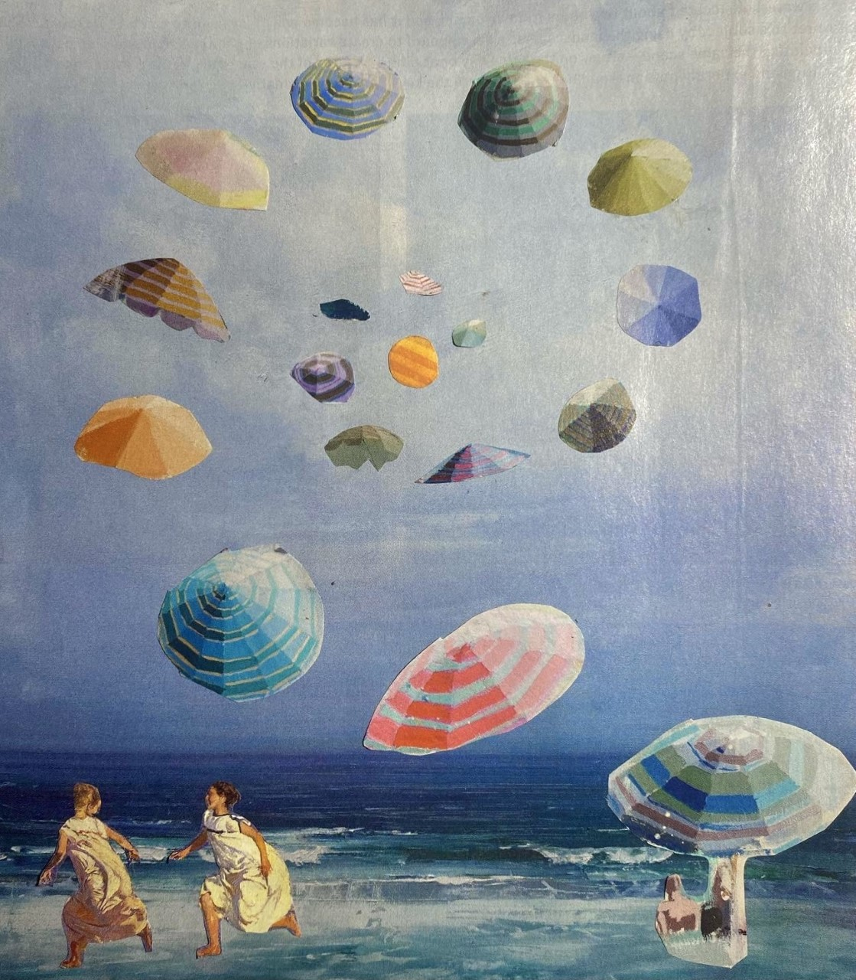
First Place
2D and 3D Foundations
A Blissful Wandering
by Isabella Gullotta

Slide 21
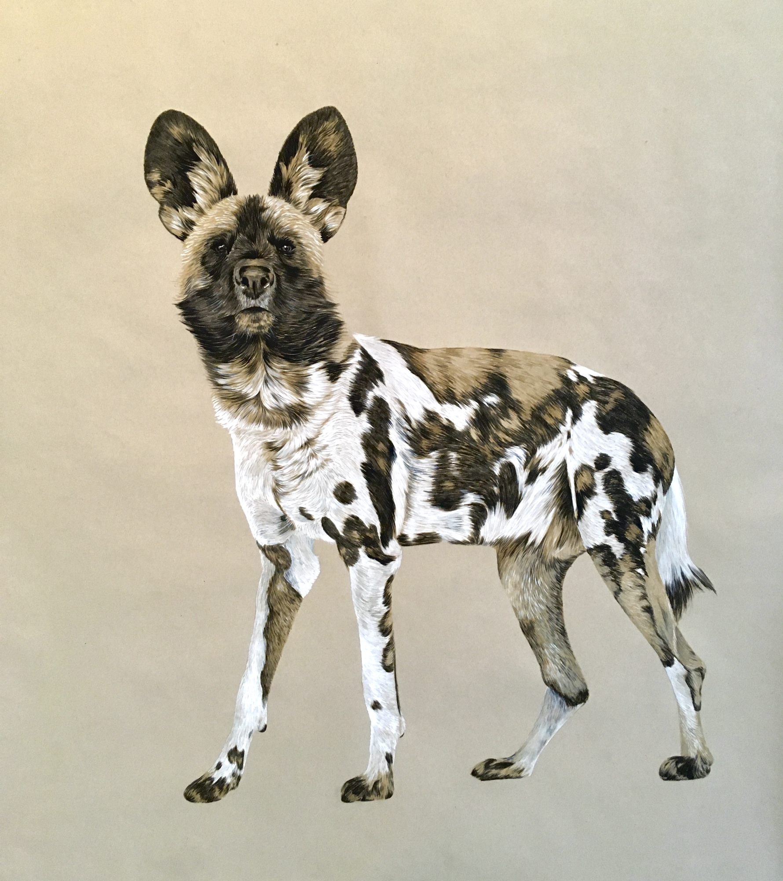
First Place
Advanced Drawing
Last Glimpse
by Anna Brown

Slide 22
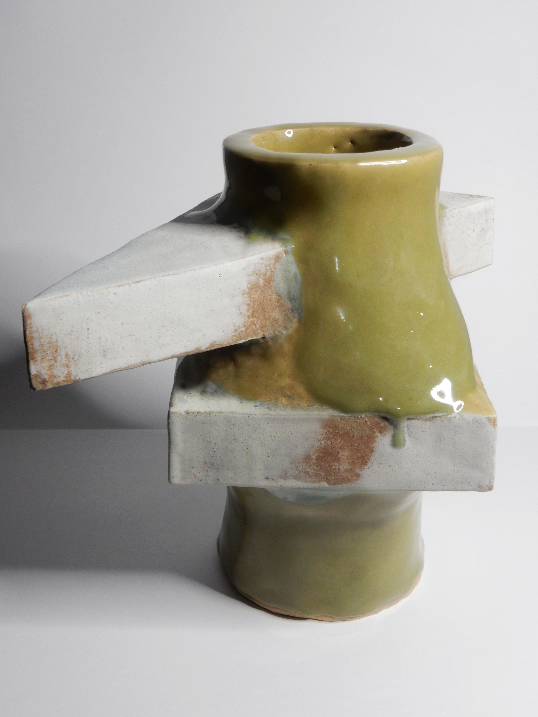
First Place
Ceramics
Honesty
By Tsuyoshi Suzuki

Slide 23

First Place
Digital Art – Image/Video/Sound
Takeo’s Adventures by Kofi Bazzell-Smith

Slide 24
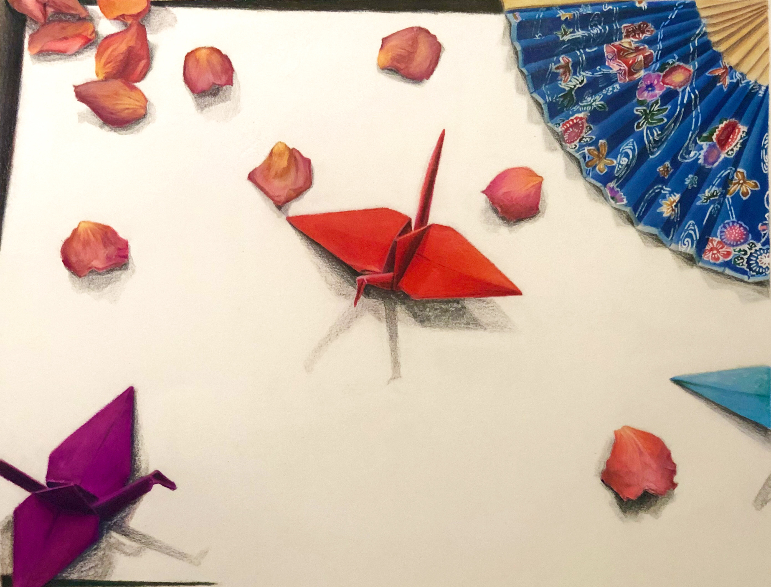
First Place
Foundations Drawing
Object Still Life by Eva Weber

Slide 25
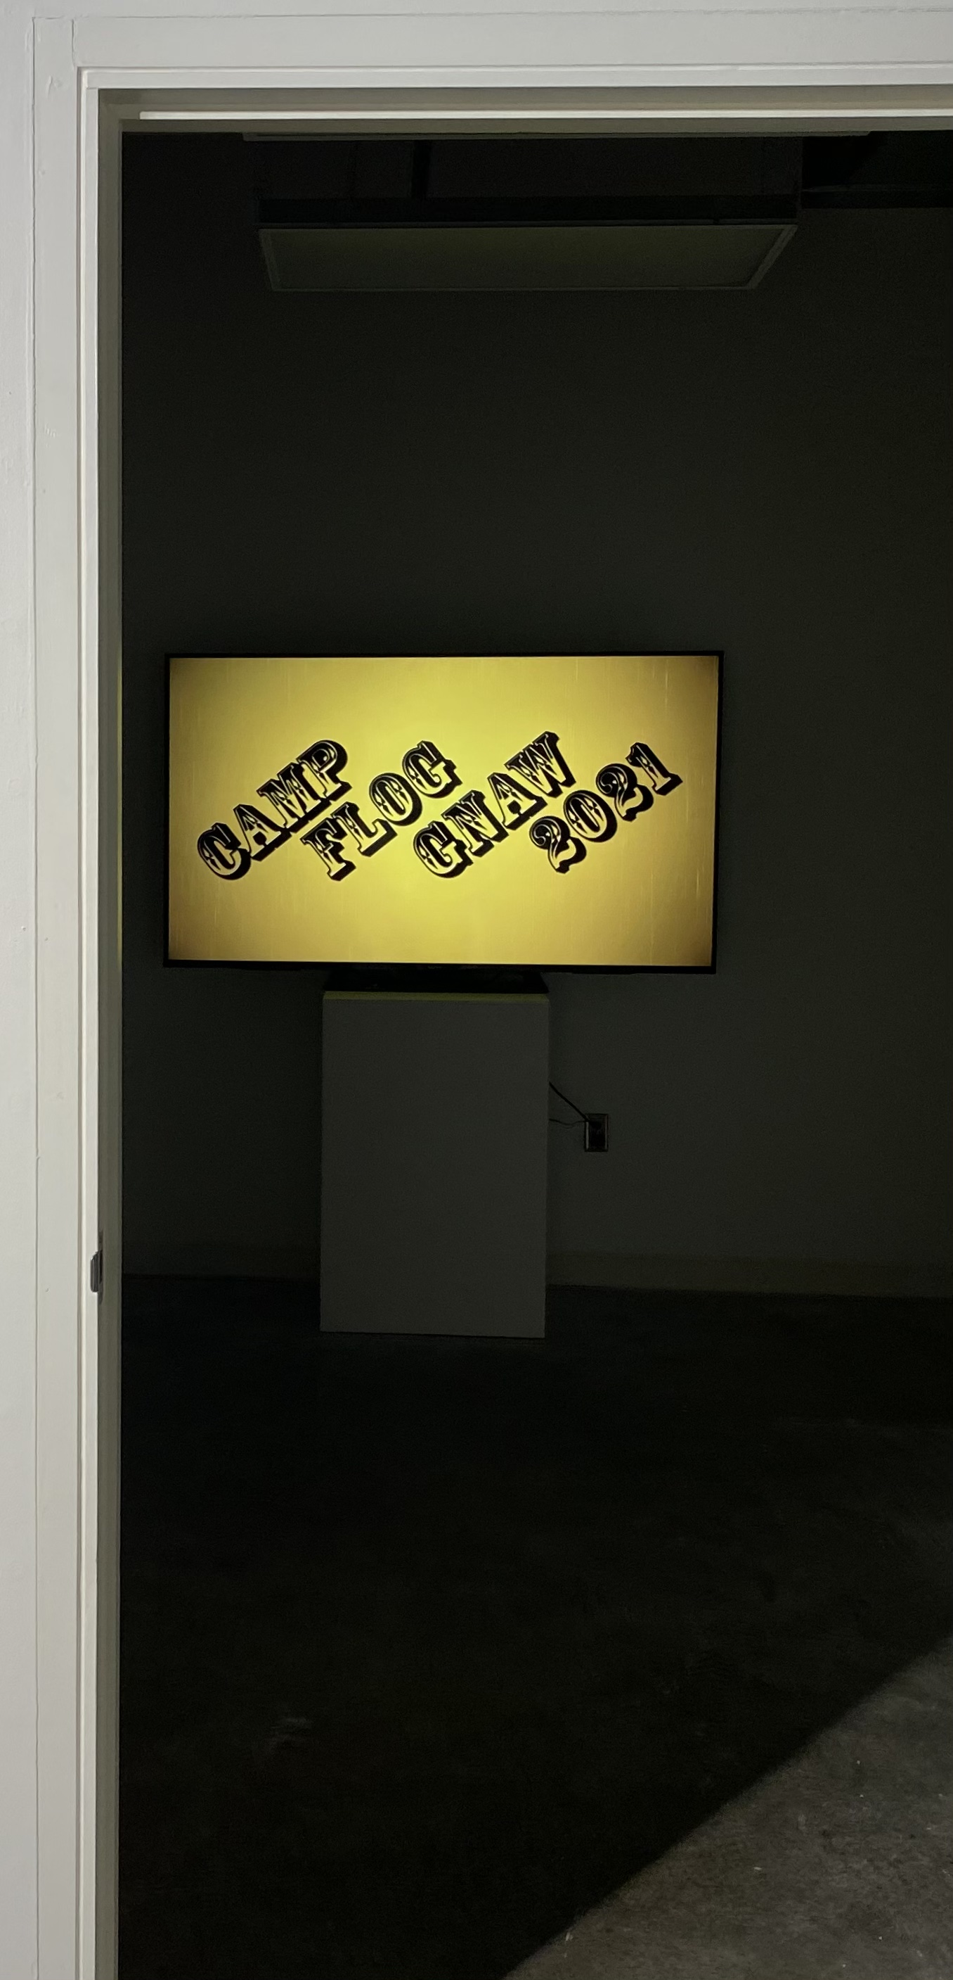
First Place
Graphic Design – Interactive/Motion
Camp Flog Gnaw Promo
by Nick Paul

Slide 26

First Place
Graphic Design – Visual Communications
Rational Serif Cards by Kelly Cothern

Slide 27
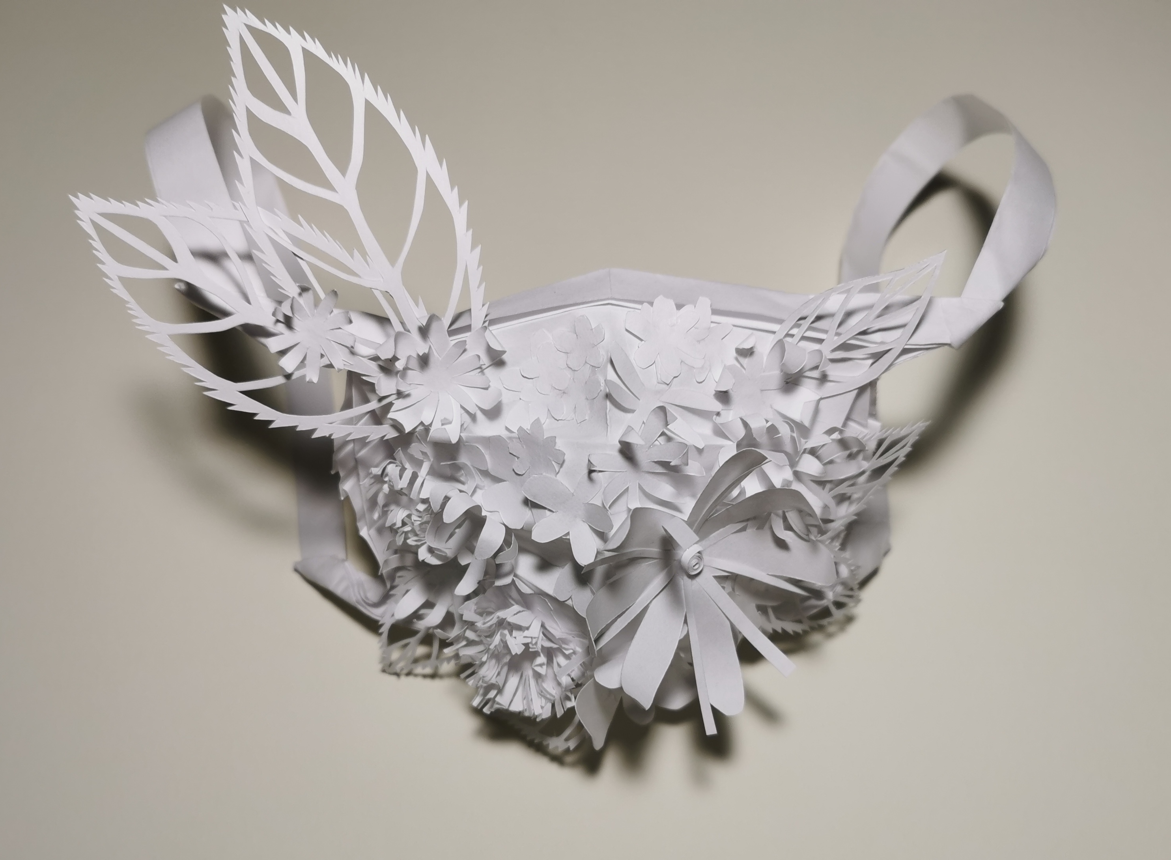
First Place
Jewelry/Metalwork
Hid the Smile By Quiping Liang

Slide 28
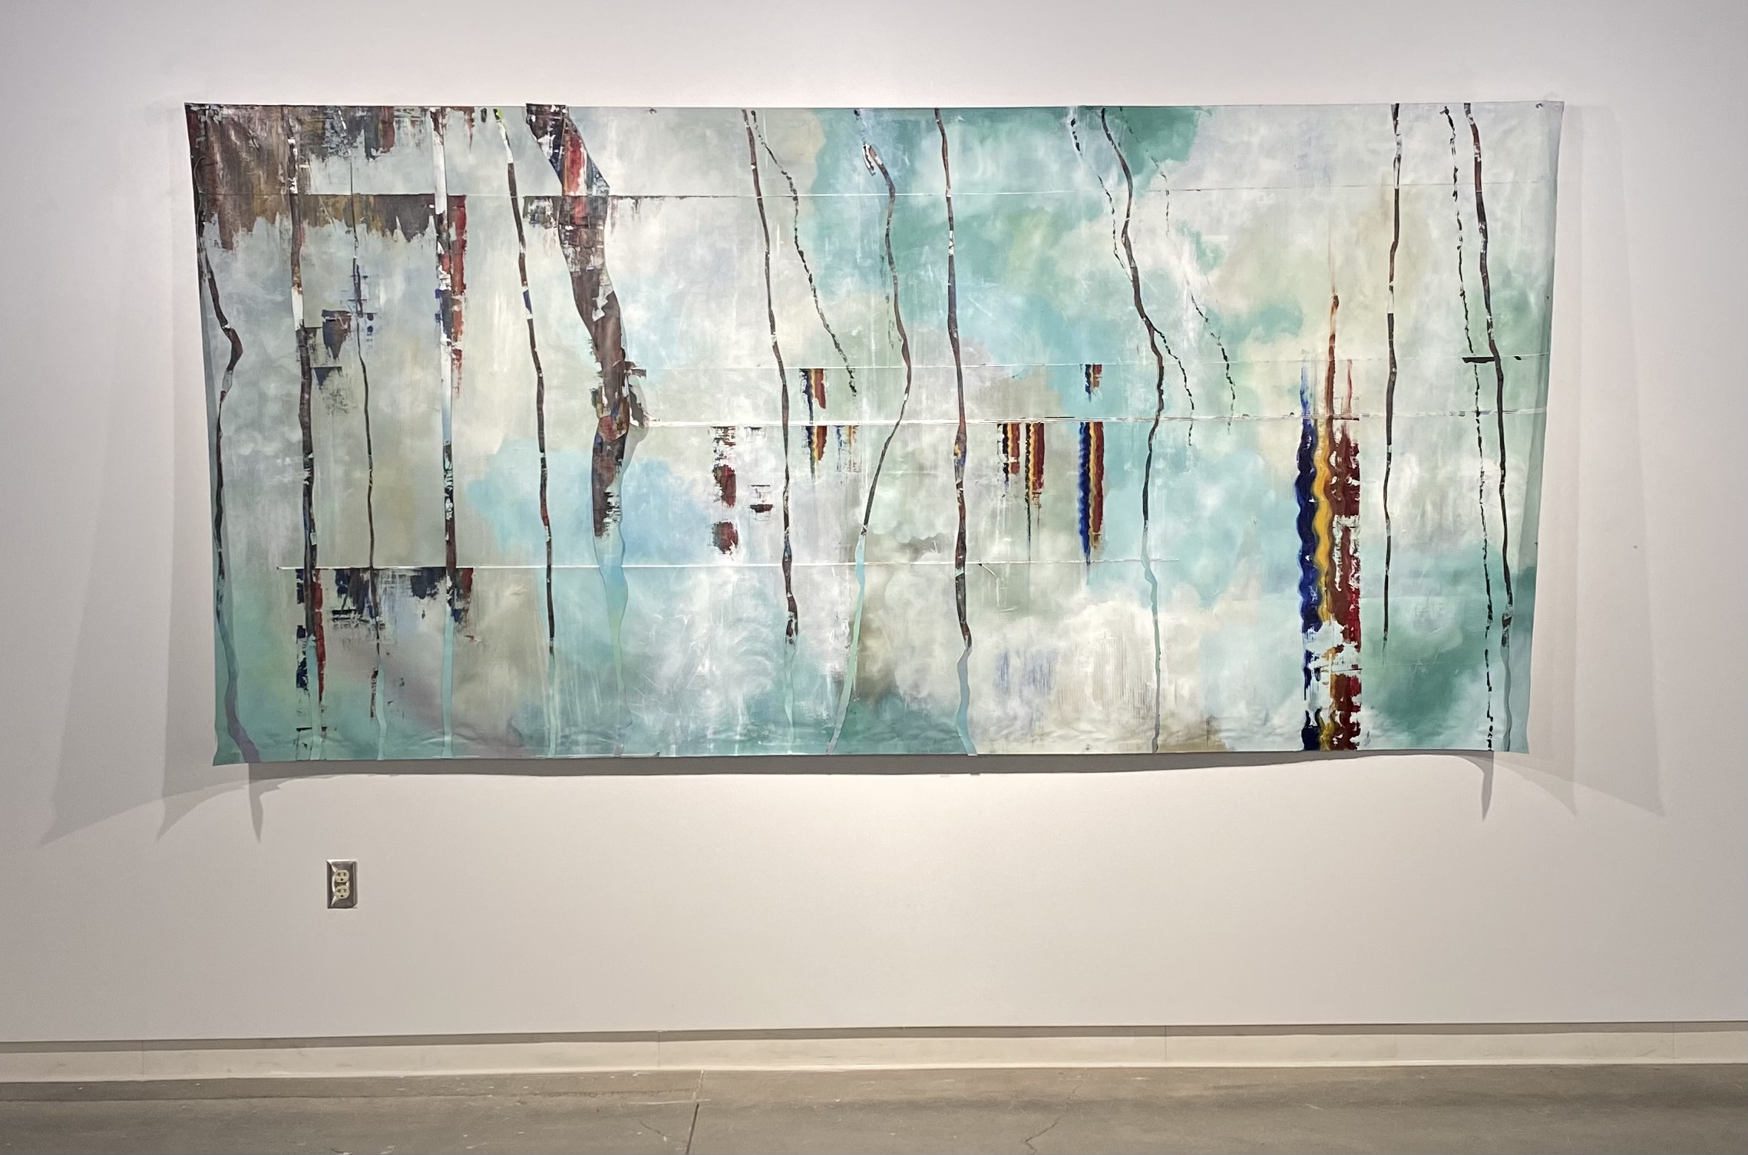
First Place
Painting
Age of Man
By Grace West

Slide 29
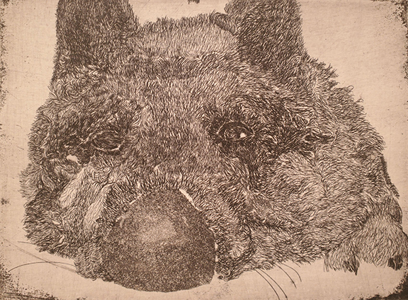
First Place
Printmaking
Grunt by Valen Fulton

Slide 30
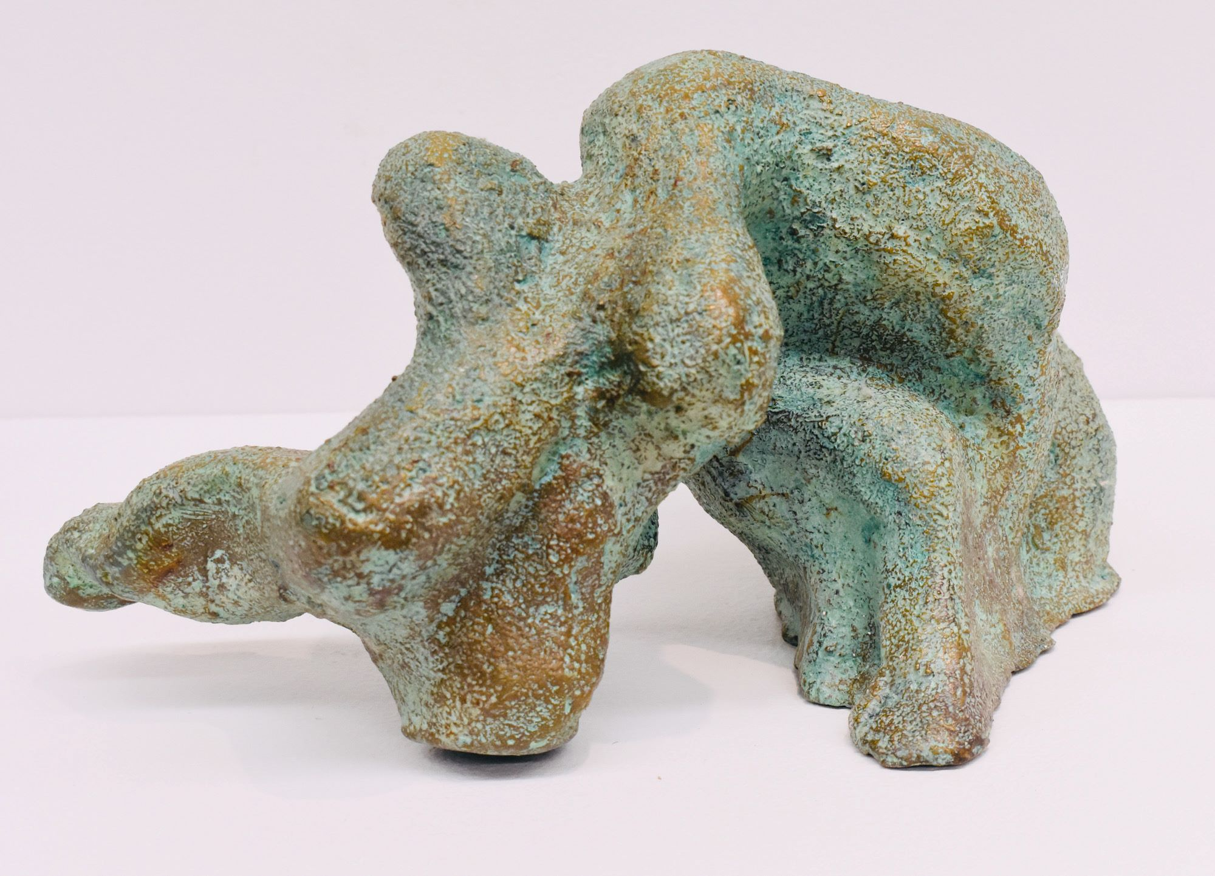
First Place
Sculpture
Untitled Four by Ashlynd Risley

Slide 31
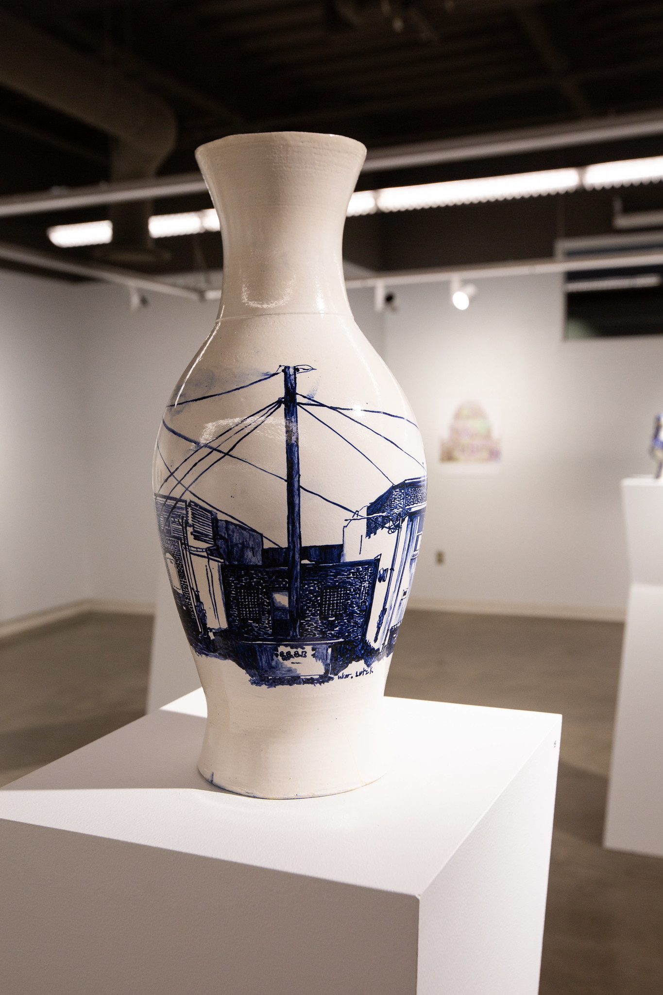
Bill Heyduck Ceramics Award
Talk on the Street by Grace West

Slide 32
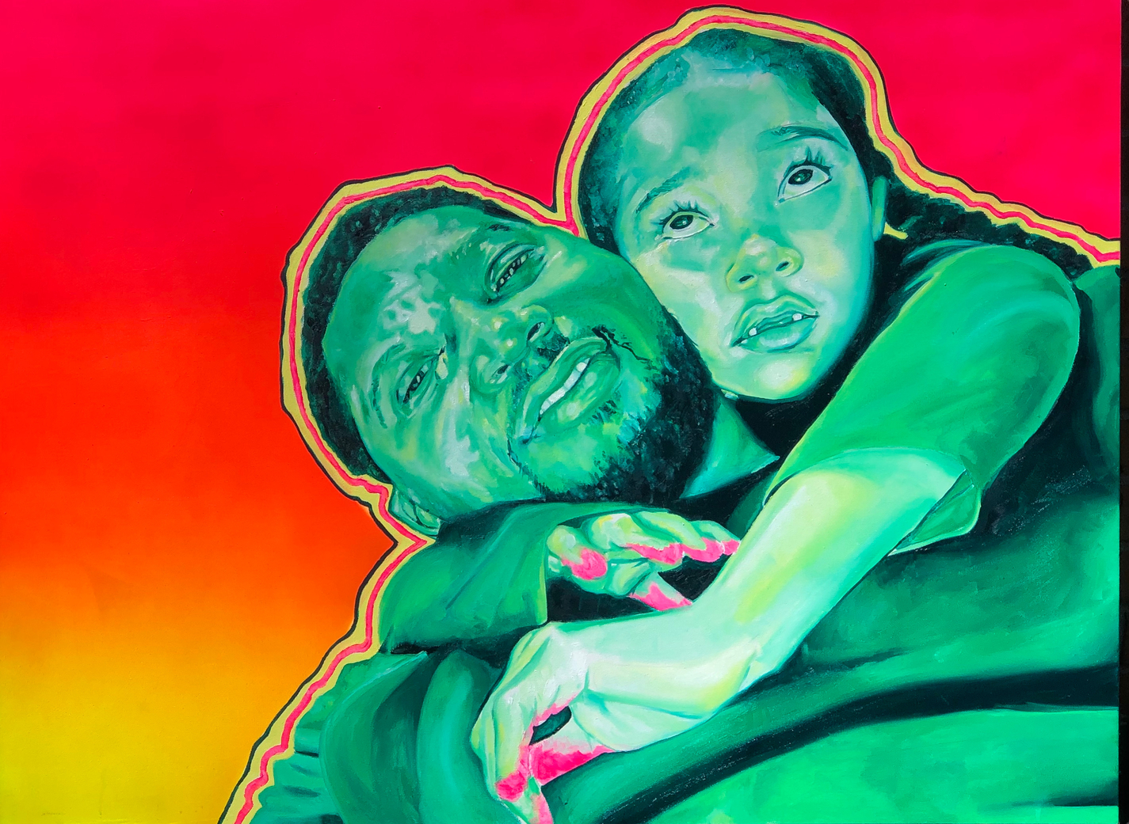
Glenn Hild Painting Award
Euphoria: Olivia by Kyniesha Overall

Slide 33
Sarah Wozencraft Cox Art Award
8.21.2017 by Valen Fulton

Slide 34
Sarah Wozencraft Cox Art Award
Camp Flog Gnaw by Nick Paul

Slide 35
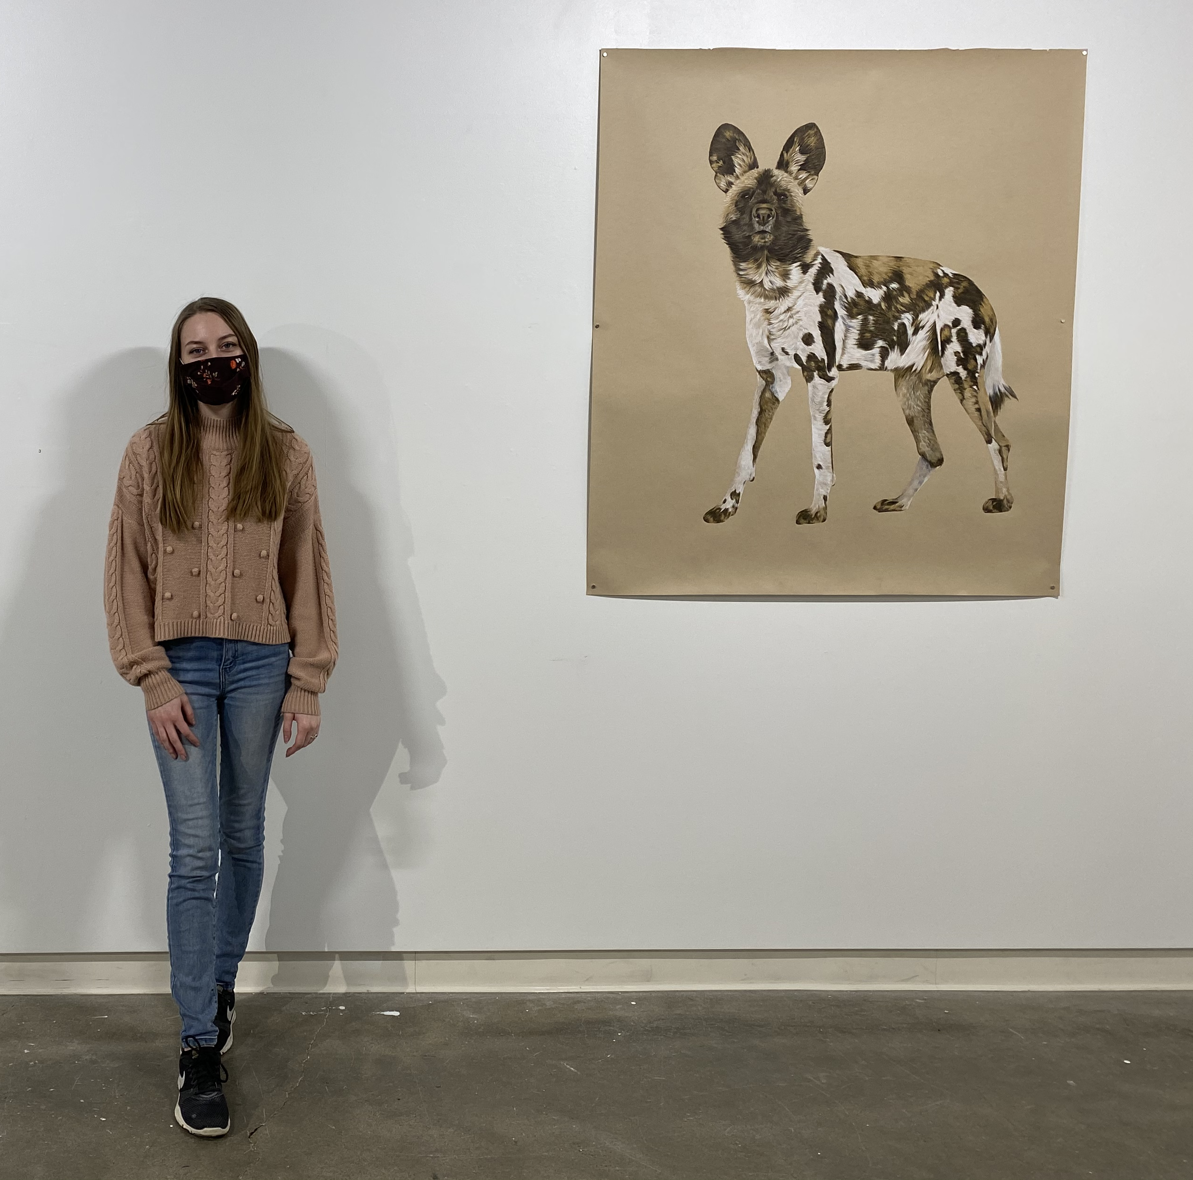
Best of show
Last Glimpse by Anna Brown

Slide 36
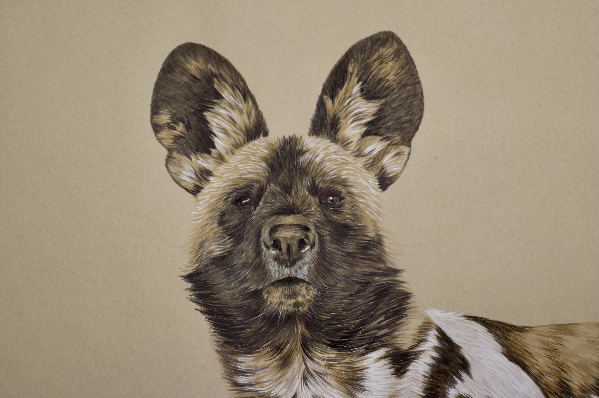
Best of show
Last Glimpse (Detail) by Anna Brown

Slide 37
Congratulations!
Congratulations to all the participating artists and thank you for making this a memorable year at EIU. Your patience and hard work made this all possible. Thanks for choosing the Department of Art + Design.
Congratulations to our graduating students and we look forward to seeing the rest of you in the Fall. Enjoy your summer!
Special thanks to Susan and Marlene Hild and all the donors that made the Glenn Hild Student Art Gallery a reality. The new lighting is in place, and we are proud of our remodeled exhibition space. We look forward to the 2021-22 Season of exhibitions and the official ceremony of the naming of the space.

Slide 38
Thanks
Special thanks also go to Deborah Reifsteck, Head of the Student Affairs Committee for organizing the jurors and student application process with Mike Schuetz of the Tarble Arts Center.

