Slide 1


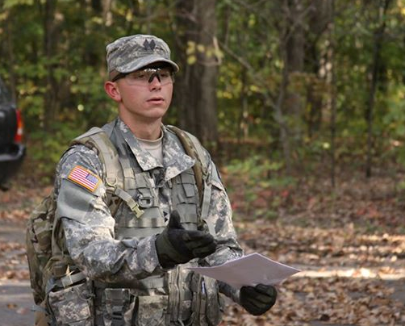
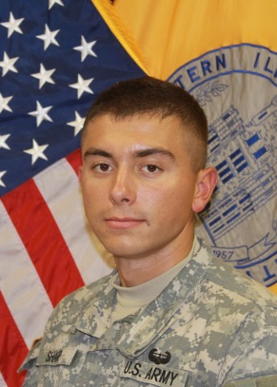
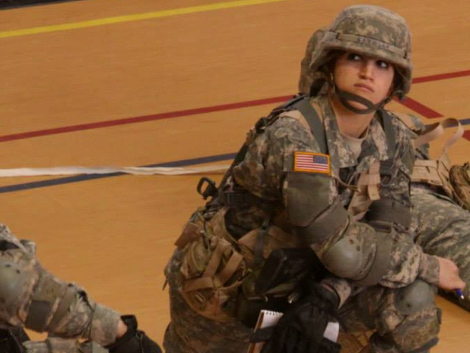
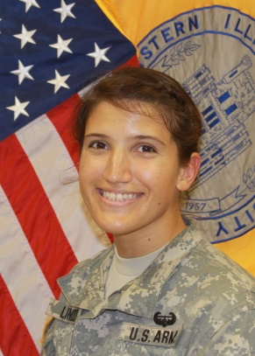
EIU ROTC
STUDENT ACHIEVEMENT.
CRAIG SHARP
Cadet Craig Sharp served as the EIU ROTC Cadet Battalion Commander in 2013-14. He earned an “E” rating for exceeding the standard at the Leadership Development and Assessment Course (LDAC). This is the top achievement a cadet can earn during this rigorous summer program. He was also ranked by the Army in the top 20% of his peers and designated as a Distinguished Military Graduate. Lastly, Cadet Sharp was awarded the George C. Marshall Award as the top cadet in the program.
ROBBI LINDLEY
Cadet Robbi Lindley served as the EIU ROTC Cadet Battalion Executive Officer in 2013-14. She earned an “E” rating for exceeding the standard at the Leadership Development and Assessment Course (LDAC). This is the top achievement a cadet can earn during this rigorous summer program. She was also ranked by the Army in the top 20% of her peers and designated as a Distinguished Military Graduate.

Slide 2
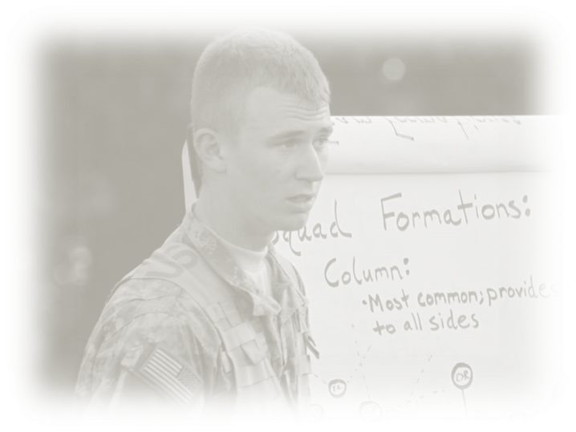
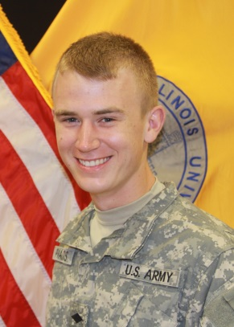
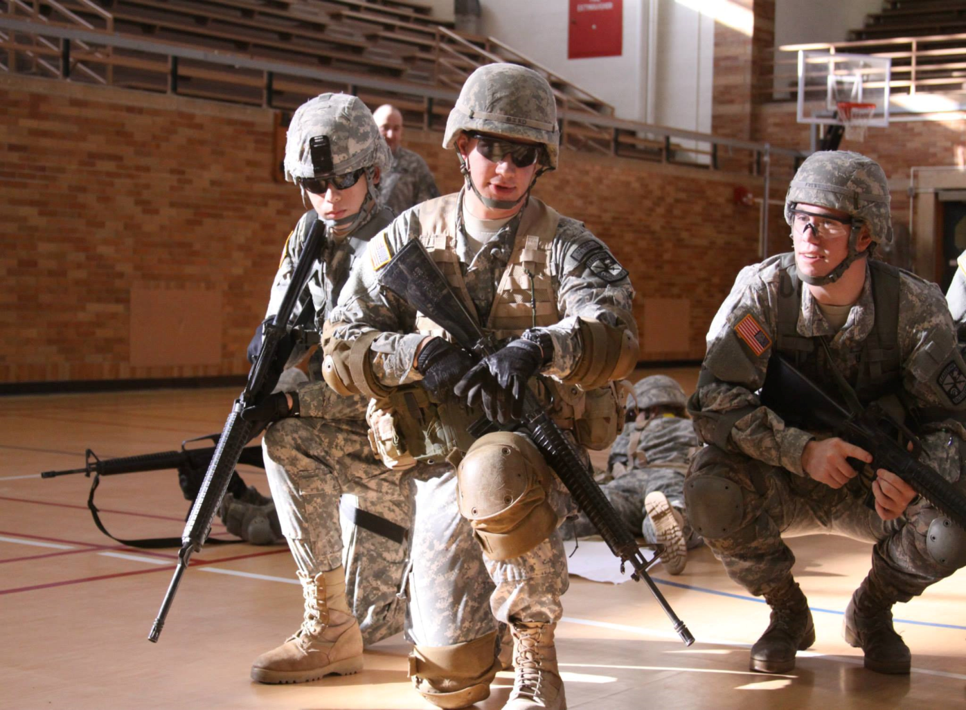
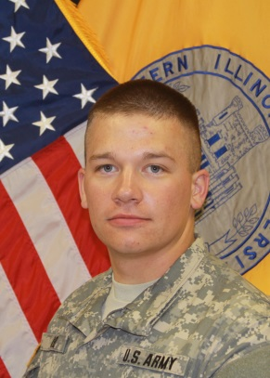
JACOB DALLAS
Cadet Jacob Dallas served as one of the EIU ROTC Training Advising and Counseling (TAC) Officers in 2013-14. He earned an “E” rating for exceeding the standard at the Leadership Development and Assessment Course (LDAC). This is the top achievement a cadet can earn during this rigorous summer program. He also earned the coveted “Recondo” badge for high military proficiency while at LDAC.
MICHAEL BIRD
Cadet Michael Bird served as the EIU ROTC Cadet Battalion Operations Officer in 2013-14. He earned an “E” rating for exceeding the standard at the Leadership Development and Assessment Course (LDAC). This is the top achievement a cadet can earn during this rigorous summer program. He also earned the coveted “Recondo” badge for high military proficiency while at LDAC. Lastly, Cadet Bird was awarded the National Sojourners Award for his patriotism and support for our national defense.
ARMY STRONG.
PANTHER STRONG.

