Slide 1
Content Connections: Literacy Strategies in the Social Sciences
Britney Whitehead
Abigail Schmitz
Eastern Illinois University

Slide 2
Meet the Presenters
We are are both graduate students at Eastern Illinois University.
We are getting our master’s degrees in Elementary Education with a Reading Certificate and ESL Endorsement.
We have know each other for six years as we both ran track and field at EIU during our undergrad and became graduate assistants for the EC/ELE/MLE department at Eastern last winter.

Slide 3
Why Content Connections?
We both have Bachelor’s degrees in Elementary Education with a concentration in Language Arts and middle level and social science endorsements.
With the push for common core implementation across Illinois, there has been increased need for reading resources across the content areas particularly in relation to informational text.
With our current instruction in reading and our undergraduate background in social science, we wanted to find strategies that connect these two content areas while meeting the expectations of the CCSS.

Slide 4
Key Shifts in CCSS
Key Shifts in English Language Arts in the Common Core State Standards
Regular practice with complex texts and their academic language
Reading, writing, and speaking grounded in evidence from texts, both literary and informational
Building knowledge through content-rich nonfiction
Common Core Standards Innitiative. (2010). Key shifts in English language arts. Retrieved from http://www.corestandards.org/other-resources/key-shifts-in-english-language-arts/

Slide 5
Increase in Informational Text Use
50/50 increasing the use of informational text in all content areas.
Lapp, Grant, Moss and Johnson explain, “Primary and elementary students lack exposure to reading informational texts because teachers emphasize story over informational texts and often read aloud narratives rather than support independent reading of informational texts either in class or as homework.”
Lapp, D., Grant, M., Moss, B., & Johnson, K. (2013). Students’ close reading of science texts: Whnowat’s? What’s next? The Reading Teacher 67(2), 109-119.

Slide 6
What is Informational Text
Informational text includes
Biographies and autobiographies
Books about history, social studies, science and the arts
Primary documents
Technical texts and information displayed in graphs, charts or maps
Digital sources on a range of topics

Slide 7
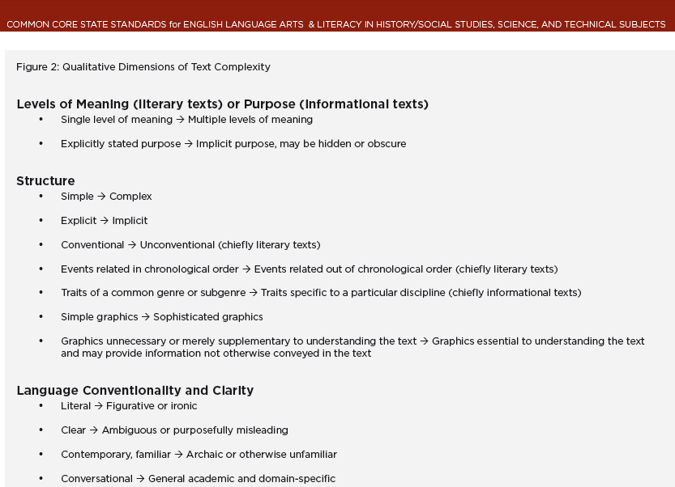

Slide 9
Why It Matters
Common Core calls for close readings of meaty, high quality texts.
Common Core also focuses on standards that are for College and Career Readiness.
It is important that as teachers we provide students with the tools to navigate through dense, highly academic texts in order to adequately comprehend.
The goal is for students to become successful, independent readers in all subject areas.

Slide 10
Application
Using the information gained through our undergraduate and graduate work we have found five successful reading strategies using informational texts to help increase reading across the content areas.
The strategies used are applicable across all content areas, although we are focusing specifically on social sciences. All of our sources are based around a central theme of the Civil Rights Movement.

Slide 11
Five Reading Strategies
Stump the Teacher
Guess the Author
Question the Author
My Rewrite
Sentence Scramble

Slide 12
Stump the Teacher
Stump the teacher allows for students to become the expert on the material while challenging their teacher!

Slide 13
Stump the Teacher
All students and the teacher read the text or portion of text silently.
Teacher closes book and students leave theirs open.
Students have 2 or 3 minutes to quiz the teacher. If they stump the teacher, they receive some type of reinforcement such as bonus points on the next quiz.
Students can ask any content questions including specific numbers or obscure facts in the reading however, they cannot ask questions such as, “How many words were in the last paragraph?”
When the timer goes off, the students now must close their books and the teacher asks the questions giving a bonus point for each correct answer. The teacher uses this time to ask all of the important content question in case students have not already done so.
There is no penalty for wrong answers.

Slide 14
Stump the Teacher
Let’s practice! We will use an except from a middle level textbook from www.eduplace.com to practice this strategy. The passage is titled “The Movement Begins” and gives an overview of the Civil Rights Movement.
Take 3 minutes to read over the article while we do that same. You will then try to stump us, asking any and all questions from the text. Good luck and be prepared to be quizzed next!

Slide 15
Guess the Author
It is important to give students a piece of text that they are somewhat familiar with and have some background knowledge of.
Students will read the piece of text and try and guess who the author is.
Students must state which clues they found in the text that helped them to make their guess.
This supports the Common Core State Standards and the push for citing text evidence
CCSS.ELA-LITERACY.RI.6.1
Cite textual evidence to support analysis of what the text says explicitly as well as inferences drawn from the text.

Slide 16
Guess the Author
Let’s practice!
We will be using a passage from www.teachingamericanhistory.org titled “The Power of Non-Violence.”
The important thing to remember is that students must find at least one clue from the text to support their answer.

Slide 17
Question the Author
Question the author gives students a chance to really analyze a text and where it came from.
They have to look at clues and details within the text in order to understand the author and their purpose for writing.

Slide 18
Question the Author
Students begin by reading the passage individually and underline the main points.
Students then create a list of everything that they know about the author, either from the text or from prior knowledge.
Once students have made some general assumptions about the speaker, they need to identify the authors purpose for writing.
Students will then work in partners to create questions to ask the author about why they wrote the passage, what their intentions for writing were and or any other questions to increase understanding.
Finally, students will share and discuss.

Slide 19
Question the Author
Your turn!
Read the article from www.teachingamericanhistory.org titled, “Letter to Martin Luther King: A Group of Clergymen.”
Then follow the steps to identify who wrote the text and why.

Slide 20
My Rewrite
In this strategy, students will read a primary document that may be difficult for them to understand based on the language and origin of the passage.
Have the students first read the passage individually.
Then students can work together to change each sentence in the passage, either omitting or changing different parts of the passage, editing the vocabulary into age appropriate language.

Slide 21
My Rewrite
Take the primary source from Martin Luther King Jr. titled “Letter From Birmingham City Jail,” and work with a partner to change the passage.
Make the passage “your own” by editing the vocabulary and rearranging words and sentences for easier understanding.
Passage from www.teachingamericanhistory.org

Slide 22
Sentence Scramble
Sentence scramble gives students a chance to work on sequencing while activating prior knowledge.

Slide 23
Sentence Scramble
Begin by taking any piece of literature- textbook, primary source, or trade book.
Copy the text onto paper then cut it into strips
Have students work in partners or groups to put the strips in the correct order, unscrambling them.
Walk around to assist students and give guidance where needed.
Once most groups have the first answer, call on one group to share what they have for their first sentence, continue to share sentences as groups progress.

Slide 24
Sentence Scramble
Time to unscramble!
Open the envelope and spread out the sentence strips inside from King’s “I Have a Dream” speech.
Work with a partner to try and unscramble the sentences, piecing them back together to make a logical passage.
Text from www.teachingamericanhistory.org

Slide 25
Conclusion
Additional questions, comments, or concerns?
Citations listed at the bottom of each page of the resource packet
Great primary document resources:
TeachingAmericanHistory.org
Archives.gov
Further comments or questions please feel free to contact us at:
bmwhitehead@eiu.edu
ajschmitz@eiu.edu

