Slide 1
Concentric
or
Radial

Slide 3
er, Wassily Kandinsky - "Color Study: Squares with Concentric Circles."

Slide 9
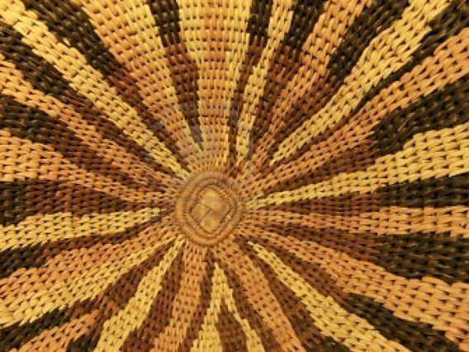

Slide 10
Monochrome
purposefully choosing a color scheme

Slide 11
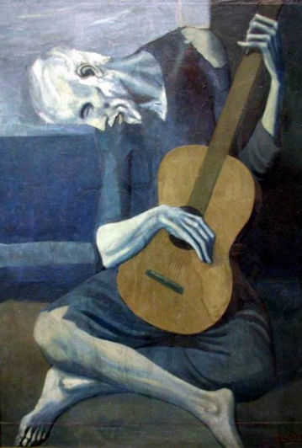

Slide 12
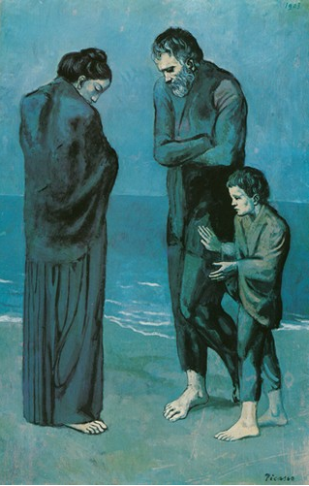

Slide 13
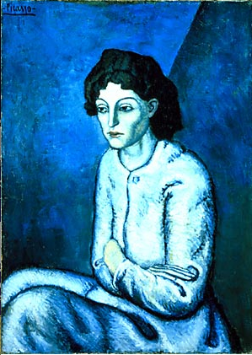

Slide 15
Silhouette
Profile view
old vs. new
Why DO we go back and look through different times and cultures???? How does it instruct us….and inspire us ?!

Slide 18
