Slide 1
Drug-Free Schools & Communities Act Compliance: Lessons from New Research & Recent Events
Bradley D. Custer
IHEC
April 25, 2017
Notes:
My presentation is on gender disparity in STEM fields as a cause for a Title IX disparate impact claim.

Slide 2
Agenda
DFSCA History/ Current Events
Study Design & Results
Recommendations for Improving Compliance

Slide 3
About Me
PhD Student
  Higher, Adult & Lifelong Education Program
  Michigan State University
6 years - student conduct officer
DFSCA and AOD program coordinator
  Moraine Valley Community College

Slide 4
History
War on Drugs: 1970s-1990s
Anti-Drug Abuse Act of 1986
  Drug-Free Schools and Communities Act
1989 National Drug Control Strategy
1989 DFSCA Amendments
  Signed by President Bush, Dec. 12, 1989
  Amended 1965 Higher Education Act
  34 CFR Part 86 - “EDGAR 86”

Slide 5
History
1990 Handbook – Gehring/Palmer
1997/2006 Handbook – Dept. of Ed
2005 Death of Kristine Guest
2011 Dear Colleague Letter (DFSCA)
2012 Inspector General Investigation
Violations: Clery and DFSCA
  2016 Penn State University

Slide 6
Penn State Investigation
Nearly $2.4M in Clery Act fines
$27,500 DFSCA violations
  Failed to distribute AN for 14 years
    All new students, including summer only students
    Combined with Clery ASR, erroneously
  AN lacked legal sanctions & health risks
  “Penn State did not conduct a single biennial review that meets the requirements of the regulations nor did it publish an accurate and complete report of findings for each review.”

Slide 7
Legal Mandates: The Big Three
§86.100
Deliver Annual Notification
  Content
  Students/Employees
  Annual distribution
Implement AOD Prevention Program
Perform Biennial Review
  Enforce sanctions consistently
  Evaluate program effectiveness

Slide 8

Questions
Up Next: The Study

Slide 9
The Study
Why now?
  No published research since 1992
  Increase in DOE enforcement
  Substantial rates of student AOD abuse
Funding: MSU College of Education
Publication: Community College Journal of Research and Practice

Slide 10
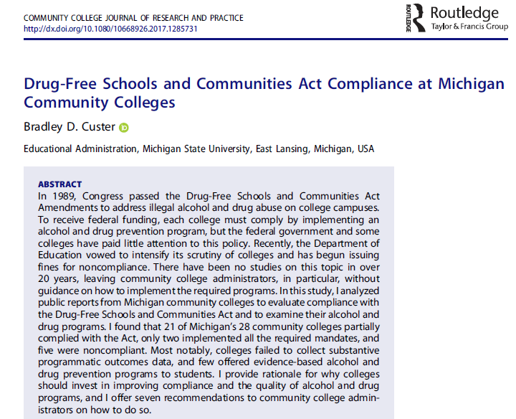

Slide 11
Research Questions
To what extent have Michigan community colleges complied with DFSCA?
  What do the colleges do to comply?
  What AOD programs do the colleges offer to students and employees?

Slide 12
Methods
Mixed Methods
  Biennial Review Reports
  Annual Notifications
Freedom of Information Act (FOIA)
Sample: 28 Michigan Community Colleges
Analysis: DOE handbook checklists

Slide 13
Key Findings
2 colleges: No BR or AN
2 additional colleges: No BR
Quality of BRs and ANs varied widely
Most offer some kind of AOD programming
  No documentation of evidence-based AOD programs
Few colleges determined program effectiveness or the consistency of sanctions enforcement

Slide 14
Compliance
Full Compliance – 2 colleges
  Satisfied 3/3 mandates
Partial Compliance – 21 colleges
  Satisfied 2/3 or 1/3 mandates
Noncompliance – 5 colleges
  Satisfied 0/3 mandates

Slide 15
Annual Notifications
Required Elements | Number of Colleges (n=26) | Percentage of Colleges (n=26)
Standards of Conduct | 25 | 96%
Health Risks | 24 | 92%
Legal Sanctions | 24 | 92%
Disciplinary Sanctions | 25 | 96%
Treatment Options | 25 | 96%
Addresses Students & Employees | 22 | 85%
Adequate Distribution Methods | 17 | 65%
16 Colleges had satisfactory Annual Notifications

Slide 16
Biennial Reviews
Required Elements | Number of Colleges (n=24) | Percentage of Colleges (n=24)
Disciplinary Sanctions Data | 18 | 75%
Program Recommendations | 18 | 75%
AOD Program Inventory | 14 | 58%
Policy Inventory | 13 | 54%
Strengths & Weaknesses Analysis | 10 | 42%
Program Goals Statement | 9 | 38%
Determined Sanction Enforcement Consistency* | 3 | 13%
Determined Program Effectiveness* | 2 | 8%
2 Colleges had satisfactory Biennial Reviews

Slide 17
AOD Programs for Students
Programs | Number of Colleges (n=26) | Percentage of Colleges
Printed/ Online Resources | 26 | 100%
Off-Campus Resources/ Referrals | 25 | 96%
Awareness/ Education/ Training | 16 | 62%
Short-Term/ Limited On-Campus Counseling Services | 15 | 58%
Alcohol-Free Student Activities | 7 | 27%
Screening Tools | 4 | 15%
Mandated Education Program | 4 | 15%
Student Organization/ Support Group | 2 | 8%
Substance Abuse Coursework | 2 | 8%
Student Athlete Drug Testing | 1 | 4%
Full-Service On-Campus Counseling Services | 1 | 4%
19 Colleges had satisfactory AOD Programs for Students

Slide 18
AOD Programs for Employees
Programs | Number of Colleges | Percentage of Colleges
Printed/ Online Resources | 26 | 100%
Off-Campus Resources/ Referrals | 25 | 96%
Employee Assistance Program | 15 | 58%
Insurance/ Medical Programs | 8 | 31%
Awareness/ Education/ Training | 8 | 31%
Screening Tools | 5 | 19%
Leave of Absence | 5 | 19%
Signed Drug-Free Policy Acknowledgement Form | 3 | 12%
Short-Term/ Limited On-Campus Counseling Services | 2 | 8%
Pre-Employment Drug Testing | 1 | 4%

Slide 19
Compliance
Full Compliance – 2 colleges
  Satisfied 3/3 mandates
Partial Compliance – 21 colleges
  Satisfied 2/3 or 1/3 mandates
Noncompliance – 5 colleges
  Satisfied 0/3 mandates

Slide 20
Questions
Up Next: Recommendations

Slide 21
Seek Training
Handbook: Complying with the Drug-Free Schools and Campuses Regulations
Focus on the Big Three
  Write complete annual notification
  Distribute notification correctly
  Conduct biennial review
  Document findings
  Implement AOD programs

Slide 22
Implement Evidence-Based Programs
Reconsider education and awareness events
Explore NIAAA-approved programs
College AIM (Alcohol Intervention Matrix)
http://www.collegedrinkingprevention.gov/collegeaim/
  Updates “A Call to Action” NIAAA (2002)

Slide 23
Collect (More) Data
18 colleges provided some disciplinary data
  7 colleges reported 0 AOD incidents
Health surveys
  Core Institute Alcohol & Other Drug Survey
  National College Health Assessment (NCHA)

Slide 24
Answer the Questions
Consistency of Policy Enforcement
  Disciplinary data
Program Effectiveness
  Outcomes

Slide 25
Find Models
CASE (Copy And Steal Everything)
Peer institutions
Illinois Higher Education Center (IHEC)
  Biennial Review Report Template
  Annual Notification Template
  Watch: State-specific drug laws

Slide 26
Be Transparent
Not required
Publish Biennial Review online
Provide updated copies to:
  FOIA Coordinator
  Financial Aid Director

Slide 27
Beware of Overlap
Drug-Free Workplace Act of 1988
  Human Resources
  Financial Aid Handbook Chapter 2, Page 122
Jeanne Clery Act of 1990
  2016 Clery Handbook Chapter 7, Page 8
  Penn State Letter
  Don’t combine ASR & AN

Slide 28
Invite Governmental Assistance
Technical assistance
Avoid surprises with audits
Contact USDE Regional Office

Slide 29
Move Beyond Compliance
Be creative
Why invest in DFSCA?
  Federal Law
    Penalties: fines & loss of funding
  Health Promotion
    High alcohol and drug use rates
  Crime Prevention
    Title IX + DFSCA

Slide 30
Limitations
Michigan community colleges
A-theoretical
Subjective

Slide 31
Future Research
Policy Evaluation
  Does DFSCA improve policy enforcement?
  Are AOD programs effective?
  Does DFSCA reduce drug crime rates?
How do colleges implement DFSCA?
  Street-Level Bureaucracy Theory
  Theory of Mandated Academic Change

Slide 32
From Penn State Letter
“Failure to comply with the DFSCA’s DAAPP requirements deprives students and employees of important information regarding the educational, disciplinary, health, and legal consequences of illegal drug use and alcohol abuse. Failure to comply with the biennial review requirements also deprives the institution of important information about the effectiveness of its own drug and alcohol programs. Such failures may contribute to increased drug and alcohol abuse as well as an increase in drug and alcohol-related violent crime.”

Slide 33
Thank you!
Bradley.custer@yahoo.com
Twitter: @BradleyDeanC
Academia Profile (slides & article)
Research Gate Profile (article)

