Slide 1
Pemberton Hall Only A Little History of EIU
By
Doug
Howell

Slide 2
Pemberton Hall
The first publicly funded residence hall in the state of Illinois!
Second oldest building (still) on campus

Slide 3
Pemberton Hall
Constructed between 1907-09
On Campus Housing, especially for women, was unheard of at this time.
It was named in honor of State Senator Stanton C. Pemberton, who was influential in getting the appropriation approved for the building of the residence hall

Slide 4
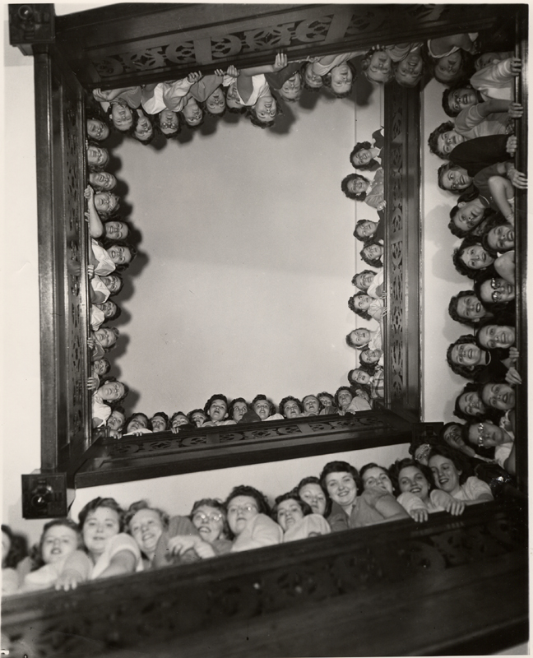
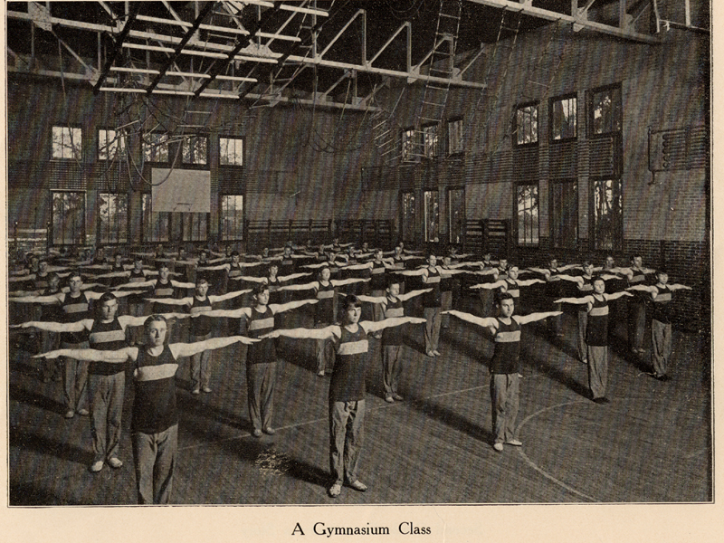
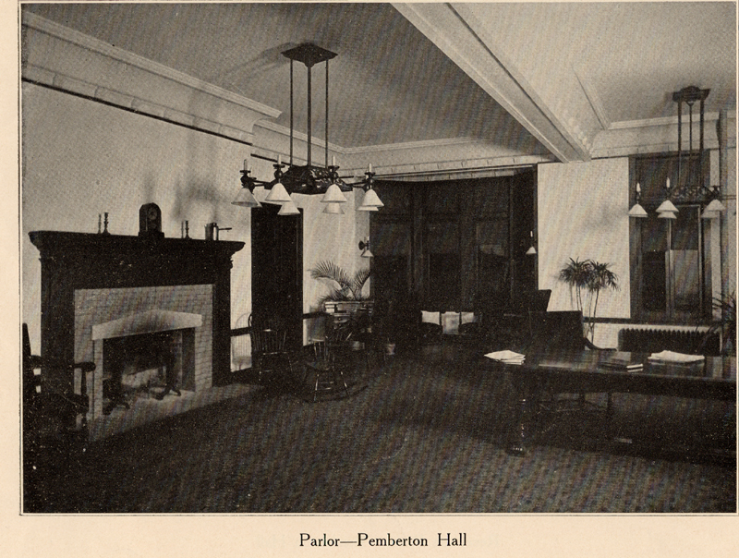
Pemberton Hall
President Lord tried to secure a women’s “dormitory” from the day he took office.
The request was laughed at in 1901
Added a gymnasium to the plans in 1903, but was vetoed by the Governor
Vetoed by a different governor in 1905
Finally in 1907 it was passed and signed

Slide 5
Pemberton Hall
The building opened January 4, 1909 with a commemorative dinner

Slide 6
Pemberton Hall
In 1962 the “New Side” was added, doubling the capacity
In 1968 the gym was converted into Textbook Rental
August 26, 1982 listed on the National Register of Historic Places

Slide 7
References
Barnhart, Terry, That “Noble Project:” The Founding of Eastern Illinois University and the Origins of Old Main, 1895-1899, http://www.eiu.edu/~localite/coles/charleston/eiu/oldmain/that_noble_project.htm
Booth Library Digital Photo Archive, http://www.library.eiu.edu/photoarchive/
Eastern Illinois University, http://www.eiu.edu
EIU History by Presidents, EIU Foundations, http://www.eiu.edu/~eiu1111/instructors/specific%20resources/eiuhist.htm
EIU Photo Collection, Media Services, http://www.library.eiu.edu/mediasrv/image_archive/image_archive.html
National Register of Historic Places, http://www.cr.nps.gov/nr/

