Slide 1
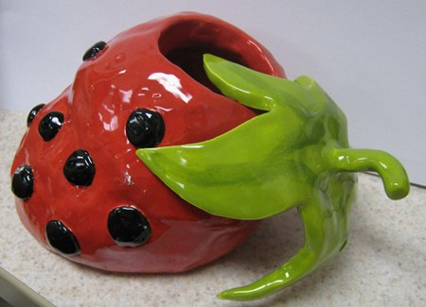
Functional Food Sculpture
Objective:
To create a sculpture that represents food, but can be used as a functional box or jar.

Slide 2
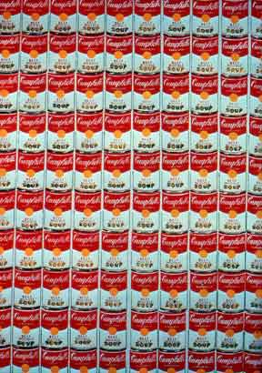
Recognizable Pop Art
Marilyn Monroe Series
Andy Warhol, 1960s
Campbell Soup Cans
Andy Warhol, 1962

Slide 3
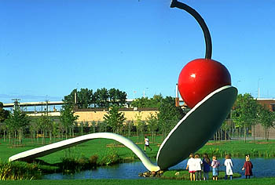
Pop Art inspired…
Spoonbridge and Cherry
Claes Oldenburg, 1988

Slide 4
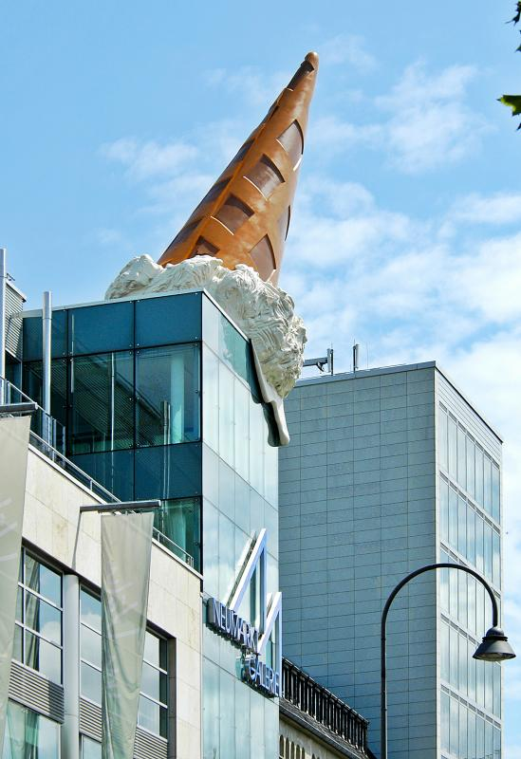
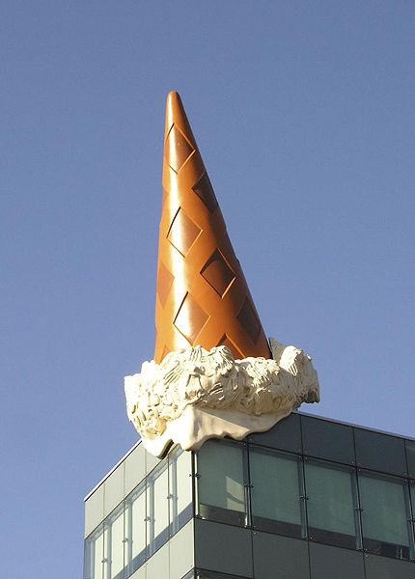
Dropped Cone
Claes Oldenburg, 2001

Slide 5
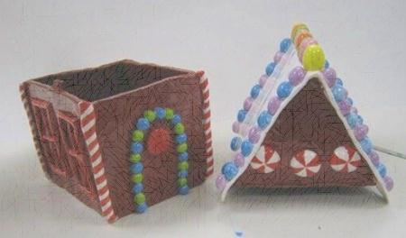
Procedure:
Choose a food…look through food magazines for ideas, if you need to.
Decide on a technique to create the food – slab, coil, or both.
Decide on how to make your lid…will you cut it off of the food, or build it separately & add it on? (it must have a “lip” to prevent it from falling off)
You may add a base (plate, bowl, napkin, etc)
These will be glazed & fired to look as realistic as possible.

Slide 6
You may need to use a mold…
A mold is something you can form clay around to give it it’s shape.
Find something in the room that you can use as a mold.
Drape plastic over it to prevent the clay from sticking.
You may need to cut a section of clay out of your slab in order to create the form.

Slide 7
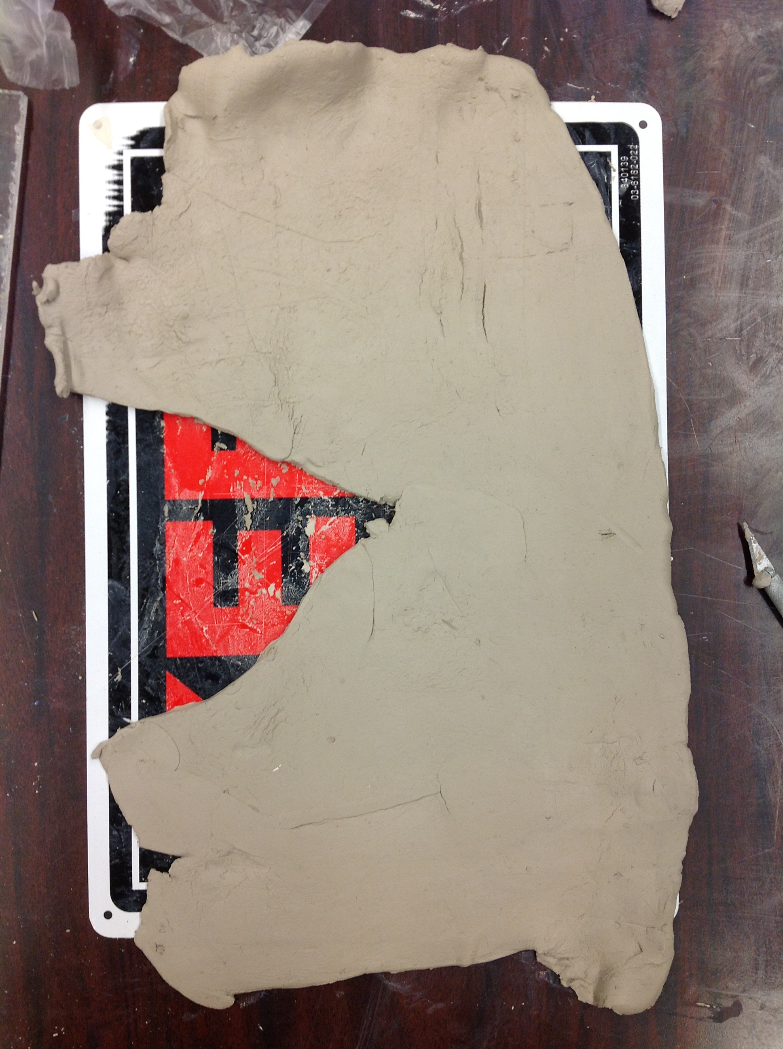
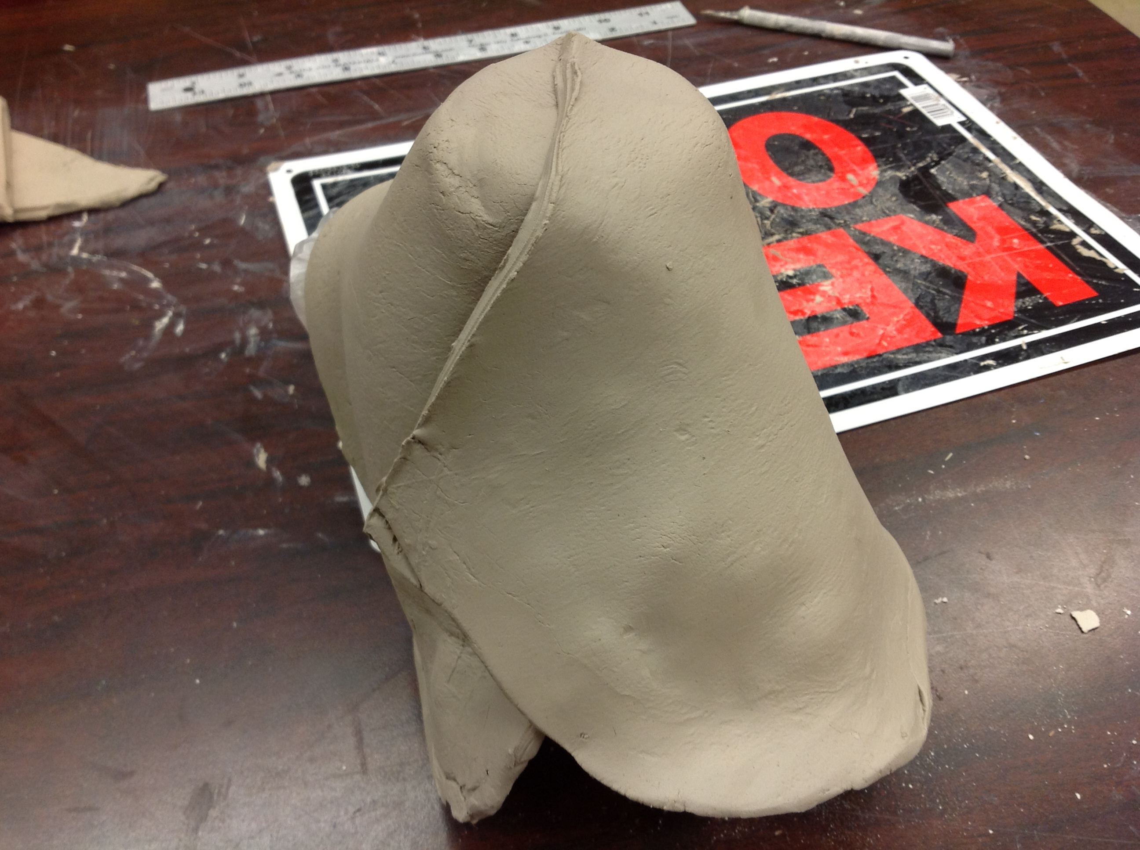
Clay slab on the mold.
Cut section out of clay
Seal seam in clay

Slide 8
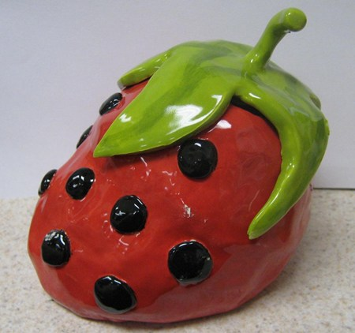
Student Examples

Slide 9
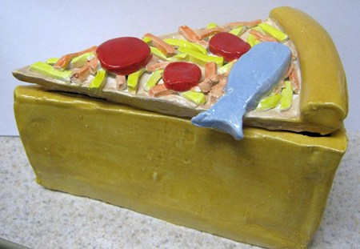
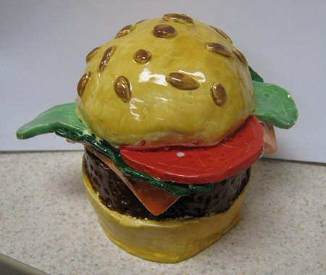
Student Examples

Slide 10
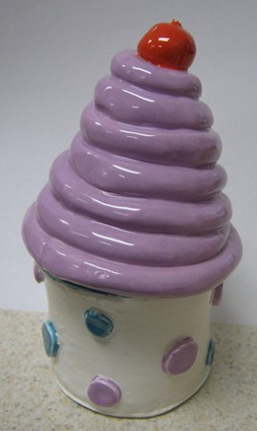
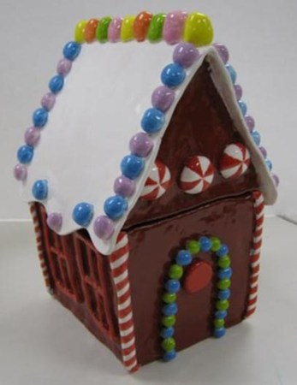
Student Examples

Slide 11
Getting started:
If you have decided to use slabs to build your food, make a paper template for correct sizes.
If you are using coils or pinch techniques, you may get your clay.
Remember to include textures using incising & applique methods to create a realistic & detailed food box.

