Slide 1
College of Liberal Arts & Sciences

Slide 2
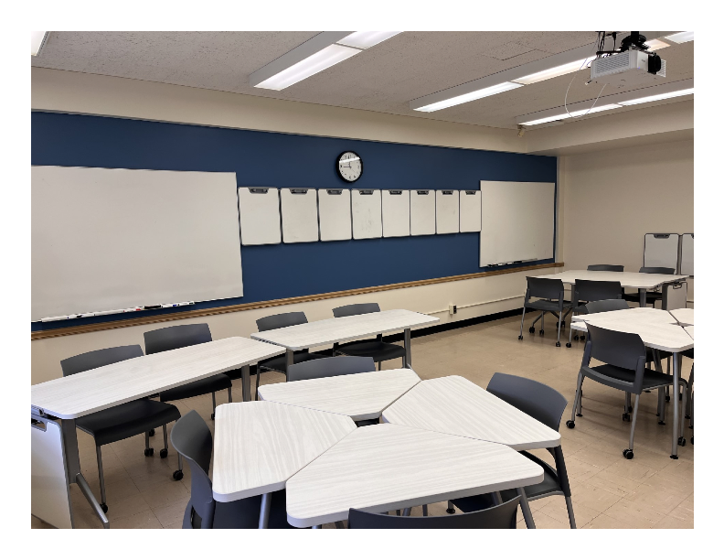
History
HIS 2030G: US History: The Black Experience
HIS 2040G: US History: Gender and Sexuality
HIS 2050G: US History: Building Latin/a/o/e Communities
HIS 1527G: World History: Gaming the Past, which is a course based on historical roleplaying games
HIS 2060G: US History: The History of Your Life, which is a course in contemporary history and the history of current events

Slide 3
CLAS Events
Minors, Academic Hubs, Events, and Performances!

